Slide 1
Year 2 Applied Mathematics
Application of Forces
- Inextensible Strings
Chapter 7
(Part 1 of 5)

Slide 2
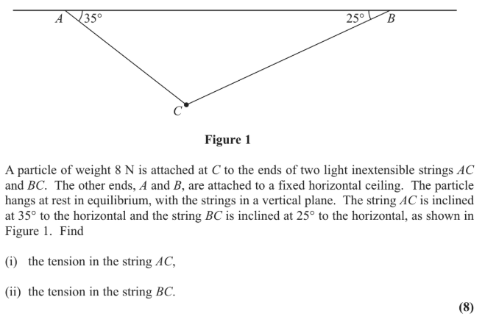
Inextensible Strings
Always ask yourself if it is
one string or two separate strings.
If it is one string threaded through a particle
then the tension will be the same
T
T

Slide 3
Inextensible Strings
If it is two separate strings then
the tension will be different.
X
Y

Slide 4
Inextensible Strings
For every question,
write two equations.
One for vertical forces
One for horizontal forces.
If you have two unknowns in an equation then solve the two equations simultaneous.

Slide 5
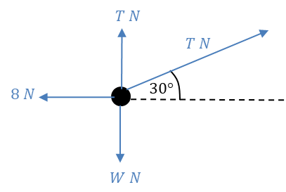
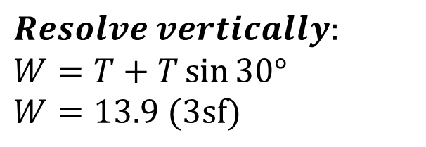
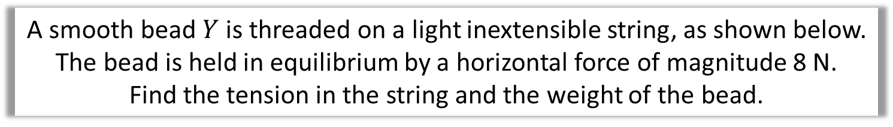
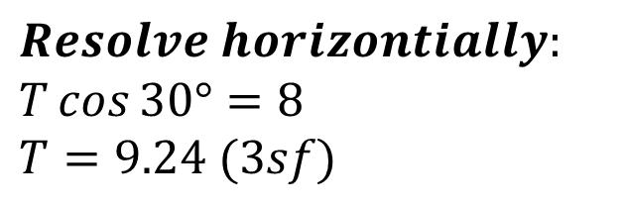
Inextensible Strings
A smooth bead $Y$ is threaded on a light inextensible string, as shown below.
The bead is held in equilibrium by a horizontal force of magnitude 8 N.
Find the tension in the string and the weight of the bead.
8N
30˚
$$Resolve horizontially:$$
$$T\cos{30°}=8$$
$$T=9.24 (3sf)$$
$$Resolve vertically:$$
$$W=T+T\sin{30°} \\ W=13.9 (3sf)$$

Slide 6
Inextensible Strings – Exam Question

Slide 7
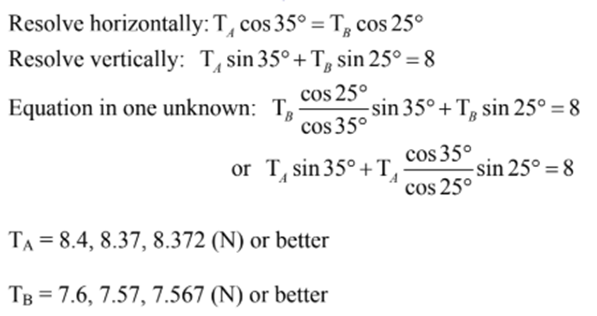
Inextensible Strings – Exam Question (Answers)
T_{A}
T_{B}

Slide 8
Exercise 7B
Pearson Stats/Mechanics Year 2
Pages 134-137
Complete before the lesson Ex7A Q3 & Ex7B Q1
In Class:
Green Q2-4
Amber Q5-7
Red Q8-12

