Slide 1
Year 2 Pure Mathematics
Differentiation
- Product Rule
Chapter 9
(Part 4 of 10)

Slide 2
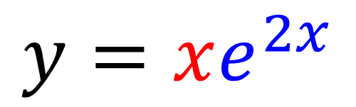
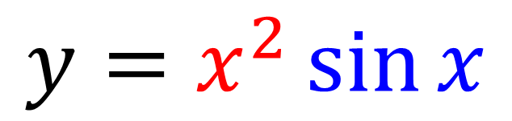
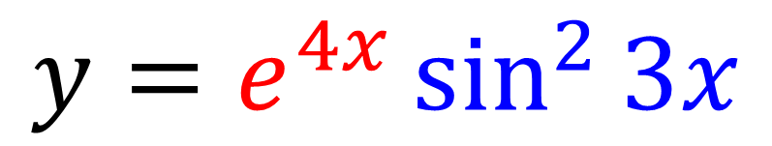
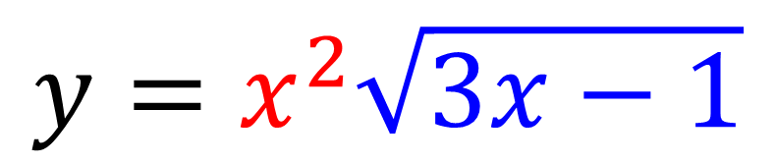
The Product Rule
The product rule is used when
you have a product of two functions.
$$y=x^{2}\sin{x}$$
$$y=xe^{2x}$$
$$y=x^{2}\sqrt{3x−1}$$
$$y=e^{4x}\sin^{2}{3x}$$

Slide 3
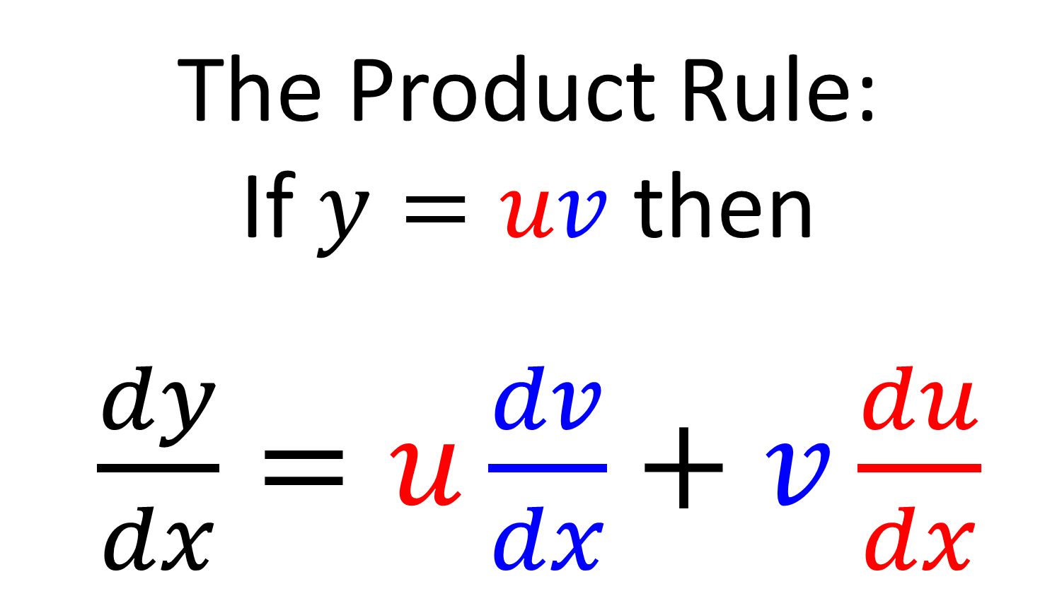
The Product Rule
The Product Rule:
If $y=uv$ then
$\frac{dy}{dx}=u\frac{dv}{dx}+v\frac{du}{dx}$

Slide 4

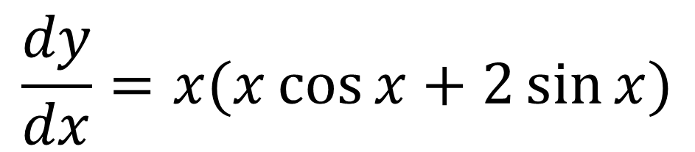
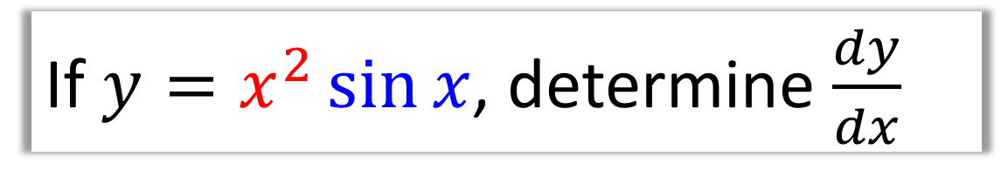


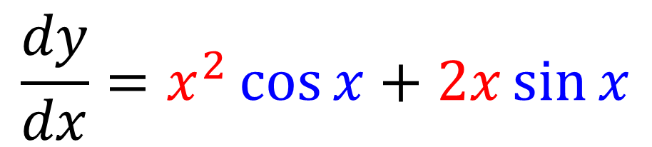
The Product Rule – Informal Method
If $y=x^{2}\sin{x}$, determine $\frac{dy}{dx}$
$$x^{2}$$ | $$sin x$$
$$2x$$ | $$\cos{x}$$
$$2x$$
$$\cos{x}$$
$$\frac{dy}{dx}=x^{2}\cos{x}+2x\sin{x}$$
multiply opposite
corners and add
$$\frac{dy}{dx}=x(x\cos{x}+2\sin{x)}$$
factorise

Slide 5
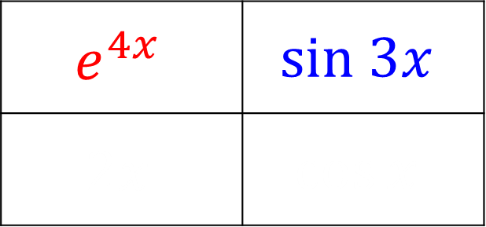
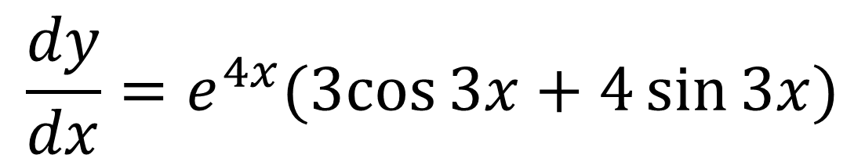
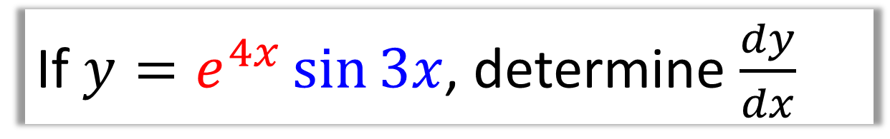


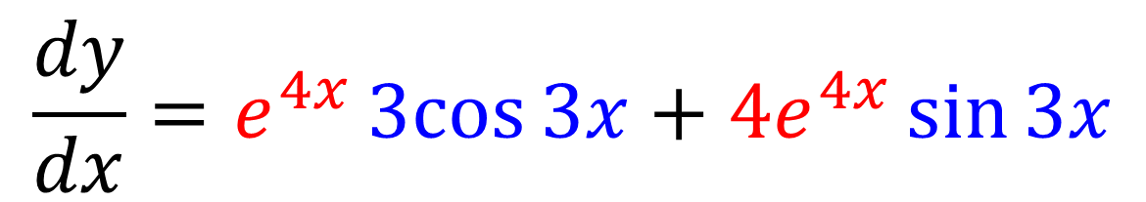
The Product Rule – Informal Method
If $y=e^{4x}\sin{3x}$, determine $\frac{dy}{dx}$
$$e^{4x}$$ | $$sin 3x$$
$$2x$$ | $$\cos{x}$$
$${4e}^{4x}$$
$$3 cos{3x}$$
$$\frac{dy}{dx}=e^{4x}3cos{3x}+{4e}^{4x}\sin{3x}$$
$$\frac{dy}{dx}=e^{4x}(3cos{3x}+4\sin{3x)}$$

Slide 6
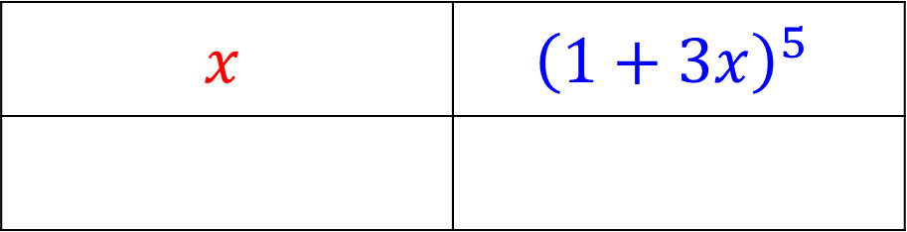
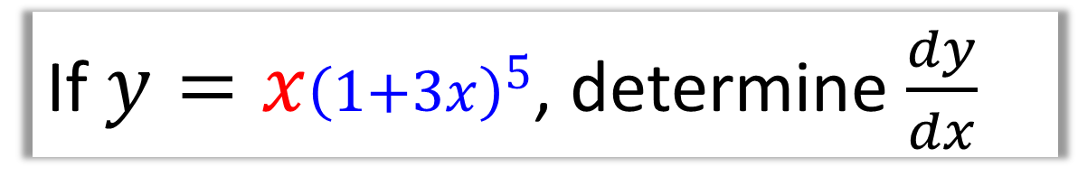
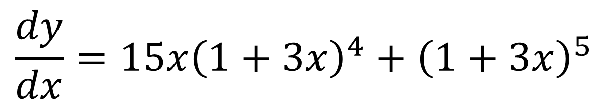
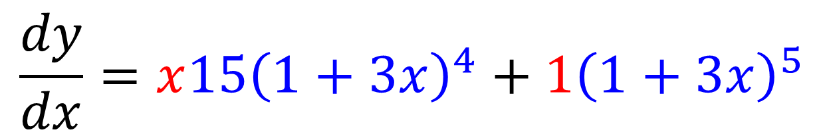

TThe Product and Chain Rule
If $y=x{\left(1+3x\right)}^{5}$, determine $\frac{dy}{dx}$
$$x$$ | $${\left(1+3x\right)}^{5}$$
$$2x$$ | $$\cos{x}$$
1
$${15\left(1+3x\right)}^{4}$$
$$\frac{dy}{dx}=x{15\left(1+3x\right)}^{4}+1{\left(1+3x\right)}^{5}$$
$$\frac{dy}{dx}={15x\left(1+3x\right)}^{4}+{\left(1+3x\right)}^{5}$$

Slide 7
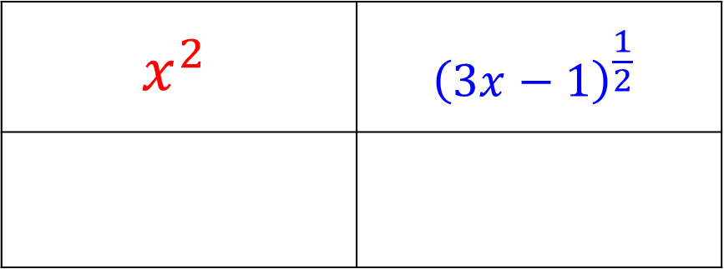
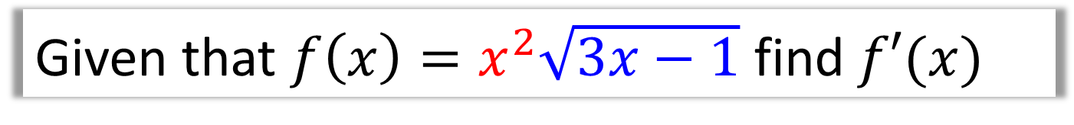


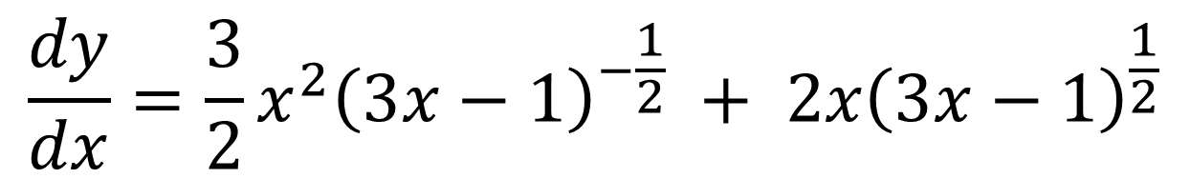
The Product and Chain Rule
Given that $f\left(x\right)=x^{2}\sqrt{3x−1}$ find $f′(x)$
$$x^{2}$$ | $${\left(3x−1\right)}^{\frac{1}{2}}$$
$$2x$$ | $$\frac{3}{2}{\left(3x−1\right)}^{−\frac{1}{2}}$$
$$2x$$
$$\frac{3}{2}{\left(3x−1\right)}^{−\frac{1}{2}}$$
$$\frac{dy}{dx}=\frac{3}{2}x^{2}{\left(3x−1\right)}^{−\frac{1}{2}} + 2x{\left(3x−1\right)}^{\frac{1}{2}}$$

Slide 8
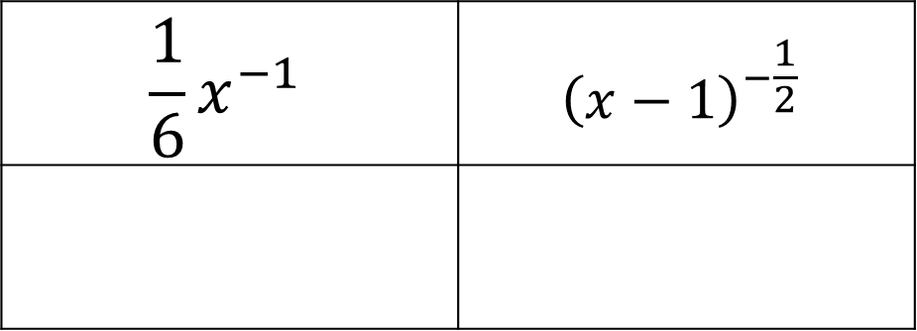

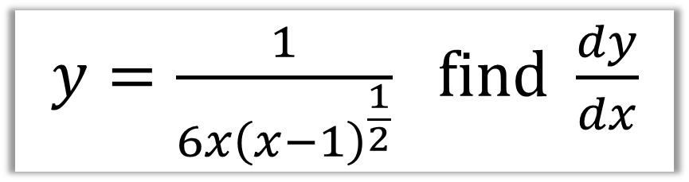

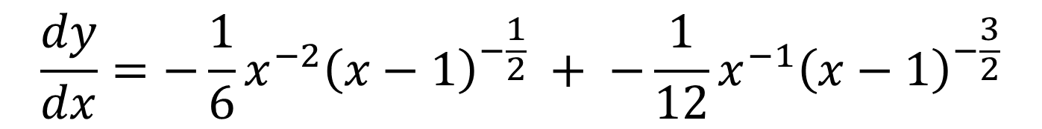
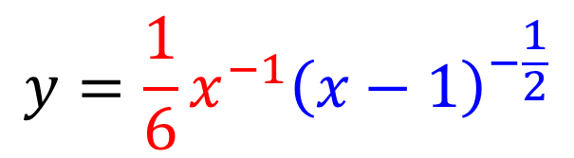
The Product and Chain Rule
$y=\frac{1}{6x{\left(x−1\right)}^{\frac{1}{2}}}$ $find \frac{dy}{dx}$
$$y=\frac{1}{6}x^{−1}{\left(x−1\right)}^{−\frac{1}{2}}$$
$$\frac{1}{6}x^{−1}$$ | $${\left(x−1\right)}^{−\frac{1}{2}}$$
$$−\frac{1}{6}x^{−2}$$ | $$−\frac{1}{2}{\left(3x−1\right)}^{−\frac{3}{2}}$$
$$−\frac{1}{6}x^{−2}$$
$$−\frac{1}{2}{\left(x−1\right)}^{−\frac{3}{2}}$$
$$\frac{dy}{dx}=−\frac{1}{6}x^{−2}{\left(x−1\right)}^{−\frac{1}{2}} + −\frac{1}{12}x^{−1}{\left(x−1\right)}^{−\frac{3}{2}}$$

Slide 9

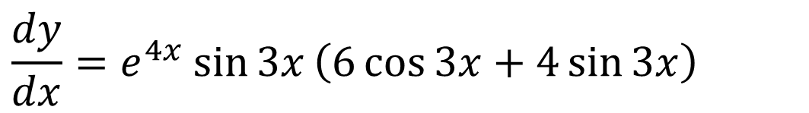

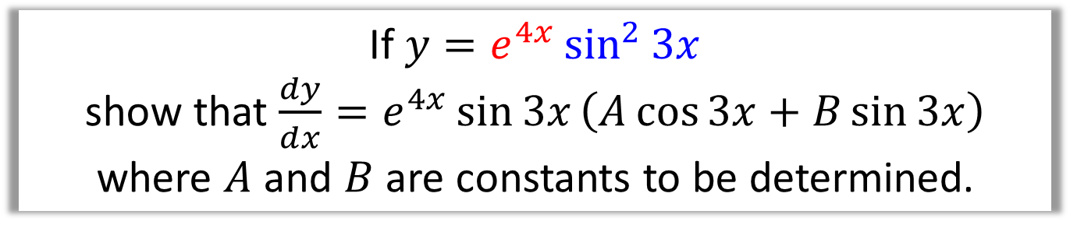
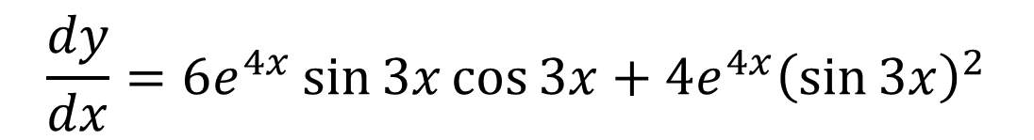
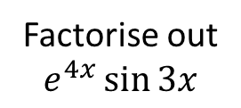
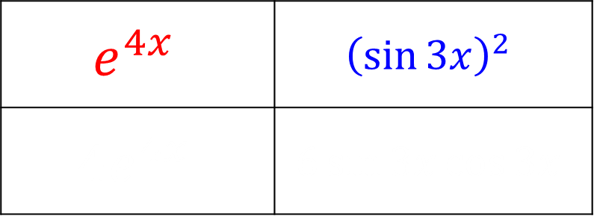
The Product and Chain Rule
If $y=e^{4x}\sin^{2}{3x}$
show that $\frac{dy}{dx}=e^{4x}\sin{3x}\left(A\cos{3x}+B\sin{3x}\right)$
where $A$ and $B$ are constants to be determined.
$$e^{4x}$$ | $${\left(\sin{3x}\right)}^{2}$$
$$4e^{4x}$$ | $$6\sin{3x}\cos{3x}$$
$$4e^{4x}$$
$$6\sin{3x}\cos{3x}$$
$$\frac{dy}{dx}=6e^{4x}\sin{3x}\cos{3x}+4e^{4x}{\left(\sin{3x}\right)}^{2}$$
Factorise out
$$e^{4x}\sin{3x}$$
$$\frac{dy}{dx}=e^{4x}\sin{3x}\left(6\cos{3x}+4\sin{3x}\right)$$

Slide 10


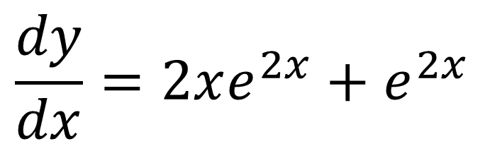
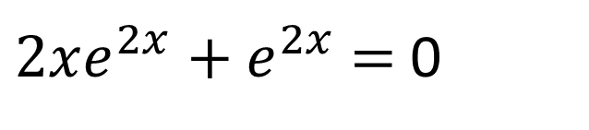
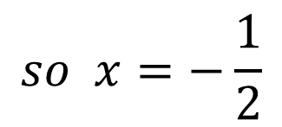
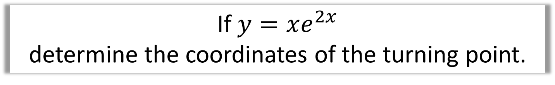
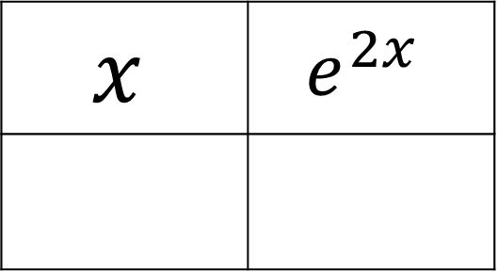

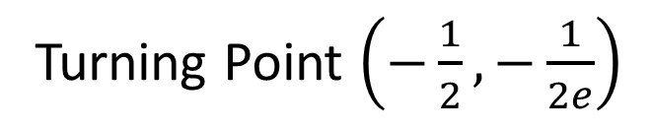


The Product Rule
If $y=xe^{2x}$
determine the coordinates of the turning point.
$$x$$ | $$e^{2x}$$
$$1$$ | $$2e^{2x}$$
$2xe^{2x}+e^{2x}$ $=$ 0
$$1$$
$$2e^{2x}$$
$$e^{2x}\left(2x+1\right)=0$$
$e^{2x}≠0$
$$\frac{dy}{dx}=2xe^{2x}+e^{2x}$$
$$so x=−\frac{1}{2}$$
$$2x+1=0$$
Turning Point $\left(−\frac{1}{2},−\frac{1}{2e}\right)$

Slide 11
Exercise 9D
Pearson Pure Mathematics Year 2/AS
Page 242
Complete before the lesson Q1-3
In Class:
Green Q4-6
Amber Q7-8
Red Q9-10 & Challenge

