Slide 1
Year 1 Pure Mathematics
Differentiation
- Tangents and Normal
Chapter 12
(Part 4 of 6)

Slide 2
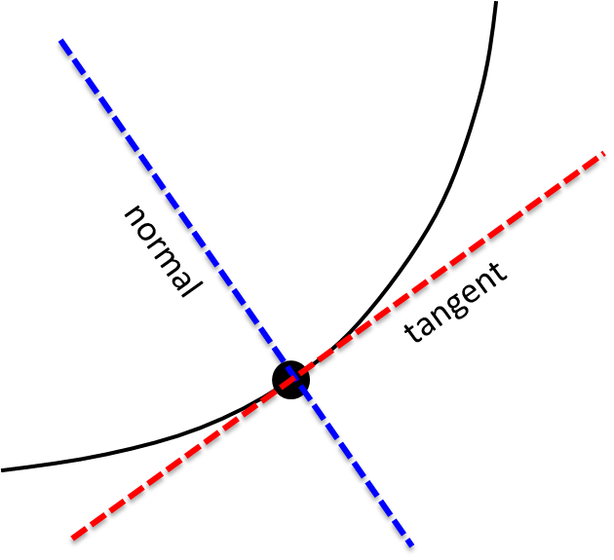
Tangents and Normals
The normal is perpendicular to the tangent.

Slide 3
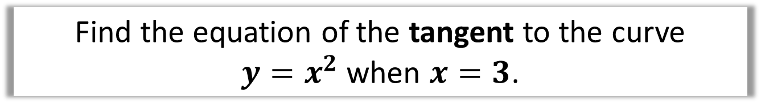


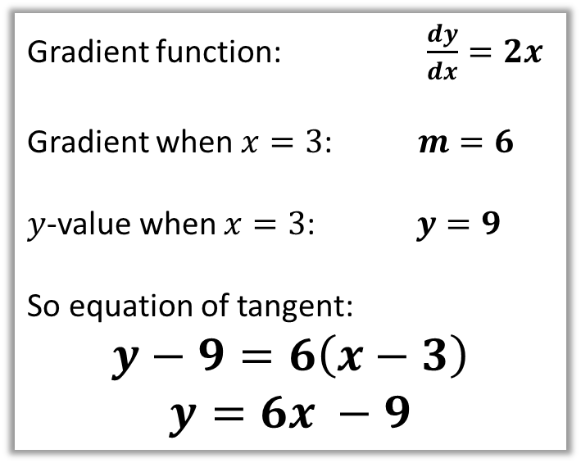
Tangents and Normals
Find the equation of the tangent to the curve
$y=x^{2}$ when $x=3$.
Use $y−y_{1}=m\left(x−x_{1}\right)$
for the tangent (as it is a straight line!).
Gradient function: $\frac{dy}{dx}=2x$
Gradient when $x=3$: $m=6$
$y$-value when $x=3$: $y=9$
So equation of tangent:
$$y−9=6\left(x−3\right)$$
$$y=6x −9$$
tangent
$$(3,?)$$

Slide 4
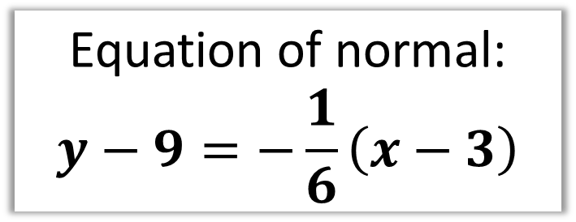

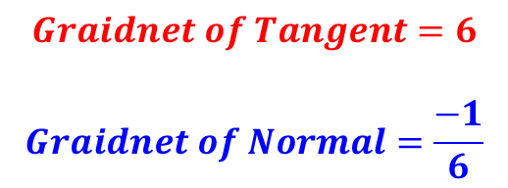


Tangents and Normals
Find the equation of the normal to the curve
$y=x^{2}$ when $x=3$.
The normal to a curve
is the line perpendicular to the tangent.
normal
$$Graidnet of Tangent=6$$
$$Graidnet of Normal=\frac{−1}{6}$$
tangent
$$(3,9)$$
Equation of normal:
$$y−9=−\frac{1}{6}\left(x−3\right)$$
$$y=6x−9$$

Slide 5
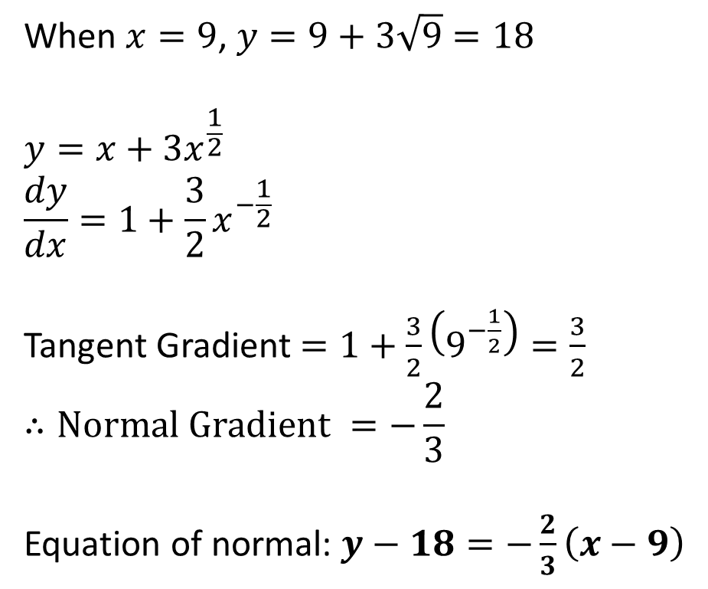

Tangents and Normals
Find the equation of the normal to the curve
$y=x+3\sqrt{x}$ when $x=9$.
When $x=9$, $y=9+3\sqrt{9}=18$
$$y=x+3x^{\frac{1}{2}}$$
$$\frac{dy}{dx}=1+\frac{3}{2}x^{−\frac{1}{2}}$$
Tangent Gradient $=1+\frac{3}{2}\left(9^{−\frac{1}{2}}\right)=\frac{3}{2}$
$$∴Normal Gradient =−\frac{2}{3}$$
Equation of normal: $y−18=−\frac{2}{3}\left(x−9\right)$

Slide 6
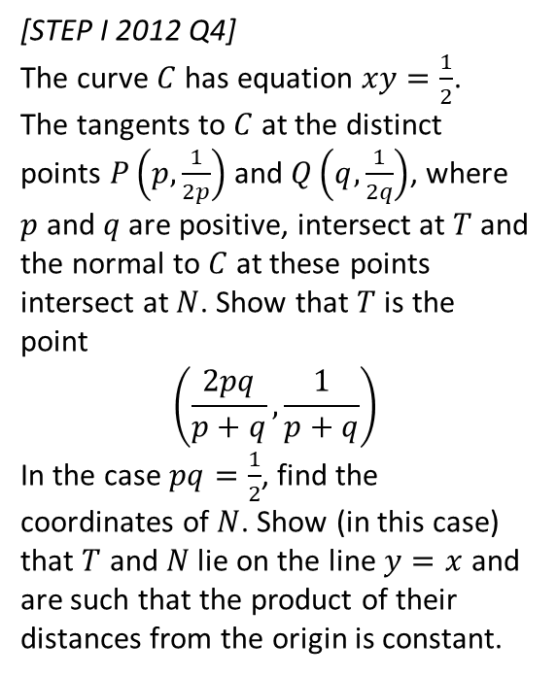
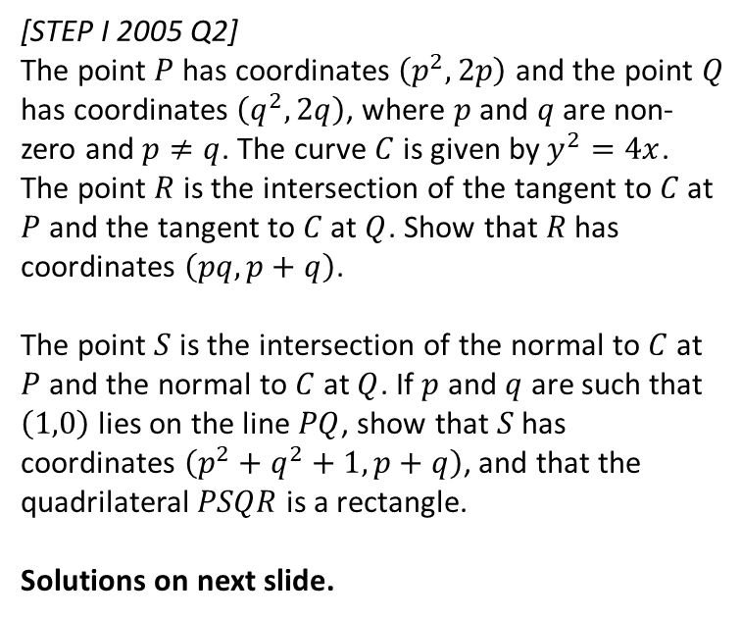
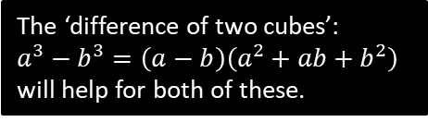
Exercise 12F
Complete before the lesson Q1
Green Q2
Amber Q3
Red
Pearson Pure Mathematics
Pages 269-270
Extension
The ‘difference of two cubes’:
$a^{3}−b^{3}=\left(a−b\right)\left(a^{2}+ab+b^{2}\right)$
will help for both of these.
2
[STEP I 2012 Q4]
The curve $C$ has equation $xy=\frac{1}{2}$.
The tangents to $C$ at the distinct points $P\left(p,\frac{1}{2p}\right)$ and $Q\left(q,\frac{1}{2q}\right)$, where $p$ and $q$ are positive, intersect at $T$ and the normal to $C$ at these points intersect at $N$. Show that $T$ is the point
$$\left(\frac{2pq}{p+q},\frac{1}{p+q}\right)$$
In the case $pq=\frac{1}{2}$, find the coordinates of $N$. Show (in this case) that $T$ and $N$ lie on the line $y=x$ and are such that the product of their distances from the origin is constant.
1
[STEP I 2005 Q2]
The point $P$ has coordinates $\left(p^{2},2p\right)$ and the point $Q$ has coordinates $\left(q^{2},2q\right)$, where $p$ and $q$ are non-zero and $p≠q$. The curve $C$ is given by $y^{2}=4x$. The point $R$ is the intersection of the tangent to $C$ at $P$ and the tangent to $C$ at $Q$. Show that $R$ has coordinates $\left(pq,p+q\right)$.
The point $S$ is the intersection of the normal to $C$ at $P$ and the normal to $C$ at $Q$. If $p$ and $q$ are such that $\left(1,0\right)$ lies on the line $PQ$, show that $S$ has coordinates $\left(p^{2}+q^{2}+1,p+q\right)$, and that the quadrilateral $PSQR$ is a rectangle.
Solutions on next slide.

