Slide 1
Think about the following random variables…
The number of dandelions in a square metre of open
ground
The number of errors in a page of a typed manuscript
The number of cars passing under a bridge on a
motorway in a minute (when there is no traffic
interference on the motorway)
The number of telephone calls received by a company
switchboard in half an hour
… what do they have in common?
The behaviour of these random variables follows the
POISSON DISTRIBUTION
Notes:
Notice that all these situations involve some sort of average rate – this is usually a tell-tale sign that the Poisson distribution is appropriate – named after the French mathematician Simeon Poisson.

Slide 2
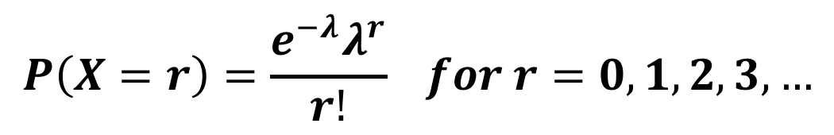
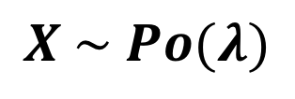
The conditions required for a Poisson distribution are:
Events occur at random
Events occur independently of each other
The average rate of occurrences remains constant
There is zero probability of simultaneous occurrences
The Poisson distribution is defined as…
$$X \sim Po(λ)$$
$$P\left(X=r\right)=\frac{e^{−λ}λ^{r}}{r!} for r=0, 1, 2, 3,…$$
λ is the only parameter and represents the mean number of
occurrences in the time period.
Notes:
As with the binomial distribution, the formula will work out probabilities for SPECIFIC values of X rather than ranges. If you require a range, for example P(X≤3) you would have to find P(X=0, 1, 2, 3) and add these together OR for certain values of λ, you can use tables – more about this later. As with binomial, Poisson is a DISCRETE probability distribution and so X can only take on particular values.

Slide 3
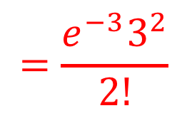

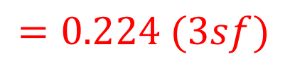
If X ~ Po(3), find P(X = 2)
$$=\frac{e^{−3}3^{2}}{2!}$$
$$P\left(X=3\right)$$
$$=0.224 (3sf)$$

Slide 4
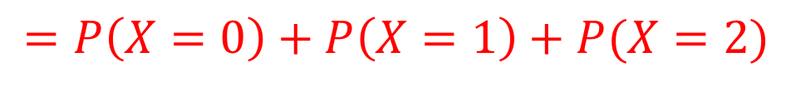
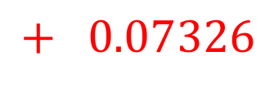
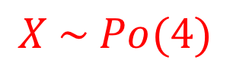
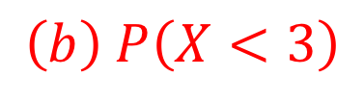

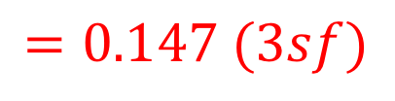
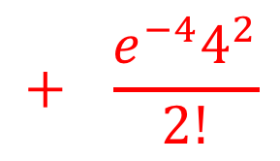
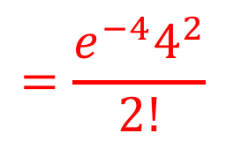
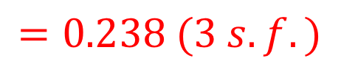
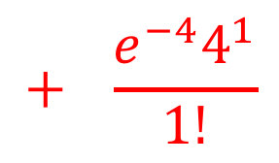
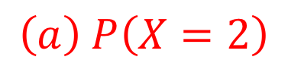
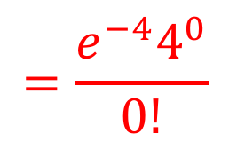
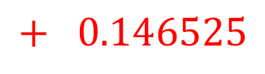
The number of cars passing a point on a road in a 5-minute
Period may be modelled by a Poisson distribution with
Parameter 4.
Find the probability that, in a 5-minute period
(a) 2 cars go past (b) fewer than 3 cars go past
$$X \sim Po(4)$$
$$=\frac{e^{−4}4^{2}}{2!}$$
$$\left(a\right) P\left(X=2\right)$$
$$=0.147 (3sf)$$
$$\left(b\right) P\left(X<3\right)$$
$$=P\left(X=0\right)+P\left(X=1\right)+P(X=2)$$
$$=\frac{e^{−4}4^{0}}{0!}$$
$$+ \frac{e^{−4}4^{1}}{1!}$$
$$+ \frac{e^{−4}4^{2}}{2!}$$
$$=0.01831$$
$$+ 0.07326$$
$$+ 0.146525$$
$$=0.238 (3 s.f.)$$
Notes:
For part (b) X must be less than 3, i.e. NOT 3, hence 0, 1 or 2.

Slide 5
The number of accidents in a week on a stretch of road is known to follow a Poisson distribution with parameter 2.1.
Find the probability that
In a given week there is 1 accident
In a two week period there are 2 accidents
There is 1 accident in each of two successive weeks.

Slide 6

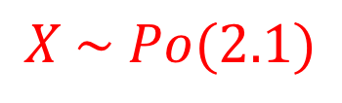
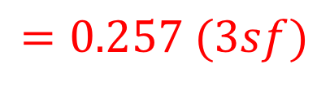
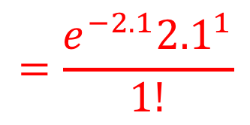
The number of accidents in a week on a stretch of road is known to follow a Poisson distribution with parameter 2.1.
Find the probability that
In a given week there is 1 accident
$$X \sim Po(2.1)$$
$$=\frac{e^{−2.1}{2.1}^{1}}{1!}$$
$$P\left(X=1\right)$$
$$=0.257 (3sf)$$

Slide 7
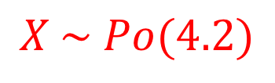
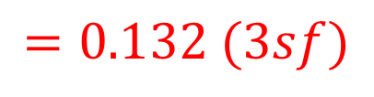
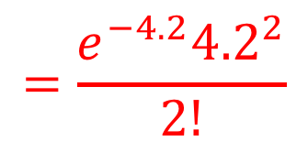

The number of accidents in a week on a stretch of road is known to follow a Poisson distribution with parameter 2.1.
Find the probability that
(b) In a two week period there are 2 accidents
$$X \sim Po(4.2)$$
$$=\frac{e^{−4.2}{4.2}^{2}}{2!}$$
$$P\left(X=2\right)$$
$$=0.132 (3sf)$$
Notes:
Note that this time the period is 2 weeks. We assume the accident rate remains constant, hence the parameter will now be 2 x 2.1 = 4.2

Slide 8
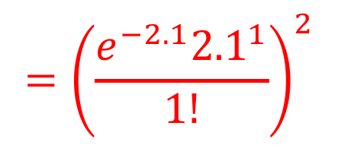
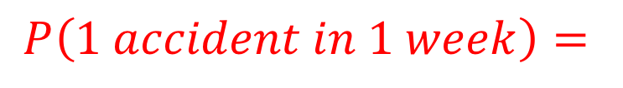
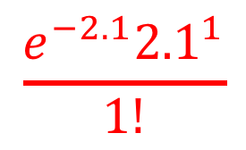
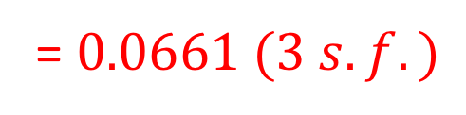
The number of accidents in a week on a stretch of road is known to follow a Poisson distribution with parameter 2.1.
Find the probability that
(c) There is 1 accident in each of two successive weeks.
$$\frac{e^{−2.1}{2.1}^{1}}{1!}$$
$$P\left(1 accident in 1 week\right)=$$
$$P\left(1 accident in each of 2 successive weeks\right)=$$
$$P\left(1 accident in 1 week\right) AND P(1 accident in 1 week)$$
$$={\left(\frac{e^{−2.1}{2.1}^{1}}{1!}\right)}^{2}$$
= $0.0661 (3 s.f.)$

Slide 9
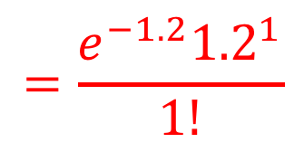
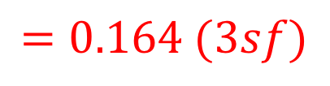
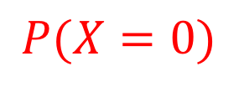
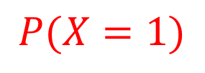
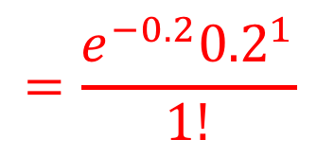
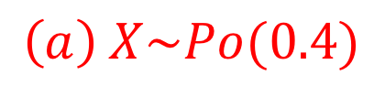
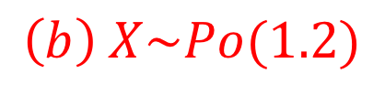
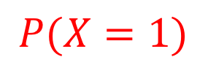
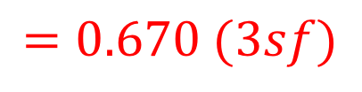
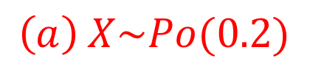
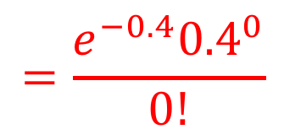
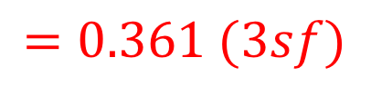
The number of flaws in a metre length of dress material is known to follow a Poisson distribution with parameter 0.4.
Find the probabilities that:
There are no flaws in a 1-metre length
There is 1 flaw in a 3-metre length
There is 1 flaw in a half-metre length.
$$=\frac{e^{−0.4}{0.4}^{0}}{0!}$$
$$\left(a\right) X\sim Po(0.4)$$
$$P(X=0)$$
$$=0.670 (3sf)$$
$$=\frac{e^{−1.2}{1.2}^{1}}{1!}$$
$$\left(b\right) X\sim Po(1.2)$$
$$P(X=1)$$
$$=0.361 (3sf)$$
$$=\frac{e^{−0.2}{0.2}^{1}}{1!}$$
$$\left(a\right) X\sim Po(0.2)$$
$$P(X=1)$$
$$=0.164 (3sf)$$

Slide 10
Summary
Many situations fit a different probability model called the Poisson Distribution
The Poisson Distribution is used when events occur :
Singly (one at a time)
Independently of each other
Eg the number of accidents on a certain road each year
Eg the number of hits a website receives in a 1 hour period
At a constant rate
A Poisson Distribution is defined by its mean λ, and is denoted by X ~ Po(λ)
The derivation of this rule is beyond the scope of S2
In which case,
Eg X ~ Po(4). Find:
a) P(X=0)
b) P(X=1)
c) P(X≤1)
The formulae booklet provides POISSON CUMULATIVE DISTRIBUTION FUNCTION tables for λ up to 10 in increments of 0.5
Eg X ~ Po(7). Find:
a) P(X≤5)
b) P(X>12)

Slide 11
Exercise 2A
Pearson Further Statistics 1
Page 21
Complete before the lesson Q1-2
In Class:
Green Q3-4
Amber Q5-6

Slide 12


Exercise 2C
Complete before the lesson Q1-2
Green Q3-6
Amber Q7-9
Red Q10-15
Pearson Further Statistics 1
Pages 24-27
N
(Knowledge of Stats Year 2 conditional probability required)
In a football game of France versus Croatia, France score goals at a rate of $λ$ per 10 minutes. Given that in a (90 minute) game France score 5 goals, determine the probability that 2 of those goals were scored within the first 10 minutes.
$$P\left(2 goals in first 10 mins | 5 goals in 90 mins\right)=\frac{P\left(2 goals in first 10 mins and 5 goals in 90 mins\right)}{P\left(5 goals in 90 mins\right)} \\ =\frac{P\left(2 goals in first 10 mins 3 goals in next 80 mins\right)}{P\left(5 goals in 90 mins\right)} \\ =\frac{\frac{e^{−λ}λ^{2}}{2!}×\frac{e^{−8λ}{\left(8λ\right)}^{3}}{3!}}{\frac{e^{−9λ}{\left(9λ\right)}^{5}}{5!}}=…=\frac{5120}{59049}$$
?
Note: I realise they actually scored 4 goals in the 2018 World Cup.

