Slide 1
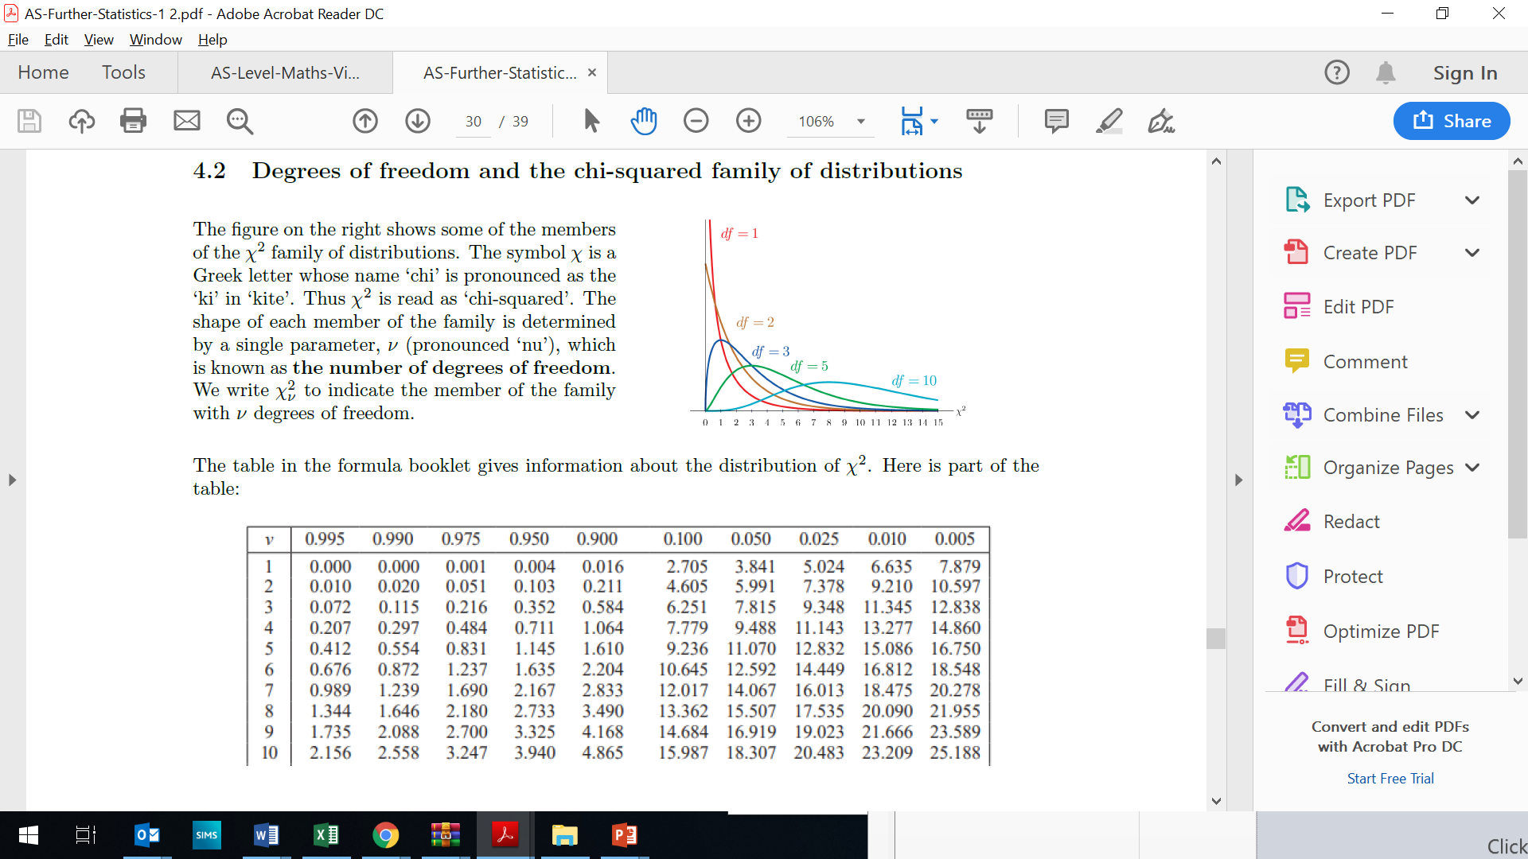

Slide 2
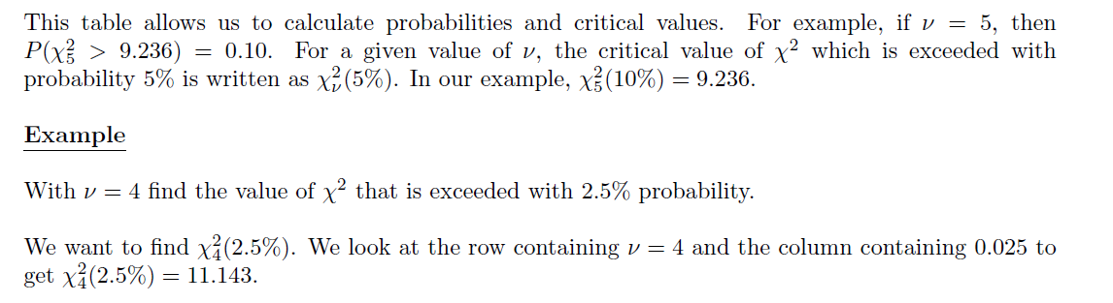

Slide 3
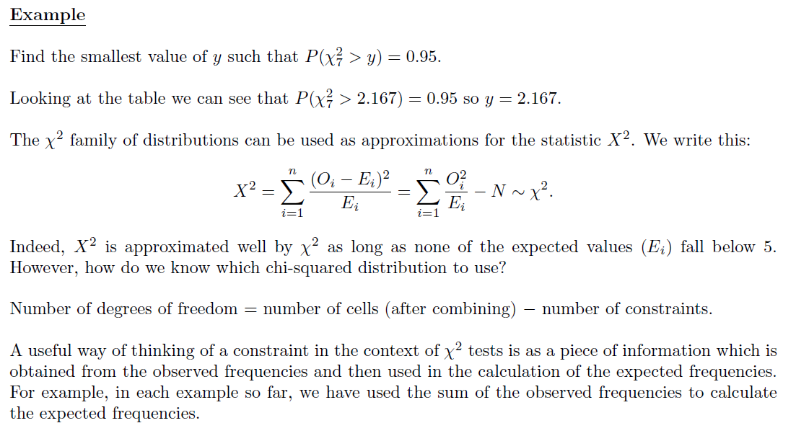

Slide 4
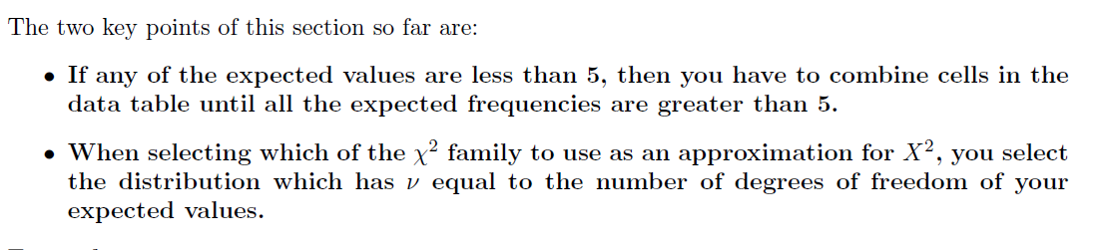

Slide 5
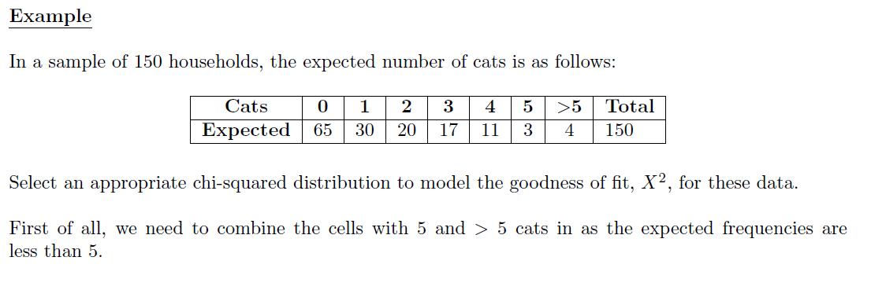
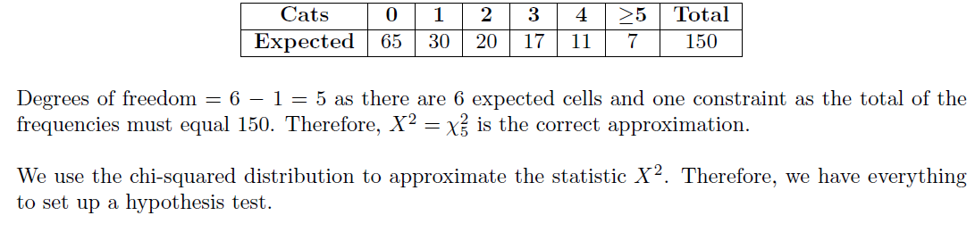

Slide 6
Exercise 6B
Pearson Further Statistics 1
Pages 99
Complete before the lesson Q1
In Class:
Green Q2-3
Amber Q4-5

