Slide 1
Year 2 Pure Mathematics
Differentiation
- More Trig Functions
Chapter 9
(Part 6 of 10)

Slide 2
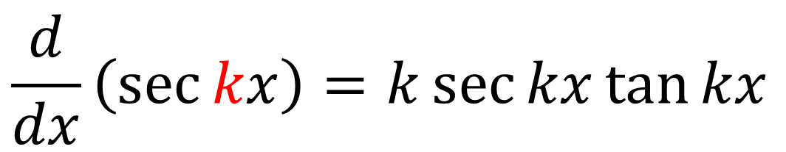
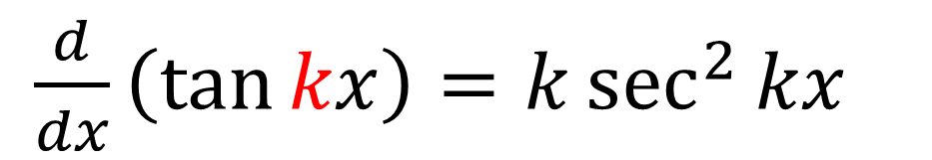
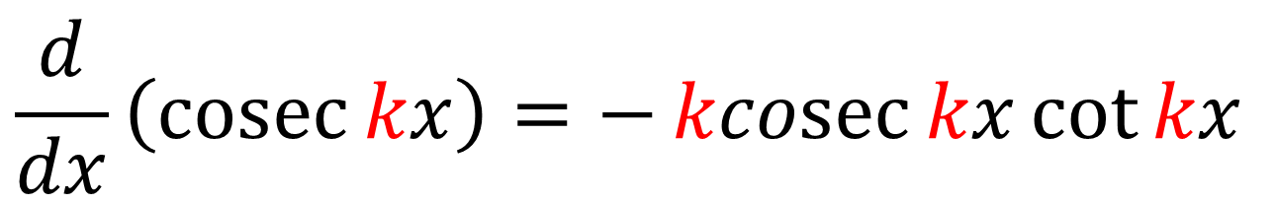
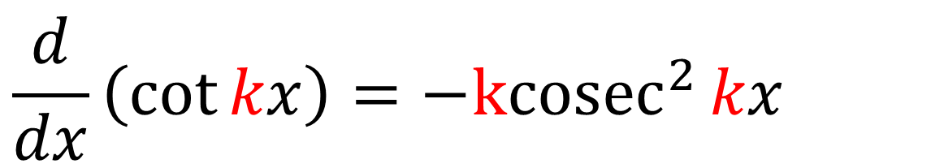
Differentiating other trigonometric functions
In the formula booklet:
$\frac{d}{dx}\left(\tan{kx}\right)=k\sec^{2}{kx}$
$$\frac{d}{dx}\left(\sec{kx}\right)=k\sec{kx}\tan{kx}$$
$$\frac{d}{dx}\left(\cot{kx}\right)={−kcosec}^{2}{kx}$$
$$\frac{d}{dx}\left(\operatorname{cosec}{kx}\right)=−\operatorname{kcosec}{kx}\cot{kx}$$

Slide 3
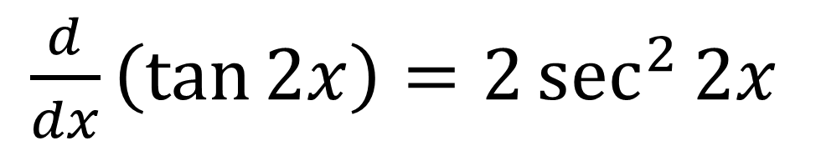
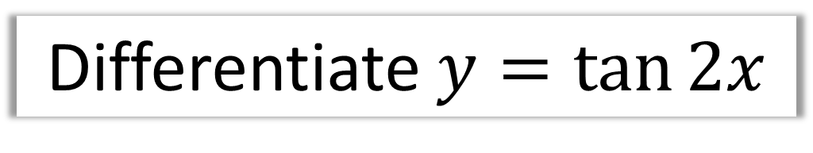
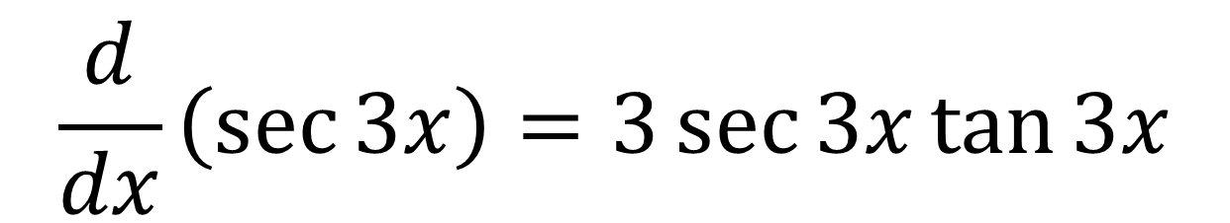
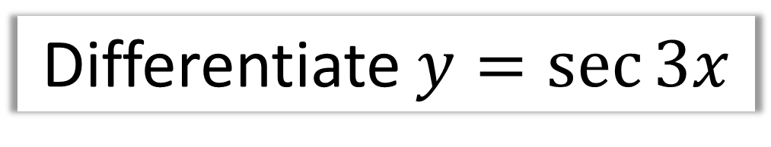
Differentiating other trigonometric functions
Differentiate $y=\tan{2x}$
$\frac{d}{dx}\left(\tan{2x}\right)=2\sec^{2}{2x}$
Differentiate $y=\sec{3x}$
$$\frac{d}{dx}\left(\sec{3x}\right)=3\sec{3x}\tan{3x}$$

Slide 4
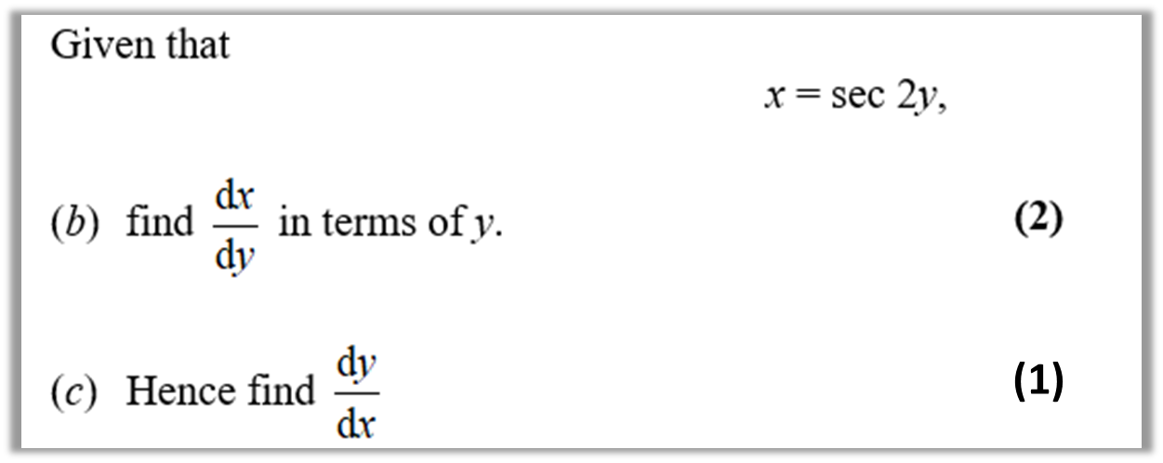
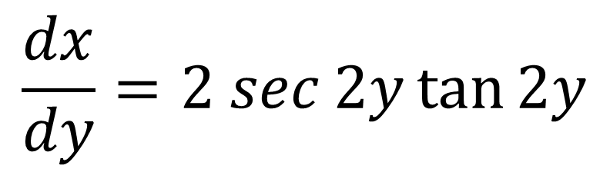
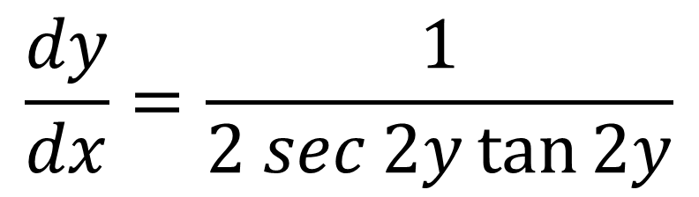
Differentiating other trigonometric functions
$$\frac{dx}{dy}=2 sec{2y}\tan{2y}$$
(b)
$$\frac{dy}{dx}=\frac{1}{2 sec{2y}\tan{2y}}$$
(c)

Slide 5
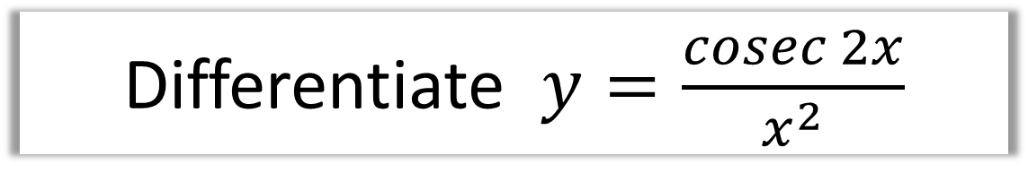
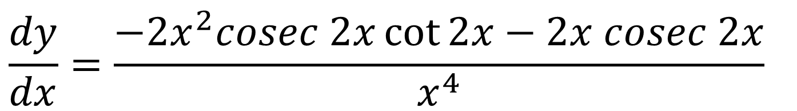


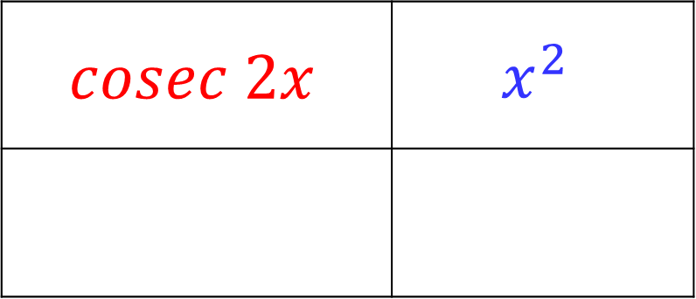
Differentiating other trigonometric functions
Differentiate $y=\frac{cosec 2x}{x^{2}}$
$$cosec 2x$$ | $$x^{2}$$
$$2x$$
$$−2cosec 2x\cot{2x}$$
$$\frac{dy}{dx}=\frac{−2x^{2}cosec 2x\cot{2x}−2x cosec 2x}{x^{4}}$$

Slide 6
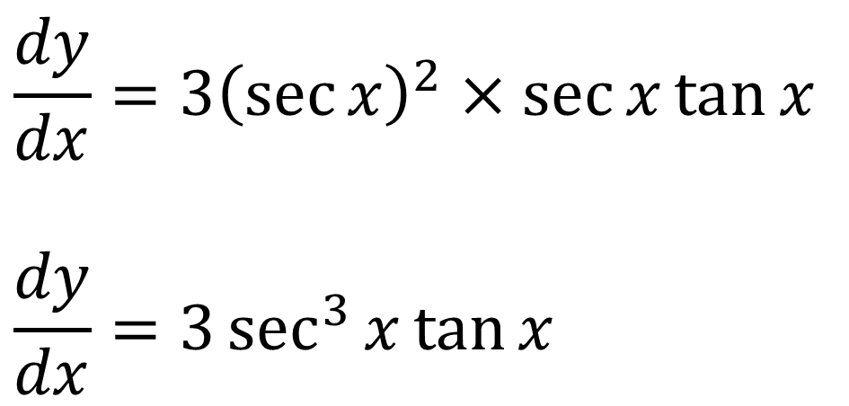
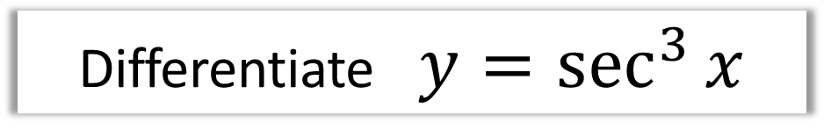
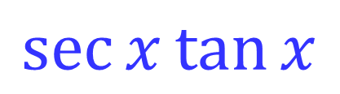

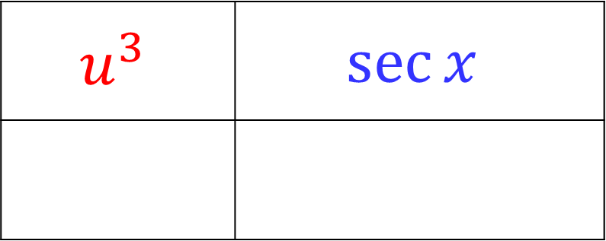
Differentiating other trigonometric functions
Differentiate $y=\sec^{3}{x}$
$$u^{3}$$ | $$\sec{x}$$
$${3u}^{2}$$
$$\sec{x}\tan{x}$$
$$\frac{dy}{dx}=3{\left(\sec{x}\right)}^{2}×\sec{x}\tan{x}$$
$$\frac{dy}{dx}=3\sec^{3}{x}\tan{x}$$

Slide 7
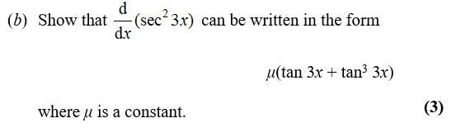
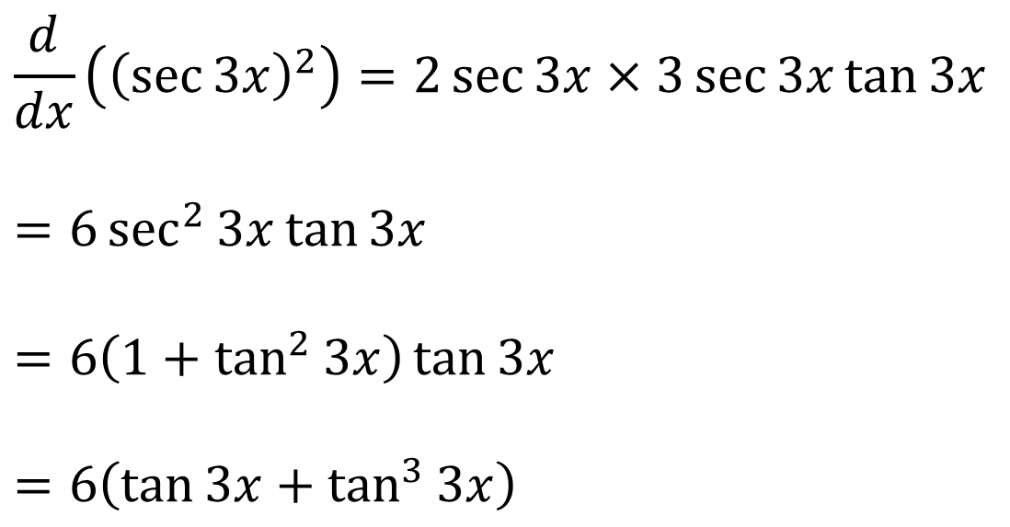
Differentiating other trigonometric functions
$$\frac{d}{dx}\left({\left(\sec{3x}\right)}^{2}\right)=2\sec{3x}×3\sec{3x}\tan{3x}$$
$$=6\sec^{2}{3x}\tan{3x}$$
$$=6\left(1+\tan^{2}{3x}\right)\tan{3x}$$
$$=6\left(\tan{3x}+\tan^{3}{3x}\right)$$

Slide 8
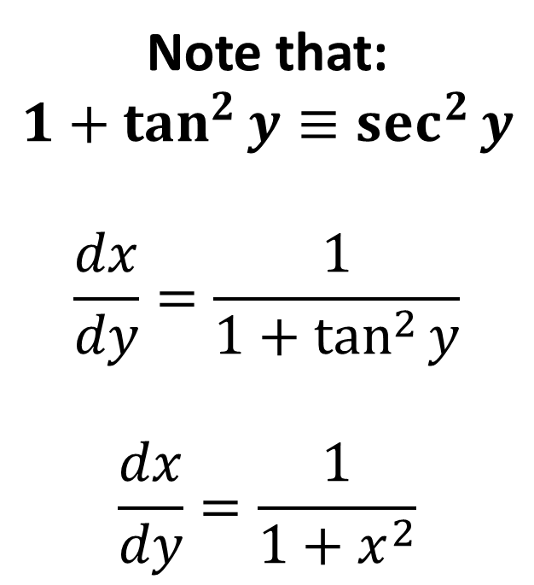
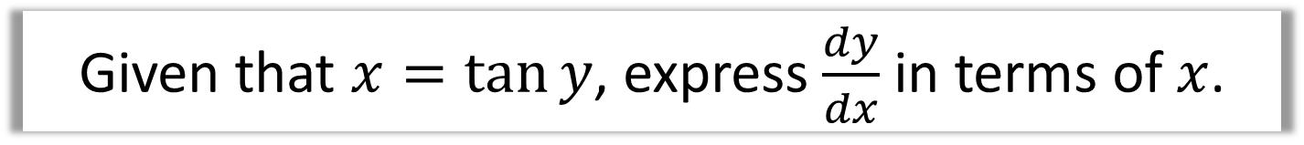
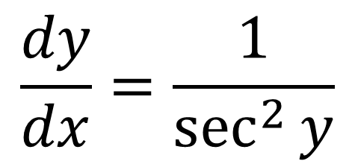
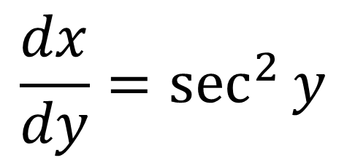
Differentiating other trigonometric functions
Given that $x=\tan{y}$, express $\frac{dy}{dx}$ in terms of $x$.
$$\frac{dx}{dy}=\sec^{2}{y}$$
Note that:
$$1+\tan^{2}{y}≡\sec^{2}{y}$$
$$\frac{dx}{dy}=\frac{1}{1+\tan^{2}{y}}$$
$$\frac{dx}{dy}=\frac{1}{1+x^{2}}$$
$$\frac{dy}{dx}=\frac{1}{\sec^{2}{y}}$$

Slide 9
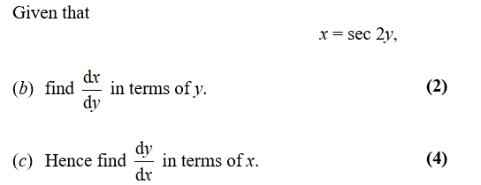
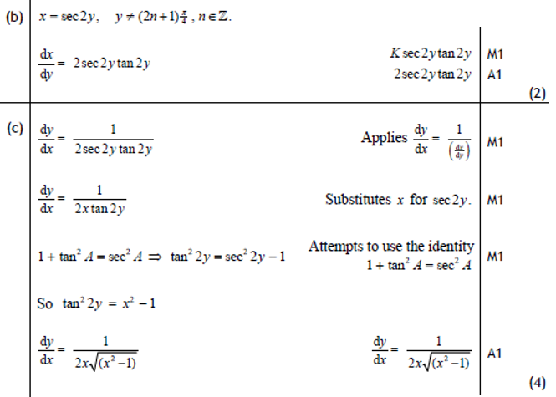

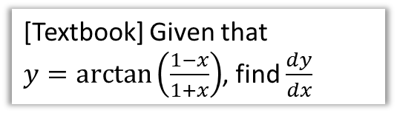
Test Your Understanding
Edexcel C3 Jan 2011 Q8b,c
[Textbook] Given that
$y=\arctan\left(\frac{1−x}{1+x}\right)$, find $\frac{dy}{dx}$
?
(Let’s use the ‘full’ Chain Rule method this time)
Let $u=\frac{1−x}{1+x}$
$$\frac{du}{dx}=…=−\frac{2}{{\left(1+x\right)}^{2}}$$
$$y=\arctan{u} \\ ∴\frac{dy}{du}=\frac{1}{1+u^{2}}$$
By the Chain Rule:
$$\frac{dy}{dx}=\frac{dy}{du}×\frac{du}{dx} \\ =\frac{1}{1+u^{2}}×\left(−\frac{2}{{\left(1+x\right)}^{2}}\right) \\ =… \\ =−\frac{1}{1+x^{2}}$$
?

Slide 10
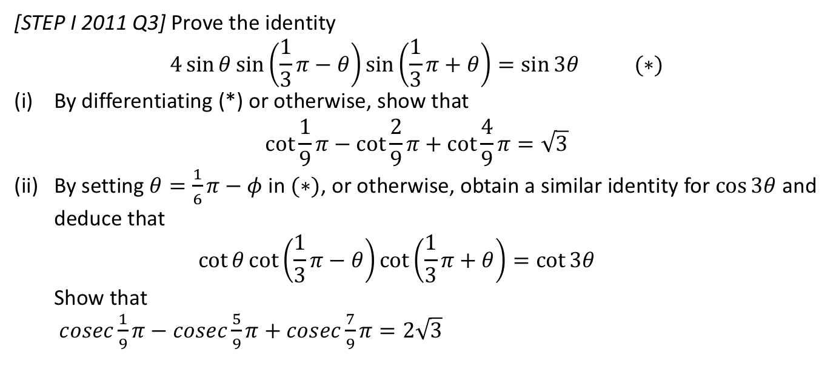
Exercise 9F
Pearson Pure Mathematics Year 2/AS
Pages 249-251
Complete before the lesson Q1-4
Green Q5-7
Amber Q8-10
Red Q11-12 & Ext
[STEP I 2011 Q3] Prove the identity
$$4\sin{θ}\sin\left(\frac{1}{3}π−θ\right)\sin\left(\frac{1}{3}π+θ\right)=\sin{3θ} (∗)$$
By differentiating (*) or otherwise, show that
$\cot{\frac{1}{9}π}−\cot{\frac{2}{9}π}+\cot{\frac{4}{9}π}=\sqrt{3}$
By setting $θ=\frac{1}{6}π−φ$ in $(∗)$, or otherwise, obtain a similar identity for $\cos{3θ}$ and deduce that
$\cot{θ}\cot\left(\frac{1}{3}π−θ\right)\cot\left(\frac{1}{3}π+θ\right)=\cot{3θ}$
Show that
$cosec\frac{1}{9}π−cosec\frac{5}{9}π+cosec\frac{7}{9}π=2\sqrt{3}$

