Slide 1
Year 2 Pure Mathematics
Sequences and Series
- Sum of Arithmetic Series
Chapter 3
(Part 2 of 7)

Slide 2
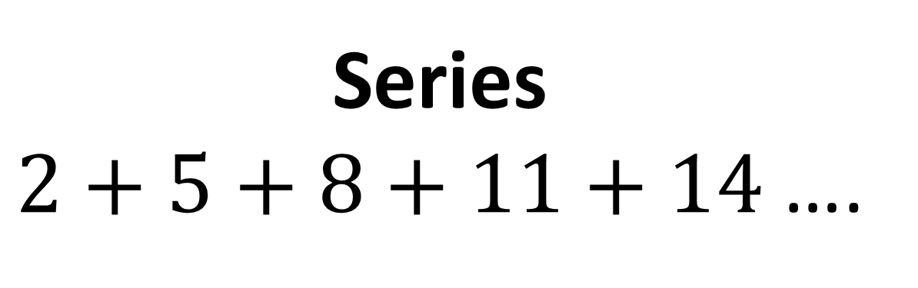
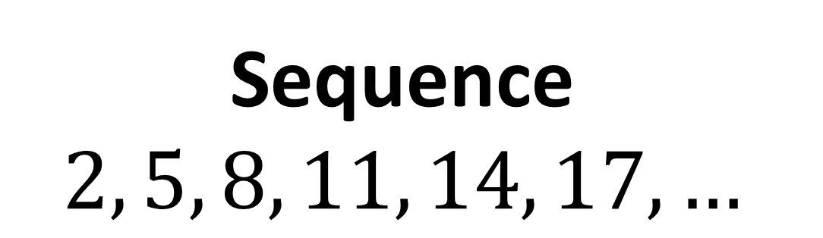
Arithmetic Series
Sequence
$$2, 5, 8, 11, 14, 17, …$$
Series
$2+5+8+11+14$ ….

Slide 3

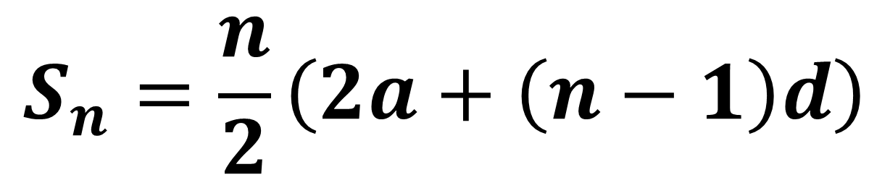
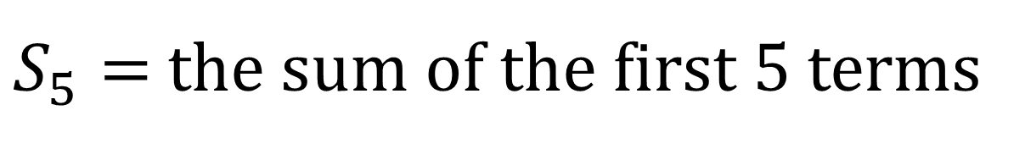
Arithmetic Series
Sum of first $n$ terms
$$S_{n}=\frac{n}{2}\left(2a+\left(n−1\right)d\right)$$
$S_{5}=$ the sum of the first 5 terms

Slide 4
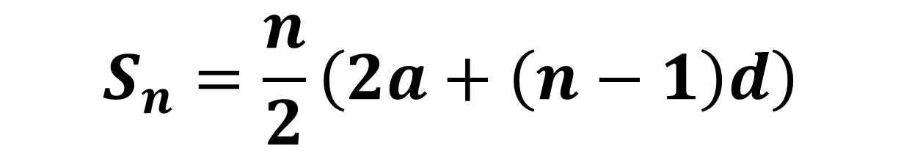
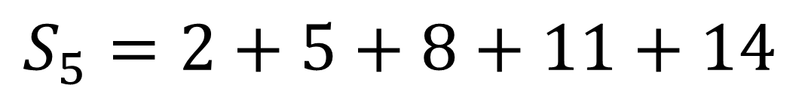

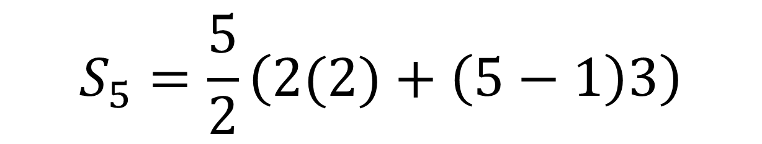
Arithmetic Series
$$S_{5}=2+5+8+11+14$$
$$S_{n}=\frac{n}{2}\left(2a+\left(n−1\right)d\right)$$
$$S_{5}=\frac{5}{2}\left(2(2)+\left(5−1\right)3\right)$$
$$S_{5}=40$$

Slide 5
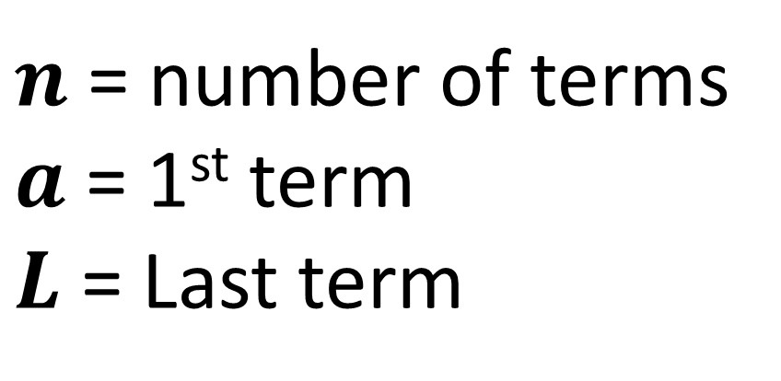
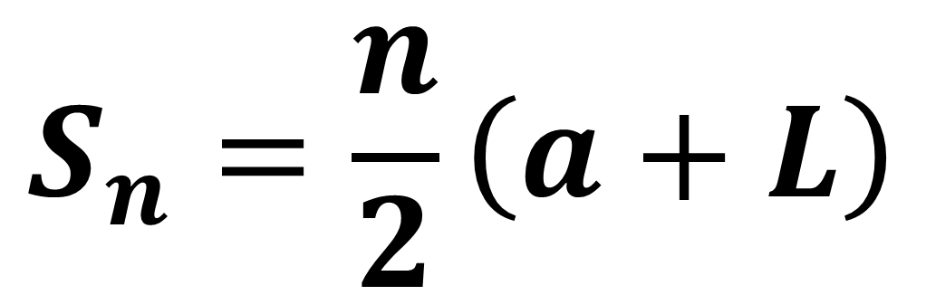
Arithmetic Series - Alternative Formula
$$S_{n}=\frac{n}{2}\left(a+L\right)$$
$n$ = number of terms
$a$ = 1st term
$L$ = Last term

Slide 6
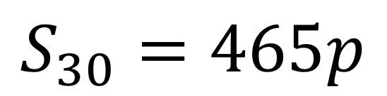

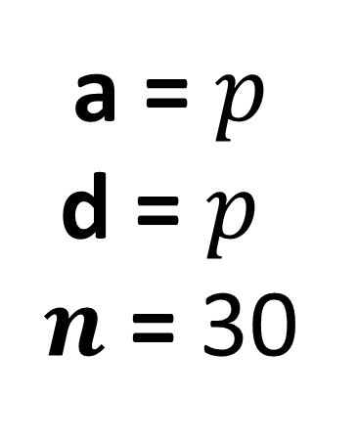
Arithmetic Series - Example
Find the sum of the first 30 terms of the following arithmetic sequence
$$p+2p+3p+…$$
a = $p$
d = $p$
$n$ = 30
$$S_{30}=465p$$

Slide 7

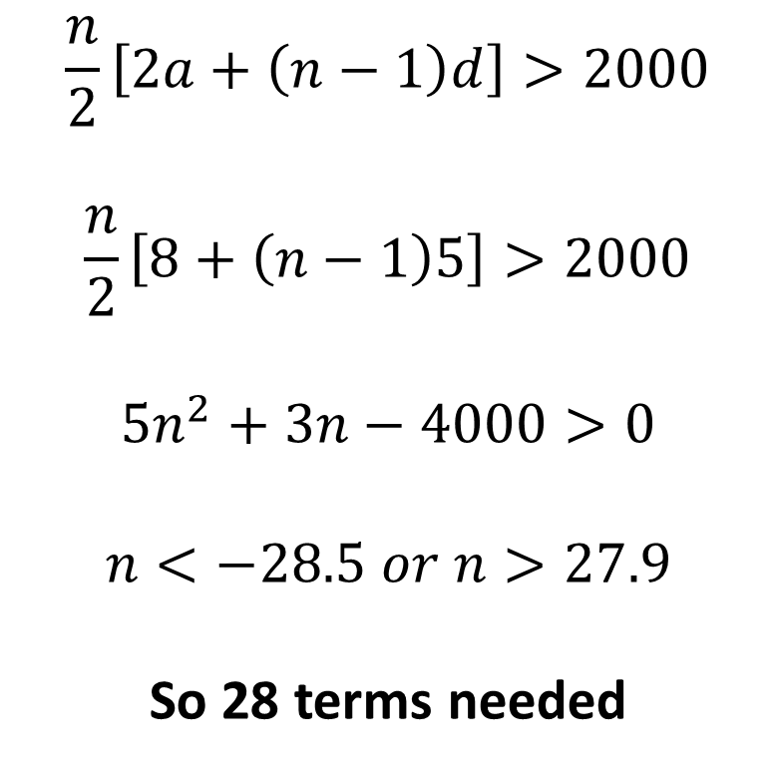
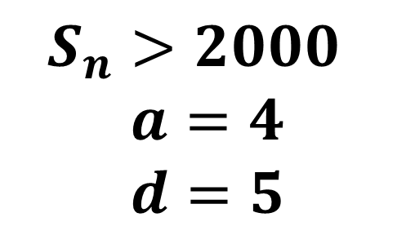
Arithmetic Series - Example
Find the greatest number of terms for the sum of $4+9+14+…$ to exceed 2000.
$$\frac{n}{2}\left[2a+\left(n−1\right)d\right]>2000$$
$$\frac{n}{2}\left[8+\left(n−1\right)5\right]>2000$$
$$5n^{2}+3n−4000>0$$
$$n<−28.5 or n>27.9$$
So 28 terms needed
$$S_{n}>2000$$
$$a=4$$
$$d=5$$

Slide 8
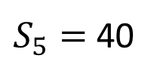



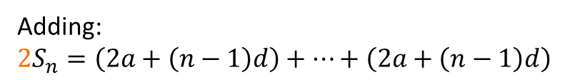





Arithmetic Series - Proof
Take an arithmetic sequence $2, 5, 8, 11, 14,$…
Sum of first 5 terms:
Proving algebraically:
$$S_{5}=2+5+8+11+14$$
$$S_{n}=a +\left(a+d\right)+\left(a+2d\right)+… +\left(a+\left(n−1\right)d\right)$$
$$S_{5}=14+11+8+5+2$$
$$S_{n}=\left(a+\left(n−1\right)d\right)+… +\left(a+2d\right)+\left(a+d\right)+a$$
Adding:
Adding:
$$2S_{n}=\left(2a+\left(n−1\right)d\right)+…+\left(2a+\left(n−1\right)d\right)$$
$${2S}_{5}=16+16+16+16+16$$
$${2S}_{5}=5(16)$$
$$2S_{n}=n\left(2a+\left(n−1\right)d\right)$$
$$S_{5}=\frac{5(16)}{2}$$
$$S_{n}=\frac{n}{2}\left(2a+\left(n−1\right)d\right)$$
$S_{5}=$40

Slide 9
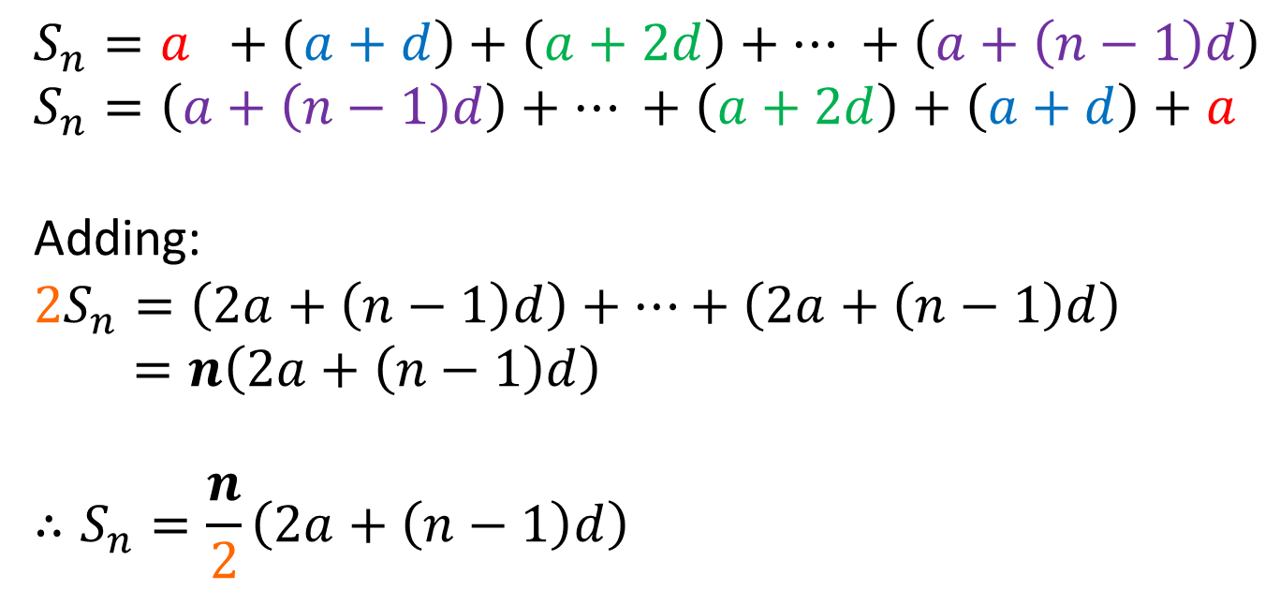
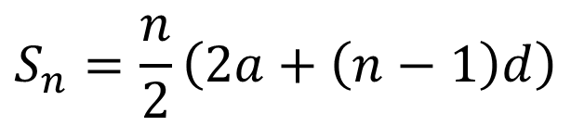
Arithmetic Series - Proof
Prove
$$S_{n}=\frac{n}{2}\left(2a+\left(n−1\right)d\right)$$
$$S_{n}=a +\left(a+d\right)+\left(a+2d\right)+… +\left(a+\left(n−1\right)d\right) \\ S_{n}=\left(a+\left(n−1\right)d\right)+… +\left(a+2d\right)+\left(a+d\right)+a$$
Adding:
$$2S_{n}=\left(2a+\left(n−1\right)d\right)+…+\left(2a+\left(n−1\right)d\right)$$
$=n\left(2a+\left(n−1\right)d\right)$
$$∴S_{n}=\frac{n}{2}\left(2a+\left(n−1\right)d\right)$$

Slide 10
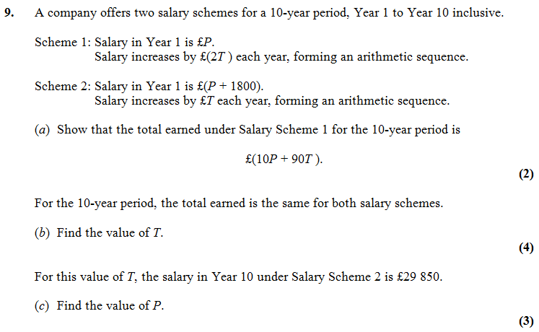


Test Your Understanding
Edexcel C1 Jan 2012 Q9
?
$$T=400$$
$$P=£24450$$
?

Slide 11
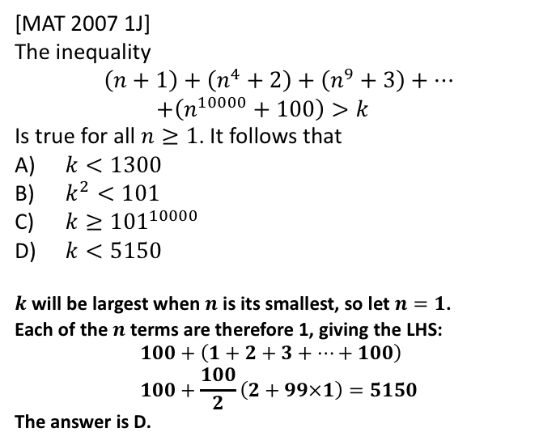
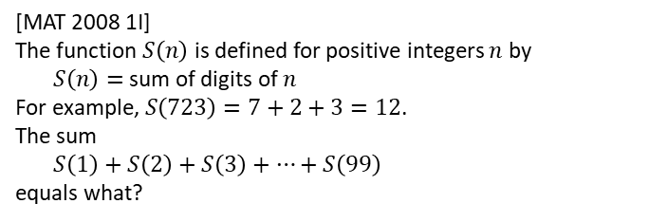
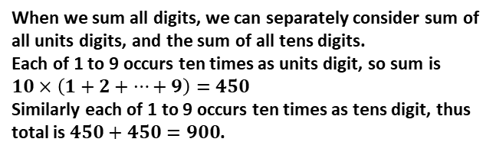
Exercise 3B
Pearson Pure Mathematics Year 2/AS
Pages 64-66
Extension
Complete before the lesson Q1-2
In Class:
Green Q3-6
Amber Q7-9
Red Q10-13 & Challenge
[MAT 2007 1J]
The inequality
$$\left(n+1\right)+\left(n^{4}+2\right)+\left(n^{9}+3\right)+… \\ +\left(n^{10000}+100\right)>k$$
Is true for all $n≥1$. It follows that
$k<1300$
$k^{2}<101$
$k≥{101}^{10000}$
$k<5150$
$k$ will be largest when $n$ is its smallest, so let $n=1$.
Each of the $n$ terms are therefore 1, giving the LHS:
$$100+\left(1+2+3+…+100\right) \\ 100+\frac{100}{2}\left(2+99×1\right)=5150$$
The answer is D.
?
3
[MAT 2008 1I]
The function $S\left(n\right)$ is defined for positive integers $n$ by
$S\left(n\right)=$sum of digits of $n$
For example, $S\left(723\right)=7+2+3=12$.
The sum
$S\left(1\right)+S\left(2\right)+S\left(3\right)+…+S\left(99\right)$
equals what?
?
When we sum all digits, we can separately consider sum of all units digits, and the sum of all tens digits.
Each of 1 to 9 occurs ten times as units digit, so sum is $10×\left(1+2+…+9\right)=450$
Similarly each of 1 to 9 occurs ten times as tens digit, thus total is $450+450=900$.

