Slide 1
Year 1 Pure Mathematics
Data Collection
– Random Sampling
Chapter 1
(Part 1 of 4)

Slide 2
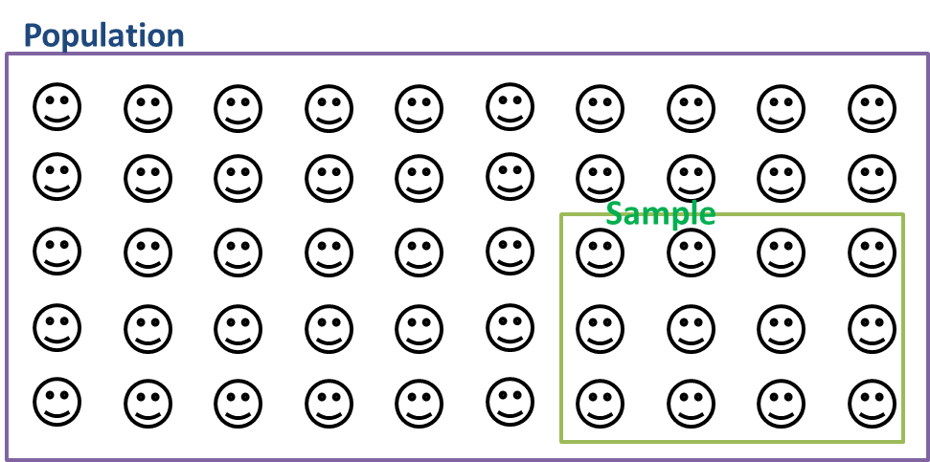
Populations and Samples
The sample should represent the population.

Slide 3
Populations and Samples
Sampling Unit
Sampling frame is a list of sampling units

Slide 4
Census and Samples
Data collected from the entire population
is known as a census.
 | Advantages | Disadvantages
Census | Accurate results | Time Consuming
 |  | Expensive
Accurate results | Time Consuming
 | Expensive
 | Advantages | Disadvantages
Sample | Cheaper | May not be accurate
 | Quicker | Small sub-groups may not be represented
Cheaper | May not be accurate
Quicker | Small sub-groups may not be represented

Slide 5
Sampling – Different Types
Type
Simple Random Sampling
Random Sampling
Systematic Sampling
Stratified Sampling
Quota Sampling
Non-Random
Opportunity Sampling

Slide 6
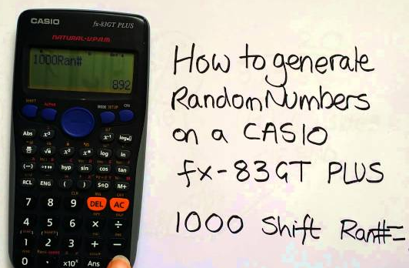
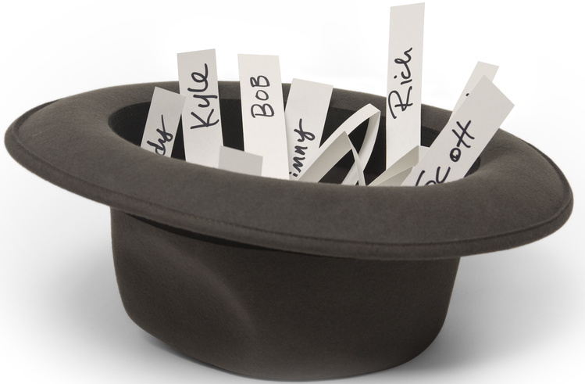
Sampling - Simple Random
Random number generator
Names/numbers out of a hat
 | Advantages | Disadvantages
Simple Random Sampling | Bias free | Time consuming
 | Easy and Cheap | Sampling frame needed
 | Data has a equal chance of being selected

Slide 7
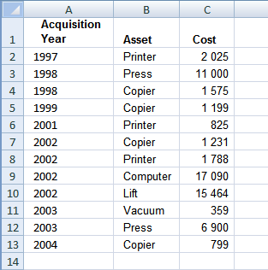
Sampling - Systematic
Data is chosen at regular intervals from an ordered list.
 | Advantages | Disadvantages
Systematic Sampling | Simple and quick to use | Sampling frame needed
 | Suitable for large sample | Introduces bias if sample frame not random
 | Data has a equal chance of being selected

Slide 8
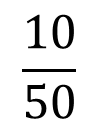



Sampling - Stratified
Population
$$\frac{20}{50}$$
$$\frac{10}{50}$$
$$\frac{15}{50}$$
$$\frac{5}{50}$$
Population is divided into distinct groups
known as ‘strata’.
Sample strata are in proportion to
the population strata.

Slide 9
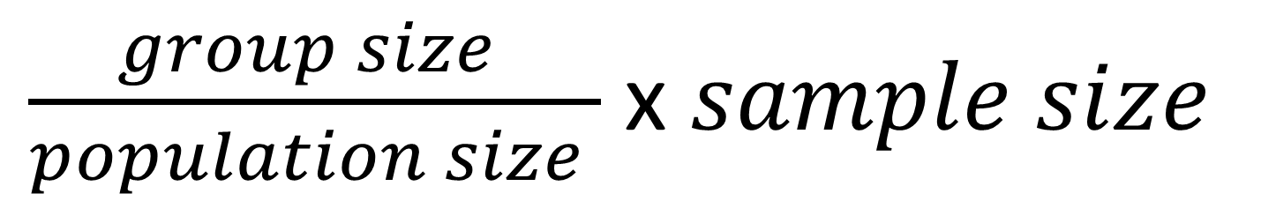
Sampling - Stratified
$\frac{group size }{population size }$ x $sample size$
 | Advantages | Disadvantages
Stratified Sampling | Simple to use | Population must be in distinct strata
 | Quick to use | Time Consuming
 | Each strata gets represented | Can introduce bias

Slide 10
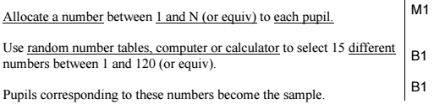
Sampling - Simple Random
There are 64 girls and 56 boys in a school.
Explain briefly how you could take a random sample of 15 pupils
using a simple random sample. (3)

Slide 11

Sampling - Systematic
A telephone directory contains 50 000 names.
A researcher wishes to select a systematic sample of 100
names from the directory.
Explain in detail how the researcher should obtain such a sample. (2)

Slide 12
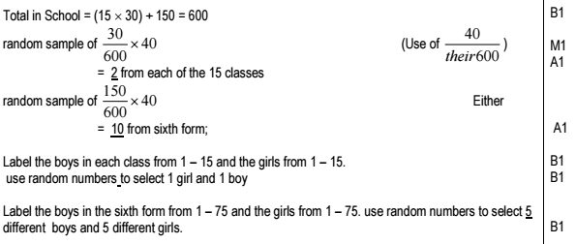
Sampling - Stratified
A school has 15 classes and a sixth form. In each class there are 30 students.
In the sixth form there are 150 students.
There are equal numbers of boys and girls in each class.
There are equal numbers of boys and girls in the sixth form.
The head teacher wishes to obtain the opinions of the students about school uniforms.
Explain how the head teacher would take a stratified sample of size 40. (7)

Slide 13
Exercise 1A
Pearson Statistics & Mechanics Year 1/AS
Page 3
Complete before the lesson Q1
In Class:
Green Q2-3
Amber
Red Q4-5

Slide 14
Exercise 1B
Pearson Statistics & Mechanics Year 1/AS
Pages 6-7
Complete before the lesson Q1-2
In Class:
Green Q3-6

