Slide 1
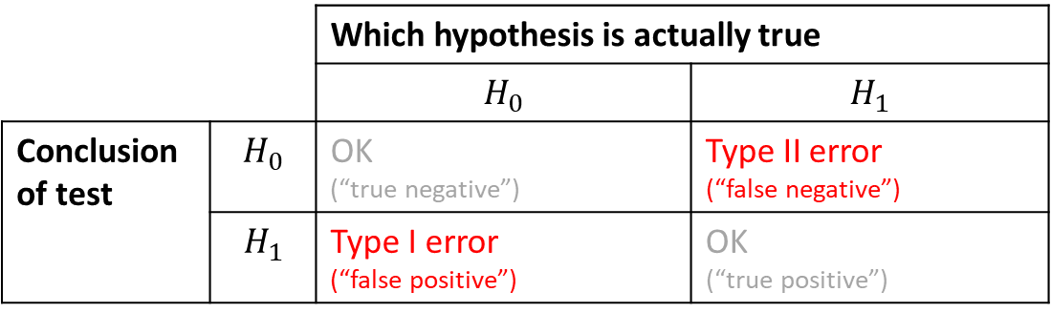
Summary Table
e.g. As a doctor, concluding someone doesn’t have a disease, when they actually have it (the worst-case scenario!)
e.g. As a doctor, concluding someone doesn’t have a disease when they indeed don’t.
 |  | Which hypothesis is actually true
 |  | $$H_{0}$$ | $$H_{1}$$
Conclusion of test | $$H_{0}$$ | OK (“true negative”) | Type II error (“false negative”)
 | $$H_{1}$$ | Type I error (“false positive”) | OK (“true positive”)
e.g. Making an incorrect diagnosis of a disease when the patient doesn’t have it.
e.g. Correctly diagnosing someone to have the disease.

Slide 2
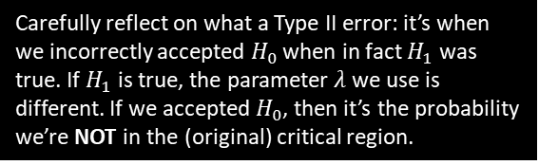

Example
[Textbook] Accidents occurred on a stretch of motorway at an average rate of 6 per month. Many of the accidents that occurred involved vehicles skidding into the back of other vehicles. By way of a trial, a new type of road surface that is said to reduce the risk of vehicles skidding is laid on this stretch of road, and during the first month of operation 4 accidents occurred.
Test this result to see if it gives evidence that there has been an improvement at the 5% level of significance.
Calculate P(Type I error) for this test.
If the true average rate of accidents occurring with the new type of road surface was 3.5, calculate the probability of a Type II error.
a
Let $X=$ num accidents in given month. $X\sim Po\left(λ\right)$
$H_{0}:λ=6$ (i.e. no change)
$H_{1}:λ<6$ (i.e. fewer accidents)
Assuming $H_{0}, X\sim Po\left(6\right)$
$P\left(X≤4 | λ=6\right)=0.2851$
0.2851 > 0.5 so do not reject $H_{0}$; insufficient evidence that number of accidents per month has decreased.
Using tables, critical region: $X≤1$ and $P\left(X≤1\right)=0.0174$
Therefore probability of Type I error = 0.0174
$P\left(Type II error \right|λ=3.5)=P\left(X≥2 \right|λ=3.5)$
$=1−P\left(X≤1 \right|λ=3.5)=0.8641$
?
For Type I or II tests you need to calculate the critical region.
b
?
Carefully reflect on what a Type II error: it’s when we incorrectly accepted $H_{0}$ when in fact $H_{1}$ was true. If $H_{1}$ is true, the parameter $λ$ we use is different. If we accepted $H_{0}$, then it’s the probability we’re NOT in the (original) critical region.
c
?

Slide 3

Two-Tailed Example
[Textbook] A coin is spun 20 times and a head is obtained on 7 occasions.
Test to see whether or not the coin is biased.
Calculate the probability of a Type I error for this test.
Given that the coin is biased and that this causes the tail to appear 3 times for each head that appears, calculate the probability of a Type II error for the test.
a
$H_{0}:p=0.5, H_{1}:p≠0.5$
Let $X=$ num heads in 20 spins
Assuming $H_{0}$, $X\sim B(20,0.5)$
Uses tables, critical region is $X≤5$or $X≥15$
where $P\left(X≤5\right)=0.0207$ and $P\left(X≥15\right)=0.0207$
$$P\left(Type I error\right)=P\left(X≤5 | p=0.5\right)+P\left(X≥15 | p=0.5\right)=0.0207+0.0207=0.0414$$
$P\left(Type II error\right)=P\left(6≤X≤14 | p=0.25\right)=…=0.3828$
?
b
?
c
?

Slide 4
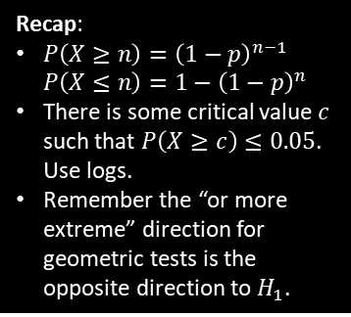

Test Your Understanding
[Textbook] Jane knows from experience that 10% of the emails she receives are spam. After her email service upgraded the spam filters, she recorded the number of emails sent up to and including the first spam email. She wants to test, at the 5% significance level, whether this upgrade improved the spam filter.
Find the critical region for her test.
Calculate the probability of a Type I error for this test.
Given that after the upgrade the probability of an email she receives being spam is now 1 in a 100, calculate the probability of a Type II error for the test.
a
Let $X=$ num emails sent up to and including first spam email. $X\sim Geo(p)$
$H_{0}:p=0.1, H_{1}:p<0.1$
Assuming $H_{0}, X\sim Geo(0.1)$
If critical value $c$, $P\left(X≥c\right)≤0.05$
$${0.9}^{c−1}≤0.05 \\ c≥(\log_{0.9}{0.05})+1 → c=30$$
Critical region is $X≥30$
$P\left(X≥30| p=0.1\right)={0.9}^{30−1}=0.0471$
$P\left(X≤29 \right| p=0.01)=1−{0.99}^{29}=0.2528$
?
Recap:
$P\left(X≥n\right)={\left(1−p\right)}^{n−1}$
$P\left(X≤n\right)=1−{\left(1−p\right)}^{n}$
There is some critical value $c$ such that $P\left(X≥c\right)≤0.05$. Use logs.
Remember the “or more extreme” direction for geometric tests is the opposite direction to $H_{1}$.
b
?
c
?

Slide 5
Exercise 8A
Pearson Further Statistics 1
Pages 152-153
Complete before the lesson Q1-2
In Class:
Green Q3-7
Amber Q8-9
Red Q10-11

