Slide 1
Year 2 Pure Mathematics
Integration
- Standard Functions
Chapter 11
(Part 1 of 11)

Slide 2
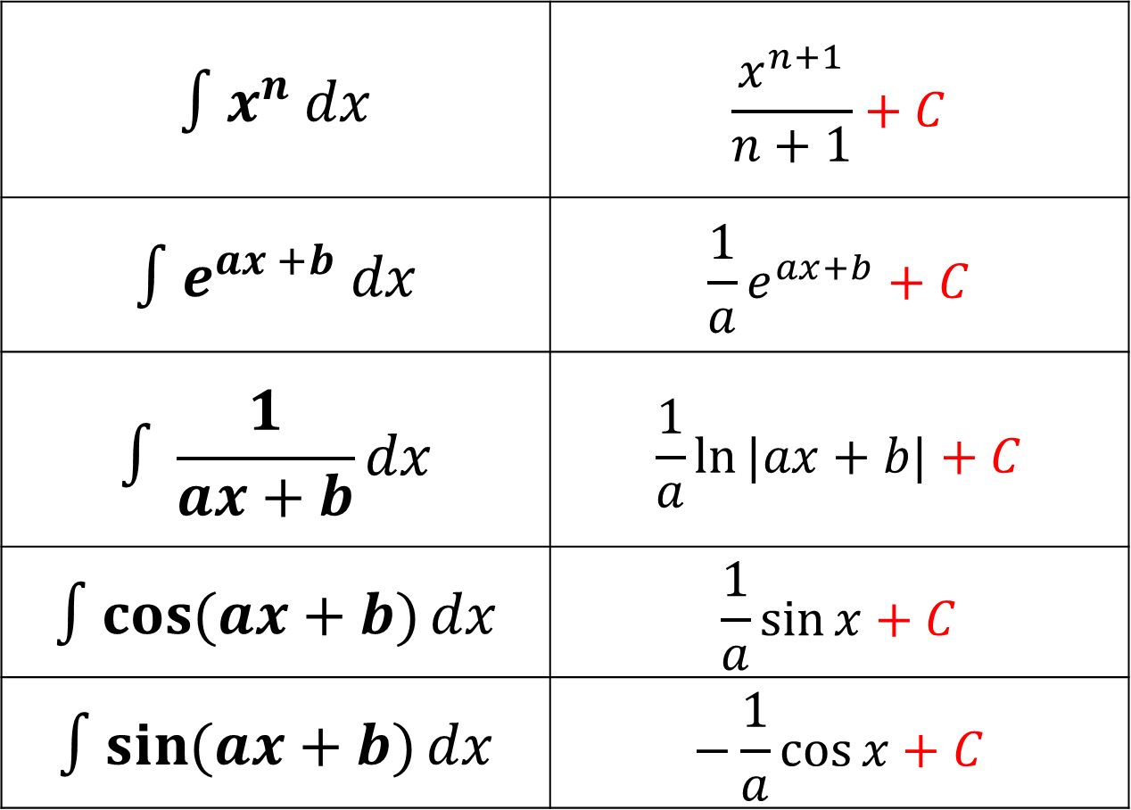
Integrating - Standard Functions
Memories these integrations.
$∫x^{n}$ $dx$ | $$\frac{x^{n+1}}{n+1}+C$$
$${∫e}^{ax +b} dx$$ | $$\frac{1}{a}e^{ax+b}+C$$
$$∫\frac{1}{ax+b}dx$$ | $$\frac{1}{a}ln{|ax+b|}+C$$
$$∫cos{(ax+b)}dx$$ | $$\frac{1}{a}\sin{x}+C$$
$$∫sin{(ax+b)}dx$$ | $$−\frac{1}{a}\cos{x}+C$$

Slide 3
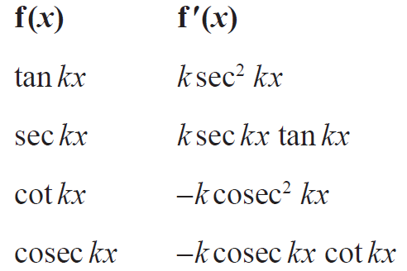




Integrating - Standard Functions
From the differentiation section in the formula booklet
Integration
$$\frac{1}{k}$$
+ C
$$\frac{1}{k}$$
+ C
$$\frac{1}{k}$$
+ C
$$\frac{1}{k}$$
+ C

Slide 4
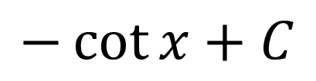
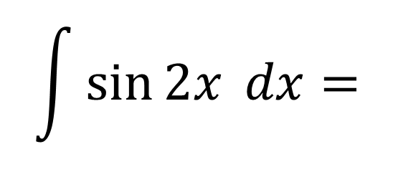
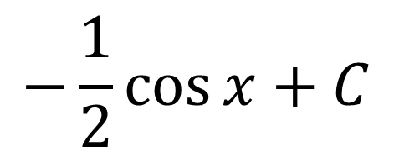
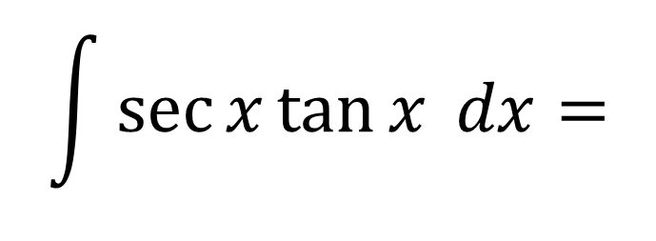
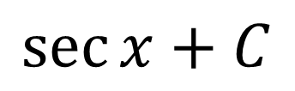
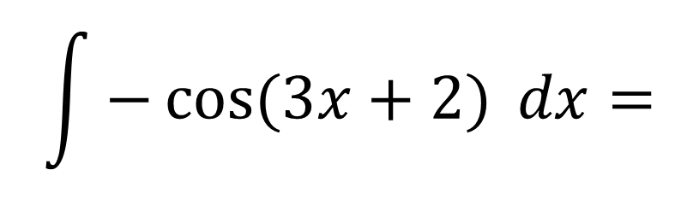
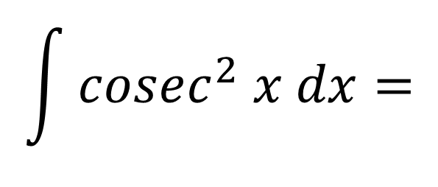
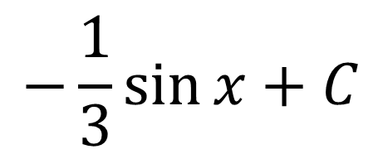
Integrating - Standard Functions
$$\int{\sec{x}\tan{x} dx}=$$
$$\sec{x}+C$$
$$\int{\sin{2x} dx}=$$
$$−\frac{1}{2}\cos{x}+C$$
$$\int{cosec^{2} x dx}=$$
$$−\cot{x}+C$$
$$\int{−\cos{(3x+2)} dx}=$$
$$−\frac{1}{3}\sin{x}+C$$

Slide 5
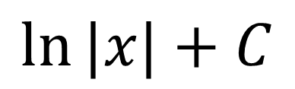
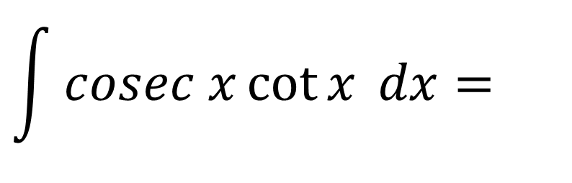
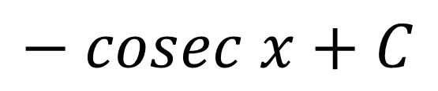
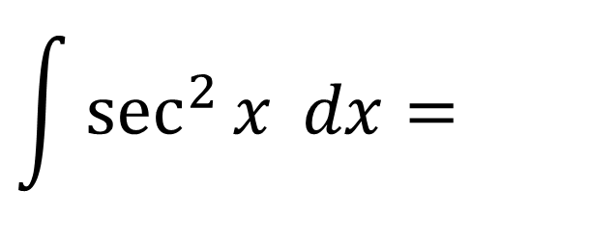
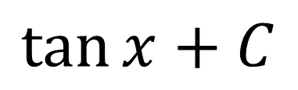
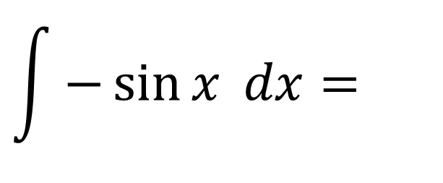
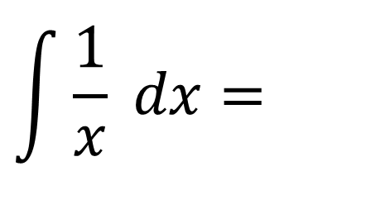
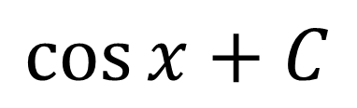
Integrating - Standard Functions
$$\int{\sec^{2}{x} dx}=$$
$$\tan{x}+C$$
$$\int{cosec x\cot{x} dx}=$$
$$− cosec x+C$$
$$\int{\frac{1}{x} dx}=$$
$$\ln{|x|}+C$$
$$\int{−\sin{x} dx}=$$
$$\cos{x}+C$$

Slide 6
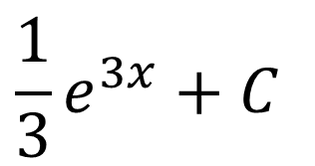
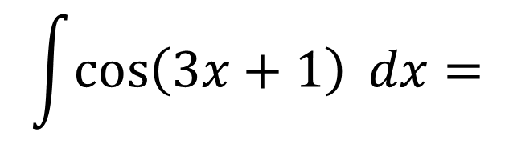
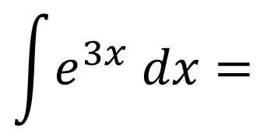
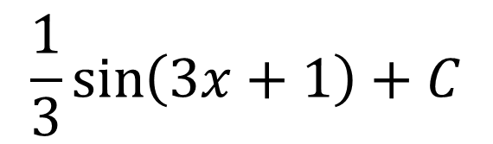
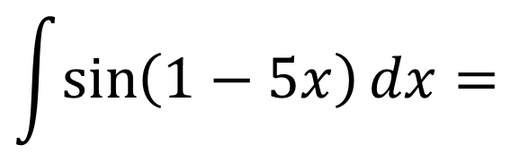
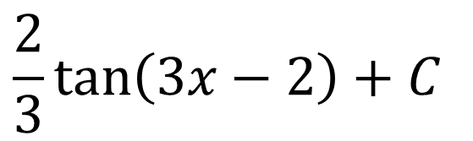
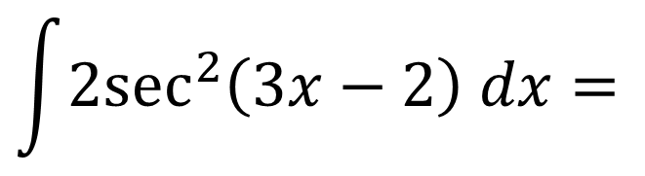
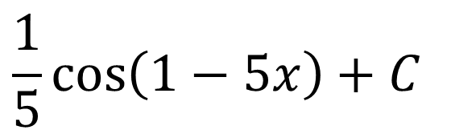
Integrating - Standard Functions
$$\int{\cos\left(3x+1\right) dx}=$$
$$\frac{1}{3}\sin\left(3x+1\right)+C$$
$$\int{e^{3x} dx}=$$
$$\frac{1}{3}e^{3x}+C$$
$$\int{\sin\left(1−5x\right)dx}=$$
$$\frac{1}{5}\cos\left(1−5x\right)+C$$
$$\int{{2sec}^{2}\left(3x−2\right) dx=}$$
$$\frac{2}{3}\tan\left(3x−2\right)+C$$

Slide 7
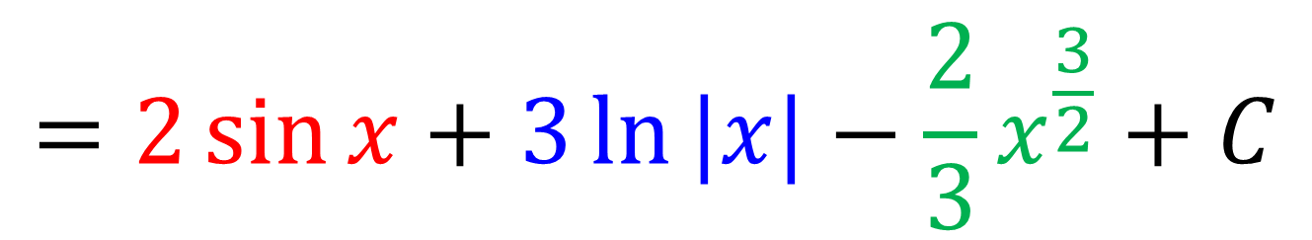
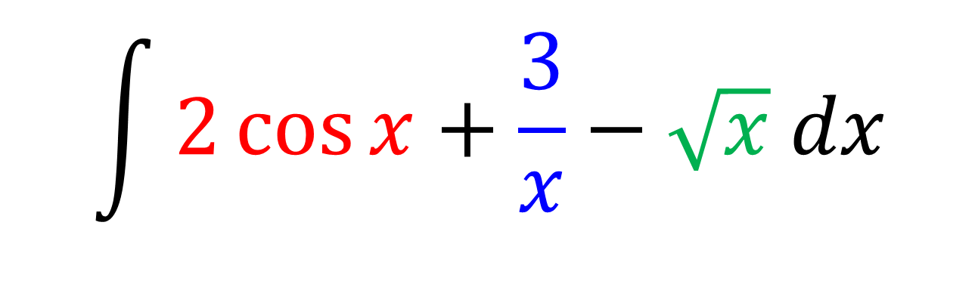
Integrating - Standard Functions
$$\int{2\cos{x}+\frac{3}{x}−\sqrt{x} dx}$$
$$=2\sin{x}+3\ln{|x|}−\frac{2}{3}x^{\frac{3}{2}}+C$$

Slide 8
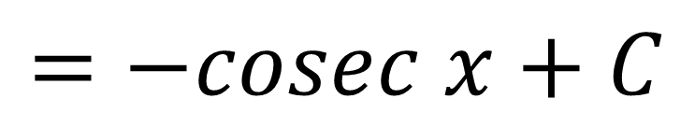
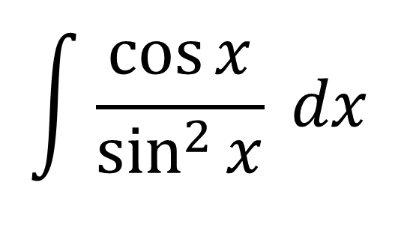
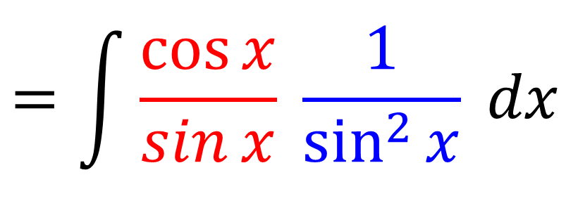
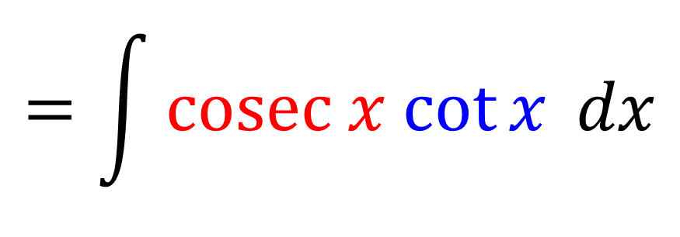
Integrating - Standard Functions
$$\int{\frac{\cos{x}}{\sin^{2}{x}} dx}$$
$$=\int{\frac{\cos{x}}{\sin{x}} \frac{1}{\sin^{2}{x}} dx}$$
$$=\int{cosec x cot{x} dx}$$
$$=−cosec x+C$$

Slide 9
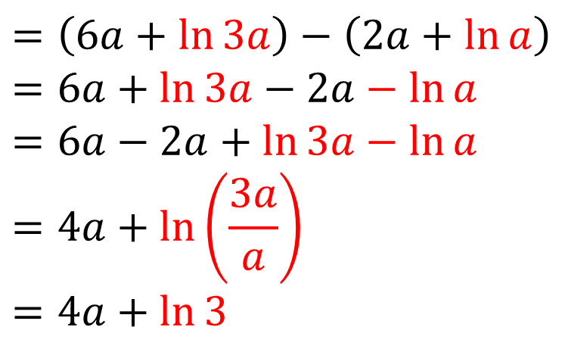
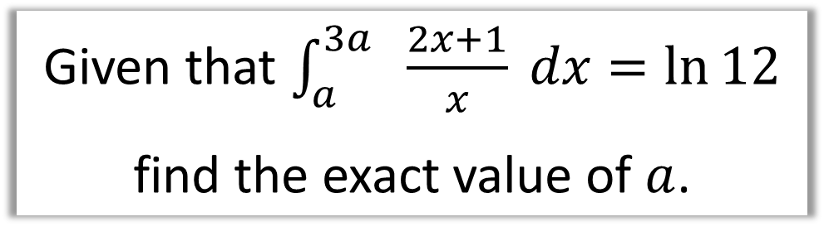
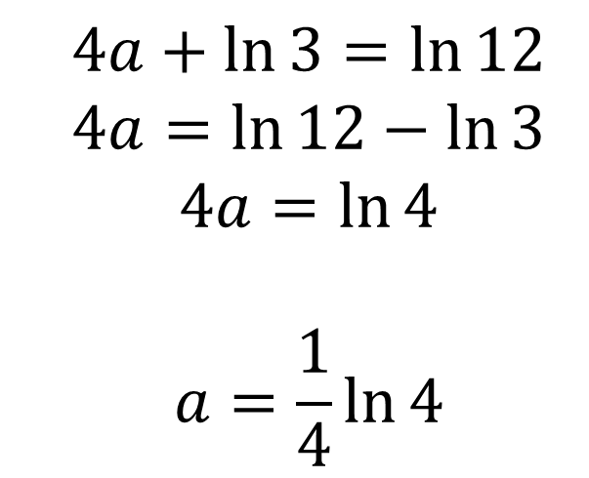
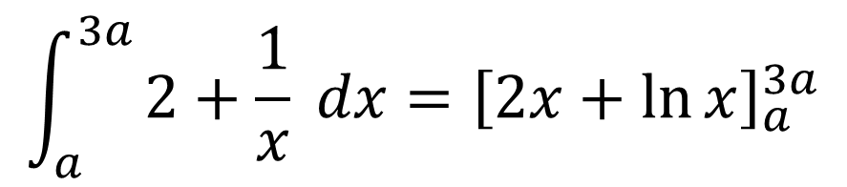
Integrating - Standard Functions
Given that $\int_{a}^{3a}{ \frac{2x+1}{x} dx}=\ln{12}$
find the exact value of $a$.
$$\int_{a}^{3a}{2+\frac{1}{x} dx}={\left[2x+\ln{x}\right]}_{a}^{3a}$$
$$=\left(6a+\ln{3a}\right)−\left(2a+\ln{a}\right)$$
$$=6a+\ln{3a}−2a−\ln{a}$$
$$=6a−2a+\ln{3a}−\ln{a} \\ =4a+\ln\left(\frac{3a}{a}\right)$$
$$=4a+\ln{3}$$
$$4a+\ln{3}=\ln{12}$$
$$4a=\ln{12}−\ln{3}$$
$$4a=\ln{4}$$
$$a=\frac{1}{4}\ln{4}$$

Slide 10
Exercise 11A
Pearson Pure Mathematics Year 2/AS
Pages 295-296
Complete before the lesson Q1-3
In Class:
Green Q4
Amber Q5-6
Red Q7

