Slide 1
Year 2 Pure Mathematics
Functions and Graphs
- Inverse Functions
Chapter 2
(Part 4 of 6)

Slide 2
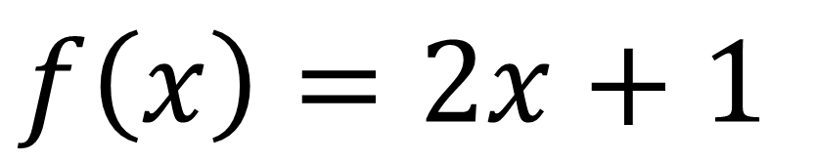

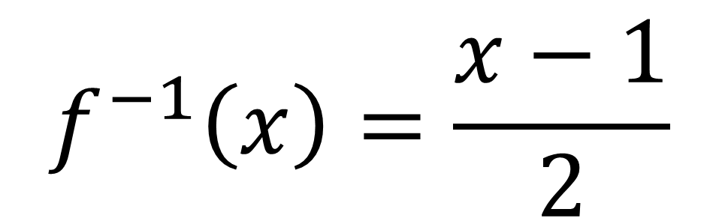
Inverse Functions
An inverse function $f^{−1}$
does the opposite of the original function.
$$f\left(x\right)=2x+1$$
$$f^{−1}\left(x\right)=\frac{x−1}{2}$$

Slide 3
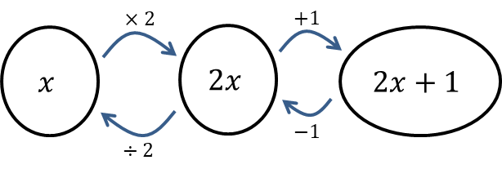

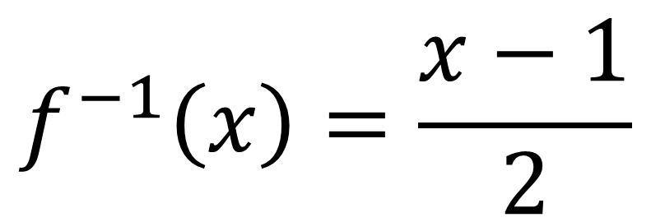
Inverse Functions
$$f\left(x\right)=2x+1$$
$$f^{−1}\left(x\right)=\frac{x−1}{2}$$

Slide 4
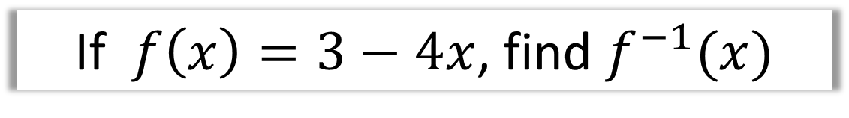
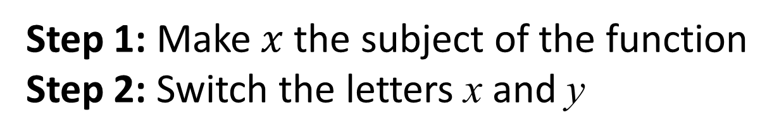
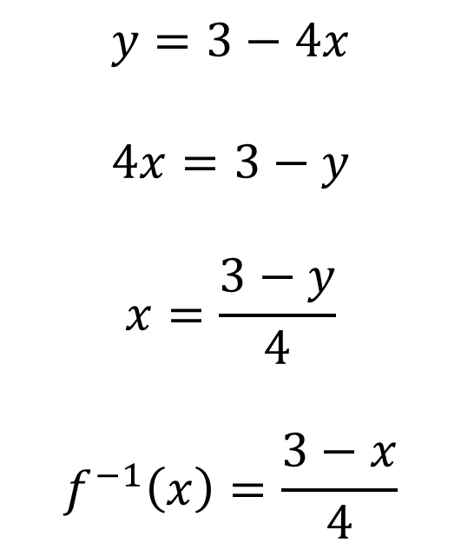
Inverse Functions
Step 1: Make $x$ the subject of the function
Step 2: Switch the letters x and y
If $f\left(x\right)=3−4x$, find $f^{−1}(x)$
$$y=3−4x$$
$$4x=3−y$$
$$x=\frac{3−y}{4}$$
$$f^{−1}\left(x\right)=\frac{3−x}{4}$$

Slide 5

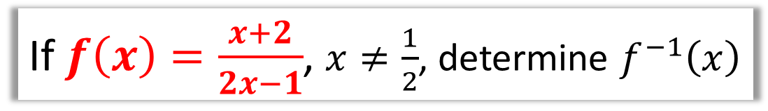
Inverse Functions
If $f\left(x\right)=\frac{x+2}{2x−1}$, $x≠\frac{1}{2}$, determine $f^{−1}\left(x\right)$
$$y=\frac{x+2}{2x−1}$$
$$y\left(2x−1\right)=x+2$$
$$2xy−y=x+2$$
$$2xy−x=y+2$$
$$x\left(2y−1\right)=y+2$$
$$x=\frac{y+2}{2y−1}$$
$$f^{−1}\left(x\right)=\frac{x+2}{2x−1}$$

Slide 6







Inverse Functions - Graphing
To get an inverse graph,
you reflect the f(x) in the reflection line y = x
$$y$$
$$y=f^{−1}(x)$$
$$y=f(x)$$
$$2$$
$$x$$
$$2$$
$$y=x$$

Slide 7
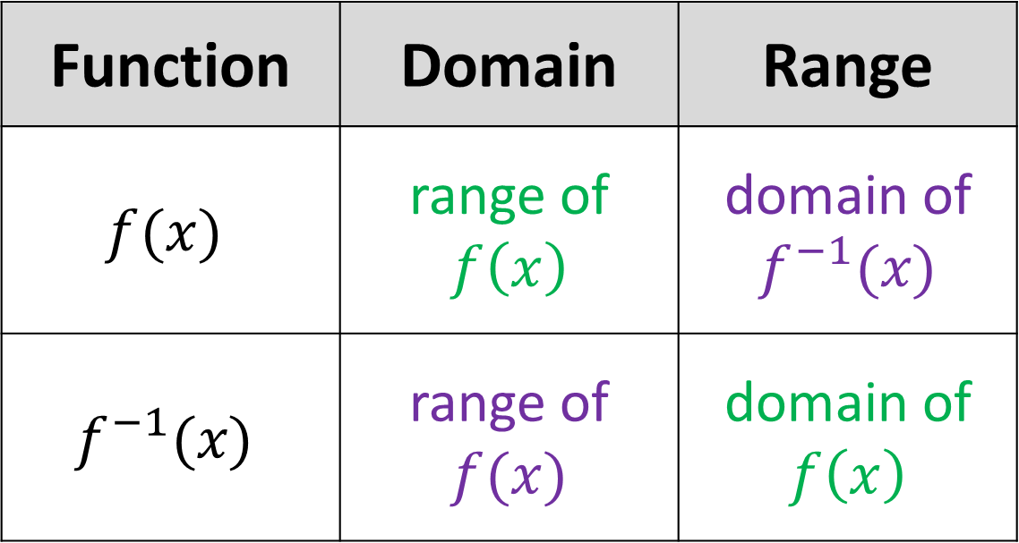
Inverse Functions - Graphing
Function | Domain | Range
$$f(x)$$ | range of $f\left(x\right)$ | domain of $f^{−1}(x)$
$$f^{−1}(x)$$ | range of $f(x)$ | domain of $f\left(x\right)$
Note:
domain and range switch

Slide 8



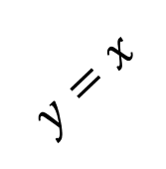
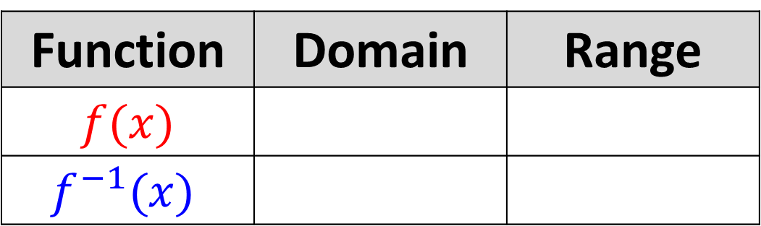



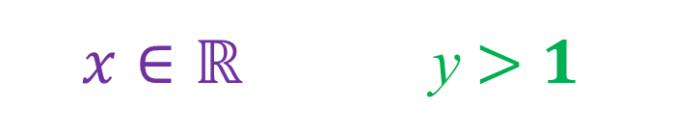
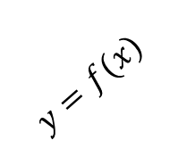


Inverse Functions - Graphing
$$y$$
$$x=1$$
$$y=f^{−1}(x)$$
$$y=f(x)$$
$$2$$
$$y=1$$
$$x$$
$$2$$
$$y=x$$
Function | Domain | Range
$$f(x)$$
$$f^{−1}(x)$$
$$x>1$$ | y $∈ℝ$
$$x∈ℝ$$ | y $>1$

Slide 9



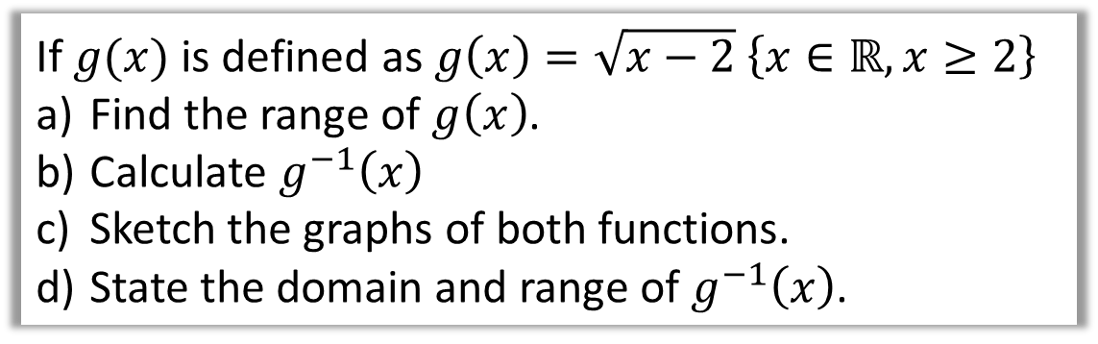

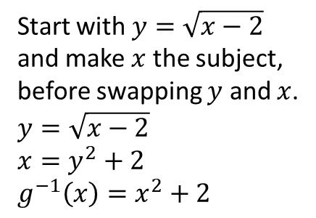

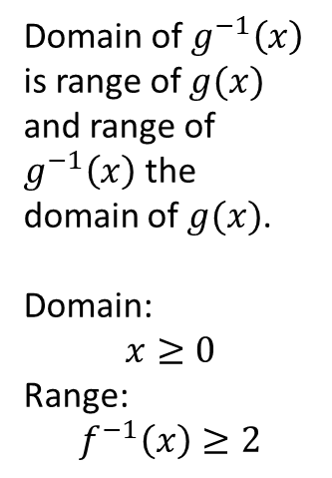


Inverse Functions
If $g(x)$ is defined as $g\left(x\right)=\sqrt{x−2} \left\{x∈ℝ,x≥2\right\}$
Find the range of $g\left(x\right)$.
Calculate $g^{−1}\left(x\right)$
Sketch the graphs of both functions.
State the domain and range of $g^{−1}\left(x\right)$.
$$y$$
d
Domain of $g^{−1}\left(x\right)$ is range of $g(x)$ and range of $g^{−1}\left(x\right)$ the domain of $g(x)$.
Domain:
$$x≥0$$
Range:
$$f^{−1}\left(x\right)≥2$$
a
$$f\left(x\right)≥0$$
c
$$y=g^{−1}(x)$$
b
Start with $y=\sqrt{x−2}$ and make $x$ the subject, before swapping $y$ and $x$.
$$y=\sqrt{x−2}$$
$$x=y^{2}+2$$
$$g^{−1}\left(x\right)=x^{2}+2$$
$$2$$
$$y=g(x)$$
$$x$$
$$2$$

Slide 10

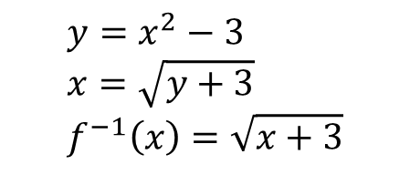

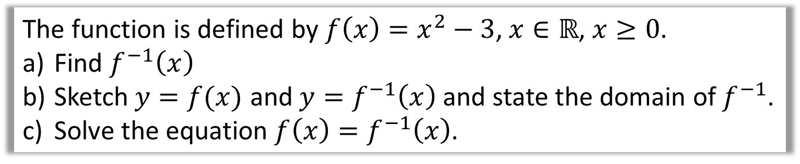



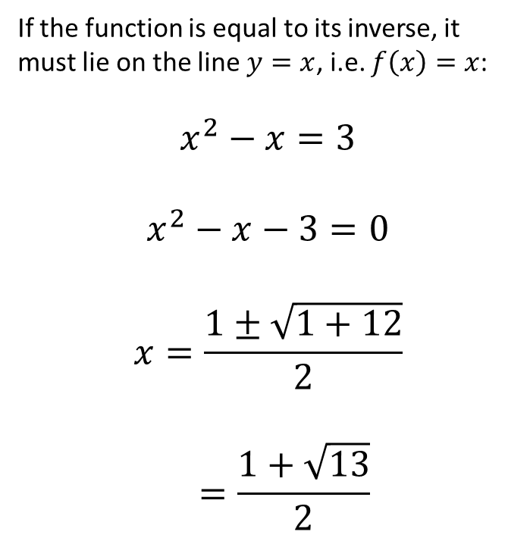


Inverse Functions
The function is defined by $f\left(x\right)=x^{2}−3$, $x∈ℝ$, $x≥0$.
Find $f^{−1}\left(x\right)$
Sketch $y=f(x)$ and $y=f^{−1}\left(x\right)$ and state the domain of $f^{−1}$.
Solve the equation $f\left(x\right)=f^{−1}\left(x\right)$.
a
$$y=x^{2}−3 \\ x=\sqrt{y+3} \\ f^{−1}\left(x\right)=\sqrt{x+3}$$
c
If the function is equal to its inverse, it must lie on the line $y=x$, i.e. $f\left(x\right)=x$:
$$x^{2}−x=3$$
$$x^{2}−x−3=0$$
$$x=\frac{1±\sqrt{1+12}}{2}$$
$$=\frac{1+\sqrt{13}}{2}$$
b
$$y$$
$$y=f\left(x\right)$$
$$y=x$$
$$3$$
$$y=f^{−1}\left(x\right)$$
$$3$$
$$x$$

Slide 11
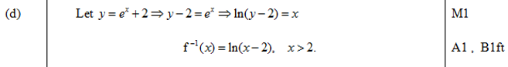

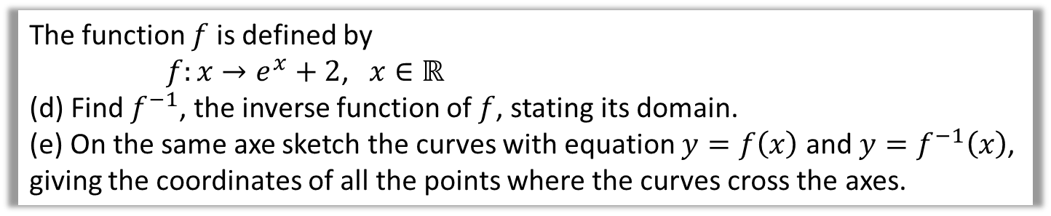
Inverse Functions – Exam Questions
The function $f$ is defined by
$f:x→e^{x}+2$, $x∈ℝ$
(d) Find $f^{−1}$, the inverse function of $f$, stating its domain.
(e) On the same axe sketch the curves with equation $y=f\left(x\right)$ and $y=f^{−1}\left(x\right)$, giving the coordinates of all the points where the curves cross the axes.

Slide 12
Exercise 2D
Pearson Pure Mathematics Year 2/AS
Pages 38-39
Complete before the lesson Q1-3
In Class:
Green Q4-5
Amber Q6-8
Red Q9-12

