Slide 1
Year 1 Applied Mathematics
Constant Acceleration
- SUVAT Horizontal
Chapter 9
(Part 3 of 4)

Slide 2
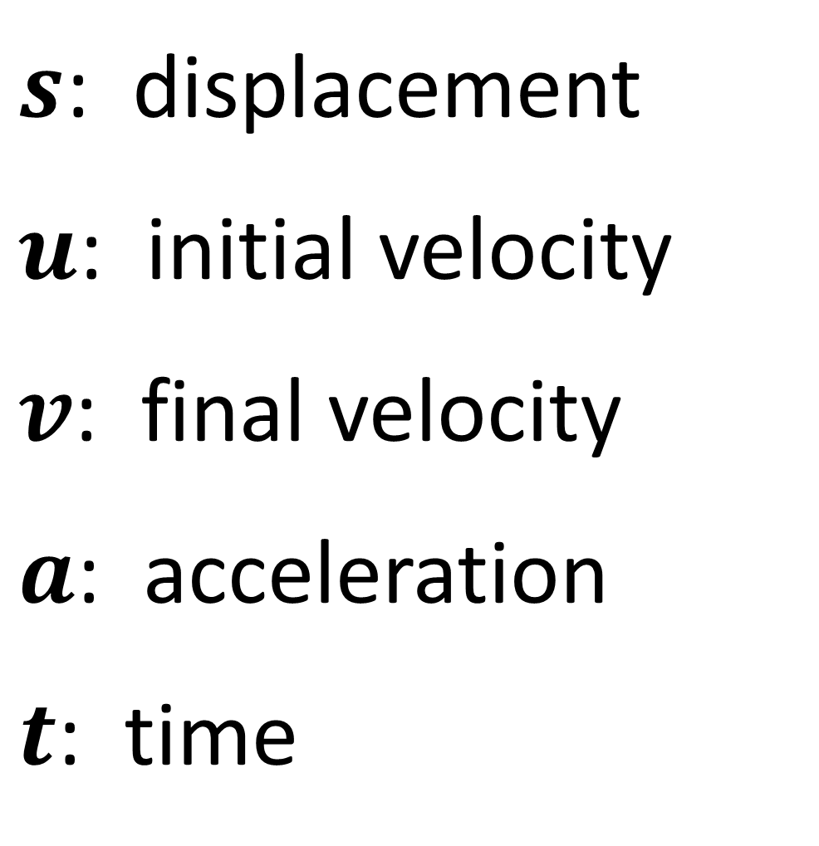
Constant Acceleration - SUVAT Equations
$s$: displacement
$u$: initial velocity
$v$: final velocity
$a$: acceleration
$t$: time

Slide 3

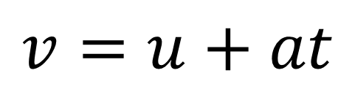

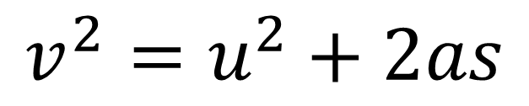
Constant Acceleration - SUVAT Equations
SUVAT equations are to be used when you have constant acceleration.
$$v=u+at$$
$$v^{2}=u^{2}+2as$$
$$s=\left(\frac{u+v}{2}\right)t$$
$$s=ut+\frac{1}{2}at^{2}$$

Slide 4
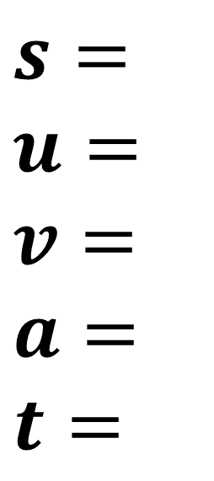
Constant Acceleration – SUVAT Equations
For each question write out SUVAT
and identify the information you know.
$s=$
$$u=$$
$$v=$$
$$a=$$
$$t=$$
Then identify which SUVAT equation
you can use that only gives you one unknown.

Slide 5
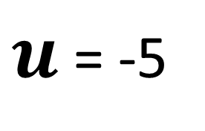
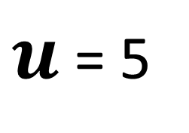
Constant Acceleration - SUVAT Equations
Forward motion is positive
5 ms⁻¹
$u$ = 5
Backward motion is negative
-5 ms⁻¹
$u$ = -5

Slide 6


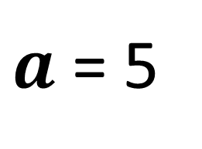
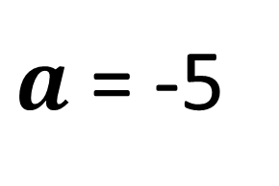
Constant Acceleration - SUVAT Equations
Acceleration motion is positive
5 ms⁻²
$a$ = 5
Deceleration motion is negative
-5 ms⁻²
$a$ = -5

Slide 7

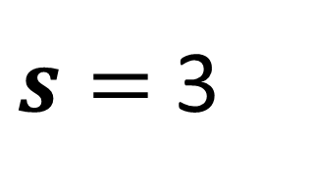
Constant Acceleration - SUVAT Equations
Displacement is the distance from
you starting point to you current position.
5m
Start
2m
What is the displacement of the particle?
$s=$ 3
Finish
Displacement is not the total distance travelled.

Slide 8
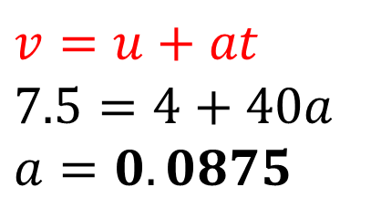
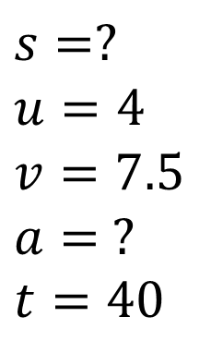
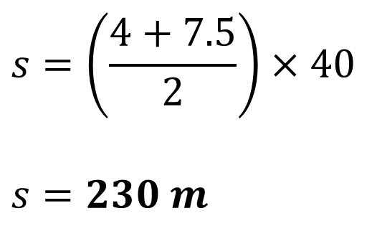
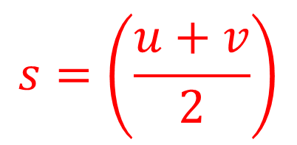
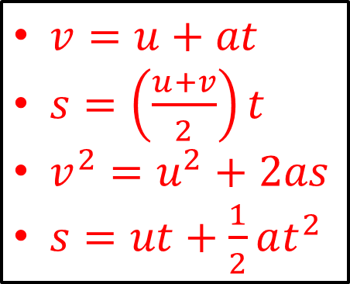
Constant Acceleration - - SUVAT Equations
A cyclist is travelling along a straight road.
She accelerates at a constant rate from a velocity of 4 ms⁻¹ to a velocity of
7.5 ms⁻¹ in 40 seconds. Find:
the distance she travels in these 40 seconds
her acceleration in these 40 seconds.
a
$$s=?$$
$$u=4$$
$$v=7.5 \\ a= ?$$
$$t=40$$
$$s=\left(\frac{u+v}{2}\right)$$
b
$$v=u+at \\ 7.5=4+40a \\ a=0.0875$$
$$s=\left(\frac{4+7.5}{2}\right)×40$$
$$s=230 m$$
$v=u+at$
$s=\left(\frac{u+v}{2}\right)t$
$v^{2}=u^{2}+2as$
$s=ut+\frac{1}{2}at^{2}$

Slide 9
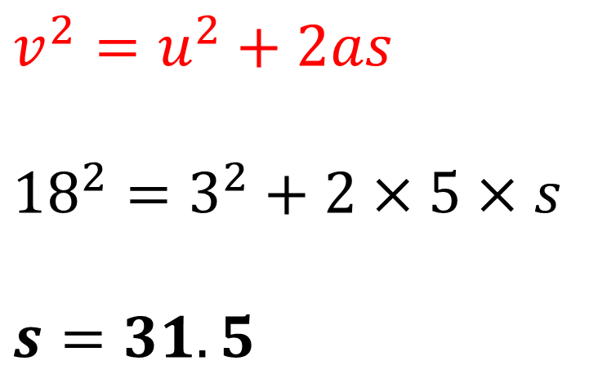
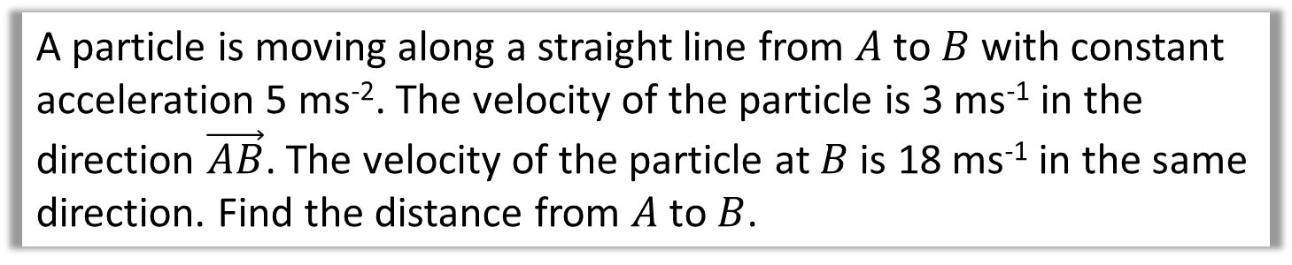
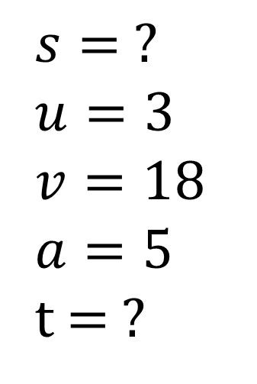
Constant Acceleration - suvat
A particle is moving along a straight line from $A$ to $B$ with constant acceleration 5 ms⁻². The velocity of the particle is 3 ms⁻¹ in the direction $\vec{AB}$. The velocity of the particle at $B$ is 18 ms⁻¹ in the same direction. Find the distance from $A$ to $B$.
$$s= ?$$
$$u=3$$
$$v=18$$
$$a=5$$
t = ?
$$v^{2}=u^{2}+2as$$
$${18}^{2}=3^{2}+2×5×s$$
$$s=31.5$$

Slide 10
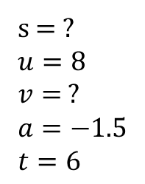
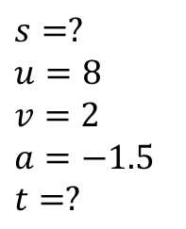
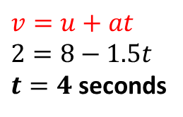
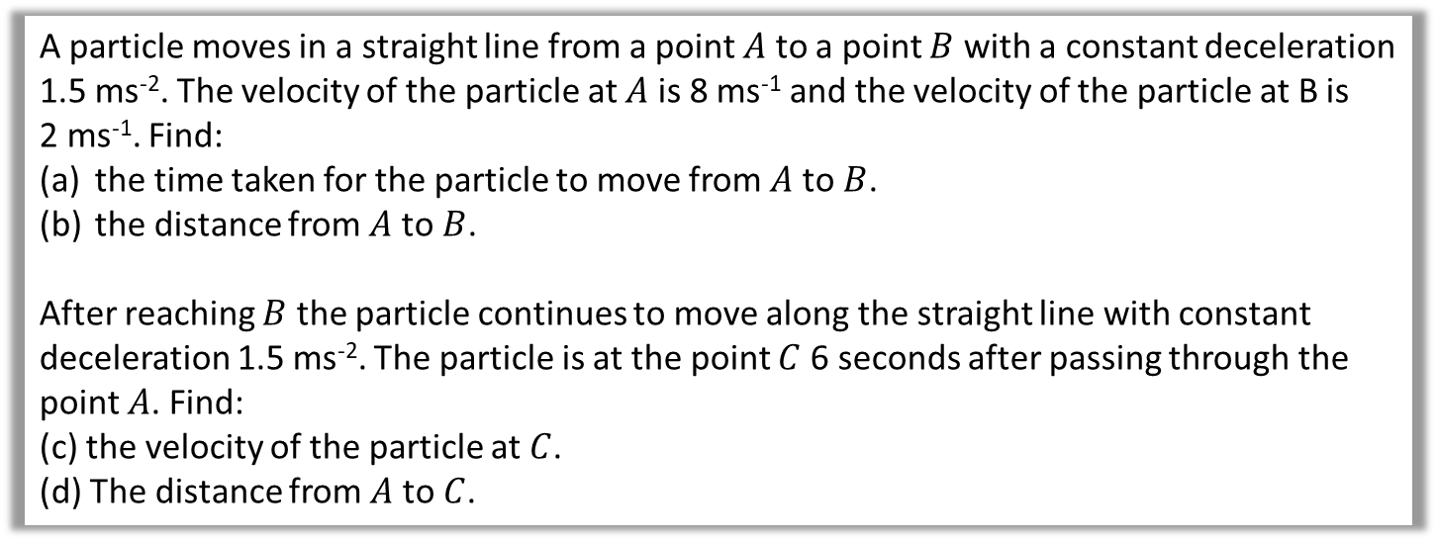


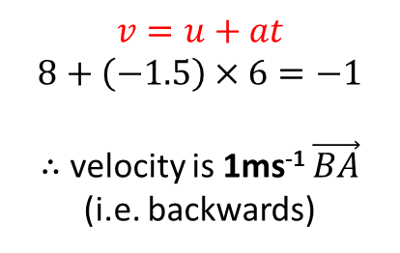
Constant Acceleration - - SUVAT Equations
A particle moves in a straight line from a point $A$ to a point $B$ with a constant deceleration 1.5 ms⁻². The velocity of the particle at $A$ is 8 ms⁻¹ and the velocity of the particle at B is
2 ms⁻¹. Find:
the time taken for the particle to move from $A$ to $B$.
the distance from $A$ to $B$.
After reaching $B$ the particle continues to move along the straight line with constant deceleration 1.5 ms⁻². The particle is at the point $C$ 6 seconds after passing through the point $A$. Find:
(c) the velocity of the particle at $C$.
(d) The distance from $A$ to $C$.
a
$$s=?$$
$$u=8$$
$$v=2$$
$$a=−1.5$$
$$t=?$$
$$v=u+at \\ 2=8−1.5t$$
$t=4$ seconds
c
s = ?
$$u=8$$
$$v= ?$$
$$a=−1.5$$
$$t=6$$
$$v=u+at \\ 8+\left(−1.5\right)×6=−1$$
$∴$ velocity is 1ms⁻¹ $\vec{BA}$
(i.e. backwards)
b
$s=\left(\frac{u+v}{2}\right)t=\left(\frac{8+2}{2}\right)×4=20$m
$s=\left(\frac{u+v}{2}\right)t=\left(\frac{8−1}{2}\right)×6=21$m
d

Slide 11
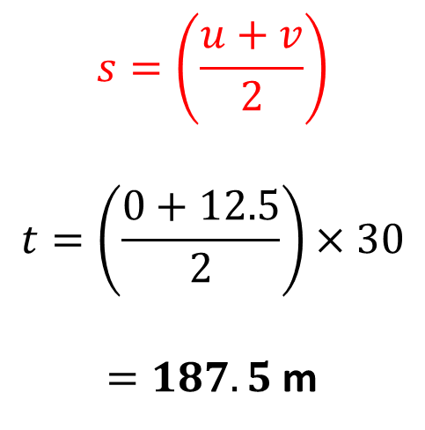
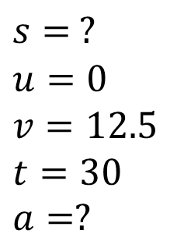
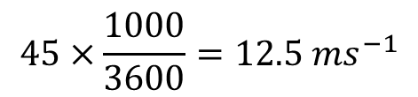
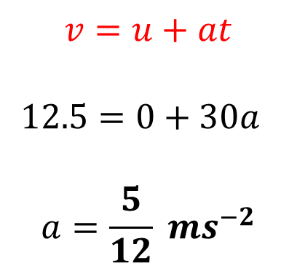
Constant Acceleration - - SUVAT Equations
A car moves from traffic lights along a straight road with constant acceleration. The car starts from rest at the traffic lights and 30 second later the car passes a speed-trap where it is registered as travelling at 45 km h⁻¹.
Find:
the acceleration of the car
the distance between the traffic lights and the speed-trap.
$$45×\frac{1000}{3600}=12.5 ms^{−1}$$
$$s=\left(\frac{u+v}{2}\right)$$
$$t=\left(\frac{0+12.5}{2}\right)×30$$
$=187.5$m
a
b
$$s= ?$$
$$u=0$$
$$v=12.5$$
$$t=30$$
$$a=?$$
$$v=u+at$$
$$12.5=0+30a$$
$$a=\frac{5}{12} ms^{−2}$$

Slide 12
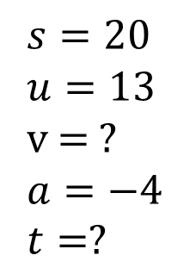
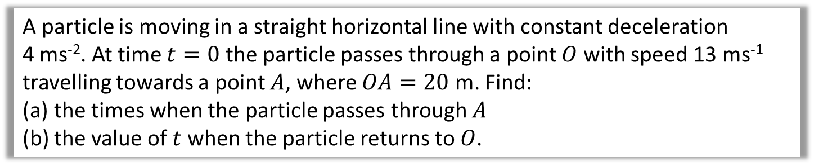
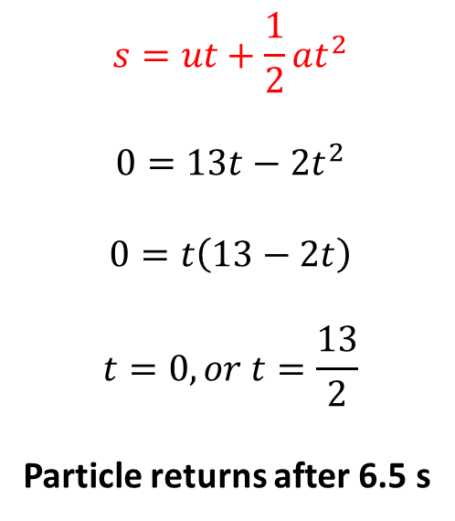
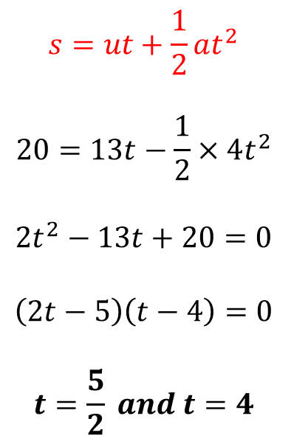
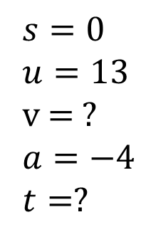
Constant Acceleration - suvat
A particle is moving in a straight horizontal line with constant deceleration
4 ms⁻². At time $t=0$ the particle passes through a point $O$ with speed 13 ms⁻¹ travelling towards a point $A$, where $OA=20$ m. Find:
the times when the particle passes through $A$
the value of $t$ when the particle returns to $O$.
a
$$s=20$$
$$u=13$$
v = ?
$$a=−4$$
$$t=?$$
b
$$s=0$$
$$u=13$$
v = ?
$$a=−4$$
$$t=?$$
$$s=ut+\frac{1}{2}at^{2}$$
$$20=13t−\frac{1}{2}×4t^{2}$$
$$2t^{2}−13t+20=0$$
$$\left(2t−5\right)\left(t−4\right)=0$$
$$t=\frac{5}{2} and t=4$$
$$s=ut+\frac{1}{2}at^{2}$$
$$0=13t−2t^{2}$$
$$0=t\left(13−2t\right)$$
$$t=0, or t=\frac{13}{2}$$
Particle returns after 6.5 s

Slide 13
Exercise 9C
Pearson Stats/Mechanics Year 1
Pages 140-141
Complete before the lesson Q1-3
In Class:
Green Q4-6
Amber Q7-9
Red Q10-13 & Challenge

Slide 14
Exercise 9D
Pearson Stats/Mechanics Year 1
Pages 145-146
Complete before the lesson Q1-4
In Class:
Green Q5-7
Amber Q8-10
Red Q11-15

