Slide 1
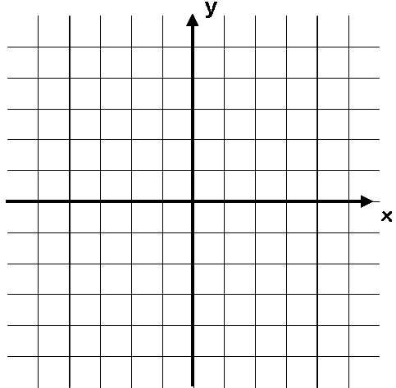



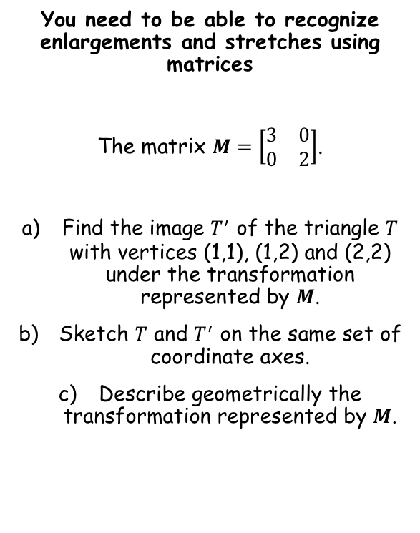

Linear Transformations
You need to be able to recognize enlargements and stretches using matrices
The matrix $M=\left[\begin{matrix}3 & 0 \\ 0 & 2\end{matrix}\right]$.
Find the image $T^{′}$ of the triangle $T$ with vertices (1,1), (1,2) and (2,2) under the transformation represented by $M$.
Sketch $T$ and $T^{′}$ on the same set of coordinate axes.
Describe geometrically the transformation represented by $M$.
Multiply the matrix $M$ by the set of coordinates
$$\left[\begin{matrix}3 & 0 \\ 0 & 2\end{matrix}\right]\left[\begin{matrix}\begin{matrix}1 & 1 & 2\end{matrix} \\ \begin{matrix}1 & 2 & 2\end{matrix}\end{matrix}\right]$$
$$=\left[\begin{matrix}\begin{matrix}3 & 3 & 6\end{matrix} \\ \begin{matrix}2 & 4 & 4\end{matrix}\end{matrix}\right]$$
The new coordinates will be at (3,2), (3,4) and (6,4)
5
$$T^{′}$$
$$T$$
-5
5
The triangle has been stretched by a factor of 3 parallel to the x-axis and a factor of 2 parallel to the y-axis
-5
7C

Slide 2
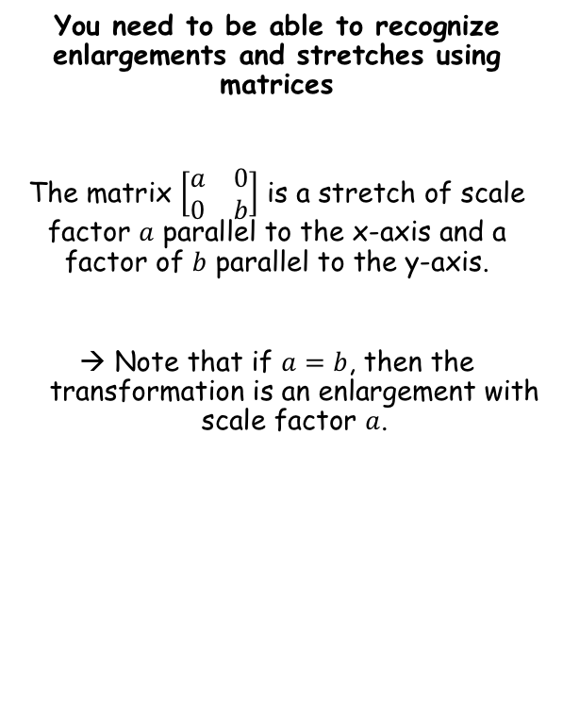
Linear Transformations
You need to be able to recognize enlargements and stretches using matrices
The matrix $\left[\begin{matrix}a & 0 \\ 0 & b\end{matrix}\right]$ is a stretch of scale factor $a$ parallel to the x-axis and a factor of $b$ parallel to the y-axis.
Note that if $a=b$, then the transformation is an enlargement with scale factor $a$.
For any of these stretches, the x and y-axes are invariant lines and the origin is an invariant point
For a stretch parallel to the x-axis only, points on the y-axis are invariant points, and any line parallel to the x-axis is an invariant line
For a stretch parallel to the y-axis only, points on the x-axis are invariant points, and any line parallel to the y-axis is an invariant line
It is important to realise that if the stretch is in both directions, then although the x and y-axes are invariant lines, the individual points on the lines are not
7C

Slide 3



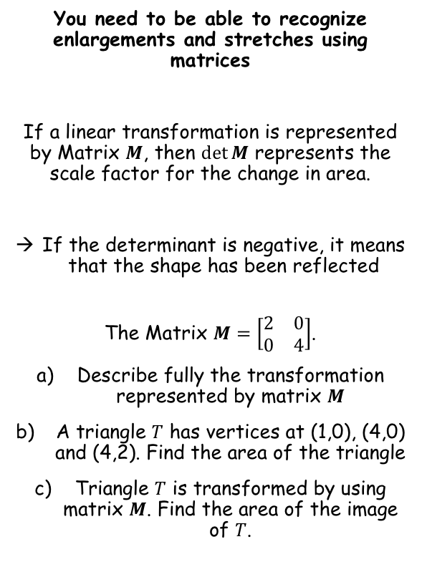



Linear Transformations
You need to be able to recognize enlargements and stretches using matrices
If a linear transformation is represented by Matrix $M$, then $\det{M}$ represents the scale factor for the change in area.
If the determinant is negative, it means that the shape has been reflected
The Matrix $M=\left[\begin{matrix}2 & 0 \\ 0 & 4\end{matrix}\right]$.
Describe fully the transformation represented by matrix $M$
A triangle $T$ has vertices at (1,0), (4,0) and (4,2). Find the area of the triangle
Triangle $T$ is transformed by using matrix $M$. Find the area of the image of $T$.
a) The transformation will be a stretch parallel to the x axis with scale factor 2, and a stretch parallel to the y-axis with scale factor 4.
b) A sketch helps!
$$(4,2)$$
$$2$$
$$(1,0)$$
$$3$$
$$(4,0)$$
So the area is 3 square units
c) $\det{M}=8$
So the area of the new triangle will be 24 square units
7C

Slide 4
Exercise 7C
Pearson Pure Mathematics Year 1/AS
Pages 3-5
Complete before the lesson Q1-4
In Class:
Green Q5-7
Amber Q8-10
Red Q11-13 & challenge

