Slide 1
Year 2 Applied Mathematics
Normal Distribution
- Introduction
Chapter 3
(Part 1)

Slide 2
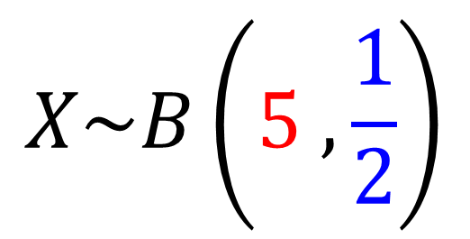
Year 2 Applied Mathematics
Binomial Distribution looks at the probability
of an event happening, when discrete data.
Binomial
Distribution
$$X\sim B\left(5 ,\frac{1}{2}\right)$$
31%
31%
Probability of success
19%
19%
3%
3%
0
1
2
3
4
5
Number of Trials

Slide 3
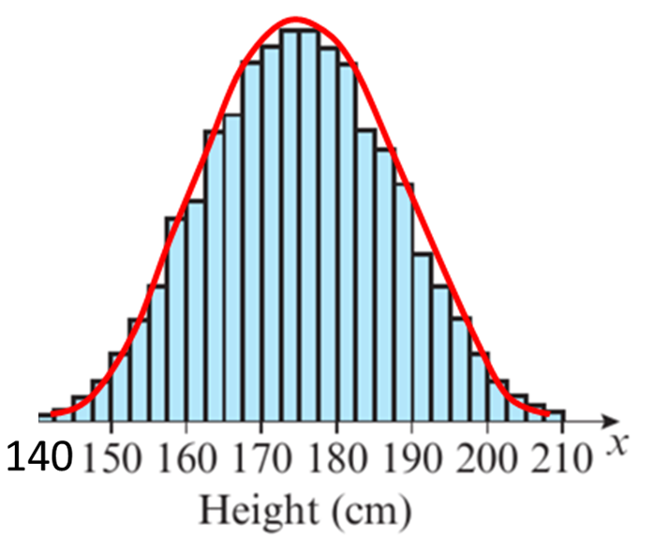
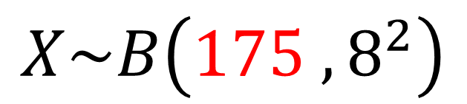
Year 2 Applied Mathematics
Normal Distribution looks at the probability
of an event happening, when continuous data.
Binomial
Distribution
$$X\sim B\left(175 ,8^{2}\right)$$
Standard Deviation
Mean

Slide 4
Normal Distribution - Modelling
The normal distribution can be used to model
many naturally occurring characteristics.
Example of models that use
the normal distribution are:
Height of people within a population
Weight of tigers in a jungle
Errors in scientific measurements
Size variation in manufactured objects

Slide 5
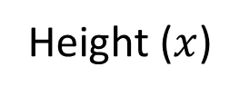
Normal Distribution - Characteristics
Probability
mean
Height ($x$)
The normal distribution:
only uses continuous data
is symmetrical about the mean
has total area under the graph of 1 (100%)

Slide 6
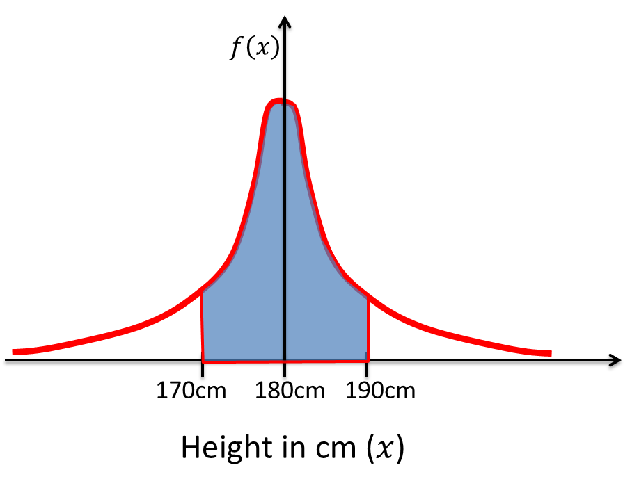

Normal Distribution - Probability Density
The probability of an even occurring will be represented by the area under the graph.
$$P\left(170<X<190\right)$$

Slide 7
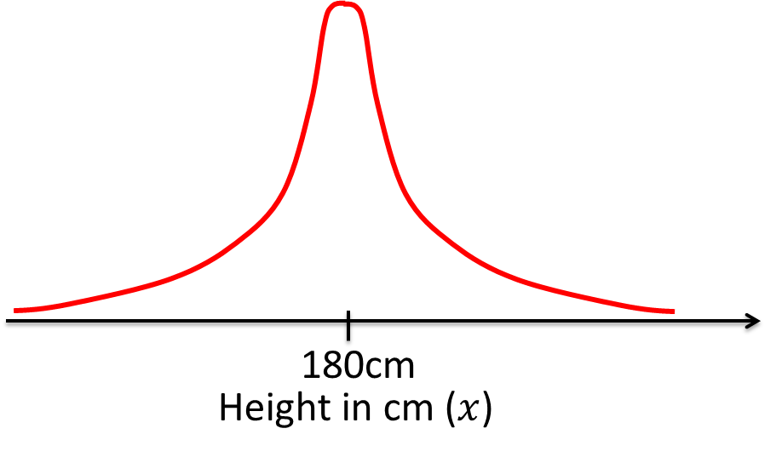
Normal Distribution – Probability Density
Although a variable could take any value,
in practice observations more than 5 standard deviation
from the mean have probabilities close to 0.

Slide 8
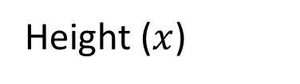
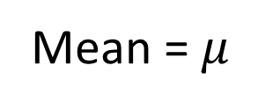
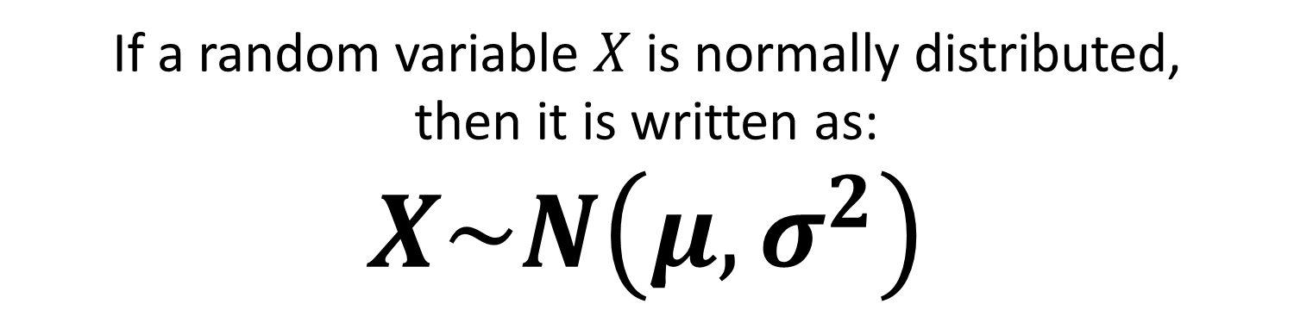
Normal Distribution - Notation
Mean = $μ$
Height ($x$)
If a random variable $X$ is normally distributed,
then it is written as:
$$X\sim N\left(μ,σ^{2}\right)$$

Slide 9
Exercise 3A
Pearson Stats/Mechanics Year 2
Pages 40-41
Complete before the lesson Q1-5
In Class:
Green Q6
Amber Q7
Red Q8&9

