Slide 1

P2 Chapter 4 :: Binomial Expansion
jfrost@tiffin.kingston.sch.uk
www.drfrostmaths.com
@DrFrostMaths
Last modified: 6th September 2018

Slide 2








www.drfrostmaths.com
Everything is completely free.
Why not register?
Register now to interactively practise questions on this topic, including past paper questions and extension questions (including MAT + UKMT).
Teachers: you can create student accounts (or students can register themselves), to set work, monitor progress and even create worksheets.
With questions by:
Dashboard with points, trophies, notifications and student progress.
Questions organised by topic, difficulty and past paper.
Teaching videos with topic tests to check understanding.

Slide 3
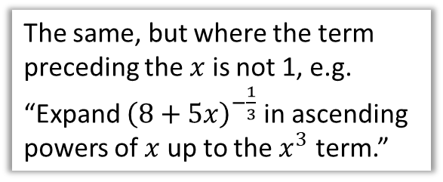
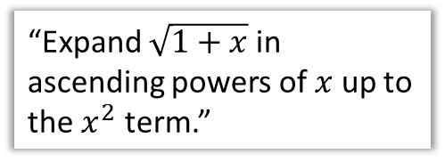
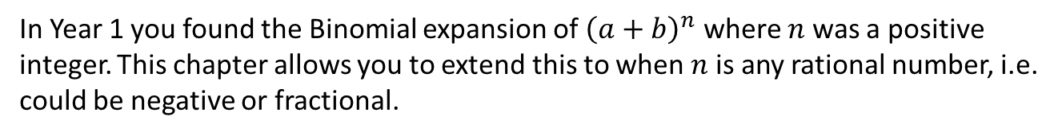
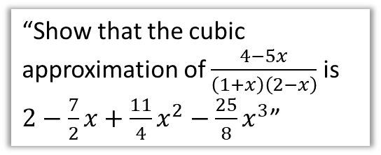
Chapter Overview
In Year 1 you found the Binomial expansion of ${\left(a+b\right)}^{n}$ where $n$ was a positive integer. This chapter allows you to extend this to when $n$ is any rational number, i.e. could be negative or fractional.
1:: Binomial Expansion for negative/fractional powers.
2:: Constant is not 1.
“Expand $\sqrt{1+x}$ in ascending powers of $x$ up to the $x^{2}$ term.”
The same, but where the term preceding the $x$ is not 1, e.g.
“Expand ${\left(8+5x\right)}^{−\frac{1}{3}}$ in ascending powers of $x$ up to the $x^{3}$ term.”
3:: Using Partial Fractions
“Show that the cubic approximation of $\frac{4−5x}{\left(1+x\right)\left(2−x\right)}$ is $2−\frac{7}{2}x+\frac{11}{4}x^{2}−\frac{25}{8}x^{3}$”

Slide 4
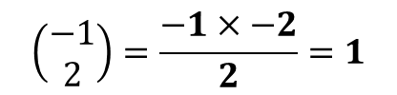
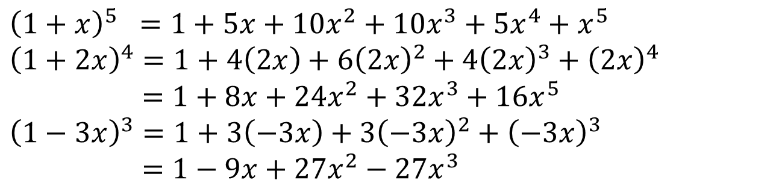
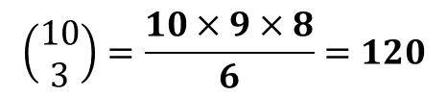
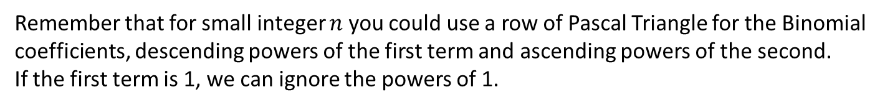

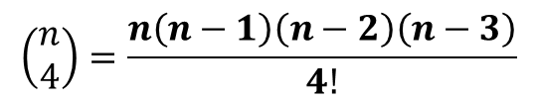
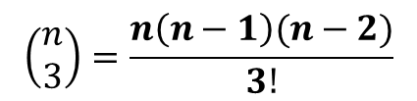
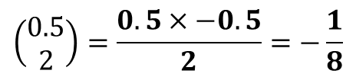
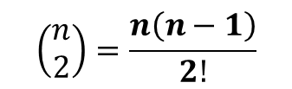
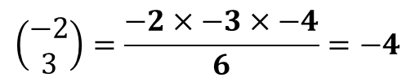
Pure Year 1 Recap
Remember that for small integer $n$ you could use a row of Pascal Triangle for the Binomial coefficients, descending powers of the first term and ascending powers of the second.
If the first term is 1, we can ignore the powers of 1.
$${\left(1+x\right)}^{5} =1+5x+10x^{2}+10x^{3}+5x^{4}+x^{5} \\ {\left(1+2x\right)}^{4}=1+4\left(2x\right)+6{\left(2x\right)}^{2}+4{\left(2x\right)}^{3}+{\left(2x\right)}^{4} \\ =1+8x+24x^{2}+32x^{3}+16x^{5} \\ {\left(1−3x\right)}^{3}=1+3\left(−3x\right)+3{\left(−3x\right)}^{2}+{\left(−3x\right)}^{3} \\ =1−9x+27x^{2}−27x^{3}$$
?
?
?
Do you remember the simple way to find your Binomial coefficients?
Hopefully you can see the pattern by this point.
?
?
?
?
$$\left(\begin{matrix}n \\ 1\end{matrix}\right)=n$$
$$\left(\begin{matrix}n \\ 2\end{matrix}\right)=\frac{n\left(n−1\right)}{2!}$$
$$\left(\begin{matrix}n \\ 3\end{matrix}\right)=\frac{n\left(n−1\right)(n−2)}{3!}$$
$$\left(\begin{matrix}n \\ 4\end{matrix}\right)=\frac{n\left(n−1\right)\left(n−2\right)\left(n−3\right)}{4!}$$
?
?
?
$$\left(\begin{matrix}10 \\ 3\end{matrix}\right)=\frac{10×9×8}{6}=120$$
$$\left(\begin{matrix}−1 \\ 2\end{matrix}\right)=\frac{−1×−2}{2}=1$$
$$\left(\begin{matrix}−2 \\ 3\end{matrix}\right)=\frac{−2×−3×−4}{6}=−4$$
?
Note: You can work out a ‘choose’ value, in the same way, when the top number is negative or fractional, but your calculator can not do this directly.
$$\left(\begin{matrix}0.5 \\ 2\end{matrix}\right)=\frac{0.5×−0.5}{2}=−\frac{1}{8}$$

Slide 5
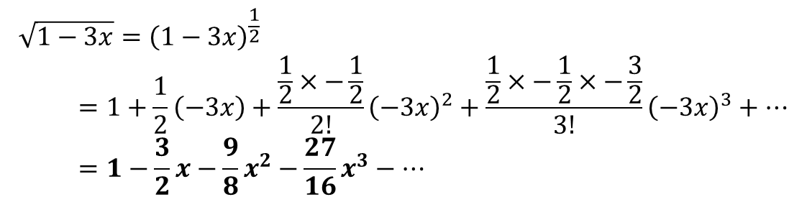
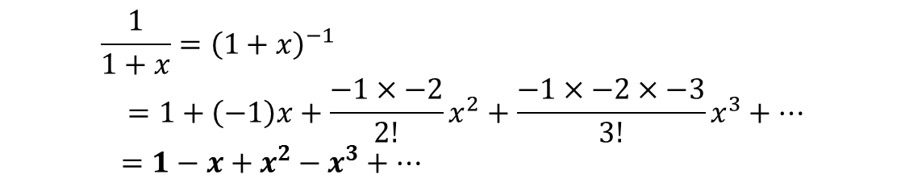
Binomial Expansion
! ${\left(1+x\right)}^{n}=1+nx+\frac{n\left(n−1\right)}{2!}x^{2}+\frac{n\left(n−1\right)\left(n−2\right)}{3!}x^{3}+…+nCr x^{n}$
Binomial expansions, when $n$ is either negative or fractions, are infinitely long.
Use the binomial expansion to find the first four terms of $\frac{1}{1+x}$
?
$$\frac{1}{1+x}={\left(1+x\right)}^{−1} \\ =1+\left(−1\right)x+\frac{−1×−2}{2!}x^{2}+\frac{−1×−2×−3}{3!}x^{3}+… \\ =1−x+x^{2}−x^{3}+…$$
And the first four terms of $\sqrt{1−3x}$
?
$$\sqrt{1−3x}={\left(1−3x\right)}^{\frac{1}{2}} \\ =1+\frac{1}{2}\left(−3x\right)+\frac{\frac{1}{2}×−\frac{1}{2}}{2!}{\left(−3x\right)}^{2}+\frac{\frac{1}{2}×−\frac{1}{2}×−\frac{3}{2}}{3!}{\left(−3x\right)}^{3}+… \\ =1−\frac{3}{2}x−\frac{9}{8}x^{2}−\frac{27}{16}x^{3}−…$$

Slide 6

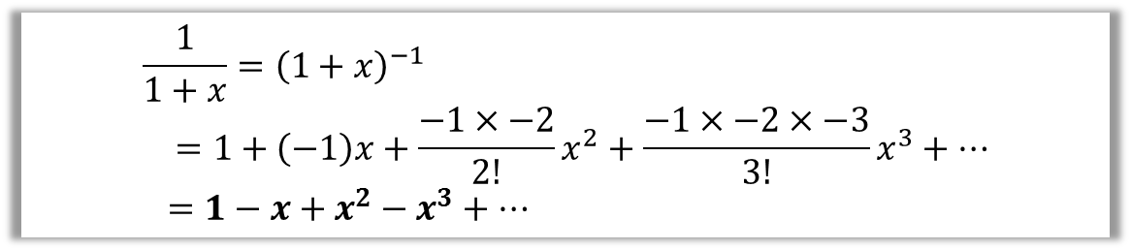
When are infinite expansions valid?
Our expansion might be an infinite number of terms. If so, the result must converge
$$\frac{1}{1+x}={\left(1+x\right)}^{−1} \\ =1+\left(−1\right)x+\frac{−1×−2}{2!}x^{2}+\frac{−1×−2×−3}{3!}x^{3}+… \\ =1−x+x^{2}−x^{3}+…$$
What would happen in the expansion if:
a) $x>1$ : e.g. $1−2+2^{2}−2^{4}+…$ This diverges, so expansion is not valid.
b) $0<x<1$: e.g $1−0.5+{0.5}^{2}−{0.5}^{3}+…$ This converges, as the terms
become smaller each time.
c) $−1<x<0$: Again, this converges.
d) $x=1$ : This would suggest $1−1+1−1+1−…=\frac{1}{2}$ ! Indeed in
some branches of mathematics this result is valid, but for the purposes
of A Level this expansion is not valid.
Therefore requirement on $x$:
$$−1<x<1$$
which we’d typically write as $\left|x\right|<1$
?
?
?
?
?

Slide 7

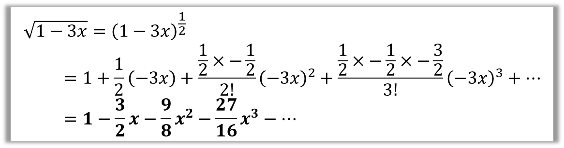
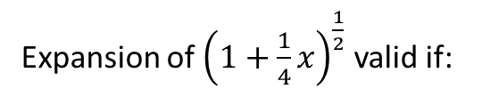

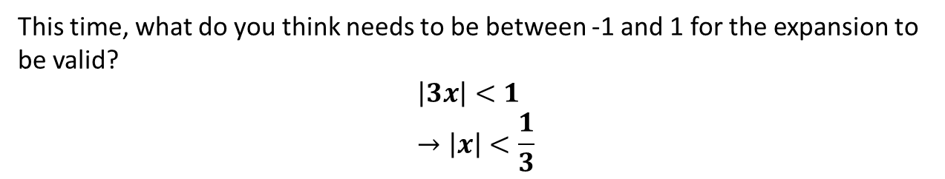

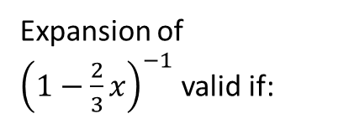



When are infinite expansions valid?
Expansions are allowed to infinite. However, the result must converge
$$\sqrt{1−3x}={\left(1−3x\right)}^{\frac{1}{2}} \\ =1+\frac{1}{2}\left(−3x\right)+\frac{\frac{1}{2}×−\frac{1}{2}}{2!}{\left(−3x\right)}^{2}+\frac{\frac{1}{2}×−\frac{1}{2}×−\frac{3}{2}}{3!}{\left(−3x\right)}^{3}+… \\ =1−\frac{3}{2}x−\frac{9}{8}x^{2}−\frac{27}{16}x^{3}−…$$
This time, what do you think needs to be between -1 and 1 for the expansion to be valid?
$$\left|3x\right|<1 \\ →\left|x\right|<\frac{1}{3}$$
?
! An infinite expansion ${\left(1+x\right)}^{n}$ is valid if $\left|x\right|<1$
Quickfire Examples:
Expansion of ${\left(1−\frac{2}{3}x\right)}^{−1}$ valid if:
?
Expansion of ${\left(1+2x\right)}^{−1}$ valid if:
$$\left|2x\right|<1 → \left|x\right|<\frac{1}{2}$$
$$|x|<1$$
Expansion of ${\left(1−x\right)}^{−2}$ valid if:
?
?
Expansion of ${\left(1+\frac{1}{4}x\right)}^{\frac{1}{2}}$ valid if:
$$\left|\frac{2}{3}x\right|<1 → \left|x\right|<\frac{3}{2}$$
?
$$\left|\frac{1}{4}x\right|<1 → \left|x\right|<4$$

Slide 8
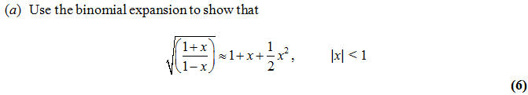


Combining Expansions
Edexcel C4 June 2013 Q2
?
Firstly express as a product:
$$\sqrt{\frac{1+x}{1−x}}={\left(1+x\right)}^{\frac{1}{2}}{\left(1−x\right)}^{−\frac{1}{2}}$$
How many terms do we need in each expansion?
We don’t need beyond $x^{2}$ in each, because in the product other terms would have a power higher than 2.
Completing:
$${\left(1+x\right)}^{\frac{1}{2}}=1+\frac{1}{2}x+\frac{\frac{1}{2}×−\frac{1}{2}}{2!}x^{2} =1+\frac{1}{2}x−\frac{1}{8}x^{2}+… \\ {\left(1−x\right)}^{−\frac{1}{2}}=1+\left(−\frac{1}{2}\right)\left(−x\right)+\frac{−\frac{1}{2}×−\frac{3}{2}}{2!}{\left(−x\right)}^{2}=1+\frac{1}{2}x+\frac{3}{8}x^{2}−… \\ \left(1+\frac{1}{2}x−\frac{1}{8}x^{2}\right)\left(1+\frac{1}{2}x+\frac{3}{8}x^{2}\right)=1+\frac{1}{2}x+\frac{1}{2}x+\frac{1}{4}x−\frac{1}{8}x^{2}+\frac{3}{8}x^{2}+… \\ =1+x+\frac{1}{2}x^{2}$$
?
?

Slide 9
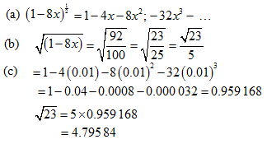
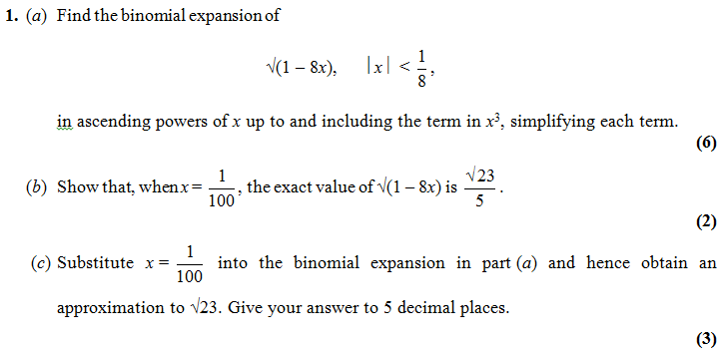
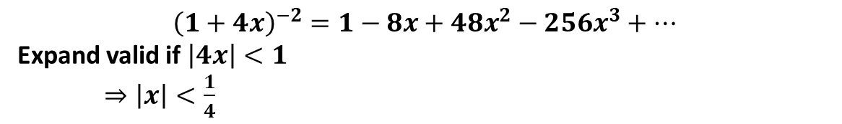
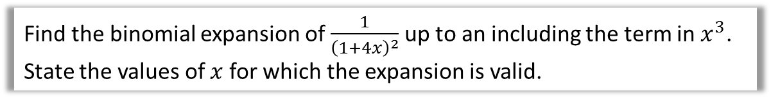
Test Your Understanding
Find the binomial expansion of $\frac{1}{{\left(1+4x\right)}^{2}}$ up to an including the term in $x^{3}$. State the values of $x$ for which the expansion is valid.
?
$${\left(1+4x\right)}^{−2}=1−8x+48x^{2}−256x^{3}+…$$
Expand valid if $\left|4x\right|<1$
$⇒\left|x\right|<\frac{1}{4}$
?
C4 Edexcel Jan 2010

Slide 10
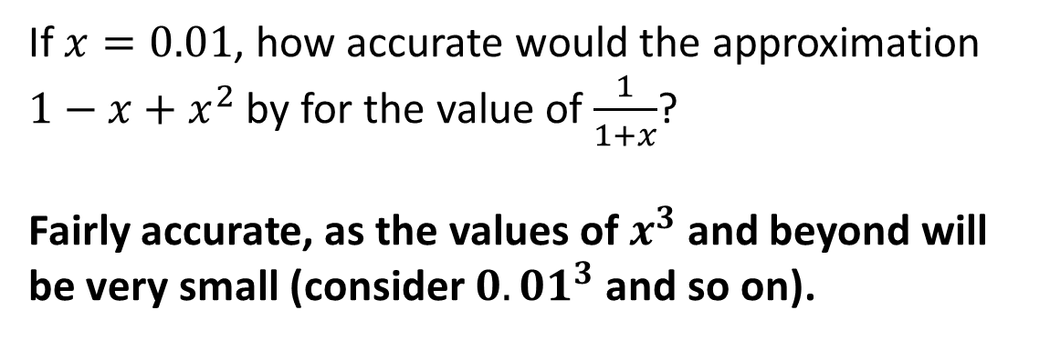
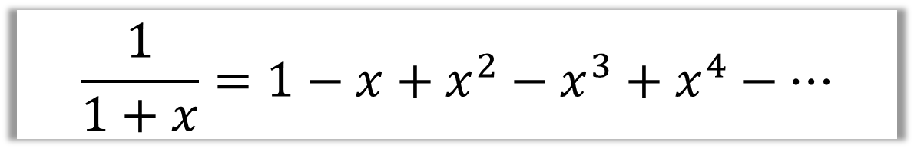
Accuracy of an approximation
$$\frac{1}{1+x}=1−x+x^{2}−x^{3}+x^{4}−…$$
If $x=0.01$, how accurate would the approximation $1−x+x^{2}$ by for the value of $\frac{1}{1+x}$?
Fairly accurate, as the values of $x^{3}$ and beyond will be very small (consider ${0.01}^{3}$ and so on).
?

Slide 11
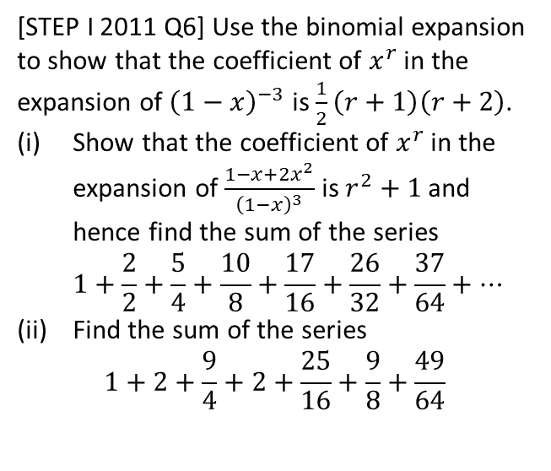
Exercise 4A
Pearson Pure Mathematics Year 2/AS
Pages 96-97
Complete before the lesson Q1 & 3
In Class:
Green Q4-6
Amber Q7-8
Red Q9 & Challenge
Extension
[STEP I 2011 Q6] Use the binomial expansion to show that the coefficient of $x^{r}$ in the expansion of ${\left(1−x\right)}^{−3}$ is $\frac{1}{2}\left(r+1\right)\left(r+2\right)$.
Show that the coefficient of $x^{r}$ in the expansion of $\frac{1−x+2x^{2}}{{\left(1−x\right)}^{3}}$ is $r^{2}+1$ and hence find the sum of the series
$1+\frac{2}{2}+\frac{5}{4}+\frac{10}{8}+\frac{17}{16}+\frac{26}{32}+\frac{37}{64}+…$
Find the sum of the series
$1+2+\frac{9}{4}+2+\frac{25}{16}+\frac{9}{8}+\frac{49}{64}$

Slide 12
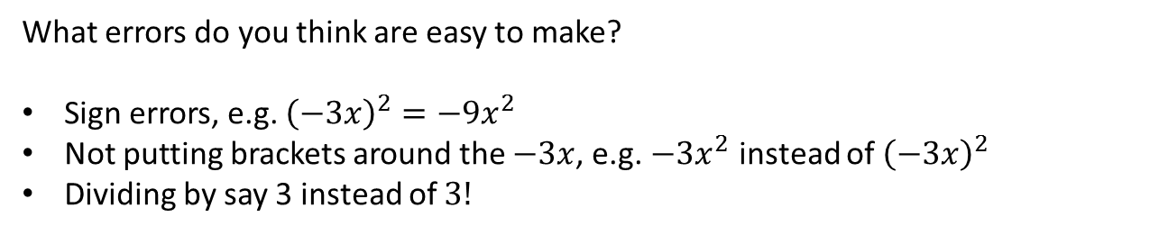

Common Errors
$$\sqrt{1−3x}={\left(1−3x\right)}^{\frac{1}{2}} \\ =1+\frac{1}{2}\left(−3x\right)+\frac{\frac{1}{2}×−\frac{1}{2}}{2!}{\left(−3x\right)}^{2}+\frac{\frac{1}{2}×−\frac{1}{2}×−\frac{3}{2}}{3!}{\left(−3x\right)}^{3}+… \\ =1−\frac{3}{2}x−\frac{9}{8}x^{2}−\frac{27}{16}x^{3}−…$$
What errors do you think are easy to make?
Sign errors, e.g. ${\left(−3x\right)}^{2}=−9x^{2}$
Not putting brackets around the $−3x$, e.g. $−3x^{2}$ instead of ${\left(−3x\right)}^{2}$
Dividing by say 3 instead of $3!$

Slide 13

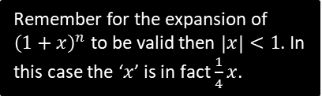
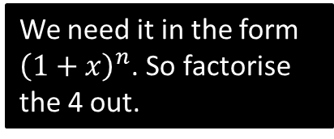

Dealing with ${\left(a+bx\right)}^{n}$
Find first four terms in the binomial expansion of $\sqrt{4+x}$
State the values of $x$ for which the expansion is valid.
?
We need it in the form ${\left(1+x\right)}^{n}$. So factorise the 4 out.
$${\left(4+x\right)}^{\frac{1}{2}}={\left[4\left(1+\frac{1}{4}x\right)\right]}^{\frac{1}{2}} \\ =4^{\frac{1}{2}}{\left(1+\frac{1}{4}x\right)}^{\frac{1}{2}} \\ =2(1+\left(\frac{1}{2}\right)\left(\frac{1}{4}x\right)+\frac{\frac{1}{2}×−\frac{1}{2}}{2!}{\left(\frac{1}{4}x\right)}^{2}+\frac{\left(\frac{1}{2}×−\frac{1}{2}×−\frac{3}{2}\right)}{3!}{\left(\frac{1}{4}x\right)}^{3} \\ =2\left(1+\frac{1}{8}x−\frac{1}{128}x^{2}+\frac{1}{1024}x^{3}−…\right) \\ =2+\frac{1}{4}x−\frac{1}{64}x^{2}+\frac{1}{512}x^{3}−…$$
Valid if $\left|\frac{1}{4}x\right|<1 ⇒ \left|x\right|<4$
?
?
?
?
?
Remember for the expansion of ${\left(1+x\right)}^{n}$ to be valid then $\left|x\right|<1$. In this case the ‘$x$’ is in fact $\frac{1}{4}x$.

Slide 14
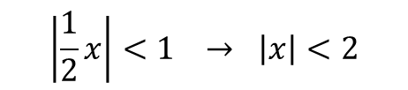
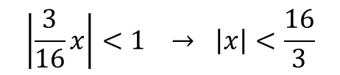

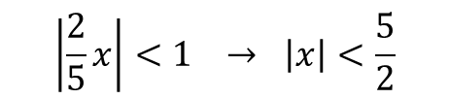
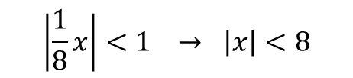
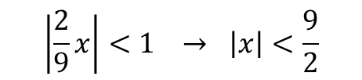
Quickfire First Step
What would be the first step in finding the Binomial expansion of each of these?
Binomial expansion valid if:
?
?
$${\left(2+x\right)}^{−3} ⇒ \frac{1}{8}{\left(1+\frac{1}{2}x\right)}^{−3} \\ {\left(9+2x\right)}^{\frac{1}{2}} ⇒ 3{\left(1+\frac{2}{9}x\right)}^{\frac{1}{2}} \\ {\left(8−x\right)}^{\frac{1}{3}} ⇒ 2{\left(1−\frac{1}{8}x\right)}^{\frac{1}{3}} \\ {\left(5−2x\right)}^{−3}⇒ \frac{1}{25}{\left(1−\frac{2}{5}x\right)}^{−3} \\ {\left(16+3x\right)}^{−\frac{1}{2}} ⇒ \frac{1}{4}{\left(1+\frac{3}{16}x\right)}^{−\frac{1}{2}}$$
$$\left|\frac{1}{2}x\right|<1 → \left|x\right|<2$$
?
?
$$\left|\frac{2}{9}x\right|<1 → \left|x\right|<\frac{9}{2}$$
?
?
$$\left|\frac{1}{8}x\right|<1 → \left|x\right|<8$$
?
?
$$\left|\frac{2}{5}x\right|<1 → \left|x\right|<\frac{5}{2}$$
?
?
$$\left|\frac{3}{16}x\right|<1 → \left|x\right|<\frac{16}{3}$$

Slide 15
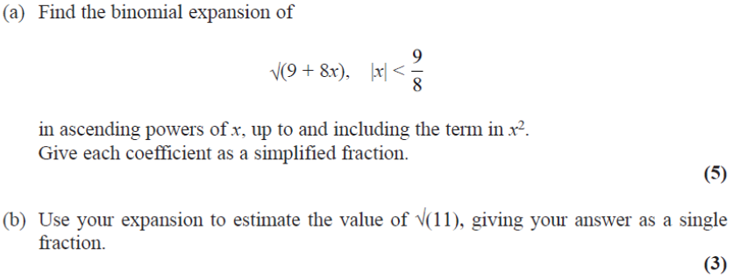
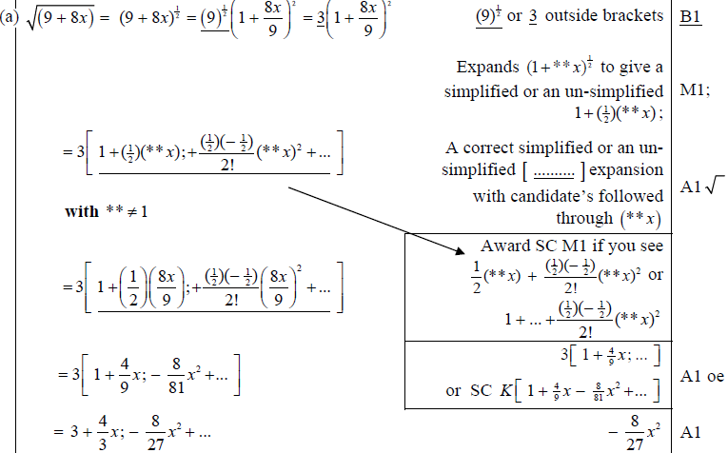
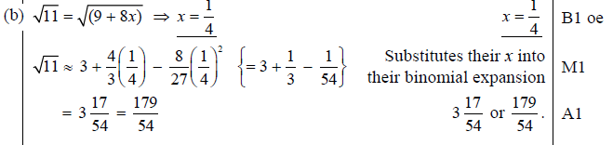
Test Your Understanding
Edexcel C4 June 2013 (Withdrawn) Q1
?
?

Slide 16
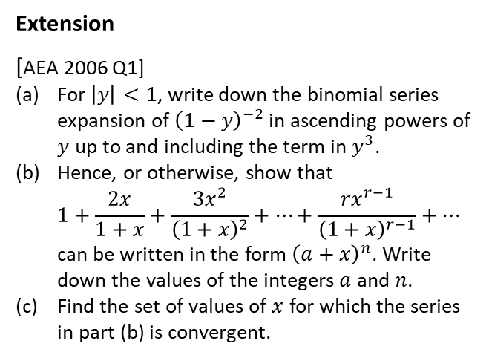
Exercise 4B
Pearson Pure Mathematics Year 2/AS
Pages 99-100
Complete before the lesson Q1 all parts
In Class:
Green Q2-3
Amber Q4-5
Red Q6-8
Extension
[AEA 2006 Q1]
For $\left|y\right|<1$, write down the binomial series expansion of ${\left(1−y\right)}^{−2}$ in ascending powers of $y$ up to and including the term in $y^{3}$.
Hence, or otherwise, show that
$1+\frac{2x}{1+x}+\frac{3x^{2}}{{\left(1+x\right)}^{2}}+…+\frac{rx^{r−1}}{{\left(1+x\right)}^{r−1}}+…$
can be written in the form ${\left(a+x\right)}^{n}$. Write down the values of the integers $a$ and $n$.
Find the set of values of $x$ for which the series in part (b) is convergent.
? a
? b
? c

Slide 17

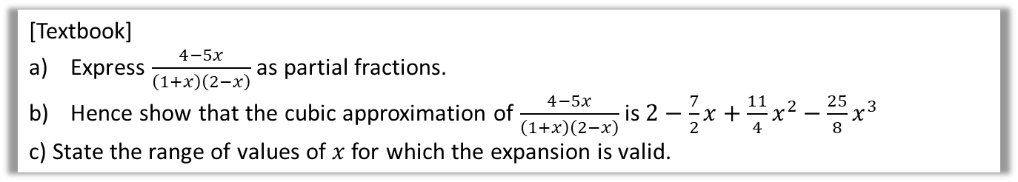


Using Partial Fractions
Partial fractions allows us to split up a fraction into ones we can then find the binomial expansion of.
[Textbook]
Express $\frac{4−5x}{\left(1+x\right)\left(2−x\right)}$ as partial fractions.
Hence show that the cubic approximation of $\frac{4−5x}{\left(1+x\right)\left(2−x\right)}$ is $2−\frac{7}{2}x+\frac{11}{4}x^{2}−\frac{25}{8}x^{3}$
c) State the range of values of $x$ for which the expansion is valid.
First find the valid range for each of the expansions:
$$\left|x\right|<1 \\ \left|\frac{x}{2}\right|<1 → \left|x\right|<2$$
$$∴\left|x\right|<1$$
a
?
?
$$\frac{4−5x}{\left(1+x\right)\left(2−x\right)}=\frac{A}{1+x}+\frac{B}{2−x}$$
$$4−5x=A\left(2−x\right)+B\left(1+x\right)$$
Let $x=2$: $−6=3B → B=−2$
Let $x=−1$: $9=3A → A=3$
Therefore $\frac{4−5x}{\left(1+x\right)\left(2−x\right)}=\frac{3}{1+x}−\frac{2}{2−x}$
$$=3{\left(1+x\right)}^{−1}−2{\left(2−x\right)}^{−1}$$
Expansion of $3{\left(1+x\right)}^{−1}$:
$$3\left[1+\left(−1\right)x+\frac{\left(−1\right)\left(−2\right)}{2!}x^{2}+\frac{\left(−1\right)\left(−2\right)\left(−3\right)}{3!}x^{3}+…\right]=3−3x+3x^{2}−3x^{3}+…$$
Similarly $2{\left(2−x\right)}^{−1}=2×2^{−1}{\left(1−\frac{1}{2}x\right)}^{−1}=…=1+\frac{1}{2}x+\frac{1}{4}x^{2}+\frac{1}{8}x^{3}$
Hence $\frac{4−5x}{\left(1+x\right)\left(2−x\right)}≈3−3x+3x^{2}−3x^{3}−\left(1+\frac{1}{2}x+\frac{1}{4}x^{2}+\frac{1}{8}x^{3}\right)$
$$=2−\frac{7}{2}x+\frac{11}{4}x^{2}−\frac{25}{8}x^{3}$$
c
b
?
$−1<x<1$ is more restrictive than $−2<x<2$. If both have to be true, the more restrictive one applies (this can be seen by drawing the inequalities a number line).

Slide 18
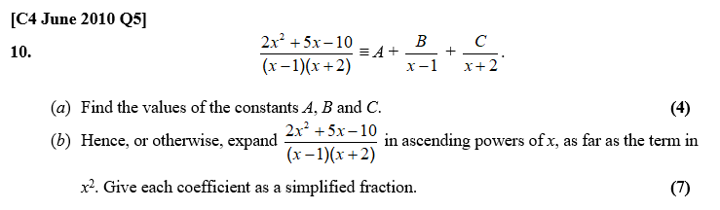
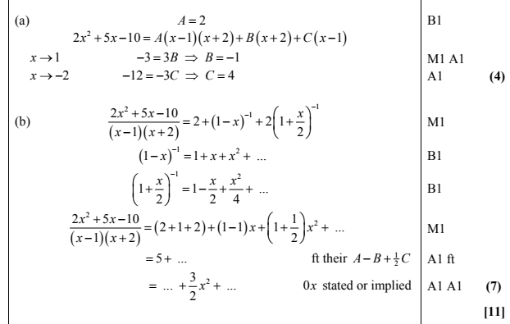
Test Your Understanding
? a
? b

Slide 19
Exercise 4C
Pearson Pure Mathematics Year 2/AS
Pages 102-103
Complete before the lesson Q1
In Class:
Green Q2-3
Amber Q4-5
Red Q6-7

