Slide 1
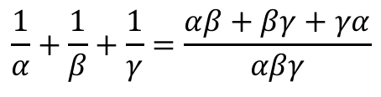
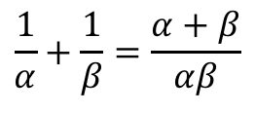
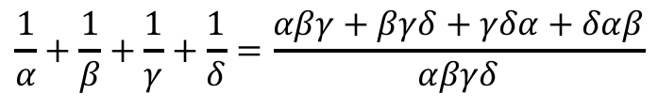
Roots of Polynomials
There are some expressions relating to roots of polynomials that you should familiarise yourself with…
You have seen some of these already!
Rules for sums of reciprocals
Quadratic
$$\frac{1}{α}+\frac{1}{β}=\frac{α+β}{αβ}$$
Cubic
$$\frac{1}{α}+\frac{1}{β}+\frac{1}{γ}=\frac{αβ+βγ+γα}{αβγ}$$
Quartic
$$\frac{1}{α}+\frac{1}{β}+\frac{1}{γ}+\frac{1}{δ}=\frac{αβγ+βγδ+γδα+δαβ}{αβγδ}$$
4D

Slide 2


Roots of Polynomials
There are some expressions relating to roots of polynomials that you should familiarise yourself with…
You have (hopefully) also encountered these in some of the questions so far. These are specifically when the roots are of a quadratic.
There are also equivalent results for the roots of cubic and quartic equations
$$α^{2}+β^{2}={\left(α+β\right)}^{2}−2αβ$$
$$α^{3}+β^{3}={\left(α+β\right)}^{3}−3αβ(α+β)$$
4D

Slide 3




Roots of Polynomials
There are some expressions relating to roots of polynomials that you should familiarise yourself with…
Expand ${\left(α+β+γ\right)}^{2}$
$${\left(α+β+γ\right)}^{2}$$
Write as a double bracket
$$=\left(α+β+γ\right)\left(α+β+γ\right)$$
Expand
$$=α^{2}+αβ+αγ+βα+β^{2}+βγ+γα+γβ+γ^{2}$$
Group like terms and re-factorise part
$$=α^{2}+β^{2}+γ^{2}+2(αβ+βγ+γα)$$
Therefore, we can find a relationship for the sum of squares of the roots
$${\left(α+β+γ\right)}^{2}=α^{2}+β^{2}+γ^{2}+2(αβ+βγ+γα)$$
Rearrange
$$α^{2}+β^{2}+γ^{2}={\left(α+β+γ\right)}^{2}−2(αβ+βγ+γα)$$
4D

Slide 4
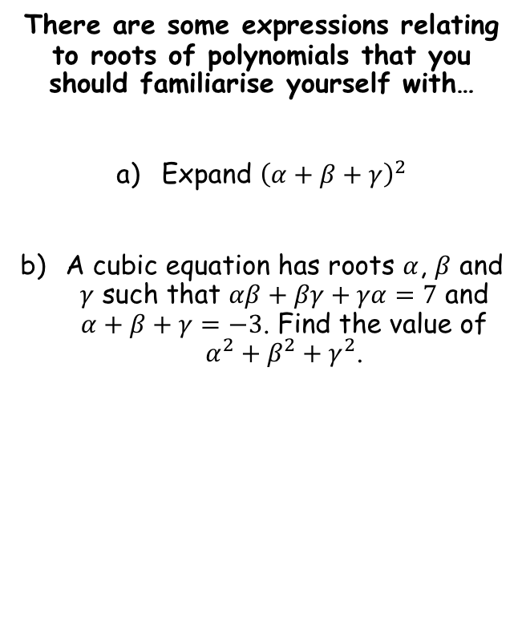


Roots of Polynomials
There are some expressions relating to roots of polynomials that you should familiarise yourself with…
Expand ${\left(α+β+γ\right)}^{2}$
A cubic equation has roots $α$, $β$ and $γ$ such that $αβ+βγ+γα=7$ and $α+β+γ=−3$. Find the value of $α^{2}+β^{2}+γ^{2}$.
$$α^{2}+β^{2}+γ^{2}={\left(α+β+γ\right)}^{2}−2(αβ+βγ+γα)$$
$$α^{2}+β^{2}+γ^{2}={\left(α+β+γ\right)}^{2}−2(αβ+βγ+γα)$$
Sub in values
$$={\left(−3\right)}^{2}−2(7)$$
Calculate
$$=−5$$
4D

Slide 5

Roots of Polynomials
There are some expressions relating to roots of polynomials that you should familiarise yourself with…
You could do a similar expansion for the squares of the roots of a quartic equation
Rules for the sums of squares
Quadratic
$$α^{2}+β^{2}={\left(α+β\right)}^{2}−2αβ$$
Cubic
$$α^{2}+β^{2}+γ^{2}={\left(α+β+γ\right)}^{2}−2(αβ+βγ+γα)$$
Quartic
$$α^{2}+β^{2}+γ^{2}+δ^{2}={\left(α+β+γ+δ\right)}^{2}−2(αβ+αγ+αδ+βγ+βδ+γδ)$$
4D

Slide 6

Roots of Polynomials
There are some expressions relating to roots of polynomials that you should familiarise yourself with…
You could do a similar expansion for the squares of the cubes of equations
Rules for the sums of cubes
Quadratic
$$α^{3}+β^{3}={\left(α+β\right)}^{3}−3αβ(α+β)$$
Cubic
$$α^{3}+β^{3}+γ^{3}={\left(α+β+γ\right)}^{3}−3\left(α+β+γ\right)\left(αβ+βγ+γα\right)+3αβγ$$
Fortunately, the sum of cubes of a quartic is not required!
4D

Slide 7




Roots of Polynomials
There are some expressions relating to roots of polynomials that you should familiarise yourself with…
The three roots of a cubic equation are $α$, $β$ and $γ$. Given that $αβγ=4$, $αβ+βγ+γα=−5$ and $α+β+γ=3$, find the value of $\left(α+3\right)\left(β+3\right)\left(γ+3\right)$.
$$\left(α+3\right)\left(β+3\right)\left(γ+3\right)$$
Expand brackets
$$=αβγ+3αβ+3αγ+9α+3βγ+9β+9γ+27$$
Factorise some parts
$$=αβγ+3\left(αβ+αγ+βγ\right)+9(α+β+γ)+27$$
Sub in values
$$=(4)+3\left(−5\right)+9(3)+27$$
Calculate
$$=43$$
4D

Slide 8
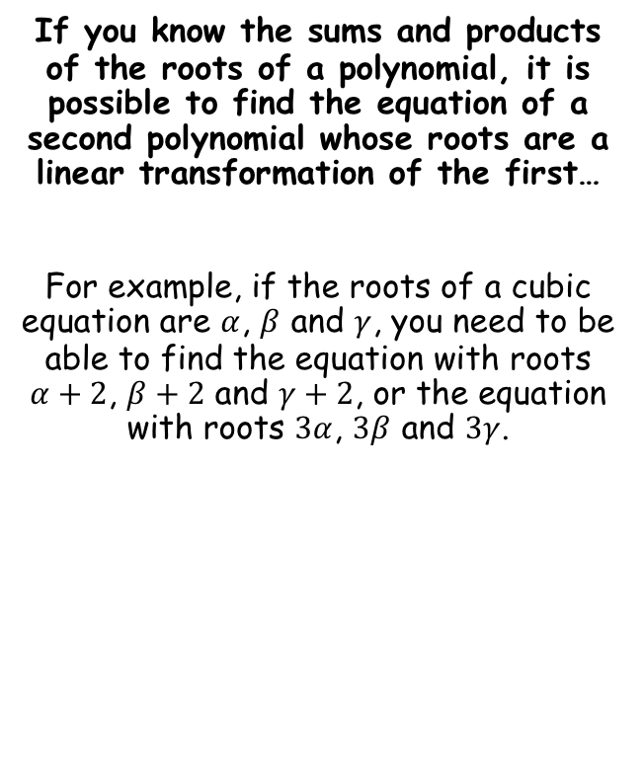
Roots of Polynomials
If you know the sums and products of the roots of a polynomial, it is possible to find the equation of a second polynomial whose roots are a linear transformation of the first…
For example, if the roots of a cubic equation are $α$, $β$ and $γ$, you need to be able to find the equation with roots $α+2$, $β+2$ and $γ+2$, or the equation with roots $3α$, $3β$ and $3γ$.
4E

Slide 9
Exercise 4D
Pearson Further Core Mathematics Year 1/AS
Complete before the lesson Q2-4
In Class:
Green Q5-7
Amber Q8-10
Red Q11-16

