Slide 1
Year 1 Pure Mathematics
Trigonometric Identities
and Equations
- Trigonometric Identities
Chapter 10
(Part 1 of 4)

Slide 2
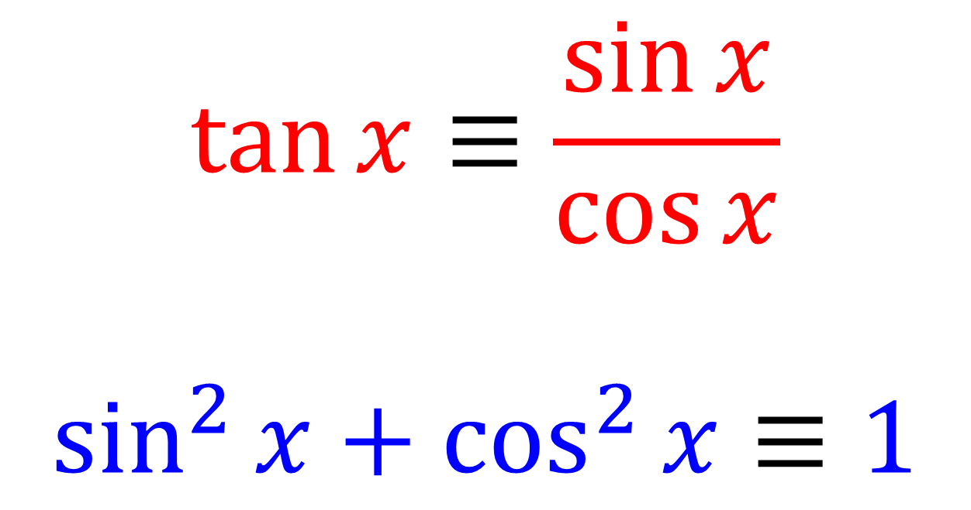

Trigonometry Identities
You need to memories the follow two identities:
$$\tan{x}≡\frac{\sin{x}}{\cos{x}}$$
$$\sin^{2}{x}+\cos^{2}{x}≡1$$
$≡$ means ‘equivalent to’
LHS is always equal to the RHS for all values.

Slide 3


Trigonometry Identities
$$\tan{x}=\frac{\sin{x}}{\cos{x}}$$
From these two identities you can also get
(by rearranging) the following:
$$\tan{x2}=\frac{\sin{x2}}{\cos{x2}}$$

Slide 4
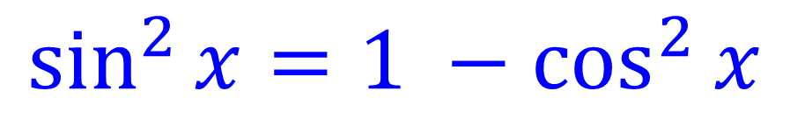
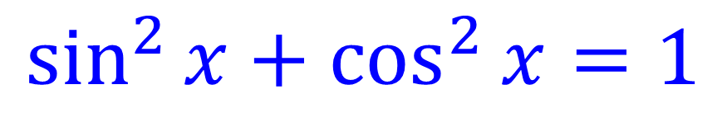
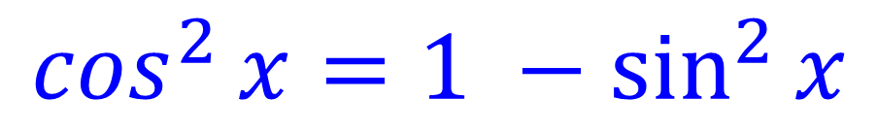
Trigonometry Identities
$$\sin^{2}{x}+\cos^{2}{x}=1$$
From these two identities you can also get
(by rearranging) the following:
$$\sin^{2}{x}=1 −\cos^{2}{x}$$
$$\cos^{2}{x}=1 −\sin^{2}{x}$$

Slide 5
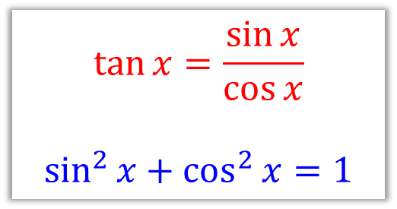


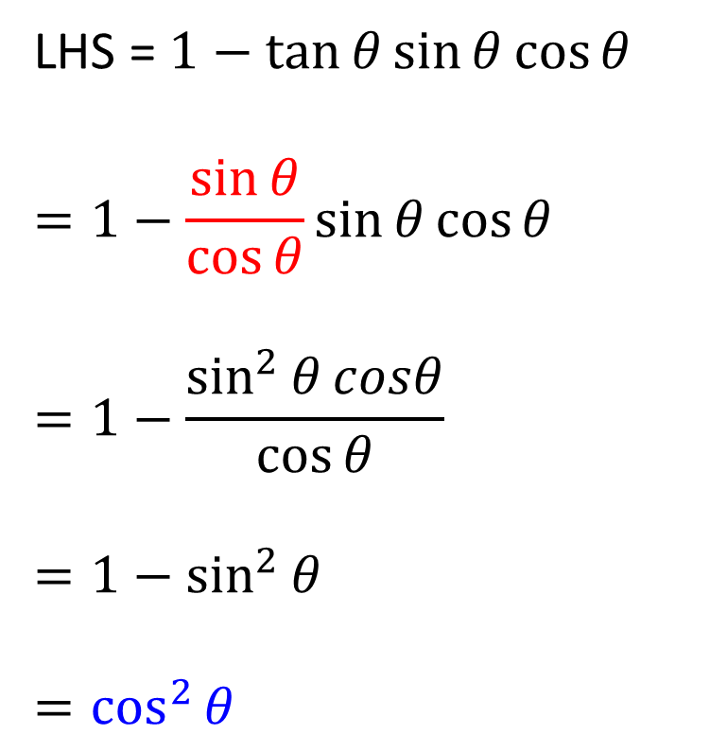
Trigonometry Identities
Prove that $1−\tan{θ}\sin{θ}\cos{θ}≡\cos^{2}{θ}$
LHS = $1−\tan{θ}\sin{θ}\cos{θ}$
$$=1−\frac{\sin{θ}}{\cos{θ}}\sin{θ}\cos{θ}$$
$$=1−\frac{\sin^{2}{θ}cosθ}{\cos{θ}}$$
$$=1−\sin^{2}{θ}$$
$$=\cos^{2}{θ}$$
Tip: Start by replacing tan $θ$
$$\tan{x}=\frac{\sin{x}}{\cos{x}}$$
$$\sin^{2}{x}+\cos^{2}{x}=1$$

Slide 6
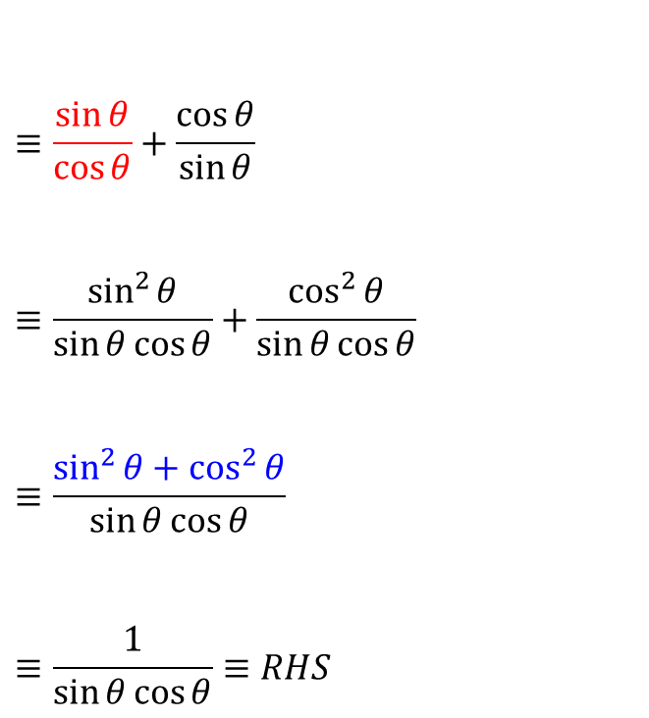



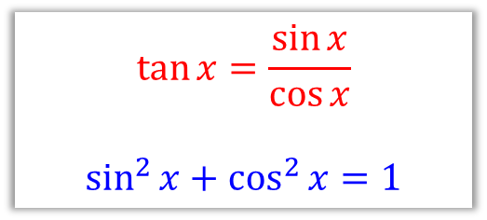
Trigonometry Identities
Prove that $\tan{θ}+\frac{1}{\tan{θ}}≡\frac{1}{\sin{θ}\cos{θ}}$
$$LHS ≡tan{θ}+\frac{1}{\tan{θ}}$$
$$≡\frac{\sin{θ}}{\cos{θ}}+\frac{\cos{θ}}{\sin{θ}}$$
$$≡\frac{\sin^{2}{θ}}{\sin{θ}\cos{θ}}+\frac{\cos^{2}{θ}}{\sin{θ}\cos{θ}}$$
$$≡\frac{\sin^{2}{θ}+\cos^{2}{θ}}{\sin{θ}\cos{θ}}$$
$$≡\frac{1}{\sin{θ}\cos{θ}}≡RHS$$
Tip 1: Start by replacing tan $θ$
Tip 2: Turn into a single fraction.
$$\tan{x}=\frac{\sin{x}}{\cos{x}}$$
$$\sin^{2}{x}+\cos^{2}{x}=1$$

Slide 7
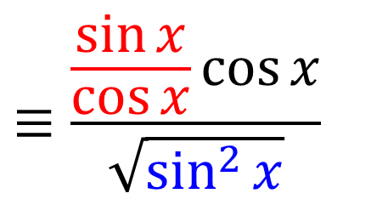
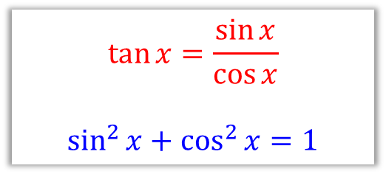


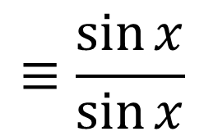

Trigonometry Identities
Prove that $\frac{\tan{x}\cos{x}}{\sqrt{1−\cos^{2}{x}}}≡1$
LHS $≡$ $\frac{\tan{x}\cos{x}}{\sqrt{1−\cos^{2}{x}}}$
$$≡\frac{\frac{\sin{x}}{\cos{x}}\cos{x}}{\sqrt{\sin^{2}{x}}}$$
$$≡\frac{\sin{x}}{\sin{x}}$$
$$\tan{x}=\frac{\sin{x}}{\cos{x}}$$
$$\sin^{2}{x}+\cos^{2}{x}=1$$
$$≡1$$

Slide 8

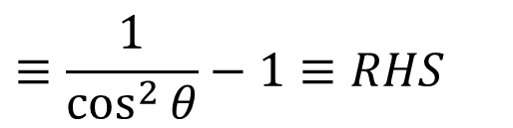
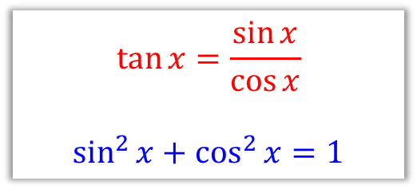

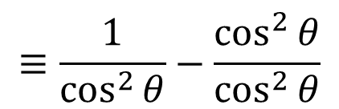
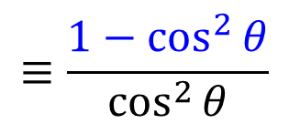
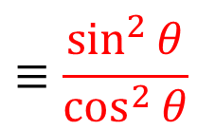
Trigonometry Identities
Prove that $\tan^{2}{θ}≡\frac{1}{\cos^{2}{θ}}−1$
$${LHS ≡tan}^{2}{θ}$$
$$≡\frac{\sin^{2}{θ}}{\cos^{2}{θ}}$$
$$≡\frac{1−\cos^{2}{θ}}{\cos^{2}{θ}}$$
$$≡\frac{1}{\cos^{2}{θ}}−\frac{\cos^{2}{θ}}{\cos^{2}{θ}}$$
$$\tan{x}=\frac{\sin{x}}{\cos{x}}$$
$$\sin^{2}{x}+\cos^{2}{x}=1$$
$$≡\frac{1}{\cos^{2}{θ}}−1≡RHS$$

Slide 9
Exercise 10A/B
Pearson Pure Mathematics Year 1/AS
Page 207, 209
Complete before the lesson Ex10A and Ex10B Q1
Green Ex10A Q2
Amber Ex10A Q3-4
Red Ex10B Q5-6 & Challenges from Ex10A & Ex10B

