Slide 1
Year 1 Pure Mathematics
Circles
- Midpoints and Bisectors
Chapter 6
(Part 1 of 5)

Slide 2
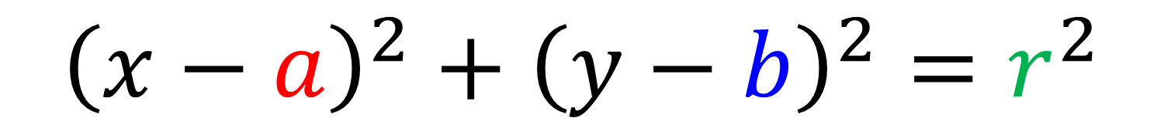
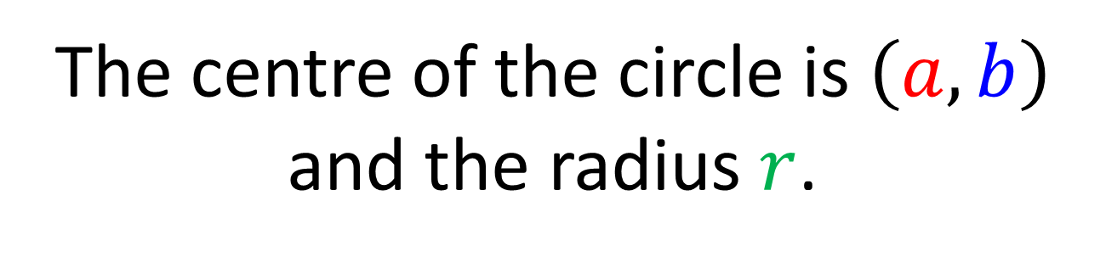
Circles – Equation of a Circle
The equation of a circle can be given as
$${\left(x−a\right)}^{2}+{\left(y−b\right)}^{2}=r^{2}$$
The centre of the circle is $\left(a,b\right)$
and the radius $r$.

Slide 3





















Circles – Equation of a Circle
Centre
Radius
Equation
$$(0,0)$$
$$5$$
$$x^{2}+y^{2}=25$$
$$(1,2)$$
$$6$$
$$(x−1)2+(y−2)2=36$$
$$(−3,5)$$
$$1$$
$$(x+3)2+(y−5)2=1$$
$$(−5,2)$$
$$7$$
$$(x+5)2+(y−2)2=49$$
$$(−6,0)$$
$$4$$
$${\left(x+6\right)}^{2}+y^{2}=16$$
$$(1,−1)$$
$$\sqrt{3}$$
$$(x−1)2+(y+1)2=3$$
$$(−2,3)$$
$$2\sqrt{2}$$
$$(x+2)2+(y−3)2=8$$

Slide 4


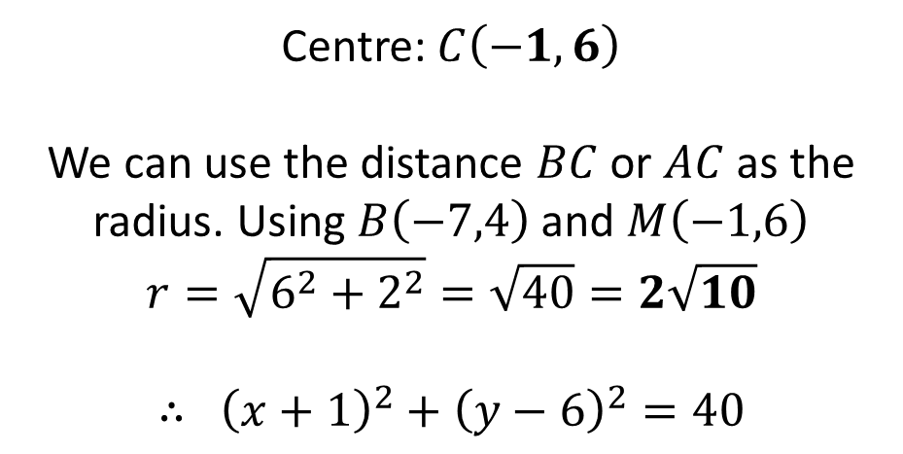
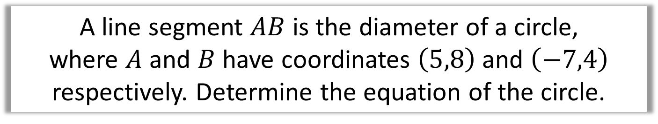
Circles - Finding the equation using points
A line segment $AB$ is the diameter of a circle,
where $A$ and $B$ have coordinates $\left(5,8\right)$ and $\left(−7,4\right)$ respectively. Determine the equation of the circle.
$$A\left(5,8\right)$$
$$B\left(−7,4\right)$$
Centre: $C\left(−1, 6\right)$
We can use the distance $BC$ or $AC$ as the radius. Using $B\left(−7,4\right)$ and $M\left(−1,6\right)$
$$r=\sqrt{6^{2}+2^{2}}=\sqrt{40}=2\sqrt{10}$$
$$∴ {\left(x+1\right)}^{2}+{\left(y−6\right)}^{2}=40$$

Slide 5
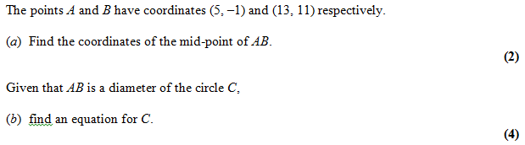
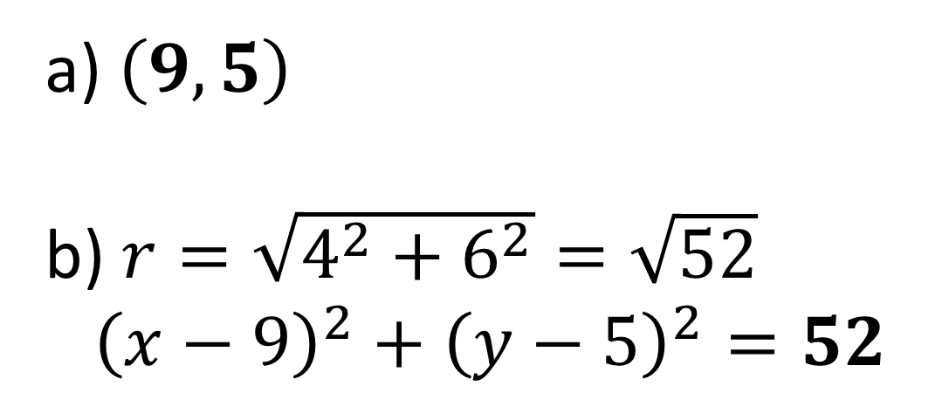
Circles - Finding the equation using points
$\left(9, 5\right)$
$r=\sqrt{4^{2}+6^{2}}=\sqrt{52}$
${\left(x−9\right)}^{2}+{\left(y−5\right)}^{2}=52$

Slide 6
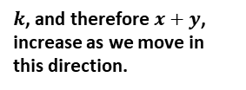




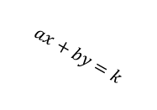



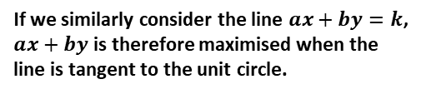





Exercise 6C
Complete before the lesson Q1-3
Green Q5&6
Amber Q7-10
Red Q11-13 & Challenge & Ext
Pearson Pure Mathematics Year 1/AS Page 119-120
Extension:
2
[MAT 2007 1D]
The point on the circle
$${\left(x−5\right)}^{2}+{\left(y−4\right)}^{2}=4$$
which is closest to the circle
$${\left(x−1\right)}^{2}+{\left(y−1\right)}^{2}=1$$
has what coordinates?
Drawing the circles on the same axes, and drawing a straight line connecting their centres, the point is where the straight line intersects the first circle.
The circle centres are 5 apart, so we need to go $\frac{2}{5}$ of the way across this line, giving $(3.4, 2.8)$
[MAT 2016 1I] Let $a$ and $b$ be positive real numbers. If
$x^{2}+y^{2}≤1$ then the largest that $ax+by$ can equal is what? Give your expression in terms of $a$ and $b$.
Many MAT questions consider maximising an expression in terms of $x$ and $y$. Consider for example the simple case
$x+y=k$. As we increase $k$, the line stays in the same direction but ‘sweeps’ across:
3
1
[MAT 2009 1B] The point on the circle $x^{2}+y^{2}+6x+8y=75$ which is closest to the origin, is at what distance from the origin?
$${\left(x+3\right)}^{2}+{\left(y+4\right)}^{2}=100 \\ ∴C\left(−3,−4\right), r=10$$
The closest point $P$ lies on the line between the circle centre and the origin. Since $\left(−3,−4\right)$ is 5 away from the origin, the distance between the origin and $P$ must be $10−5=5$
?
?
?
$$y$$
$$k=3$$
$k$, and therefore $x+y$, increase as we move in this direction.
$$k=2$$
$$k=1$$
$$x$$
If we similarly consider the line $ax+by=k$, $ax+by$ is therefore maximised when the line is tangent to the unit circle.
$$\sqrt{\frac{k^{2}}{a^{2}}+\frac{k^{2}}{b^{2}}}$$
$$\frac{k}{b}$$
$$\frac{k}{b}$$
$$ax+by=k$$
1
$$\left(−3,−4\right)$$
1
$$\frac{k}{a}$$
$$\frac{k}{a}$$
Using similar triangles, we can obtain $k=\sqrt{a^{2}+b^{2}}$

