Slide 1
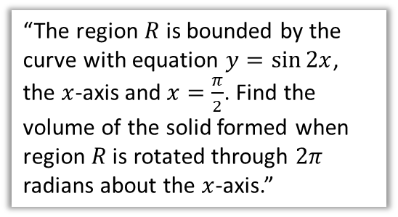
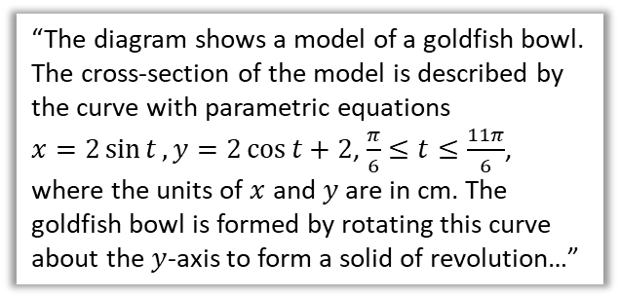

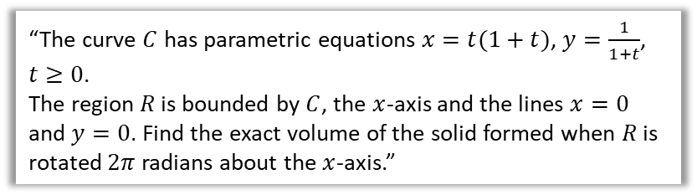

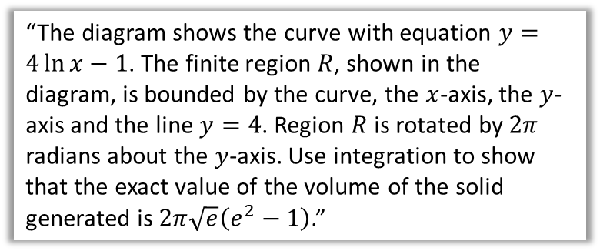
Chapter Overview
A second entire chapter on a topic that used to be just a single exercise in the old A Level. Joy!
However, it is a good opportunity to practise some integration. This is the same as the material in Core Pure Year 1, but just using the integration techniques you have since seen (e.g. Pure Year 2 integration techniques).
1:: Revolving around the $x$-axis.
2:: Revolving around the $y$-axis.
“The region $R$ is bounded by the curve with equation $y=\sin{2x}$, the $x$-axis and $x=\frac{π}{2}$. Find the volume of the solid formed when region $R$ is rotated through $2π$ radians about the $x$-axis.”
“The diagram shows the curve with equation $y=4\ln{x}−1$. The finite region $R$, shown in the diagram, is bounded by the curve, the $x$-axis, the $y$-axis and the line $y=4$. Region $R$ is rotated by $2π$ radians about the $y$-axis. Use integration to show that the exact value of the volume of the solid generated is $2π\sqrt{e}\left(e^{2}−1\right)$.”
3:: Volumes of revolution with parametric curves.
4:: Modelling
“The curve $C$ has parametric equations $x=t(1+t)$, $y=\frac{1}{1+t}$, $t≥0$.
The region $R$ is bounded by $C$, the $x$-axis and the lines $x=0$ and $y=0$. Find the exact volume of the solid formed when $R$ is rotated $2π$ radians about the $x$-axis.”
“The diagram shows a model of a goldfish bowl. The cross-section of the model is described by the curve with parametric equations
$x=2\sin{t}, y=2\cos{t}+2$, $\frac{π}{6}≤t≤\frac{11π}{6}$, where the units of $x$ and $y$ are in cm. The goldfish bowl is formed by rotating this curve about the $y$-axis to form a solid of revolution…”

Slide 2
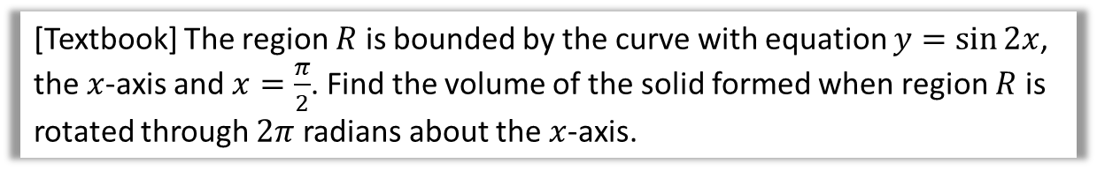
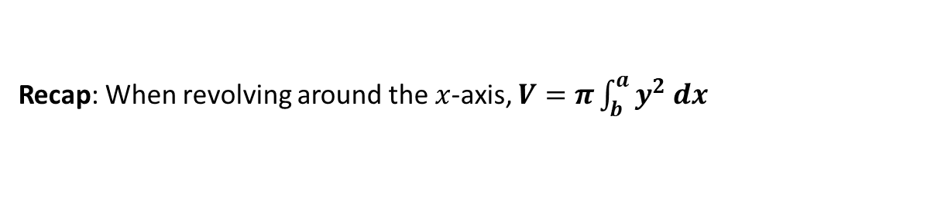
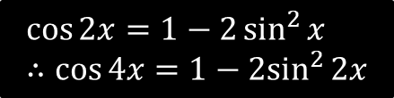

Volumes of Revolution with harder integration
Recap: When revolving around the $x$-axis, $V=π\int_{b}^{a}{y^{2} dx}$
[Textbook] The region $R$ is bounded by the curve with equation $y=\sin{2x}$, the $x$-axis and $x=\frac{π}{2}$. Find the volume of the solid formed when region $R$ is rotated through $2π$ radians about the $x$-axis.
?
$$V=π\int_{0}^{\frac{π}{2}}{\sin^{2}{2x}} dx \\ =π\int_{0}^{\frac{π}{2}}{\frac{1}{2}\left(1−\cos{4x}\right)} dx \\ =π{\left[\frac{1}{2}x−\frac{1}{8}\sin{4x}\right]}_{0}^{\frac{π}{2}} \\ =\frac{π^{2}}{4}$$
$$\cos{2x}=1−2\sin^{2}{x} \\ ∴\cos{4x}=1−2\sin^{2}{2x}$$

Slide 3
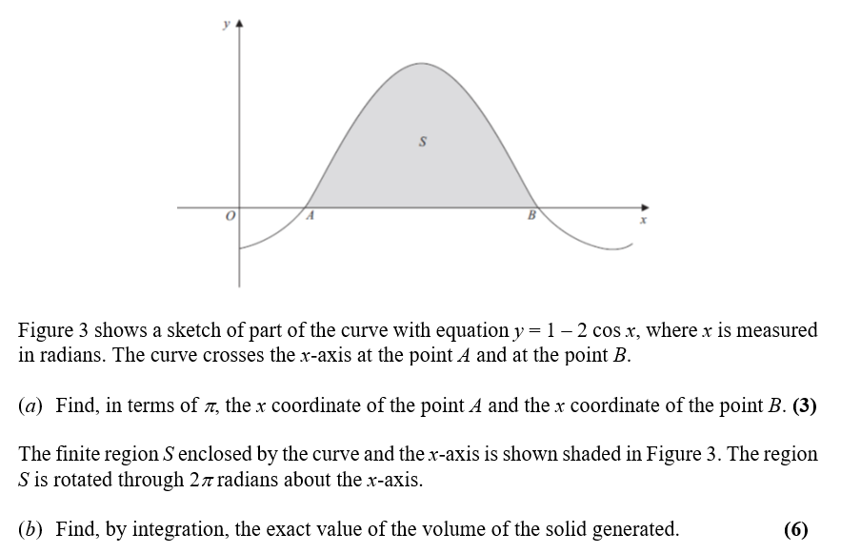

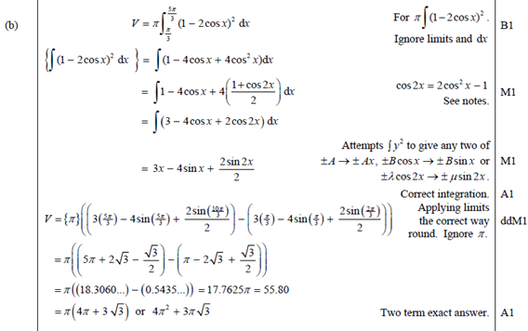
Test Your Understanding
Edexcel C4(Old) Jan 2013 Q6
?
?

Slide 4
Exercise 4A
Pearson Core Pure Year 2
Pages 78-80
Complete before the lesson Q1
In Class:
Green Q2-5
Amber Q6
Red Q7-8 & Challenge

Slide 5

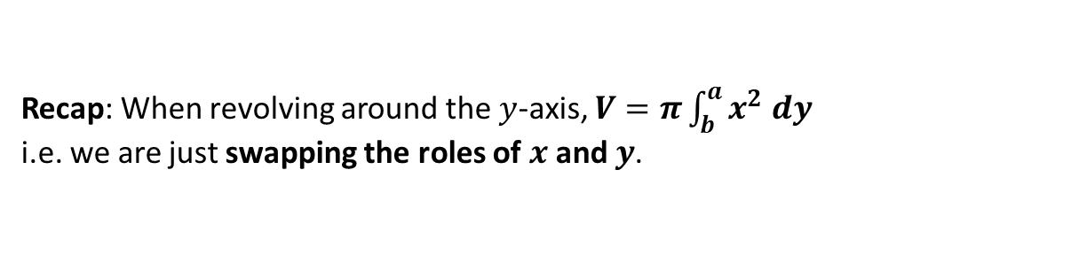



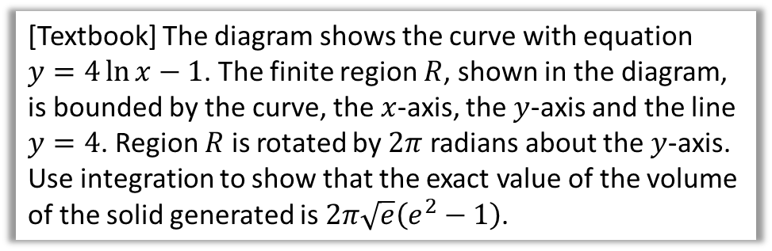
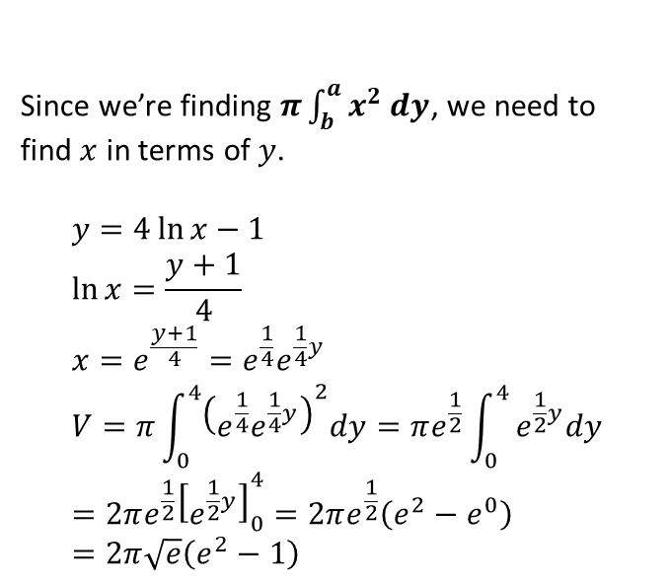
Revolving around the $y$-axis
Recap: When revolving around the $y$-axis, $V=π\int_{b}^{a}{x^{2} dy}$
i.e. we are just swapping the roles of $x$ and $y$.
$$y$$
[Textbook] The diagram shows the curve with equation $y=4\ln{x}−1$. The finite region $R$, shown in the diagram, is bounded by the curve, the $x$-axis, the $y$-axis and the line $y=4$. Region $R$ is rotated by $2π$ radians about the $y$-axis. Use integration to show that the exact value of the volume of the solid generated is $2π\sqrt{e}\left(e^{2}−1\right)$.
$$R$$
$$x$$
$$O$$
?
Since we’re finding $π\int_{b}^{a}{x^{2} dy}$, we need to find $x$ in terms of $y$.
$$y=4\ln{x}−1 \\ \ln{x}=\frac{y+1}{4} \\ x=e^{\frac{y+1}{4}}=e^{\frac{1}{4}}e^{\frac{1}{4}y} \\ V=π\int_{0}^{4}{{\left(e^{\frac{1}{4}}e^{\frac{1}{4}y}\right)}^{2}dy}=πe^{\frac{1}{2}}\int_{0}^{4}{e^{\frac{1}{2}y}dy} \\ =2πe^{\frac{1}{2}}{\left[e^{\frac{1}{2}y}\right]}_{0}^{4}=2πe^{\frac{1}{2}}\left(e^{2}−e^{0}\right) \\ =2π\sqrt{e}\left(e^{2}−1\right)$$

Slide 6
Exercise 4B
Pearson Core Pure Year 2
Pages 81-83
Complete before the lesson Q1-2
In Class:
Green Q3-4
Amber Q5-6
Red Q7-8

Slide 7
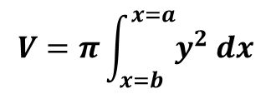
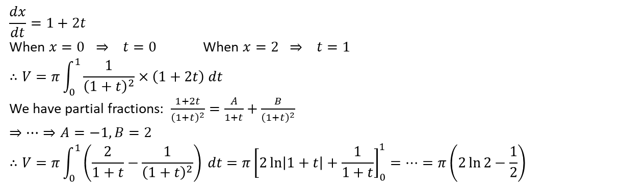
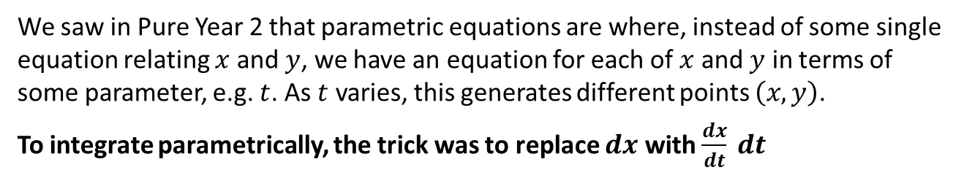
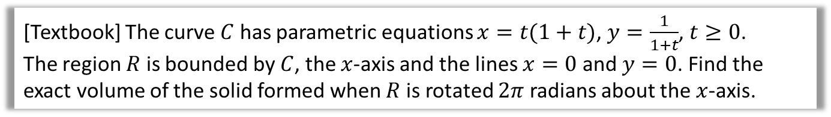
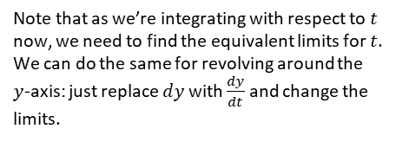
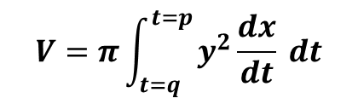
Volumes of revolution for parametric curves
We saw in Pure Year 2 that parametric equations are where, instead of some single equation relating $x$ and $y$, we have an equation for each of $x$ and $y$ in terms of some parameter, e.g. $t$. As $t$ varies, this generates different points $\left(x,y\right)$.
To integrate parametrically, the trick was to replace $dx$ with $\frac{dx}{dt} dt$
?
Note that as we’re integrating with respect to $t$ now, we need to find the equivalent limits for $t$.
We can do the same for revolving around the $y$-axis: just replace $dy$ with $\frac{dy}{dt}$ and change the limits.
$$V=π\int_{x=b}^{x=a}{y^{2} dx}$$
$$V=π\int_{t=q}^{t=p}{y^{2}\frac{dx}{dt} dt}$$
[Textbook] The curve $C$ has parametric equations $x=t(1+t)$, $y=\frac{1}{1+t}$, $t≥0$.
The region $R$ is bounded by $C$, the $x$-axis and the lines $x=0$ and $y=0$. Find the exact volume of the solid formed when $R$ is rotated $2π$ radians about the $x$-axis.
?
$$\frac{dx}{dt}=1+2t$$
When $x=0 ⇒ t=0$ When $x=2 ⇒ t=1$
$$∴V=π\int_{0}^{1}{\frac{1}{{\left(1+t\right)}^{2}}×\left(1+2t\right) dt}$$
We have partial fractions: $\frac{1+2t}{{\left(1+t\right)}^{2}}=\frac{A}{1+t}+\frac{B}{{\left(1+t\right)}^{2}}$
$$⇒…⇒A=−1, B=2 \\ ∴V=π\int_{0}^{1}{\left(\frac{2}{1+t}−\frac{1}{{\left(1+t\right)}^{2}}\right) dt}=π{\left[2\ln\left|1+t\right|+\frac{1}{1+t}\right]}_{0}^{1}=…=π\left(2\ln{2}−\frac{1}{2}\right)$$

Slide 8
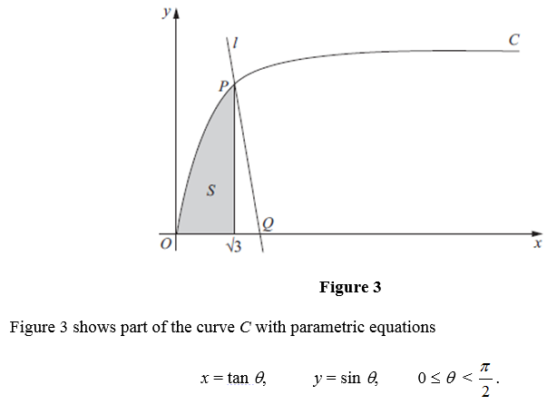
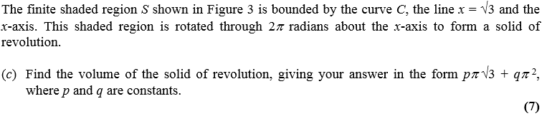

Test Your Understanding
$$\frac{dx}{dθ}=\sec^{2}{θ}$$
When $x=\sqrt{3}$, $θ=\frac{π}{3}$
When $x=0$, $θ=0$
$$π\int_{0}^{\frac{π}{3}}{y^{2}\frac{dx}{dθ} dθ} \\ =π\int_{0}^{\frac{π}{3}}{\sin^{2}{θ\sec^{2}{θ} dθ}}=π\int_{0}^{\frac{π}{3}}{\frac{\sin^{2}{θ}}{\cos^{2}{θ}}dθ} \\ =π\int_{0}^{\frac{π}{3}}{\tan^{2}{θ dθ}} \\ =π\int_{0}^{\frac{π}{3}}{\sec^{2}{θ}−1 dθ} \\ π{\left[\tan{θ}−θ\right]}_{0}^{\frac{π}{3}} \\ =π\left(\tan{\frac{π}{3}}−\frac{π}{3}\right) \\ =π\left(\sqrt{3}−\frac{π}{3}\right) \\ =π\sqrt{3}−\frac{1}{3}π^{2}$$
?
Edexcel C4(Old) June 2011 Q7

Slide 9
Exercise 4C
Pearson Core Pure Year 2
Pages 84-87
Complete before the lesson Q1
In Class:
Green Q2-4
Amber Q5-9
Red Q10-11

Slide 10
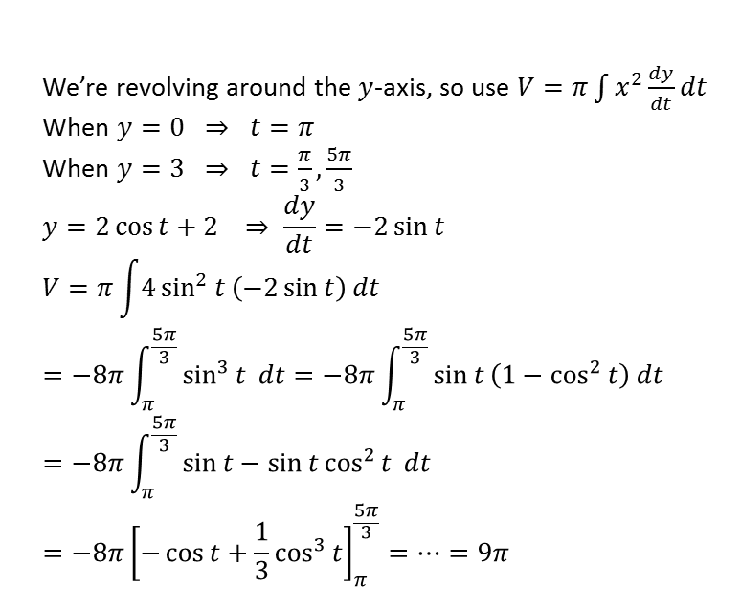
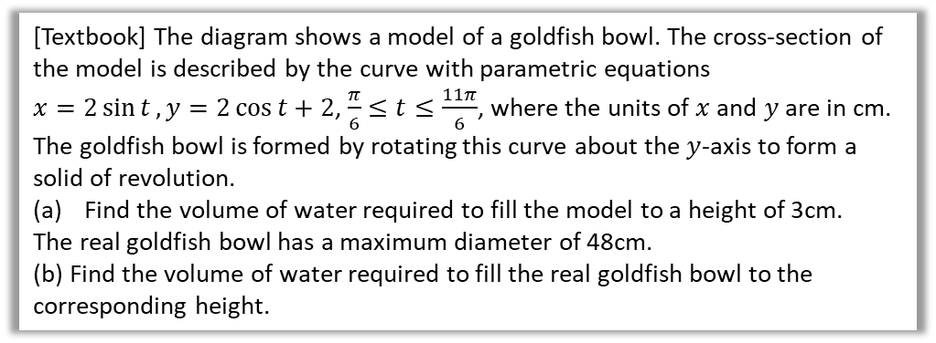

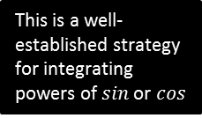
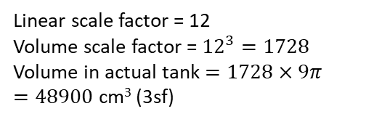
Modelling with Volumes of Revolution
[Textbook] The diagram shows a model of a goldfish bowl. The cross-section of the model is described by the curve with parametric equations
$x=2\sin{t}, y=2\cos{t}+2$, $\frac{π}{6}≤t≤\frac{11π}{6}$, where the units of $x$ and $y$ are in cm. The goldfish bowl is formed by rotating this curve about the $y$-axis to form a solid of revolution.
Find the volume of water required to fill the model to a height of 3cm.
The real goldfish bowl has a maximum diameter of 48cm.
(b) Find the volume of water required to fill the real goldfish bowl to the corresponding height.
3cm
4cm
a
We’re revolving around the $y$-axis, so use $V=π\int{x^{2}\frac{dy}{dt}dt}$
When $y=0 ⇒ t=π$
When $y=3 ⇒ t=\frac{π}{3},\frac{5π}{3}$
$$y=2\cos{t}+2 ⇒ \frac{dy}{dt}=−2\sin{t} \\ V=π\int{4\sin^{2}{t}\left(−2\sin{t}\right) dt} \\ =−8π\int_{π}^{\frac{5π}{3}}{\sin^{3}{t} dt}=−8π\int_{π}^{\frac{5π}{3}}{\sin{t}\left(1−\cos^{2}{t}\right) dt} \\ =−8π\int_{π}^{\frac{5π}{3}}{\sin{t}−\sin{t}\cos^{2}{t} dt} \\ =−8π{\left[−\cos{t}+\frac{1}{3}\cos^{3}{t}\right]}_{π}^{\frac{5π}{3}}=…=9π$$
?
The $\frac{π}{3}$ and $\frac{5π}{3}$ corresponds to the two sides of the bowl. But we only want to integrate the curve on one side of the bowl, so choose one.
Linear scale factor = 12
Volume scale factor = ${12}^{3}=1728$
Volume in actual tank $=1728×9π$
$=48900$ cm³ (3sf)
This is a well-established strategy for integrating powers of $sin$ or $cos$
b
?
Can use integration by inspection (‘reverse chain rule’). This is one to remember.

Slide 11
Exercise 4D
Pearson Core Pure Year 2
Pages 88-89
Complete before the lesson Q1
In Class:
Green Q2
Amber Q3
Red Q4-5

