Slide 1
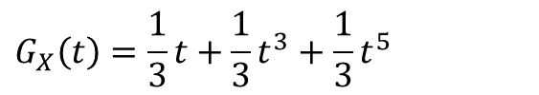

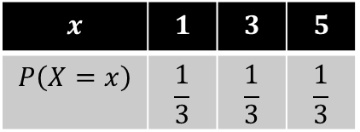
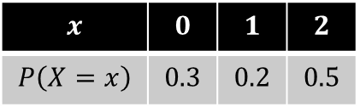

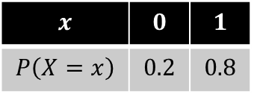

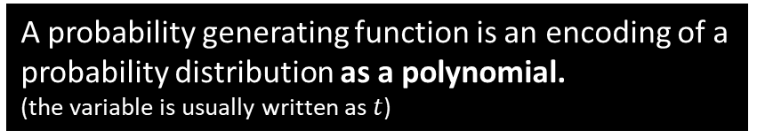
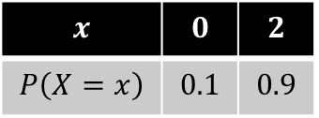
What is a probability generating function?
$$x$$ | $$0$$ | $$1$$ | $$2$$
$$P\left(X=x\right)$$ | $$0.3$$ | $$0.2$$ | $$0.5$$
$$G_{X}\left(t\right)=0.3t^{0}+0.2t^{1}+0.5t^{2}$$
A probability generating function is an encoding of a probability distribution as a polynomial.
(the variable is usually written as $t$)
Fro Note: Because polynomials only have non-negative integer powers, we can only obtain the probability generating function for discrete distributions with non-negative outcomes.
The outcomes are the powers and the probabilities are the coefficients of each term.
$$x$$ | $$0$$ | $$1$$
$$P\left(X=x\right)$$ | $$0.2$$ | $$0.8$$
?
$$G_{X}\left(t\right)=0.2+0.8t$$
$$x$$ | $$1$$ | $$3$$ | $$5$$
$$P\left(X=x\right)$$ | $$\frac{1}{3}$$ | $$\frac{1}{3}$$ | $$\frac{1}{3}$$
$$G_{X}\left(t\right)=\frac{1}{3}t+\frac{1}{3}t^{3}+\frac{1}{3}t^{5}$$
?
$$x$$ | $$0$$ | $$2$$
$$P\left(X=x\right)$$ | $$0.1$$ | $$0.9$$
?
$$G_{X}\left(t\right)=0.1+0.9t^{2}$$

Slide 2

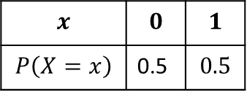

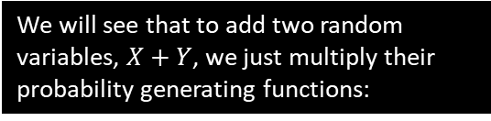
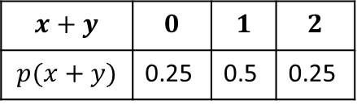
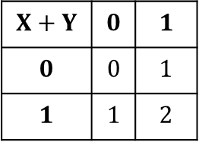


Why use probability generating functions?
It seems a bit bizarre to use write a probability distribution as a polynomial, when they seem to have no conceptual connection.
We will see that there are operations on probability distributions, e.g. finding the expected value or adding random variables, where we can combine/manipulate their polynomial forms in a certain way.
Polynomials are easy to manipulate: we can quickly multiply polynomials or differentiate them. Therefore, it is often easiest to work on their polynomial form instead, and where relevant, convert the resulting polynomial back into a standard probability distribution form. e.g.:
We will see that to add two random variables, $X+Y$, we just multiply their probability generating functions:
$$X+Y$$ | $$0$$ | $$1$$
$$0$$ | $$0$$ | $$1$$
$$1$$ | $$1$$ | $$2$$
$$x+y$$ | $$0$$ | $$1$$ | $$2$$
$$p(x+y)$$ | 0.25 | 0.5 | 0.25
$$x$$ | $$0$$ | $$1$$
$$P\left(X=x\right)$$ | 0.5 | $$0.5$$
Working out using GCSE method
$$X$$
$$+$$
$$Y$$
Using probability generating functions
Convert back to distribution
$$G_{X}\left(t\right)=0.5+0.5t$$
$$∴\left(0.5+0.5t\right)\left(0.5+0.5t\right) \\ =0.25+0.5t+0.25t^{2}$$
0
1
0
1

Slide 3

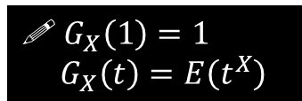

A few properties of P.G.F.s
$$x$$ | $$0$$ | $$1$$ | $$2$$
$$P\left(X=x\right)$$ | $$0.3$$ | $$0.2$$ | $$0.5$$
$$G_{X}\left(t\right)=0.3+0.2t+0.5t^{2}$$
What is $G_{X}(1)$, and why?
$$G_{X}\left(1\right)=0.3+0.2+0.5=1$$
$G_{X}(1)$ will always be 1 for all random variables $X$, because substituting in 1 gives us the sum of the coefficients of the polynomial; these are the probabilities, and we know these sum to 1.
Find $E\left(X\right), E(X^{2})$ and $E\left(t^{X}\right)$. What do you notice about $E\left(t^{X}\right)$?
$$E\left(X\right)=0.3\left(0\right)+0.2\left(1\right)+0.5(2) \\ E\left(X^{2}\right)=0.3\left(0^{2}\right)+0.2\left(1^{2}\right)+0.5\left(2^{2}\right) \\ E\left(t^{X}\right)=0.3\left(t^{0}\right)+0.2\left(t^{1}\right)+0.5\left(t^{2}\right)=G_{X}(t)$$
The last of these is the same as the probability generating function of $X$.
?
?
! $G_{X}\left(1\right)=1$
$G_{X}\left(t\right)=E\left(t^{X}\right)$
You’re implicitly using this one when you form a polynomial with the outcomes as the powers and the probabilities as the coefficients.

Slide 4
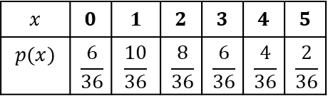
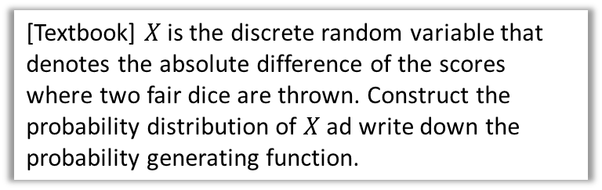

Examples
[Textbook] $X$ is the discrete random variable that denotes the absolute difference of the scores where two fair dice are thrown. Construct the probability distribution of $X$ ad write down the probability generating function.
?
 | 1 | 2 | 3 | 4 | 5 | 6
1 | 0 | 1 | 2 | 3 | 4 | 5
2 | 1 | 0 | 1 | 2 | 3 | 4
3 | 2 | 1 | 0 | 1 | 2 | 3
4 | 3 | 2 | 1 | 0 | 1 | 2
5 | 4 | 3 | 2 | 1 | 0 | 1
6 | 5 | 4 | 3 | 2 | 1 | 0
$$x$$ | $$0$$ | $$1$$ | $$2$$ | $$3$$ | $$4$$ | $$5$$
$$p(x)$$ | $$\frac{6}{36}$$ | $$\frac{10}{36}$$ | $$\frac{8}{36}$$ | $$\frac{6}{36}$$ | $$\frac{4}{36}$$ | $$\frac{2}{36}$$
$$G_{X}\left(t\right)=\frac{1}{6}+\frac{5}{18}t+\frac{2}{9}t^{2}+\frac{1}{6}t^{3}+\frac{1}{9}t^{4}+\frac{1}{18}t^{5}$$

Slide 5
Exercise 7A
Pearson Further Statistics 1
Pages 130-131
Complete before the lesson Q1-2
In Class:
Green Q3-5
Amber Q6-8
Red Q9-11

