Slide 1

MechYr2 Chapter 6 :: Projectiles
jfrost@tiffin.kingston.sch.uk
www.drfrostmaths.com
@DrFrostMaths
Last modified: 7th January 2019

Slide 2








www.drfrostmaths.com
Everything is completely free.
Why not register?
Register now to interactively practise questions on this topic, including past paper questions and extension questions (including MAT + UKMT).
Teachers: you can create student accounts (or students can register themselves), to set work, monitor progress and even create worksheets.
With questions by:
Dashboard with points, trophies, notifications and student progress.
Questions organised by topic, difficulty and past paper.
Teaching videos with topic tests to check understanding.

Slide 3

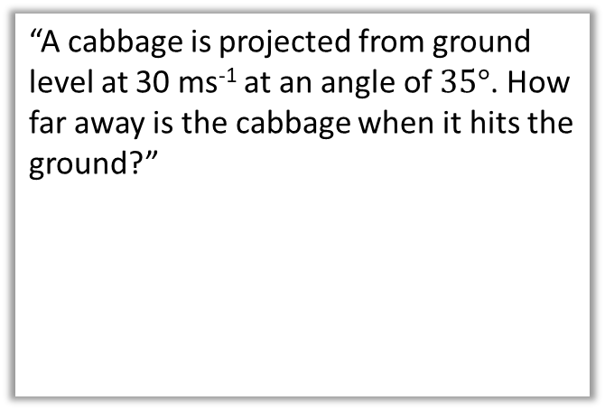





Overview
In Mechanics Year 1 we already encountered problems of vertical motion of objects when projected vertically. We used “suvat” equations where the acceleration was $g$ ms⁻².
In this chapter we allow the object to be projected sideways!
1:: Horizontally projected
2:: Projection at any angle
“A particle is projected horizontally at 20 ms⁻¹, at a distance 50m above the ground. How far along the ground does it travel?”
“A cabbage is projected from ground level at 30 ms⁻¹ at an angle of $35°$. How far away is the cabbage when it hits the ground?”
50m
$30$ms⁻¹
$$35°$$
$x$ m
$x$ m

Slide 4



Acceleration in each direction.
The key is separately considering the motion in the vertical and horizontal directions:
! In vertical direction, acceleration downwards is $g$ ms⁻².
Use suvat equations as before.
In horizontal direction, acceleration is 0 ms⁻².
Constant velocity, so can use bog standard $speed=\frac{distance}{time}$
?
?
[Textbook] A particle is project horizontally at 25 ms⁻¹ from a point 78.4 metres above a horizontal surface. Find:
the time taken by the particle to reach the surface
the horizontal distance travelled in that time.
the distance of the impact point from the original point.
a
?
$$R\left(↓\right): s=78.4, u=0, v= , \\ a=9.8, t=?$$
$$s=ut+\frac{1}{2}at^{2} \\ 78.4=4.9t^{2} \\ t=4 s$$
$$R\left(→\right): x=25×4=100 m$$
$\sqrt{{78.4}^{2}+{100}^{2}}=130$ m (2sf)
$25$ms⁻¹
78.4m
b
?
$x$ m
d
Just using ‘sdt triangle’:
s
t
c
?

Slide 5

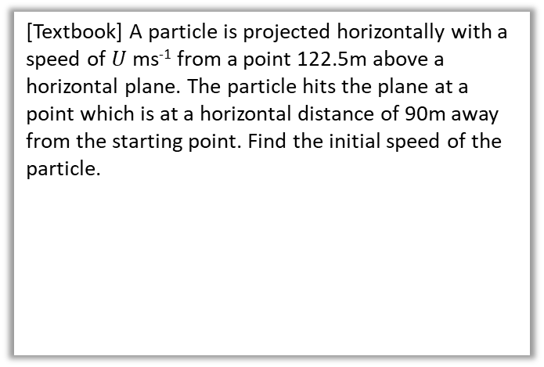

Further Example
?
[Textbook] A particle is projected horizontally with a speed of $U$ ms⁻¹ from a point 122.5m above a horizontal plane. The particle hits the plane at a point which is at a horizontal distance of 90m away from the starting point. Find the initial speed of the particle.
$$R\left(↓\right): s=122.5, u=0, v= , \\ a=9.8, t=?$$
$$s=ut+\frac{1}{2}at^{2} \\ 122.5=4.9t^{2} \\ t=5 s$$
$$R\left(→\right): 90=U×5 \\ U=18 ms^{−1}$$
$U$ ms⁻¹
122.5m
90 m

Slide 6

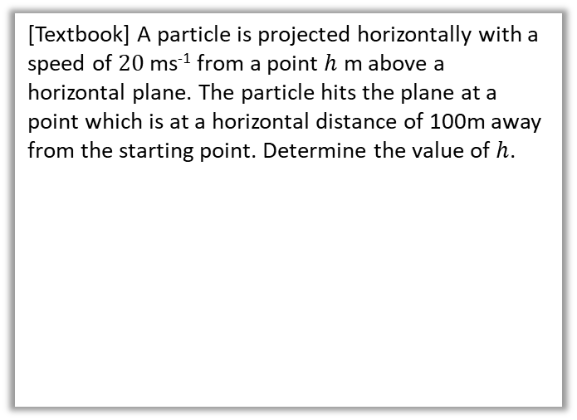


Test Your Understanding
[Textbook] A particle is projected horizontally with a speed of $20$ ms⁻¹ from a point $h$ m above a horizontal plane. The particle hits the plane at a point which is at a horizontal distance of 100m away from the starting point. Determine the value of $h$.
$$R\left(→\right): t=\frac{100}{20}=5 s$$
$$R\left(↓\right): s=h, u=0, v= , \\ a=9.8, t=5$$
$$s=ut+\frac{1}{2}at^{2} \\ h=\frac{1}{2}×9.8×5^{2} \\ =122.5 m$$
?
$20$ ms⁻¹
$$h$$
100 m

Slide 7
Exercise 6A
Pearson Stats/Mechanics Year 2
Pages 110-111
Complete before the lesson Q1-3
In Class:
Green Q4
Amber Q5
Red Q6-7

Slide 8






Components of velocity
Just as we split forces into its horizontal and vertical components, in order to consider forces in the horizontal and vertical directions respectively, we can do exactly the same with velocity!
When the object is at its highest point:
The vertical velocity is 0.
?
We know that the scalar form of velocity is speed, and thus we just find the magnitude of the velocity vector:
$20$ ms⁻¹
?
$20\sin{70°}$ ms⁻¹
$$70°$$
$20\cos{70°}$ ms⁻¹
?
$$\left(\begin{matrix}12 \\ 5\end{matrix}\right) ms^{−1} \\ ⇒\sqrt{{12}^{2}+5^{2}} \\ =13 ms^{−1}$$
?
Click for Tomanimation

Slide 9


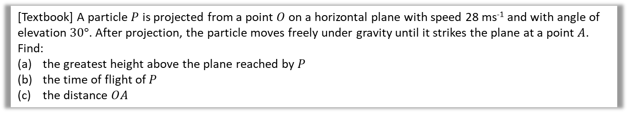



Simple Example
[Textbook] A particle $P$ is projected from a point $O$ on a horizontal plane with speed 28 ms⁻¹ and with angle of elevation $30°$. After projection, the particle moves freely under gravity until it strikes the plane at a point $A$. Find:
the greatest height above the plane reached by $P$
the time of flight of $P$
the distance $OA$
a
?
$$R\left(↑\right): s=?, u=28\sin{30°},v=0,a=−9.8, t= \\ v^{2}=u^{2}+2as \\ 0={14}^{2}+2×\left(−9.8\right)×s \\ s=10$$
Greatest height is 10 m.
$$R\left(↑\right): s=0, u=28\sin{30°},v= ,a=−9.8, t=? \\ s=ut+\frac{1}{2}at^{2} \\ 0=14t−4.9t^{2}=t\left(14−4.9t\right) \\ t=0 or\frac{14}{4.9}=2.857…$$
Time of flight is 2.9 s (2sf)
$28\cos{30°}×2.857…=69.282…=69$ m (2sf)
$28$ ms⁻¹
$28\sin{30°}$ ms⁻¹
$$30°$$
$28\cos{30°}$ ms⁻¹
b
?
Vertically the particle has returned to its original position, so displacement is 0.
c
?

Slide 10



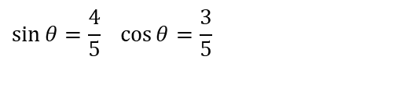

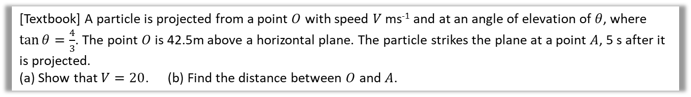







Projected from above ground
[Textbook] A particle is projected from a point $O$ with speed $V$ ms⁻¹ and at an angle of elevation of $θ$, where $\tan{θ=\frac{4}{3}}$. The point $O$ is 42.5m above a horizontal plane. The particle strikes the plane at a point $A$, 5 s after it is projected.
(a) Show that $V=20$. (b) Find the distance between $O$ and $A$.
? Diagram
(It’s important you draw one!)
a
?
$V$ ms⁻²
$$5$$
$$\sin{θ}=\frac{4}{5} \cos{θ}=\frac{3}{5}$$
$$4$$
$$θ$$
$$θ$$
$$O$$
$$3$$
$$R\left(↑\right): s=−42.5, u=\frac{4}{5}V,v= , a=−9.8, t=5 \\ s=ut+\frac{1}{2}at^{2} \\ −42.5=\frac{4}{5}V×5−4.9×25 \\ … ⇒ V=20$$
Let horizontal distance be $x$ m:
$x=20\cos{θ}×5=\frac{3}{5}\left(20\right)×5=60$ m
Using Pythagoras’ theorem:
$$OA=\sqrt{{42.5}^{2}+{60}^{2}}=73.527…$$
Distance is 74 m to 2sf.
$$42.5m$$
$$t=5$$
$$A$$
b
?
c
?

Slide 11



Time above a given point
[Textbook] A particle is projected from a point $O$ with speed $35$ ms⁻¹ and at an angle of elevation of $30°$. The particle moves freely under gravity. Find the length of time for which the particle is 15 m or more above $O$.
The key is to find the two times at which the particle is 15m above ground. The time above 15m will then be the difference between these times.
$$R\left(↑\right): s=15, u=35\sin{30°=75}, v= , a=−9.8, t=? \\ s=ut+\frac{1}{2}at^{2} \\ 15=17.5t −4.9t^{2} \\ 4.9t^{2}−17.5 t+15=0$$
$t=\frac{10}{7},\frac{15}{7}$
Time above 15m: $\frac{15}{7}−\frac{10}{7}=\frac{5}{7}=0.71$ s (2sf)
?
Use the quadratic solver on your calculator.
Note: The textbook implies you can leave your answer as an exact value of $\frac{5}{7}$. But we have used an approximate value of $g$, to 2 significant figures, so it would not be appropriate to do so.

Slide 12

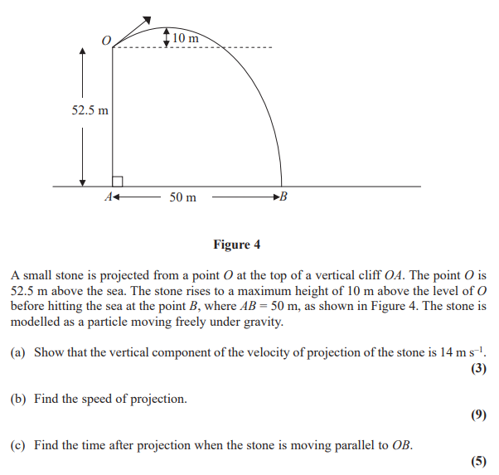
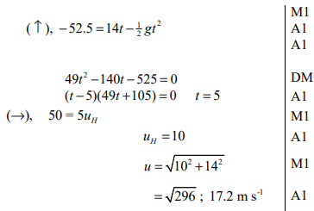
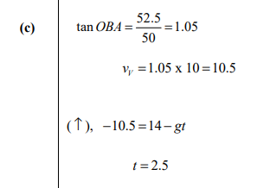
Test Your Understanding
Edexcel M2(Old) May 2012 Q7
a
?
b
?
c
?

Slide 13


Exercise 6C
Pearson Stats/Mechanics Year 2
Pages 117-120
N
A ball is projected from ground level at an angle of $θ$. Prove that when the ball hits the ground, the distance the ball has travelled along the ground is maximised when $θ=45°$.
(Year 2 differentiation knowledge required)
Let speed be $u_{0}$ and horizontal distance be $x$.
$$R\left(↑\right): s=0, u=u_{0}\sin{θ}, v= ,a=−g,t=? \\ s=ut+\frac{1}{2}at^{2} \\ 0=u_{0}\left(\sin{θ}\right)t−\frac{1}{2}gt^{2}=t\left(u_{0}\left(\sin{θ}\right)−\frac{1}{2}gt\right) \\ t=0 or t=\frac{2\left(\sin{θ}\right)u_{0}}{g}$$
$$R\left(→\right): x=u_{0}cosθ×\frac{2\left(\sin{θ}\right)u_{0}}{g}=\frac{2{\left(u_{0}\right)}^{2}}{g}\sin{θ}\cos{θ} \\ x=\frac{{\left(u_{0}\right)}^{2}}{g}\sin{2θ}$$
$\frac{dx}{dθ}=\frac{2{\left(u_{0}\right)}^{2}}{g}\cos{2θ=0} ⇒ \cos{2θ=0} ⇒ 2θ=90° ⇒ θ=45°$
?
We want to maximise $x$ as $θ$ varies, i.e. $\frac{dx}{dθ}=0$

Slide 14
Exercise 6C
Pearson Stats/Mechanics Year 2
Pages 117-120
Complete before the lesson Ex6b Q6 & Q1-2
In Class:
Green Q3-8
Amber Q9-12
Red Q13-16 & Challenge

Slide 15

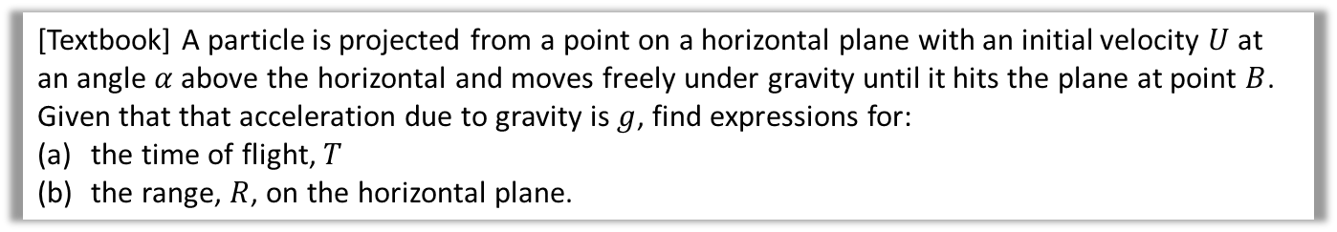

Projectile Formulae
There’s nothing new here, but you may be asked to prove more general results regarding projectile motion.
[Textbook] A particle is projected from a point on a horizontal plane with an initial velocity $U$ at an angle $α$ above the horizontal and moves freely under gravity until it hits the plane at point $B$.
Given that that acceleration due to gravity is $g$, find expressions for:
the time of flight, $T$
the range, $R$, on the horizontal plane.
a
?
$$R\left(↑\right): s=0, u=U\sin{α}, v= ,a=−g,t=? \\ s=ut+\frac{1}{2}at^{2} \\ 0=\left(U\sin{α}\right)t−\frac{1}{2}gt^{2}=t\left(U\sin{α}−\frac{1}{2}gt\right) \\ t=0 (at A) or t=\frac{2U\sin{α}}{g}$$
$$R\left(→\right): R=U\cos{α}×\frac{2U\sin{α}}{g}=\frac{2U^{2}}{g}\sin{α}cos{α} \\ R=\frac{U^{2}\sin{2α}}{g}$$
b
?
Using double-angle formula for $sin$

Slide 16

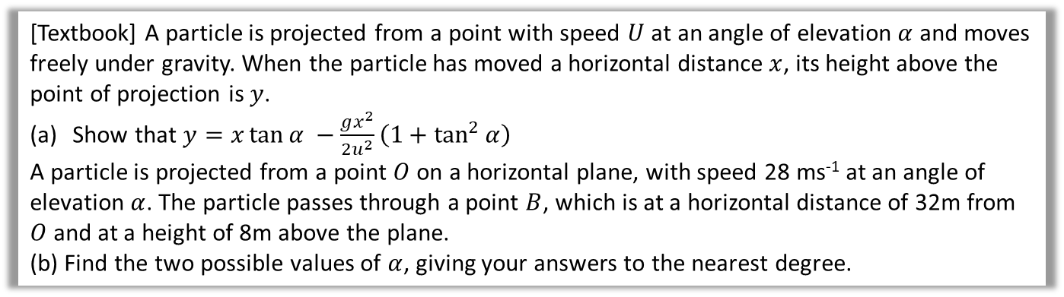
Projectile Formulae
[Textbook] A particle is projected from a point with speed $U$ at an angle of elevation $α$ and moves freely under gravity. When the particle has moved a horizontal distance $x$, its height above the point of projection is $y$.
Show that $y=x\tan{α −\frac{gx^{2}}{2u^{2}}\left(1+\tan^{2}{α}\right)}$
A particle is projected from a point $O$ on a horizontal plane, with speed 28 ms⁻¹ at an angle of elevation $α$. The particle passes through a point $B$, which is at a horizontal distance of 32m from $O$ and at a height of 8m above the plane.
(b) Find the two possible values of $α$, giving your answers to the nearest degree.
a
?
$R\left(→\right): x=U\cos{α}×t (1)$
$$R\left(↑\right): s=ut+\frac{1}{2}at^{2} \\ y=U\sin{α}×t−\frac{1}{2}gt^{2} (2)$$
The target equation doesn’t contain $t$, so much $t$ the subject of $(1)$ and substitute into $(2)$:
$$t=\frac{x}{U\cos{α}} ⇒ y=U\sin{α} \left(\frac{x}{U\cos{α}}\right)−\frac{1}{2}g{\left(\frac{x}{U\cos{α}}\right)}^{2} \\ =x\tan{α}−\frac{gx^{2}}{2U^{2}}\sec^{2}{α} \\ =x\tan{α −\frac{gx^{2}}{2u^{2}}\left(1+\tan^{2}{α}\right)}$$
Don’t be intimidated by the lack of numerical values. Just do what you’d usually do and resolve both vertically and horizontally!

Slide 17




Projectile Formulae
[Textbook] A particle is projected from a point with speed $U$ at an angle of elevation $α$ and moves freely under gravity. When the particle has moved a horizontal distance $x$, its height above the point of projection is $y$.
Show that $y=x\tan{α −\frac{gx^{2}}{2u^{2}}\left(1+\tan^{2}{α}\right)}$
A particle is projected from a point $O$ on a horizontal plane, with speed 28 ms⁻¹ at an angle of elevation $α$. The particle passes through a point $B$, which is at a horizontal distance of 32m from $O$ and at a height of 8m above the plane.
(b) Find the two possible values of $α$, giving your answers to the nearest degree.
b
?
$y =x\tan{α −\frac{gx^{2}}{2u^{2}}\left(1+\tan^{2}{α}\right)}$
$$8=32\tan{α}−6.4\left(1+\tan^{2}{α}\right)$$
This is quadratic in $\tan{α}$:
$$6.4\tan^{2}{α}−32\tan{α+14.4=0} \\ 4\tan^{2}{α}−20\tan{α}+9=0 \\ \left(2\tan{α}−1\right)\left(2\tan{α}−9\right)=0 \\ \tan{α=\frac{1}{2},\frac{9}{2}} \\ α=27°, 77°$$
This is an interesting result, because in general, for a fixed initial speed, there are 2 (and only 2) angles which result in a specified (reachable) point being passed.
$$y$$
$$B$$
$$x$$

Slide 18
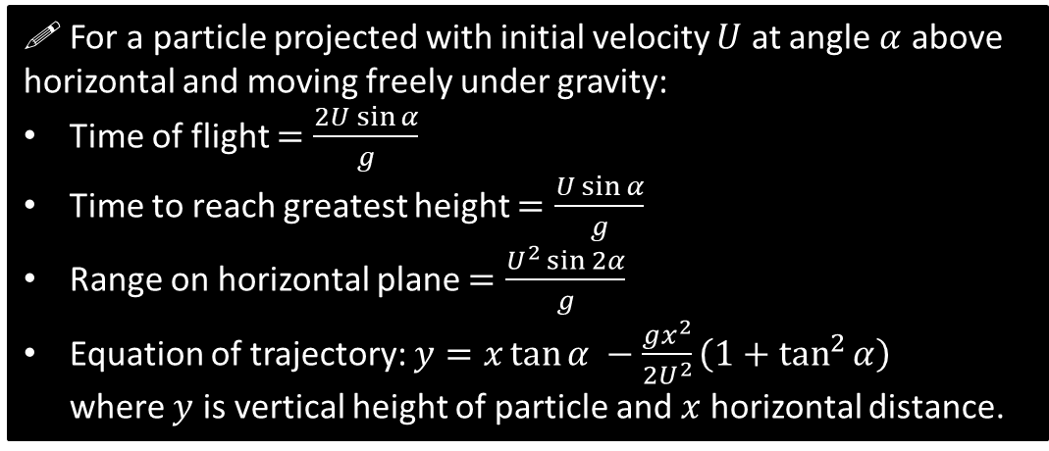
General Results
Exam Note: You may be asked to derive these. But don’t attempt to memorise them or actually use them to solve exam problems – instead use the techniques used earlier in the chapter.
! For a particle projected with initial velocity $U$ at angle $α$ above horizontal and moving freely under gravity:
Time of flight $=\frac{2U\sin{α}}{g}$
Time to reach greatest height $=\frac{U\sin{α}}{g}$
Range on horizontal plane $=\frac{U^{2}\sin{2α}}{g}$
Equation of trajectory: $y=x\tan{α −\frac{gx^{2}}{2U^{2}}\left(1+\tan^{2}{α}\right)}$
where $y$ is vertical height of particle and $x$ horizontal distance.

Slide 19
Exercise 6D
Pearson Stats/Mechanics Year 2
Pages 123-125
Complete before the lesson Q1
In Class:
Green Q2-4
Amber Q4-5
Red Q6-8 & Challenge

