Slide 1

P1 Chapter 4 :: Graphs & Transformations
jfrost@tiffin.kingston.sch.uk
www.drfrostmaths.com
@DrFrostMaths
Last modified: 23rd July 2018

Slide 2








www.drfrostmaths.com
Everything is completely free.
Why not register?
Register now to interactively practise questions on this topic, including past paper questions and extension questions (including MAT + UKMT).
Teachers: you can create student accounts (or students can register themselves), to set work, monitor progress and even create worksheets.
With questions by:
Dashboard with points, trophies, notifications and student progress.
Questions organised by topic, difficulty and past paper.
Teaching videos with topic tests to check understanding.

Slide 3
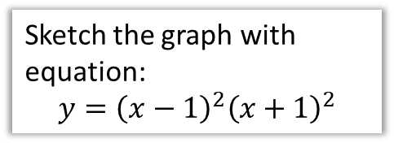
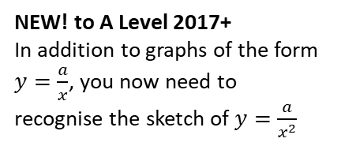
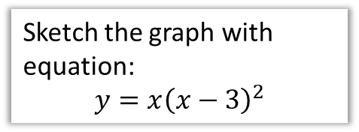
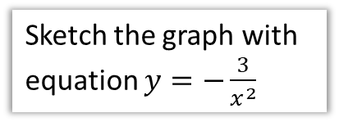
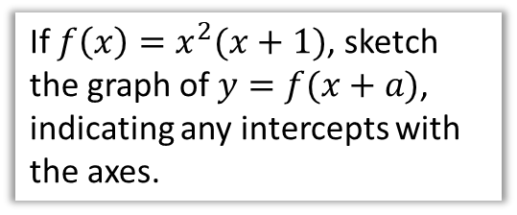
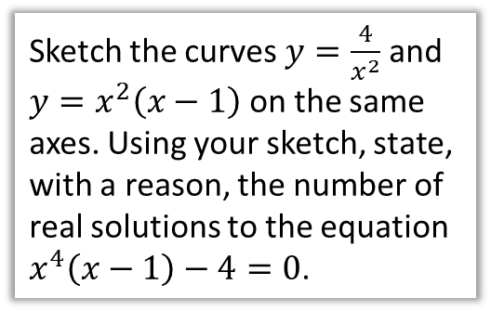
Chapter Overview
There are a few new bits and pieces since GCSE!
1a:: Cubic Graphs
1b:: Quartic Graphs
1c:: Reciprocal Graphs
Sketch the graph with equation:
$$y=x{\left(x−3\right)}^{2}$$
Sketch the graph with equation:
$$y={\left(x−1\right)}^{2}{\left(x+1\right)}^{2}$$
Sketch the graph with equation $y=−\frac{3}{x^{2}}$
NEW! to A Level 2017+
The old A Level only included cubic graphs, not quartics.
NEW! to A Level 2017+
In addition to graphs of the form $y=\frac{a}{x}$, you now need to recognise the sketch of $y=\frac{a}{x^{2}}$
2:: Points of Intersection
3:: Graph Transformations
Sketch the curves $y=\frac{4}{x^{2}}$ and $y=x^{2}\left(x−1\right)$ on the same axes. Using your sketch, state, with a reason, the number of real solutions to the equation $x^{4}\left(x−1\right)−4=0$.
If $f\left(x\right)=x^{2}(x+1)$, sketch the graph of $y=f(x+a)$, indicating any intercepts with the axes.
NEW! since GCSE
The GCSE 2015+ syllabus included translations of graphs but not stretches.

Slide 4
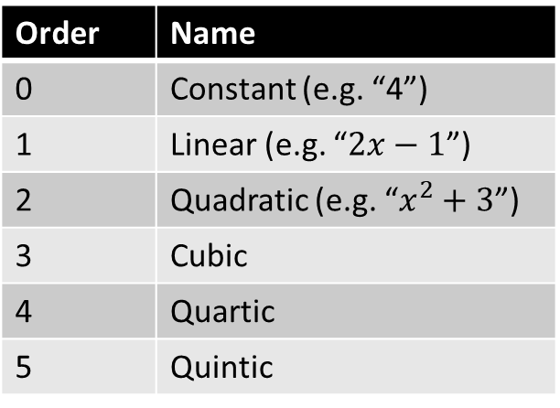
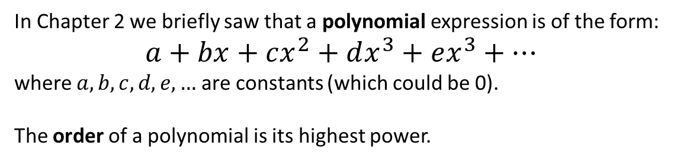
Polynomial Graphs
In Chapter 2 we briefly saw that a polynomial expression is of the form:
$$a+bx+cx^{2}+dx^{3}+ex^{3}+…$$
where $a,b,c,d,e,…$ are constants (which could be 0).
The order of a polynomial is its highest power.
Order | Name
0 | Constant (e.g. “4”)
1 | Linear (e.g. “$2x−1$”)
2 | Quadratic (e.g. “$x^{2}+3$”)
3 | Cubic
4 | Quartic
5 | Quintic
These are covered in Chapter 5.
?
Chapter 2 explored the graphs for these.
?
?
We will cover these now.
?
?
While these are technically beyond the A Level syllabus, we will look at how to sketch polynomials in general.

Slide 5
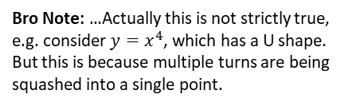

Polynomial Graphs
What property connects the order of the polynomial and the shape?
The number of ‘turns’ is one less than the order, e.g. a cubic has 2 ‘turns’, a quartic 3 ‘turns’.
Order:
?
2
Bro Note: …Actually this is not strictly true, e.g. consider $y=x^{4}$, which has a U shape. But this is because multiple turns are being squashed into a single point.
In Chapter 2 how did we tell what way up a quadratic is, and why does this work?
For a quadratic $y=ax^{2}+bx+c$, i.f. $a>0$, we had a ‘valley’ shape. This is because if $x$ was a large positive value, $ax^{2}$ would be large and positive, thus the graph’s $y$ value tends towards infinity.
We would write:
“As $x→∞, y→∞$” where “$→$” means “tends towards”.
?
3
4

Slide 6



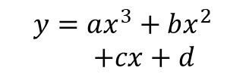




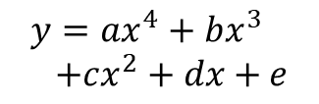

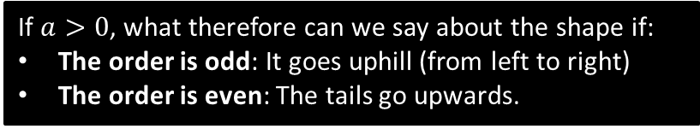




Polynomial Graphs
e.g. If $y=2x^{2}+3$, try a large positive value like $x=1000$. We can see we’d get a large positive $y$ value. Thus as $x→∞$, $y→∞$
Resulting Shape
Resulting Shape
Equation
If $a>0$
If $a<0$
$$y=ax^{2}+bx+c$$
As $x→∞, y→∞$
As $x→−∞, y→∞$
As $x→∞, y→−∞$
As $x→−∞, y→−∞$
?
?
$$y=ax^{3}+bx^{2}$$
$+cx+d$
As $x→∞, y→∞$
As $x→−∞, y→−∞$
As $x→∞, y→−∞$
As $x→−∞, y→∞$
$$y=ax^{4}+bx^{3} \\ +cx^{2}+dx+e$$
?
?
As $x→∞, y→∞$
As $x→−∞, y→∞$
As $x→∞, y→−∞$
As $x→−∞, y→−∞$
?
?
As $x→∞, y→−∞$
As $x→−∞, y→∞$
$$y=ax^{5}+bx^{4}+…$$
As $x→∞, y→∞$
As $x→−∞, y→−∞$
If $a>0$, what therefore can we say about the shape if:
The order is odd: It goes uphill (from left to right)
The order is even: The tails go upwards.
?
(And we have the opposite if $a<0$)
?

Slide 7



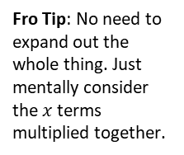

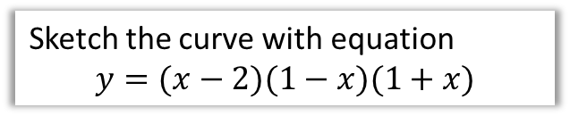

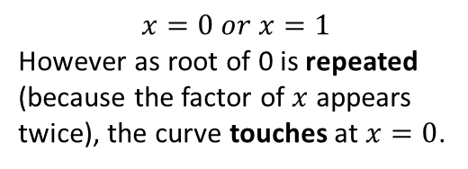

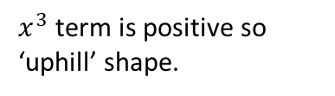



Cubics
Sketch the curve with equation
$$y=(x−2)(1−x)(1+x)$$
Sketch the curve with equation
$$y=x^{2}(x−1)$$
Features you must consider:
Shape?
$x^{3}$ term is positive so ‘uphill’ shape.
Fro Tip: No need to expand out the whole thing. Just mentally consider the $x$ terms multiplied together.
?
Shape?
?
If we expanded, $x^{3}$ term would be negative, so ‘downhill’ shape.
Roots?
$$x=0 or x=1$$
However as root of 0 is repeated (because the factor of $x$ appears twice), the curve touches at $x=0$.
?
Roots?
If $y=0$, $x=2, 1 or −1$
?
This is sort of because the curve crosses at 0 then immediately crosses at 0 again!
$y$-intercept?
?
If $x=0,$ $y=−2$
$y$-intercept?
?
If $x=0, y=0$
$$y$$
? Final sketch
$$y$$
? Final sketch
-1
1
2
$$x$$
1
$$x$$
-2
Fro Tip: It’s incredibly easy to forget to write in one of the intercepts. So don’t!

Slide 8







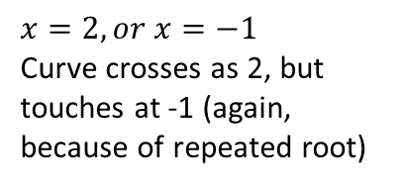
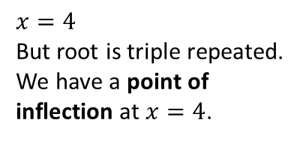
Cubics
Sketch the curve with equation
$$y=\left(2−x\right){\left(x+1\right)}^{2}$$
Sketch the curve with equation
$$y={\left(x−4\right)}^{3}$$
Downhill.
Shape?
?
Uphill.
Shape?
?
Roots?
$$x=2, or x=−1$$
Curve crosses as 2, but touches at -1 (again, because of repeated root)
?
Roots?
$$x=4$$
But root is triple repeated.
We have a point of inflection at $x=4$.
?
?
$y$-intercept?
2
$y$-intercept?
-64
?
? Final sketch
? Final sketch
$$y$$
Fro Exam Notes: The term ‘point of inflection’ has been removed from the new A Level syllabus (bad idea!!).
You might be able to see we get this shape at $x=4$ because as the root is triple repeated, the curve crosses at 4, then crosses again, then crosses again, hence ending up in the same direction and the line becoming momentarily horizontal.
A point of inflection is where the curve goes from ‘convex’ to ‘concave’ (or vice versa), i.e. curves in one direction before and curves in another direction after. You might have encountered these terms in Physics.
$$y$$
2
-1
2
$$x$$
$$x$$
4
-64

Slide 9


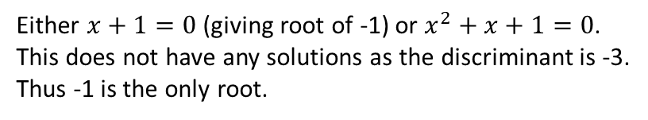
Cubics with Limited Roots
Sketch the curve with equation
$$y=\left(x+1\right)\left(x^{2}+x+1\right)$$
Uphill.
Shape?
?
Either $x+1=0$ (giving root of -1) or $x^{2}+x+1=0$.
This does not have any solutions as the discriminant is -3.
Thus -1 is the only root.
Roots?
?
?
$y$-intercept?
1
? Final sketch
We don’t have enough information to determine the exact shape. It could for example have been:
$$y$$
However, in Chapter 12, we’ll be able to work turning points using ‘differentiation’, and hence conclude that it doesn’t have any!
1
$$y$$
-1
$$x$$
1
-1
$$x$$

Slide 10
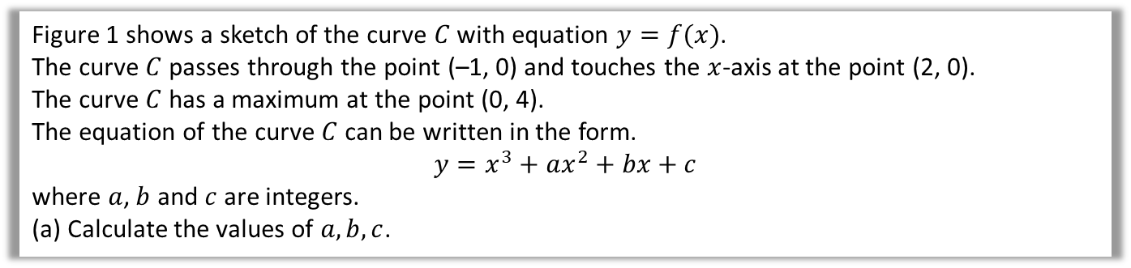

Finding the equation yourself
Edexcel C1 May 2013(R) Q9
Figure 1 shows a sketch of the curve $C$ with equation $y=f(x)$.
The curve $C$ passes through the point (–1, 0) and touches the $x$-axis at the point (2, 0).
The curve $C$ has a maximum at the point (0, 4).
The equation of the curve $C$ can be written in the form.
$$y=x^{3}+ax^{2}+bx+c$$
where $a$, $b$ and $c$ are integers.
(a) Calculate the values of $a,b,c$.
?
If it crosses at $\left(−1,0\right)$ we must have $(x+1)$.
If it touches at $\left(2,0\right)$ we must have ${\left(x−2\right)}^{2}$
$$∴ y={\left(x−2\right)}^{2}\left(x+1\right) \\ =\left(x^{2}−4x+4\right)\left(x+1\right) \\ =x^{3}+x^{2}−4x^{2}−4x+4x+4 \\ =x^{3}−3x^{2}+4 \\ ∴a=−3, b=0, c=4$$

Slide 11
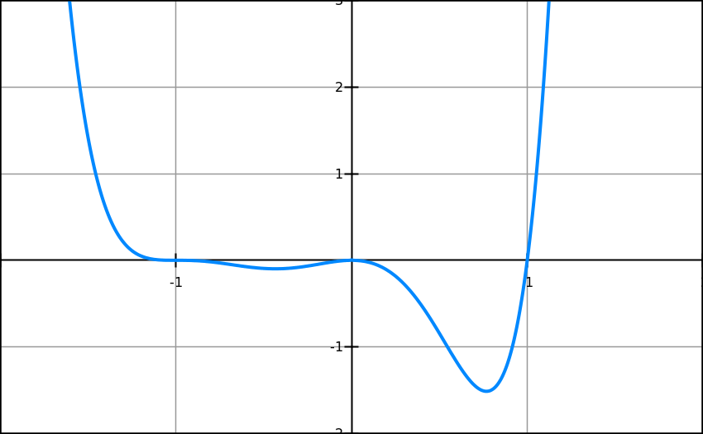



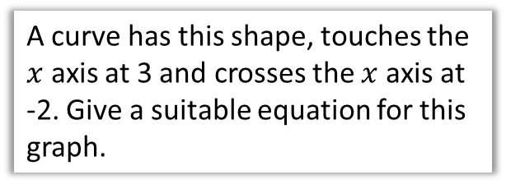

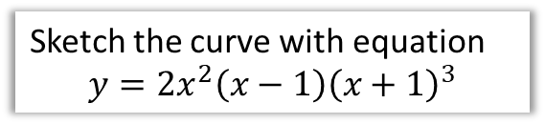

Test Your Understanding
3
A curve has this shape, touches the $x$ axis at 3 and crosses the $x$ axis at -2. Give a suitable equation for this graph.
1
Sketch the curve with equation
$$y=x{\left(x−3\right)}^{2}$$
?
$$y$$
?
$$y={\left(x−3\right)}^{2}\left(x+2\right)$$
N
Sketch the curve with equation
$$y=2x^{2}\left(x−1\right){\left(x+1\right)}^{3}$$
3
$$x$$
?
Point of inflection
Touches
$x$-axis
Crosses
$x$-axis
2
Sketch the curve with equation
$$y=−{\left(x+2\right)}^{3}$$
$$y$$
?
-2
$$x$$
(I took this question from my Riemann Zeta Club materials:
www.drfrostmaths.com/rzc )
[end shameless plug]
-8

Slide 12
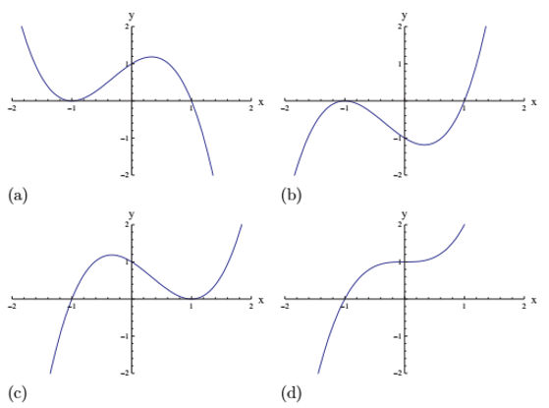
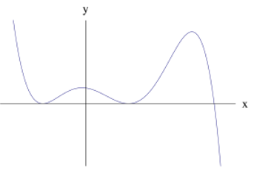
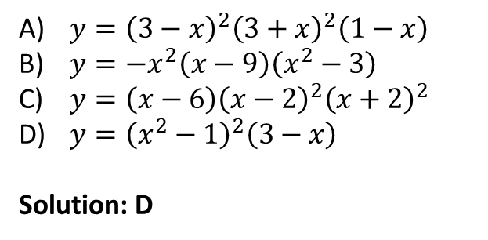
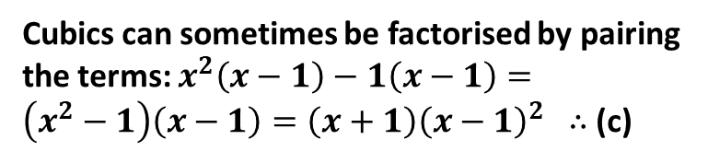
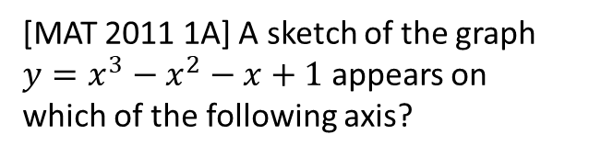
Exercise 4A
Complete before the lesson Q1-2 a-d only
Green Q3-4
Amber Q5
Red Q6-7
Pearson Pure Mathematics Year 1/AS Pages 62-63
Extension
2
[MAT 2011 1A] A sketch of the graph $y=x^{3}−x^{2}−x+1$ appears on which of the following axis?
1
[MAT 2012 1E] Which one of the following equations could possibly have the graph given below?
(a)
(b)
$y={\left(3−x\right)}^{2}{\left(3+x\right)}^{2}\left(1−x\right)$
$y=−x^{2}\left(x−9\right)\left(x^{2}−3\right)$
$y=\left(x−6\right){\left(x−2\right)}^{2}{\left(x+2\right)}^{2}$
$y={\left(x^{2}−1\right)}^{2}\left(3−x\right)$
Solution: D
(c)
(d)
?
Cubics can sometimes be factorised by pairing the terms: $x^{2}\left(x−1\right)−1\left(x−1\right)=\left(x^{2}−1\right)\left(x−1\right)=\left(x+1\right){\left(x−1\right)}^{2}$ $∴$ (c)
?

Slide 13







Recap
If we sketched $y=\left(x−a\right){\left(x−b\right)}^{2}{\left(x−c\right)}^{3}$ what happens on the $x$-axis at:
$x=a$: The line crosses the axis.
$x=b$: The line touches the axis.
$x=c$: Point of inflection on the axis.
?
$$x$$
$$a$$
?
$$x$$
$$b$$
?
$$x$$
$$c$$

Slide 14
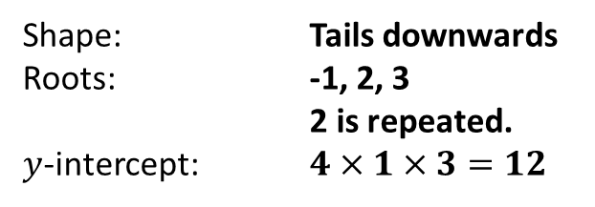
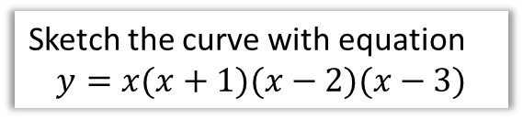
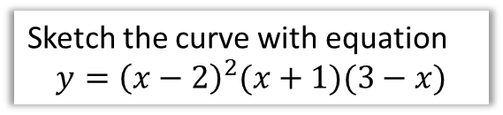
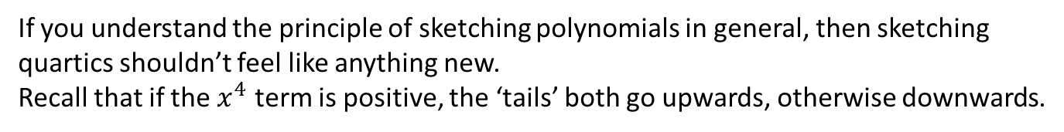
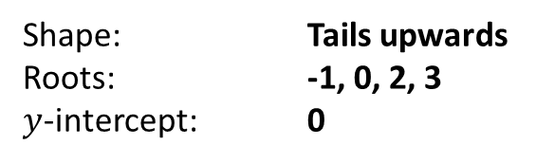
Quartics
If you understand the principle of sketching polynomials in general, then sketching quartics shouldn’t feel like anything new.
Recall that if the $x^{4}$ term is positive, the ‘tails’ both go upwards, otherwise downwards.
Sketch the curve with equation
$$y=x(x+1)(x−2)(x−3)$$
Sketch the curve with equation
$$y={\left(x−2\right)}^{2}(x+1)(3−x)$$
Shape: Tails upwards
Roots: -1, 0, 2, 3
$y$-intercept: 0
Shape: Tails downwards
Roots: -1, 2, 3
2 is repeated.
$y$-intercept: $4×1×3=12$
?
?
?
?
?
?
$$y$$
?
?
$$y$$
12
-1
2
3
$$x$$
-1
2
3
$$x$$

Slide 15


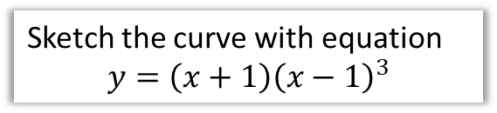
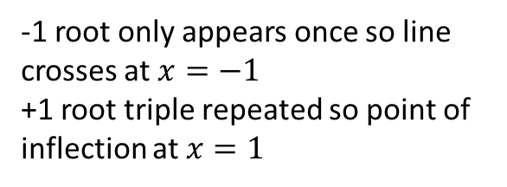
Quartics
Sketch the curve with equation
$$y=\left(x+1\right){\left(x−1\right)}^{3}$$
Sketch the curve with equation
$$y={\left(x−2\right)}^{4}$$
-1 root only appears once so line crosses at $x=−1$
+1 root triple repeated so point of inflection at $x=1$
2 is a quadruple repeated root! Because the line effectively crosses the axis 4 times all at -2, it ends up in the opposite direction, and hence looks like a ‘touch’ point.
?
$$y$$
?
$$y$$
16
2
$$x$$
-1
1
$$x$$
-1

Slide 16
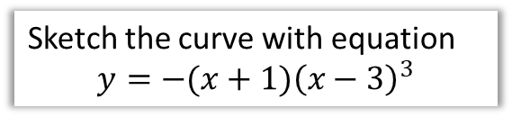
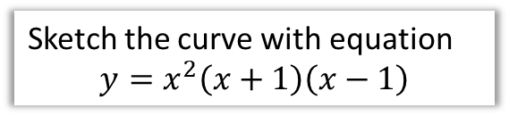

Test Your Understanding
Sketch the curve with equation
$$y=x^{2}\left(x+1\right)\left(x−1\right)$$
Sketch the curve with equation
$$y=−(x+1){\left(x−3\right)}^{3}$$
?
?
$$y$$
$$y$$
27
-1
1
$$x$$
-1
3
$$x$$

Slide 17
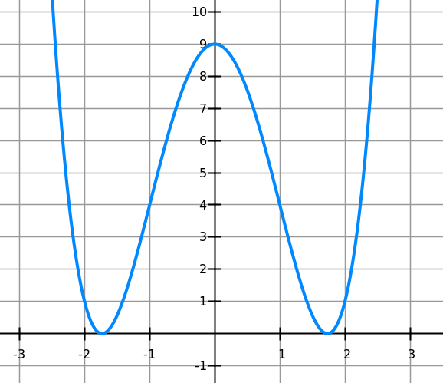
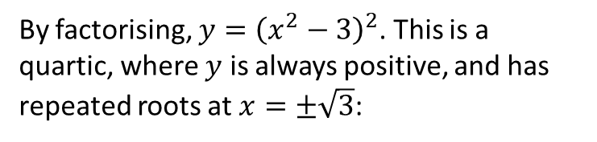
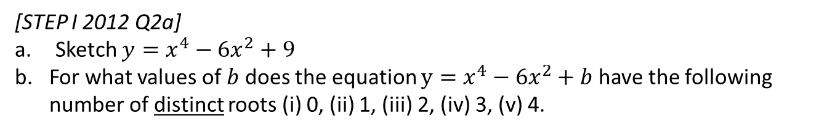

Exercise 4B
Complete before the lesson Q1 a-d only
Green Complete Q1
Amber Q2-3
Red Q4 & Challenge
Pearson Pure Mathematics Year 1/AS
Pages 65-66
Extension
[STEP I 2012 Q2a]
Sketch $y=x^{4}−6x^{2}+9$
For what values of $b$ does the equation $y=x^{4}−6x^{2}+b$ have the following number of distinct roots (i) 0, (ii) 1, (iii) 2, (iv) 3, (v) 4.
1
a)
By factorising, $y={\left(x^{2}−3\right)}^{2}$. This is a quartic, where $y$ is always positive, and has repeated roots at $x=±\sqrt{3}$:
b)
By changing $b$, we shift the graph up and down. Then we can see that:
0 roots: When $b>9$
1 root: Not possible.
2 roots: When $b=9 or b<0$
3 roots: $b=0$
4 roots: $0<b<9$
?
?
?
?
?
?

Slide 18
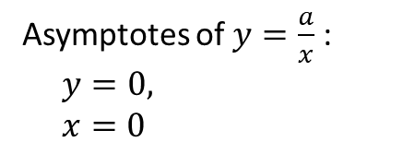

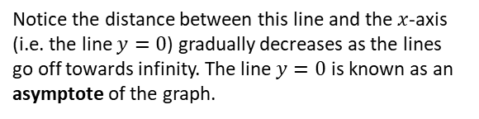

GCSE RECAP :: Reciprocal Graphs
Sketch $y=\frac{1}{x}$
Sketch $y=−\frac{3}{x}$
?
?
$$y$$
$$y$$
Fro Note: The scaling caused by the 3 isn’t observable for this graph in isolation because the axes have no scale. This will only be observation for multiple graphs on the same axes.
$$x$$
$$x$$
Notice the distance between this line and the $x$-axis (i.e. the line $y=0$) gradually decreases as the lines go off towards infinity. The line $y=0$ is known as an asymptote of the graph.
! An asymptote is a line which the graph approaches but never reaches.
Asymptotes of $y=\frac{a}{x}$ :
$y=0,$
$x=0$
?

Slide 19


Reciprocal Graphs
This is new to the A Level 2017 syllabus.
Sketch $y=\frac{3}{x^{2}}$
Sketch $y=−\frac{4}{x^{2}}$
?
?
$$y$$
$$y$$
$$x$$
$$x$$
Hint: Note that anything squared will always be at least 0.

Slide 20

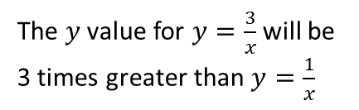


Reciprocal Graphs
On the same axes, sketch $y=\frac{1}{x}$ and $y=\frac{3}{x}$
?
$$y$$
$$y=\frac{3}{x}$$
The $y$ value for $y=\frac{3}{x}$ will be 3 times greater than $y=\frac{1}{x}$
$$y=\frac{1}{x}$$
$$x$$

Slide 21
Exercise 4C
Pearson Pure Mathematics Year 1/AS
Page 67
Complete before the lesson Q1
Green Q2

Slide 22




Points of Intersection
In the previous chapter we saw why the points of intersection of two graphs gave the solutions to the simultaneous equations corresponding to these graphs.
If $y=f(x)$ and $y=g(x)$, then the $x$ values of the points of intersection can be found when $f\left(x\right)=g(x)$.
Example: On the same diagram sketch the curves with equations $y=x(x−3)$ and $y=x^{2}\left(1−x\right)$. Find the coordinates of their points of intersection.
?
$$y$$
$$x\left(x−3\right)=x^{2}\left(1−x\right) \\ x^{2}−3x=x^{2}−x^{3} \\ x^{3}−3x=0 \\ x\left(x^{2}−3\right)=0$$
$x=0$ or $x=−\sqrt{3}$ or $x=+\sqrt{3}$
Substituting these values back into either equation, we obtain points:
$$\left(−\sqrt{3}, 3+3\sqrt{3}\right), \\ \left(0,0\right), \\ \left(\sqrt{3}, 3−3\sqrt{3}\right)$$
Froflections: Cubics generally have 3 solutions. And this seems good news as we have 3 points of intersection.
$$y=x^{2}\left(1−x\right)$$
$$y=x\left(x−3\right)$$
1
3
$$x$$
Fro Tip: A classic mistake is to divide by $x$ to get $x^{2}−3=0$. NEVER divide an equation by a variable, because you lose a solution. Always factorise.

Slide 23







Further example involving unknown constants
On the same diagram sketch the curves with equations $y=x^{2}\left(3x−a\right)$ and $y=\frac{b}{x}$, where $a,b$ are positive constants. State, giving a reason, the number of real solutions to the equation $x^{2}\left(3x−a\right)−\frac{b}{x}=0$
?
If the points of intersection are given by:
$$x^{2}\left(3x−a\right)=\frac{b}{x}$$
then clearly:
$$x^{2}\left(3x−a\right)−\frac{b}{x}=0$$
There are 2 points of intersection, thus 2 solutions to this equation.
$$y$$
$$y=x^{2}\left(3x−a\right)$$
$$y=\frac{b}{x}$$
$$x$$
$$\frac{a}{3}$$
Fro Note: Note that the question is asking for the number of solutions, not the solutions themselves. We’d have to solve a quartic, with roots in terms of $a$ and $b$. While there is a ‘quartic formula’ (like the quadratic formula), it is absolutely horrific.
If $x^{2}\left(3x−a\right)=0$ then $x=0$ or $x=\frac{a}{3}$
We were told that $a$ is positive, thus this latter root is positive.

Slide 24




Test Your Understanding
On the same diagram sketch the curves with equations $y=x(x−4)$ and $y=x{\left(x−2\right)}^{2}$, and hence find the coordinates of any points of intersection.
?
$$y$$
Looking at the diagram we expect that $\left(0,0\right)$ will be the only point of intersection (as the cubic will rise more rapidly than the quadratic). But we need to show this algebraically.
$$x{\left(x−2\right)}^{2}=x\left(x−4\right) \\ x\left(x^{2}−4x+4\right)=x^{2}−4x \\ x^{3}−4x^{2}+4x=x^{2}−4x \\ x^{3}−5x^{2}+8x=0 \\ x\left(x^{2}−5x+8\right)=0$$
Thus $x=0$ giving $(0,0)$.
But the discriminant of $x^{2}−5x+8$ is -7, thus there are no further solutions to this equation.
$$y=x{\left(x−2\right)}^{2}$$
2
4
$$x$$
$$y=x\left(x−4\right)$$
Hint: Remember you can use the discriminant to reason about the number of solutions of a quadratic.

Slide 25





Exercise 4D
Pearson Pure Mathematics Year 1/AS, Pages 69-71
2
[MAT 2010 1A] The values of $k$ for which the line $y=kx$ intersects the parabola $y={\left(x−1\right)}^{2}$ are precisely
$k≤0$ B) $k≥−4$
C) $k≥0$ or $k≤−4$ D) $−4≤k≤0$
Equating:
$${\left(x−1\right)}^{2}=kx \\ x^{2}−2x+1=kx \\ x^{2}+\left(−2−k\right)x+1=0$$
Discriminant:
$$a=1, b=−2−k, c=1 → k^{2}+4k+4−4≥0 \\ k\left(k+4\right)≥0 \\ k≤−4 or k≥0$$
Extension
?
1
[MAT 2005 1B]
The equation ${\left(x^{2}+1\right)}^{10}=2x−x^{2}−2$
has $x=2$ as a solution;
has no real solutions;
has an odd number of real solutions;
has twenty real solutions.
3
[MAT 2013 1D]
Which of the following sketches is a graph of $x^{4}−y^{2}=2y+1$?
Complete before the lesson
Q1
Green Q2-4
Amber Q5-8
Red Q9-10 & Ext
?
$$x^{4}=y^{2}+2y+1={\left(y+1\right)}^{2} \\ ∴x^{2}=±(y+1)$$
i.e. $y=x^{2}−1$
$$or y=−x^{2}−1$$
Answer is (b).

Slide 26


Exercise 4D
Pearson Pure Mathematics Year 1/AS, Pages 69-71
2
[MAT 2010 1A] The values of $k$ for which the line $y=kx$ intersects the parabola $y={\left(x−1\right)}^{2}$ are precisely
$k≤0$ B) $k≥−4$
C) $k≥0$ or $k≤−4$ D) $−4≤k≤0$
Equating:
$${\left(x−1\right)}^{2}=kx \\ x^{2}−2x+1=kx \\ x^{2}+\left(−2−k\right)x+1=0$$
Discriminant:
$$a=1, b=−2−k, c=1 → k^{2}+4k+4−4≥0 \\ k\left(k+4\right)≥0 \\ k≤−4 or k≥0$$
Extension
?
1
[MAT 2005 1B]
The equation ${\left(x^{2}+1\right)}^{10}=2x−x^{2}−2$
has $x=2$ as a solution;
has no real solutions;
has an odd number of real solutions;
has twenty real solutions.
To sketch $y={\left(x^{2}+1\right)}^{10}$, sketch $y=x^{2}+1$, then realise that as $x^{2}+1$ is always at least 1, raising it to a positive power (>1) makes it go up more steeply. $2x−x^{2}−2$ we can sketch by completing the square, where we realise it is always negative.
The answer is B.
?
3
[MAT 2013 1D]
Which of the following sketches is a graph of $x^{4}−y^{2}=2y+1$?
?
$$x^{4}=y^{2}+2y+1={\left(y+1\right)}^{2} \\ ∴x^{2}=±(y+1)$$
i.e. $y=x^{2}−1$
$$or y=−x^{2}−1$$
Answer is (b).

Slide 27











Transformations of Functions
Suppose $f\left(x\right)=x^{2}$
?
Then $f\left(x+2\right)={\left(x+2\right)}^{2}$
Sketch $y=f\left(x\right)$:
Sketch $y=f(x+2)$
We know $y={\left(x+2\right)}^{2}$ has a root of -2 where the graph touches.
?
?
$$y$$
y
$$y = x2$$
$$y = (x+2)2$$
x
$$x$$
-2
The graph has been translated by $\left(\begin{matrix}−2 \\ 0\end{matrix}\right)$, i.e. we have subtracted 2 from each $x$ value.
What do you notice about the relationship between the graphs of $y=f\left(x\right)$ and $y=f\left(x+2\right)$?
?

Slide 28












Transformations of Functions
This is all you need to remember when considering how transforming your function transforms your graph...
!
Affects which axis?
What we expect or opposite?
Change inside $f( )$
?
$$x$$
?
Opposite
$$y$$
Change outside $f( )$
?
?
What we expect
Therefore...
Translation by $\left(\begin{matrix}3 \\ 0\end{matrix}\right)$
$$y=f\left(x−3\right)$$
?
$$y=f\left(x\right)+4$$
Translation by $\left(\begin{matrix}0 \\ 4\end{matrix}\right)$
?
$$y=f\left(5x\right)$$
Stretch in $x$-direction by scale factor $\frac{1}{5}$
?
$$y=2f\left(x\right)$$
Stretch in $y$-direction by scale factor 2
?

Slide 29









Sketching transformed graphs
Sketch $y=x^{2}+3$
Sketch $y=\frac{2}{x+1}$
?
?
If $y=x^{2}$, the +3 is ‘outside’ the squared function, so translation of $\left(\begin{matrix}0 \\ 3\end{matrix}\right)$.
Imagine a sketch of $y=x^{2}$ and then do the translation, ensuring you adjust any intercepts with the axes.
This looks like a reciprocal function $y=\frac{2}{x}$.
The change of +1 is inside the reciprocal function, so we have a translation to the left by 1.
$$y$$
The transformation might result in new intercepts or roots. You can find these in the usual way. Do not forget them!
y
$$x=−1$$
$$y=x^{2}+3$$
2
$$x$$
3
The asymptotes were previously $x=0$ and $y=0$. The latter is unaffected but the former is now $x=−1$.
x
Draw asymptotes using a dotted line and write its equation on it.

Slide 30
















More Examples
Sketch $y=x(x+2)$. On the same axes, sketch $y=\left(x−a\right)\left(x−a+2\right)$, where $a>2$.
Sketch $y=x^{2}\left(x−4\right)$. On the same axes, sketch the graph with equation
$$y={\left(2x\right)}^{2}\left(2x−4\right)$$
The input $x$ has been replaced with $x−a$, i.e. a change inside the function. We translate right by $a$. The significance of $a>2$ is that the original root of -2 will now be positive.
The input $x$ has been doubled to $2x$, again a change inside the function, so we do the opposite and halve the $x$ values.
Ensure that 0 remains 0 and you halve any roots.
?
?
$$y$$
$$y$$
$$y=x\left(x+2\right)$$
$$y=\left(x−a\right)\left(x−a+2\right)$$
$$y=x^{2}\left(x−4\right)$$
$$y={\left(2x\right)}^{2}\left(2x−4\right)$$
$$−a\left(−a+2\right)$$
$$a$$
$$x$$
$$x$$
-2
$$a−2$$
2
4
Note that our intercepts are in terms of $a$.

Slide 31





Reflections of Graphs
If $y=x(x+2)$, sketch $y=f(x)$ and $y=−f(x)$ on the same axes.
?
You did this at GCSE. The minus is outside the function, so affects the output, i.e. the $y$ value.
The $y$ values are negated, resulting in a reflection in the $x$-axis.
$$y$$
$$y=f\left(x\right)$$
$$y=−f\left(x\right)$$
$$x$$
-2

Slide 32










Test Your Understanding
If $y=(x+1)(x−2)$, sketch $y=f(x)$ and $y=f(\frac{x}{3})$ on the same axes.
Sketch the graph of $y=\frac{2}{x}+1$, ensuring you indicate any intercepts with the axes.
?
?
$$y$$
$$y$$
$$y=f(x)$$
$$y=1$$
$$y=f\left(\frac{x}{3}\right)$$
-3
-1
2
6
$$x$$
-2
$$x$$
-2
To get this new root:
$$\frac{2}{x}+1=0 \\ \frac{2}{x}=−1 → x=\frac{2}{−1}=−2$$

Slide 33
Exercise 4E/4F
Pearson Pure Mathematics Year 1/AS
Pages 74-75 (translations), 78 (stretches/reflections)
Complete before the lesson Q1 from Ex4E & F
Green Q2-6 on both
Amber Q7&8 on both
Red complete both and Challenges

Slide 34

Effect of transformation on specific points
Sometimes you will not be given the original function, but will be given a sketch with specific points and features you need to transform.
Where would each of these points end up?
$$y=f\left(x\right)$$ | $$\left(4,3\right)$$ | $$\left(1,0\right)$$ | $$\left(6,−4\right)$$
$$y=f\left(x+1\right)$$ | $$\left(3,3\right)$$ | $$\left(0,0\right)$$ | $$\left(5,−4\right)$$
$$y=f\left(2x\right)$$ | $$\left(2,3\right)$$ | $$\left(0.5, 0\right)$$ | $$\left(3, −4\right)$$
$$y=3f\left(x\right)$$ | $$\left(4,9\right)$$ | $$\left(1,0\right)$$ | $$\left(6,−12\right)$$
$$y=f\left(x\right)−1$$ | $$\left(4,2\right)$$ | $$\left(1,−1\right)$$ | $$\left(6,−5\right)$$
$$y=f\left(\frac{x}{4}\right)$$ | $$\left(16,3\right)$$ | $$\left(4,0\right)$$ | $$\left(24,−4\right)$$
$$y=f\left(−x\right)$$ | $$\left(−4,3\right)$$ | $$\left(−1,0\right)$$ | $$\left(−6,−4\right)$$
$$y=−f\left(x\right)$$ | $$\left(4,−3\right)$$ | $$\left(1,0\right)$$ | $$\left(6,4\right)$$
?
?
?
?
?
?
?
?
?
?
?
?
?
?
?
?
?
?
?
?
?

Slide 35


Test Your Understanding
Edexcel C1 May 2012 Q10
?
?
?
?

Slide 36
Exercise 4G
Pearson Pure Mathematics Year 1/AS
Pages 80-81
Complete before the lesson Q1,2 & 4
Green Q5
Amber Q6

