Slide 1
Year 1 Applied Mathematics
Modelling in Mechanics
- Assumptions
Chapter 8
(Part 2 of 4)

Slide 2
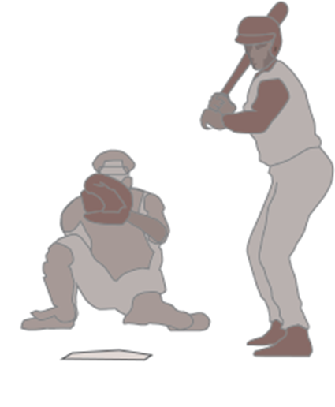
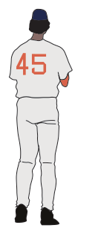

Modelling in Mechanics - Assumptions
What factors could effect the motion of the baseball?
We often have to make various
modelling assumptions,
to make the maths user friendly.

Slide 3

Modelling in Mechanics – Definitions
Particle:
Dimensions of object are negligible
Mass of object concentrated at single point.
Rotational forces/air resistance can be ignored.

Slide 4


Modelling in Mechanics – Definitions
Smooth Surface:
Objects in contact with a surface
do not experience friction.
Friction = 0 N

Slide 5
Modelling in Mechanics – Definitions
Rough surface:
Objects in contact with a surface
experience friction.
Friction = 10 N

Slide 6

Modelling Assumptions
Rod:
Thickness is negligible.
Mass is concentrated at a single point.
Rigid.
mass

Slide 7

Modelling Assumptions
Inextensible string:
String does not stretch.
Acceleration the same for both objects.

Slide 8
Modelling Assumptions
Smooth/light pulley:
No friction.
Tension the same in string either side of pulley.

Slide 9
Modelling in Mechanics - Assumptions
What assumptions could you make
to create a simple model for the motion of the baseball?
Ignore air resistance
No rotation on the ball (no spin)
- Model the baseball as a particle.

Slide 10

Modelling in Mechanics - Assumptions
What assumptions could you make
to create a simple model for the motion of the skier?
- Ignore air resistance
- Snow is smooth/no friction
- Model the skier as a particle.

Slide 11
Exercise 8B
Pearson Stats/Mechanics Year 2
Pages 127-129
Complete before the lesson Q1-2
In Class:
Green Q3-5

