Slide 1
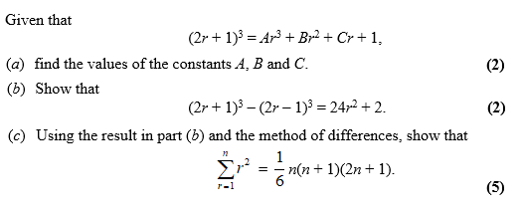
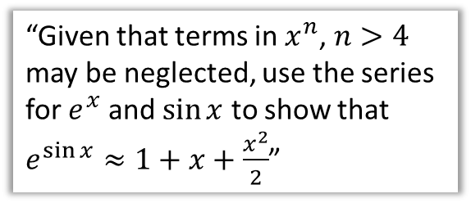
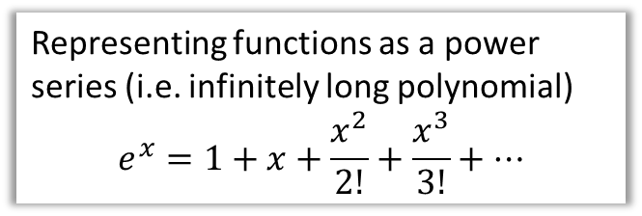
Chapter Overview
Those who have done either IGCSE Mathematics, IGCSE Further Mathematics or Additional Mathematics would have encountered this content. Otherwise it will be completely new!
1:: Method of differences
2:: Maclaurin Expansions
Representing functions as a power series (i.e. infinitely long polynomial)
$$e^{x}=1+x+\frac{x^{2}}{2!}+\frac{x^{3}}{3!}+…$$
3:: Maclaurin Expansions for Composite Functions
“Given that terms in $x^{n}$, $n>4$ may be neglected, use the series for $e^{x}$ and $\sin{x}$ to show that $e^{\sin{x}}≈1+x+\frac{x^{2}}{2}$”
Teacher Note: This is just the two old FP2 chapters on Method of Differences and Maclaurin Expansions/Taylor Series. Taylor Series has been moved to (the new) FP1.

Slide 2

STARTER – Round 1!
?
$$\frac{1}{2}×\frac{2}{3}×\frac{3}{4}×…×\frac{n−1}{n}=\frac{1}{n}$$
$$\left(1−\frac{1}{4}\right)\left(1−\frac{1}{9}\right)\left(1−\frac{1}{16}\right)…\left(1−\frac{1}{n^{2}}\right) \\ =\left(1−\frac{1}{2}\right)\left(1+\frac{1}{2}\right)\left(1−\frac{1}{3}\right)\left(1+\frac{1}{3}\right)…\left(1−\frac{1}{n}\right)\left(1+\frac{1}{n}\right) \\ =\frac{1}{2}×\frac{3}{2}×\frac{2}{3}×\frac{4}{3}×\frac{3}{4}×\frac{5}{4}×…×\frac{n−1}{n}×\frac{n+1}{n} \\ =\frac{n+1}{2n}$$
?

Slide 3
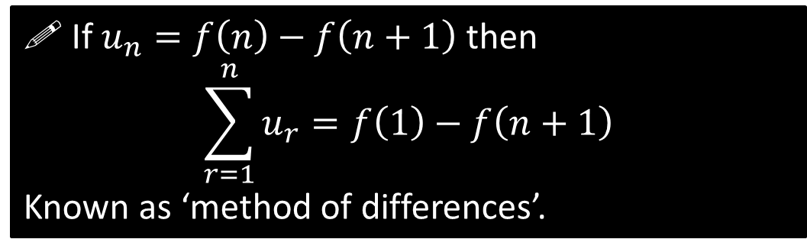

STARTER – Round 2!
$$\sum_{r=1}^{n}{\frac{1}{r}−\frac{1}{r+1}} \\ =\left(\frac{1}{1}−\frac{1}{2}\right)+\left(\frac{1}{2}−\frac{1}{3}\right)+…+\left(\frac{1}{n}−\frac{1}{n+1}\right) \\ =1−\frac{1}{n+1} \\ =\frac{n}{n+1}$$
Fro Hint: Perhaps write out the first few terms?
?
! If $u_{n}=f\left(n\right)−f\left(n+1\right)$ then
$$\sum_{r=1}^{n}{u_{r}}=f\left(1\right)−f\left(n+1\right)$$
Known as ‘method of differences’.

Slide 4
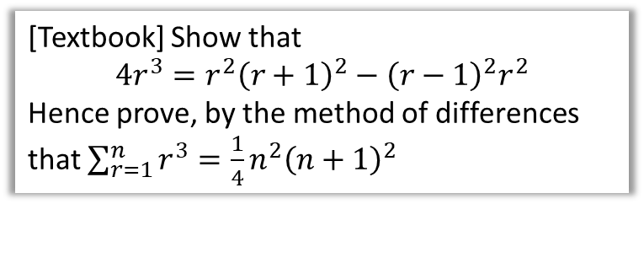
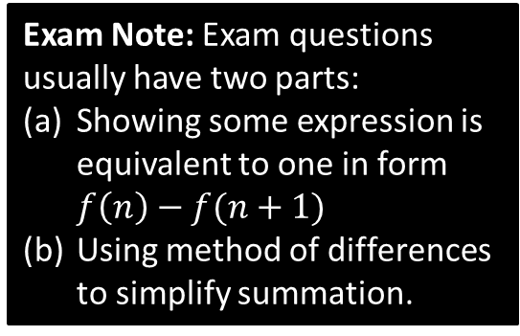
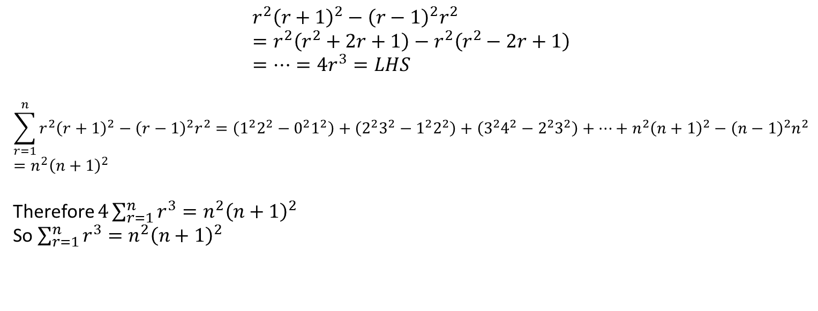
Example
[Textbook] Show that
$$4r^{3}=r^{2}{\left(r+1\right)}^{2}−{\left(r−1\right)}^{2}r^{2}$$
Hence prove, by the method of differences that $\sum_{r=1}^{n}{r^{3}}=\frac{1}{4}n^{2}{\left(n+1\right)}^{2}$
Exam Note: Exam questions usually have two parts:
Showing some expression is equivalent to one in form $f\left(n\right)−f(n+1)$
Using method of differences to simplify summation.
$$r^{2}{\left(r+1\right)}^{2}−{\left(r−1\right)}^{2}r^{2} \\ =r^{2}\left(r^{2}+2r+1\right)−r^{2}\left(r^{2}−2r+1\right) \\ =…=4r^{3}=LHS$$
$$\sum_{r=1}^{n}{r^{2}{\left(r+1\right)}^{2}−{\left(r−1\right)}^{2}r^{2}}=\left(1^{2}2^{2}−0^{2}1^{2}\right)+\left(2^{2}3^{2}−1^{2}2^{2}\right)+\left(3^{2}4^{2}−2^{2}3^{2}\right)+…+n^{2}{\left(n+1\right)}^{2}−{\left(n−1\right)}^{2}n^{2} \\ =n^{2}{\left(n+1\right)}^{2}$$
Therefore $4\sum_{r=1}^{n}{r^{3}}=n^{2}{\left(n+1\right)}^{2}$
So $\sum_{r=1}^{n}{r^{3}}=n^{2}{\left(n+1\right)}^{2}$
?
?
?
Carefully look at the pattern of cancelling. The second term in each pair is cancelled out by the first term in the previous pair.
Thus in the last pair the first term won’t have been cancelled out. While not essential, I like to put brackets around pairs to see the exact matchings more easily.
?

Slide 5

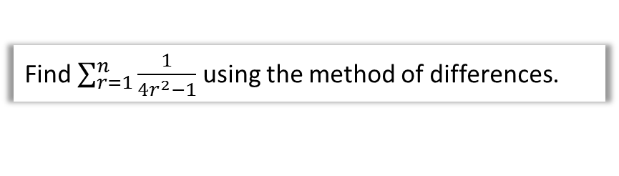
Partial Fraction Example
Find $\sum_{r=1}^{n}{\frac{1}{4r^{2}−1}}$ using the method of differences.
First split into partial fractions in hope that we get form $f\left(r\right)−f\left(r+1\right)$ or something similar.
$$\frac{1}{\left(2r+1\right)\left(2r−1\right)}=\frac{A}{2r+1}+\frac{B}{2r−1} \\ A=−\frac{1}{2}, B=\frac{1}{2}$$
Thus $\sum_{r=1}^{n}{\frac{1}{4r^{2}−1}}=\frac{1}{2}\sum_{r=1}^{n}{\left[\frac{1}{2r−1}−\frac{1}{2r+1}\right]}$
$$=\frac{1}{2}\left(\left(\frac{1}{1}−\frac{1}{3}\right)+\left(\frac{1}{3}−\frac{1}{5}\right)+\left(\frac{1}{5}−\frac{1}{7}\right)+…+\left(\frac{1}{2n−1}−\frac{1}{2n+1}\right)\right) \\ =\frac{1}{2}\left(1−\frac{1}{2n+1}\right) \\ =\frac{1}{2}\left(\frac{2n+1−1}{2n+1}\right)=\frac{n}{2n+1}$$
?
?
?
?
?
?

Slide 6
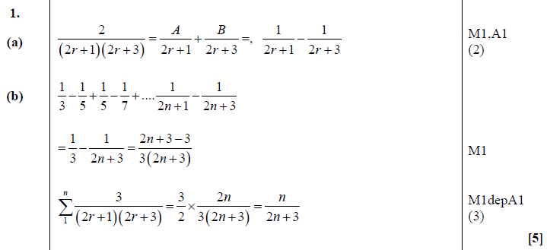
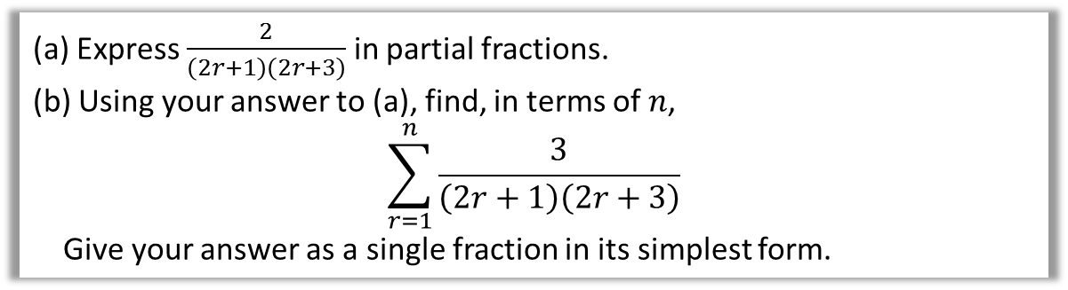
Test Your Understanding
FP2 June 2013 Q1
(a) Express $\frac{2}{\left(2r+1\right)\left(2r+3\right)}$ in partial fractions.
(b) Using your answer to (a), find, in terms of $n$,
$$\sum_{r=1}^{n}{\frac{3}{\left(2r+1\right)\left(2r+3\right)}}$$
Give your answer as a single fraction in its simplest form.
?

Slide 7
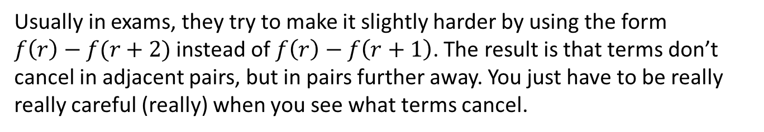

Harder Ones: $f\left(r\right)−f\left(r+2\right)$
Usually in exams, they try to make it slightly harder by using the form
$f\left(r\right)−f(r+2)$ instead of $f\left(r\right)−f\left(r+1\right)$. The result is that terms don’t cancel in adjacent pairs, but in pairs further away. You just have to be really really careful (really) when you see what terms cancel.
$$\sum_{r=1}^{n}{\frac{1}{r}−\frac{1}{r+2}}=\left(\frac{1}{1}−\frac{1}{3}\right)+\left(\frac{1}{2}−\frac{1}{4}\right)+\left(\frac{1}{3}−\frac{1}{5}\right)+\left(\frac{1}{4}−\frac{1}{6}\right)…+\left(\frac{1}{n}−\frac{1}{n+2}\right) \\ =\frac{1}{1}+\frac{1}{2}−\frac{1}{n+1}−\frac{1}{n+2} \\ =\frac{n\left(3n+5\right)}{2\left(n+1\right)\left(n+2\right)}$$
?
?
We can see the second term of each pair is cancelled out by the first term of two pairs later. This means the first term of the first two pairs won’t be cancelled, and the second term of the last two pairs won’t cancel.
?

Slide 8
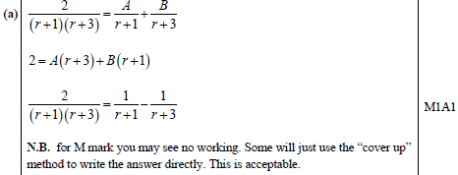
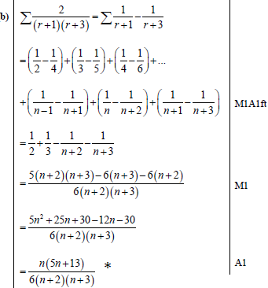
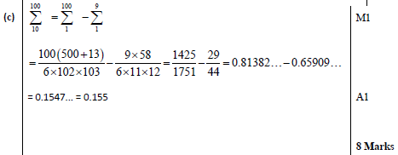
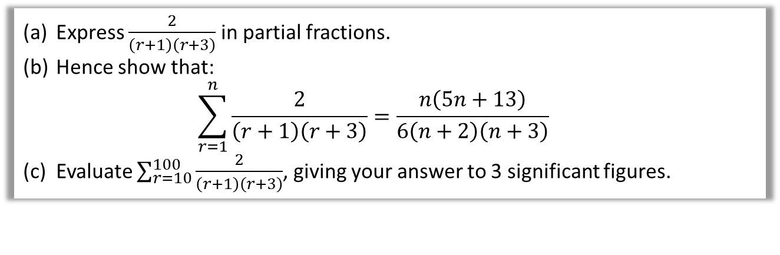
Test Your Understanding
FP2 June 2013 (R) Q3
Express $\frac{2}{\left(r+1\right)\left(r+3\right)}$ in partial fractions.
Hence show that:
$\sum_{r=1}^{n}{\frac{2}{\left(r+1\right)\left(r+3\right)}=\frac{n\left(5n+13\right)}{6\left(n+2\right)\left(n+3\right)}}$
Evaluate $\sum_{r=10}^{100}{\frac{2}{\left(r+1\right)\left(r+3\right)}}$, giving your answer to 3 significant figures.
?
?
?

Slide 9
Exercise 2A
Pearson Core Pure Year 2
Pages 36-37
Note: This exercise has few examples of the “differ by 2” type questions that were extremely common in the old FP2 exams.
I have a compilation of exam questions on this topic here:
https://www.drfrostmaths.com/resource.php?rid=19
Complete before the lesson Q1-2
In Class:
Green Q3-4
Amber Q5-7
Red Q8-13 & Challenge

Slide 10



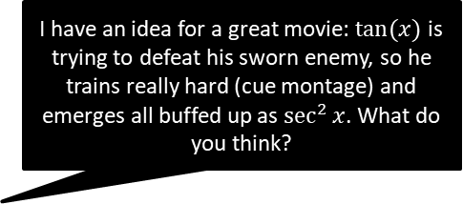




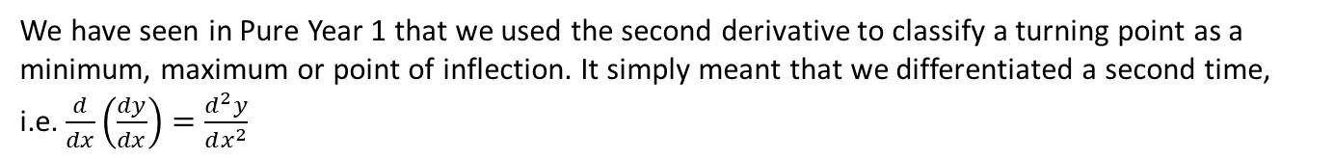









Higher Derivatives
We have seen in Pure Year 1 that we used the second derivative to classify a turning point as a minimum, maximum or point of inflection. It simply meant that we differentiated a second time, i.e. $\frac{d}{dx}\left(\frac{dy}{dx}\right)=\frac{d^{2}y}{dx^{2}}$
Original Function
1st Derivative
2nd Derivative
$n$^{th} Derivative
Lagrange’s Notation
?
?
?
$$f(x)$$
$$f′(x)$$
$$f′′(x)$$
$$f^{(n)}(x)$$
?
?
?
Leibniz’s Notation
$$\frac{dy}{dx}$$
$$\frac{d^{2}y}{dx^{2}}$$
$$\frac{d^{n}y}{dx^{n}}$$
$$y$$
Newton’s Notation
?
?
?
$$n$$
$$y$$
$$\dot{y}$$
$$\ddot{y}$$
$$\dot{y}$$
I have an idea for a great movie: $tan⁡(x)$ is trying to defeat his sworn enemy, so he trains really hard (cue montage) and emerges all buffed up as $\sec^{2}{x}$. What do you think?
It’s a bit derivative.
Joke used with kind permission of Frost Jokes Ltd.

Slide 11
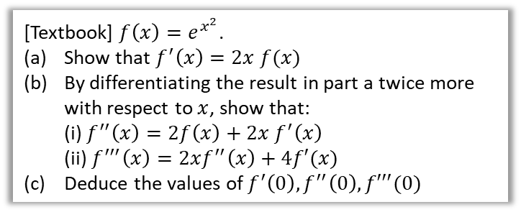

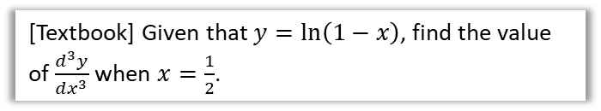

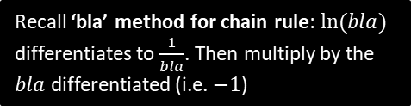

Examples
[Textbook] Given that $y=\ln\left(1−x\right)$, find the value of $\frac{d^{3}y}{dx^{3}}$ when $x=\frac{1}{2}$.
[Textbook] $f\left(x\right)=e^{x^{2}}$.
Show that $f^{′}\left(x\right)=2x f(x)$
By differentiating the result in part a twice more with respect to $x$, show that:
(i) $f^{′′}\left(x\right)=2f\left(x\right)+2x f^{′}\left(x\right)$
(ii) $f^{′′′}\left(x\right)=2xf^{′′}\left(x\right)+4f′(x)$
Deduce the values of $f^{′}\left(0\right), f^{′′}\left(0\right), f′′′(0)$
?
Recall ‘bla’ method for chain rule: $ln⁡(bla)$ differentiates to $\frac{1}{bla}$. Then multiply by the $bla$ differentiated (i.e. $−1$)
$$\frac{dy}{dx}=\frac{1}{1−x}×\left(−1\right)=−\frac{1}{1−x} \\ \frac{d^{2}y}{dx^{2}}=\frac{d}{dx}\left(−{\left(1−x\right)}^{−1}\right)=−1{\left(1−x\right)}^{−2} \\ \frac{d^{3}y}{dx^{3}}=−2{\left(1−x\right)}^{−3}$$
When $x=\frac{1}{2},\frac{d^{3}y}{dx^{3}}=−\frac{2}{{\left(1−\frac{1}{2}\right)}^{3}}=−16$
?
$$f^{′}\left(x\right)=2x e^{x^{2}}=2x f\left(x\right) \\ f^{′′}\left(x\right)=2f\left(x\right)+2x f^{′}\left(x\right) \\ f^{′′′}\left(x\right)=2f^{′}\left(x\right)+2 f^{′}\left(x\right)+2x f^{′′}\left(x\right) \\ =4f^{′}\left(x\right)+2x f^{′′}\left(x\right)$$
$$f\left(0\right)=e^{0}=1 \\ f^{′}\left(0\right)=2\left(0\right)(1)=0 \\ f^{′′}\left(0\right)=2\left(1\right)+2\left(0\right)f^{′}\left(0\right)=2 \\ f^{′′′}\left(0\right)=4\left(0\right)+2\left(0\right)f^{′′}\left(0\right)=0$$
We will see the point of finding $f^{′}\left(0\right), f^{′′}\left(0\right), f′′′(0)$ in the next section.

Slide 12
Exercise 2B
Pearson Core Pure Year 2
Pages 39-40
Note: This exercise has few examples of the “differ by 2” type questions that were extremely common in the old FP2 exams.
I have a compilation of exam questions on this topic here:
https://www.drfrostmaths.com/resource.php?rid=19
Complete before the lesson Q1-2
In Class:
Green Q3-5
Amber Q8
Red Q7

Slide 13
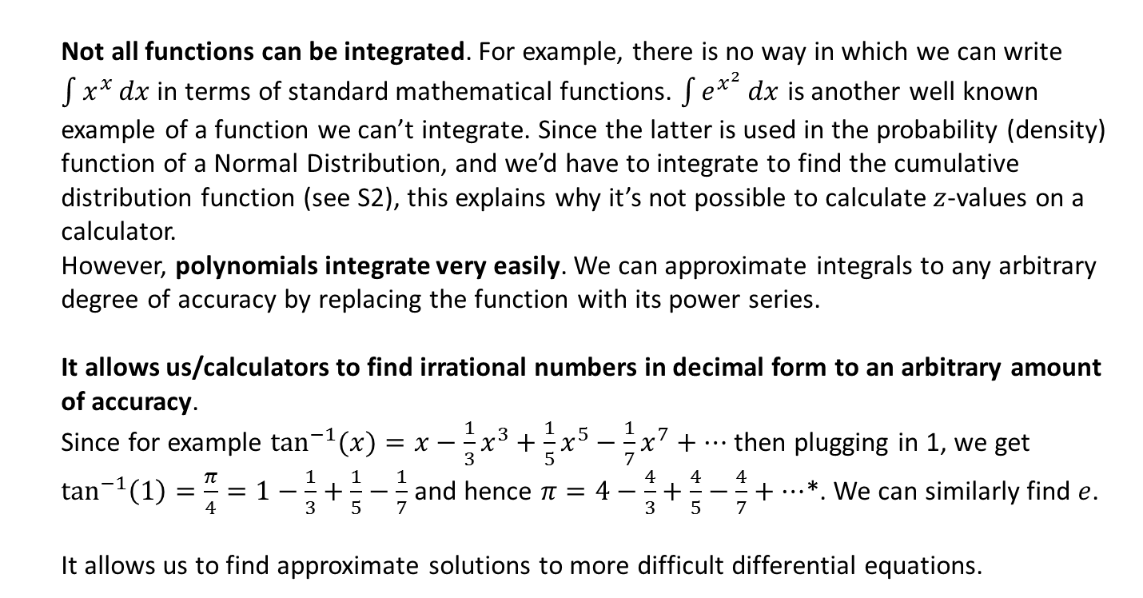

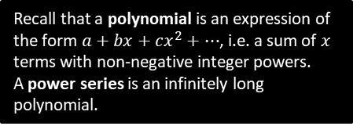
Why we might represent functions as power series
$$e^{x}=1+\frac{x}{1!}+\frac{x^{2}}{2!}+\frac{x^{3}}{3!}+…$$
Recall that a polynomial is an expression of the form $a+bx+cx^{2}+…$, i.e. a sum of $x$ terms with non-negative integer powers.
A power series is an infinitely long polynomial.
Example:
Reasons why this is awesome
1
Not all functions can be integrated. For example, there is no way in which we can write $\int{x^{x}}dx$ in terms of standard mathematical functions. $\int{e^{x^{2}}}dx$ is another well known example of a function we can’t integrate. Since the latter is used in the probability (density) function of a Normal Distribution, and we’d have to integrate to find the cumulative distribution function (see S2), this explains why it’s not possible to calculate $z$-values on a calculator.
However, polynomials integrate very easily. We can approximate integrals to any arbitrary degree of accuracy by replacing the function with its power series.
It allows us/calculators to find irrational numbers in decimal form to an arbitrary amount of accuracy.
Since for example $\tan^{−1}{(x)}=x−\frac{1}{3}x^{3}+\frac{1}{5}x^{5}−\frac{1}{7}x^{7}+…$ then plugging in 1, we get
$\tan^{−1}\left(1\right)=\frac{π}{4}=1−\frac{1}{3}+\frac{1}{5}−\frac{1}{7}$ and hence $π=4−\frac{4}{3}+\frac{4}{5}−\frac{4}{7}+…$*. We can similarly find $e$.
It allows us to find approximate solutions to more difficult differential equations.
2
3
* This is a poor method of generating digits of $π$ though: because the denominator is only increasing by 2 each time, it converges very slowly! There are better power series where the denominator has a much higher growth rate and hence the terms become smaller quicker.

Slide 14
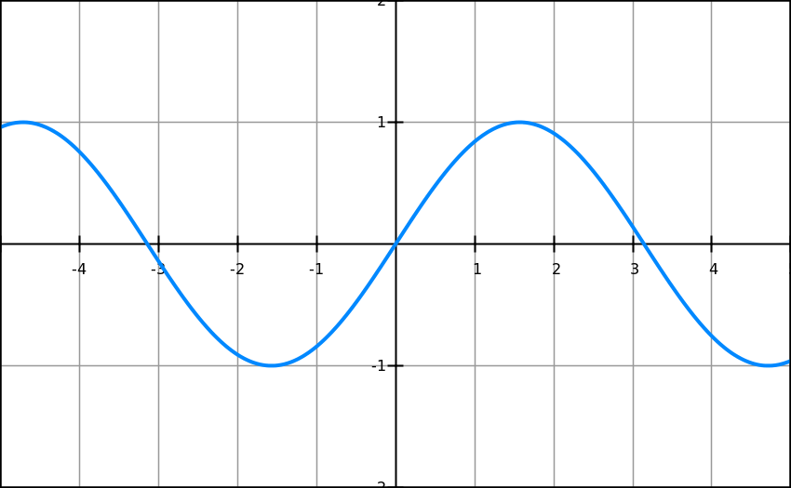
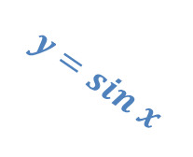

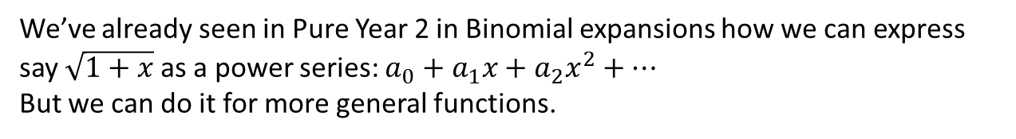

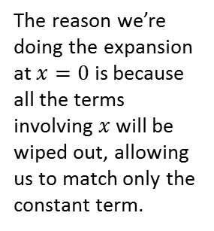


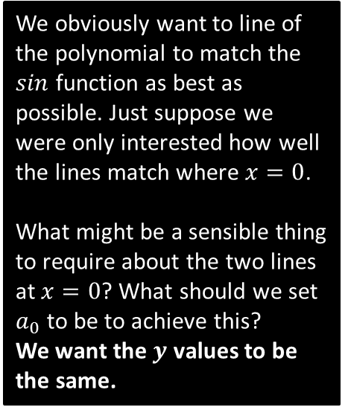
Now onto the good stuff!
We’ve already seen in Pure Year 2 in Binomial expansions how we can express say $\sqrt{1+x}$ as a power series: $a_{0}+a_{1}x+a_{2}x^{2}+…$
But we can do it for more general functions.
The reason we’re doing the expansion at $x=0$ is because all the terms involving $x$ will be wiped out, allowing us to match only the constant term.
original func
power series
$$sin⁡(x)=a_{0}+a_{1}x+a_{2}x^{2}+a_{3}x^{3}+…$$
$$f\left(x\right)=$$
$$f\left(0\right)=$$
$$0=a_{0}$$
We obviously want to line of the polynomial to match the $sin$ function as best as possible. Just suppose we were only interested how well the lines match where $x=0$.
What might be a sensible thing to require about the two lines at $x=0$? What should we set $a_{0}$ to be to achieve this?
We want the $y$ values to be the same.
$$y=sin x$$
$$y=0$$
?

Slide 15
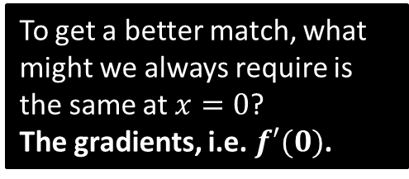


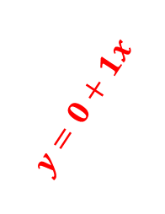


Maclaurin Expansion
original func
power series
$$sin⁡(x)=a_{0}+a_{1}x+a_{2}x^{2}+a_{3}x^{3}+…$$
$$f\left(x\right)=$$
$$\cos\left(x\right)=a_{1}+2a_{2}x+3a_{3}x^{2}$$
$$f′\left(x\right)=$$
?
$$f′\left(0\right)=$$
$$1=a_{1}$$
?
To get a better match, what might we always require is the same at $x=0$?
The gradients, i.e. $f′(0)$.
$$y=0+1x$$
$$y=sin x$$
?

Slide 16




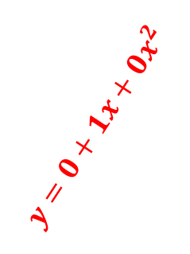


Maclaurin Expansion
original func
power series
$$\sin\left(x\right)=a_{0}+a_{1}x+a_{2}x^{2}+a_{3}x^{3}+… \\ \cos\left(x\right)=a_{1}+2a_{2}x+3a_{3}x^{2}+4a_{4}x^{3}+…$$
$$f\left(x\right)=$$
$$f′\left(x\right)=$$
$$−\sin\left(x\right)=2a_{2}+6a_{3}x+12a_{4}x^{2}+…$$
$$f′′\left(x\right)=$$
?
$$0={2a}_{2}$$
$$f′′\left(0\right)=$$
?
And what about even better?
The second derivatives match, i.e. $f′′(0)$.
$$y=0+1x+0x^{2}$$
?
$$y=sin x$$
(So the second derivatives matched already.)

Slide 17
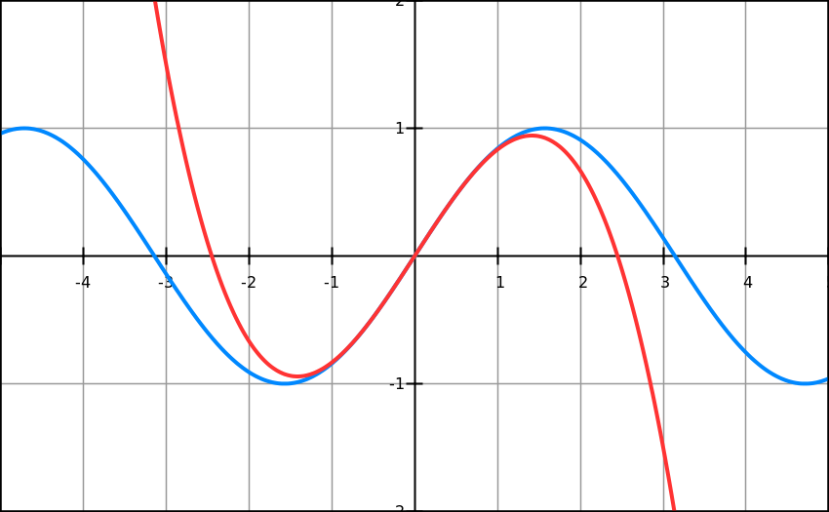


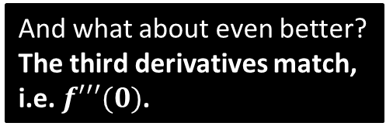

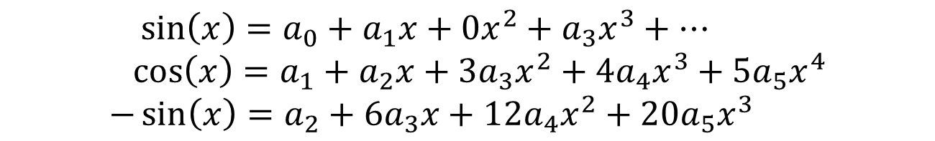


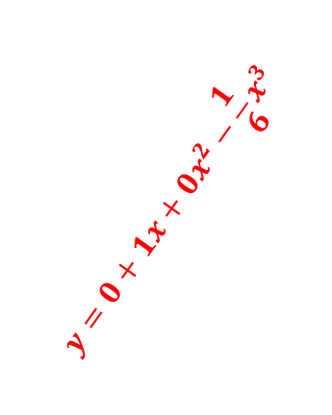
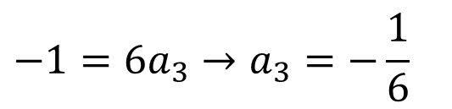

Maclaurin Expansion
original func
power series
$$\sin\left(x\right)=a_{0}+a_{1}x+0x^{2}+a_{3}x^{3}+… \\ \cos\left(x\right)=a_{1}+a_{2}x+3a_{3}x^{2}+4a_{4}x^{3}+5a_{5}x^{4} \\ −\sin\left(x\right)=a_{2}+6a_{3}x+12a_{4}x^{2}+20a_{5}x^{3}$$
$$f\left(x\right)=$$
$$f′\left(x\right)=$$
$$f′′\left(x\right)=$$
?
$$f′′′\left(x\right)=$$
$$−\cos\left(x\right)=6a_{3}+24a_{4}x+60a_{5}x^{2}+…$$
$$−1={6a}_{3}→a_{3}=−\frac{1}{6}$$
$$f′′′\left(0\right)=$$
?
And what about even better?
The third derivatives match, i.e. $f′′′(0)$.
?
$$y=sin x$$
$$y=0+1x+0x^{2}−\frac{1}{6}x^{3}$$
Can you guess the pattern in the coefficients $a_{i}$?
When the derivative is even we get 0 (as $\sin\left(0\right)=0$). For odd derivatives, we get (one over) the factorial of the original power, because each time we’re multiplying by a number one less.
?

Slide 18
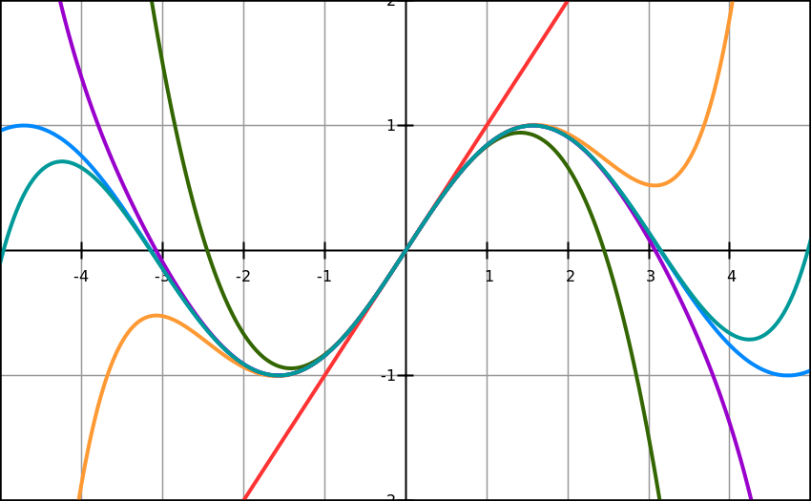

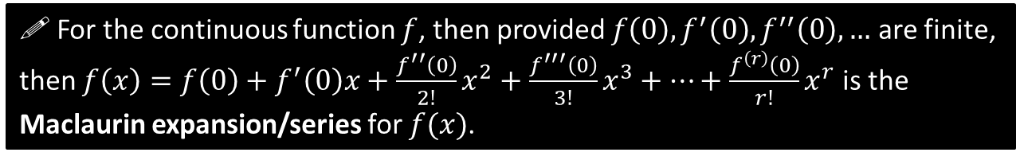
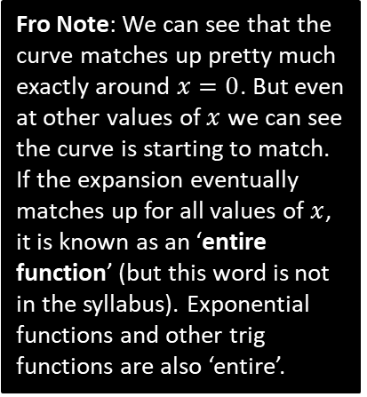
Maclaurin Expansion
1
Fro Note: We can see that the curve matches up pretty much exactly around $x=0$. But even at other values of $x$ we can see the curve is starting to match. If the expansion eventually matches up for all values of $x$, it is known as an ‘entire function’ (but this word is not in the syllabus). Exponential functions and other trig functions are also ‘entire’.
5
3
9
7
$$\sin\left(x\right)=x−\frac{x^{3}}{3!}+\frac{x^{5}}{5!}−\frac{x^{7}}{7!}+\frac{x^{9}}{9!}−…$$
These curves show the successive curves as we keep matching more and more derivatives.
! For the continuous function $f$, then provided $f\left(0\right), f^{′}\left(0\right), f^{′′}\left(0\right),…$ are finite, then $f\left(x\right)=f\left(0\right)+f^{′}\left(0\right)x+\frac{f^{′′}\left(0\right)}{2!}x^{2}+\frac{f^{′′′}\left(0\right)}{3!}x^{3}+…+\frac{f^{\left(r\right)}\left(0\right)}{r!}x^{r}$ is the Maclaurin expansion/series for $f(x)$.

Slide 19
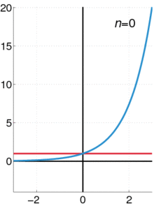






Example
Find the Maclaurin series for $e^{x}$.
Find the Maclaurin series for $\cos{x}$.
?
?
$$f\left(x\right)=\cos{x} → f\left(0\right)=1 \\ f^{′}\left(x\right)=−\sin{x} → f′\left(0\right)=0 \\ f^{′′}\left(x\right)=−\cos{x} → f^{′′}\left(0\right)=−1$$
$f^{\left(3\right)}\left(x\right)=\sin{x} →$ $f^{\left(3\right)}\left(0\right)=0$
$$f^{\left(4\right)}\left(x\right)=\cos{x} → f^{\left(4\right)}\left(0\right)=1$$
$$\cos\left(x\right)=1−\frac{x^{2}}{2!}+\frac{x^{4}}{4!}−\frac{x^{6}}{6!}+…$$
$$f\left(x\right)=e^{x} → f\left(0\right)=1 \\ f^{′}\left(x\right)=e^{x} → f′\left(0\right)=1 \\ f^{′′}\left(x\right)=e^{x} → f^{′′}\left(0\right)=1$$
$$e^{x}=1+x+\frac{x^{2}}{2!}+\frac{x^{3}}{3!}+…$$
?
?
?
?
?
?
?
?
?
?
?
?
?
?
As you can see from the animation, the curves match for all values of $x$, not just at $x=0$ (so $e^{x}$ is ‘entire’)
$$f\left(x\right)=f\left(0\right)+f^{′}\left(0\right)x+\frac{f^{′′}\left(0\right)}{2!}x^{2}+\frac{f^{′′′}\left(0\right)}{3!}x^{3}+…+\frac{f^{\left(r\right)}\left(0\right)}{r!}x^{r}+…$$
is the Maclaurin expansion/series for $f(x)$.

Slide 20



Example
Find the Maclaurin series for $ln⁡(1+x)$.
Using only the first three terms of the series in (a), find estimates for (i) $\ln{1.05}$ (ii) $\ln{1.25}$ (iii) $\ln{1.8}$
?
$$f\left(x\right)=ln⁡(1+x) → f\left(0\right)=0 \\ f^{′}\left(x\right)={\left(1+x\right)}^{−1} → f′\left(0\right)=1 \\ f^{′′}\left(x\right)=−{\left(1+x\right)}^{−2} → f^{′′}\left(0\right)=−1 \\ f^{′′′}\left(x\right)=\left(−1\right)\left(−2\right){\left(1+x\right)}^{−3} → f^{′′′}\left(0\right)=2! \\ f^{\left(r\right)}\left(x\right)=−\left(−1\right)\left(−2\right)…\left(r−1\right){\left(1+x\right)}^{−r}$$
$$\ln\left(1+x\right)=0+1x+\frac{−1! x^{2}}{2!}+\frac{2! x^{3}}{3!}+… \\ =x−\frac{x^{2}}{2}+\frac{x^{3}}{3}−\frac{x^{4}}{4}+…+\frac{{\left(−1\right)}^{r−1}x^{r}}{r!}+…$$
$$\ln{1.05}≈0.05−\frac{{0.05}^{2}}{2}+\frac{{0.05}^{3}}{3} \\ =0.0487916…$$
(correct to 5dp)
$$\ln{1.25}≈0.223958$$
(correct to 2dp)
$$\ln{1.8}≈0.650…$$
(not even correct to 1dp!)
?
?
?
?
?
?
?
?
?
?
?
$$f\left(x\right)=f\left(0\right)+f^{′}\left(0\right)x+\frac{f^{′′}\left(0\right)}{2!}x^{2}+\frac{f^{′′′}\left(0\right)}{3!}x^{3}+…+\frac{f^{\left(r\right)}\left(0\right)}{r!}x^{r}+…$$
is the Maclaurin expansion/series for $f(x)$.

Slide 21



Example
We previously said that we can only guarantee the curve is the same, i.e. the expansion is valid, ‘around’ $x=0.$
For $e^{x}$ and $\cos{x}$ we got lucky in that the curve turned out to be the same everywhere, for all $x$.
But as per the animation above, we can see that away from $x=0$, the curve actually gets worse with more terms in the expansion!
Looking at the graph on the left, for what range of $x$ is this expansion valid for?
$$−1≤x<1$$
?

Slide 22
Exercise 2C
Pearson Core Pure Year 2
Page 43-44
Complete before the lesson Q1-2
In Class:
Green Q3-5
Amber Q6-7
Red Q8-10 & Challenge

Slide 23


Composite Functions
! Standard Expansions (given in formula booklet)
$e^{x}=1+x+\frac{x^{2}}{2!}+\frac{x^{3}}{3!}+\frac{x^{4}}{4!}+…+\frac{x^{r}}{r!}+…$ (valid for all $x$)
$\ln\left(1+x\right)=x−\frac{x^{2}}{2}+\frac{x^{3}}{3}−…+{\left(−1\right)}^{r−1}\frac{x^{r}}{r}+…$ $−1<x≤1$
$\sin\left(x\right)=x−\frac{x^{3}}{3!}+\frac{x^{5}}{5!}−\frac{x^{7}}{7!}+…+\frac{{\left(−1\right)}^{r}x^{2r+1}}{\left(2r+1\right)!}+…$ (valid for all $x$)
$\cos\left(x\right)=1−\frac{x^{2}}{2!}+\frac{x^{4}}{4!}−…+\frac{{\left(−1\right)}^{r}x^{2r}}{2r!}+…$ (valid for all $x$)
$\arctan{x}=x−\frac{x^{3}}{3}+\frac{x^{5}}{5}−…+\frac{{\left(−1\right)}^{r}x^{2r+1}}{2r+1}−…$ $−1≤x≤1$
We can also apply these when the input to the function is different.
?
$$\cos\left(2x^{2}\right)=1−\frac{{\left(2x^{2}\right)}^{2}}{2!}+\frac{{\left(2x^{2}\right)}^{4}}{4! }+… \\ =1−2x^{4}+\frac{2}{3}x^{8}−\frac{4}{45}x^{12}+…$$

Slide 24




Composite Functions
You might need some manipulation first.
[Textbook] Find the first three non-zero terms of the series expansion of $\ln\left(\frac{\sqrt{1+2x}}{1−3x}\right)$, and state the interval in $x$ for which the expansion is valid.
$$\ln\left(\frac{\sqrt{1+2x}}{1−3x}\right)=\frac{1}{2}ln\left(1+2x\right)−ln\left(1−3x\right) \\ \frac{1}{2}ln\left(1+2x\right)=\frac{1}{2}\left(2x−\frac{{\left(2x\right)}^{2}}{2}+\frac{{\left(2x\right)}^{3}}{3}−…\right) \\ =x−x^{2}+\frac{4}{3}x^{3}−… \\ \ln\left(1−3x\right)=\left(−3x\right)−\frac{{\left(−3x\right)}^{2}}{2}+\frac{{\left(−3x\right)}^{3}}{3}−… \\ =−3x−\frac{9}{2}x^{2}−9x^{3}−… \\ ∴\ln\left(\frac{\sqrt{1+2x}}{1−3x}\right)=4x+\frac{7}{2}x^{2}+\frac{31}{3}x^{3}+…$$
Expansion ?
Valid Interval ?
For $\ln\left(1+2x\right)$, $−1<2x≤1$
Thus $−\frac{1}{2}<x≤\frac{1}{2}$
For $ln⁡(1−3x)$, $−1<−3x≤1$
Thus $−\frac{1}{3}≤x<\frac{1}{3}$
(Note the $≤$ and < have swapped)
Taking the intersection of the two, we obtain:
$$−\frac{1}{3}≤x<\frac{1}{3}$$
Standard Expansions (given in formula booklet)
$\ln\left(1+x\right)=x−\frac{x^{2}}{2}+\frac{x^{3}}{3}−…+{\left(−1\right)}^{r−1}\frac{x^{r}}{r}+…$ $−1<x≤1$

Slide 25



Composite Functions
[Textbook] Given that terms in $x^{n}$, $n>4$ may be neglected, use the series for $e^{x}$ and $\sin{x}$ to show that $e^{\sin{x}}≈1+x+\frac{x^{2}}{2}$
?
$$\sin{x}=x−\frac{x^{3}}{3!}+… \\ ∴e^{\sin{x}}≈e^{x−\frac{x^{3}}{6}} \\ =e^{x}×e^{−\frac{x^{3}}{6}} \\ =\left(1+x+\frac{x^{2}}{2}+\frac{x^{3}}{6}\right)\left(1+\left(−\frac{x^{3}}{6}\right)+…\right) \\ =1+x+\frac{x^{2}}{2}+\frac{x^{3}}{6}−\frac{x^{3}}{6}=1+x+\frac{x^{2}}{2}$$
Standard Expansions (given in formula booklet)
$e^{x}=1+x+\frac{x^{2}}{2!}+\frac{x^{3}}{3!}+\frac{x^{4}}{4!}+…+\frac{x^{r}}{r!}+…$ (valid for all $x$)
$\sin\left(x\right)=x−\frac{x^{3}}{3!}+\frac{x^{5}}{5!}−\frac{x^{7}}{7!}+…+\frac{{\left(−1\right)}^{r}x^{2r+1}}{\left(2r+1\right)!}+…$ (valid for all $x$)

Slide 26
Exercise 2D
Pearson Core Pure Year 2
Page 46-48
Complete before the lesson Q1
In Class:
Green Q2-5
Amber Q6-9
Red Q10-13 & Challenge

