Slide 1
Year 2 Pure Mathematics
Sequences and Series
- Arithmetic Sequences
Chapter 3
(Part 1 of 7)

Slide 2
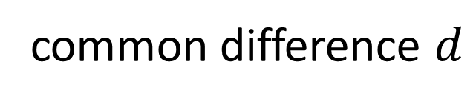
Arithmetic Sequences
Arithmetic Sequence
common difference $d$
+3
+3
+3
2, 5, 8, 11, 14, …
An arithmetic sequence is one which has a common difference between terms.

Slide 3
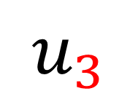
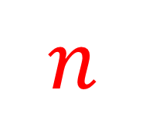

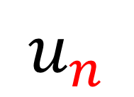
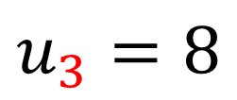
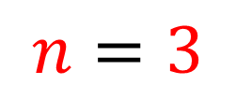
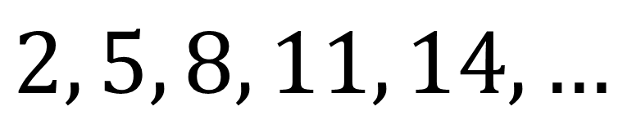
Arithmetic Sequences - Notation
$$u_{n}$$
The $n$^{th} term.
$$n$$
The position of the term in the sequence.
$$u_{3}$$
The 3rd term.
$$u_{3}=8$$
$$n=3$$
$$2, 5, 8, 11, 14, …$$

Slide 4
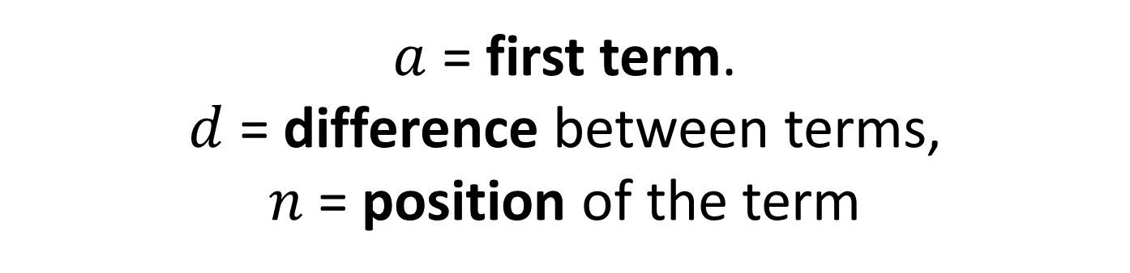
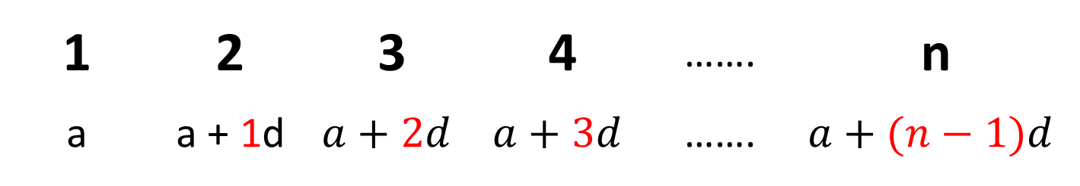
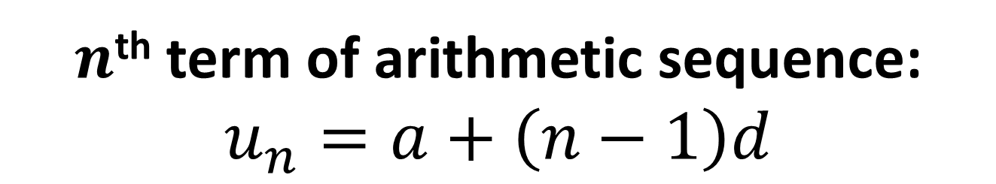
Arithmetic Sequences - $n$^{th} term
$a$ = first term.
$d$ = difference between terms,
$n$ = position of the term
1 | 2 | 3 | 4 | ……. | n
a | a + 1d | $$a+2d$$ | $$a+3d$$ | ……. | $$a+(n−1)d$$
$n$^{th} term of arithmetic sequence:
$$u_{n}=a+\left(n−1\right)d$$

Slide 5
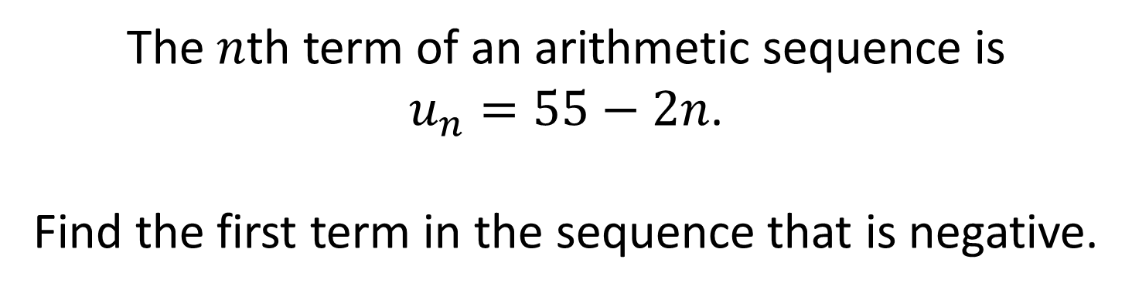
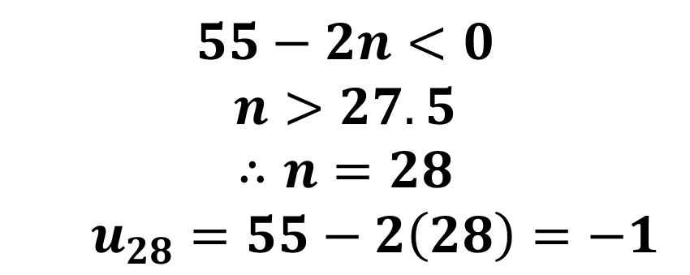
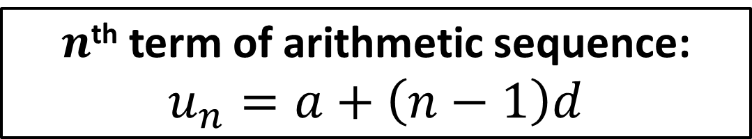
Arithmetic Sequences - $n$^{th} term
$n$^{th} term of arithmetic sequence:
$$u_{n}=a+\left(n−1\right)d$$
The $n$th term of an arithmetic sequence is
$u_{n}=55−2n$.
Find the first term in the sequence that is negative.
$$55−2n<0$$
$$n>27.5$$
$$∴n=28$$
$u_{28}=55−2\left(28\right)=−1$

Slide 6
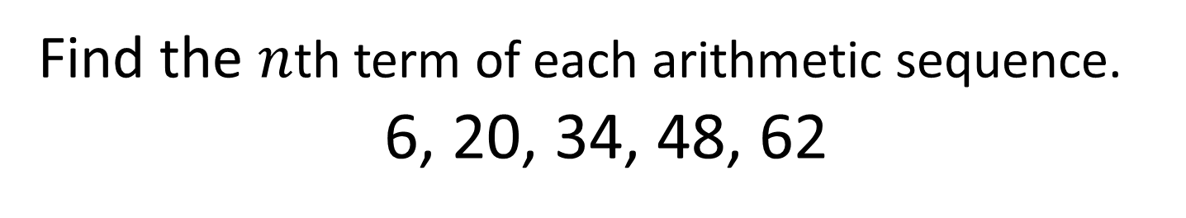
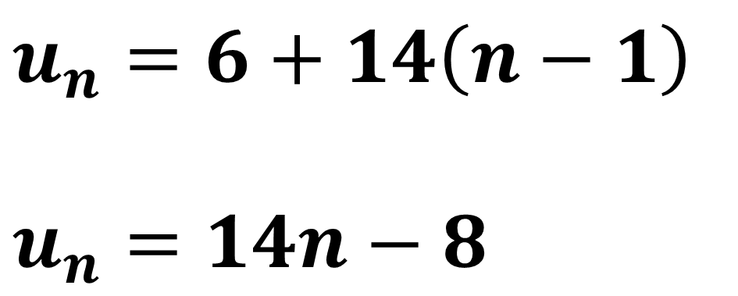
Arithmetic Sequences - $n$^{th} term
$n$^{th} term of arithmetic sequence:
$$u_{n}=a+\left(n−1\right)d$$
Find the $n$th term of each arithmetic sequence.
6, 20, 34, 48, 62
$$u_{n}=6+14\left(n−1\right)$$
$$u_{n}=14n−8$$

Slide 7
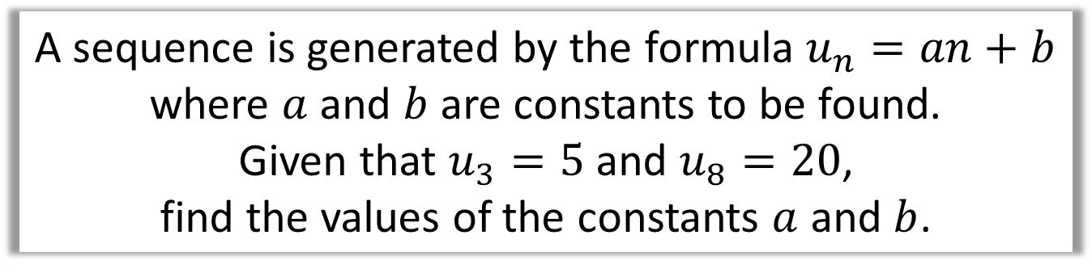
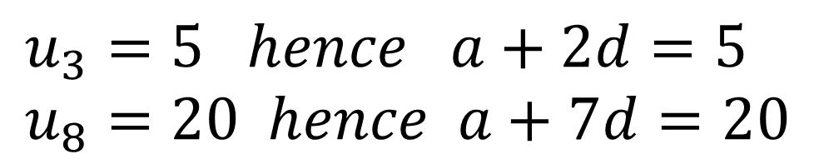
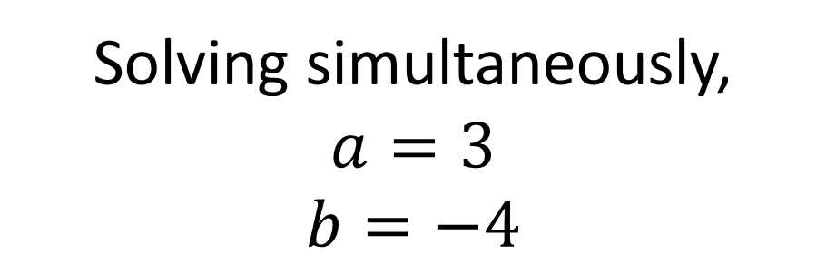
Arithmetic Sequences - $n$^{th} term
A sequence is generated by the formula $u_{n}=an+b$
where $a$ and $b$ are constants to be found.
Given that $u_{3}=5$ and $u_{8}=20$,
find the values of the constants $a$ and $b$.
$$u_{3}=5 hence a+2d=5 \\ u_{8}=20 hence a+7d=20$$
Solving simultaneously,
$$a=3$$
$$b=−4$$

Slide 8
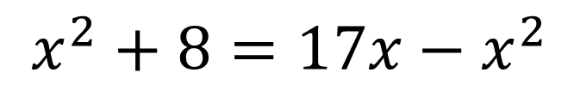
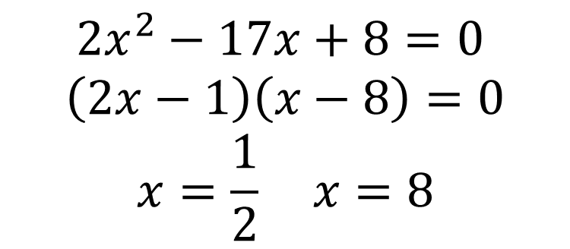
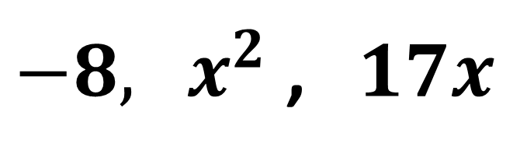
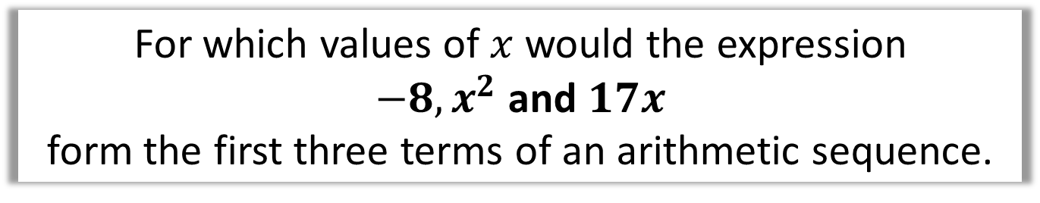
Arithmetic Sequences - $n$^{th} term
For which values of $x$ would the expression
$−8, x^{2}$ and $17x$
form the first three terms of an arithmetic sequence.
$−8, { x}^{2}$ ,$17x$
$$x^{2}+8=17x−x^{2}$$
$$2x^{2}−17x+8=0$$
$$\left(2x−1\right)\left(x−8\right)=0$$
$$x=\frac{1}{2} x=8$$

Slide 9
Exercise 3A
Pearson Pure Mathematics Year 2/AS
Pages 61-62
Complete before the lesson Q1-3
In Class:
Green Q4-7
Amber Q8-10
Red Challenge

