Slide 1
Year 2 Pure Mathematics
Algebraic Methods
- Partial Fractions
Chapter 1
(Part 3 of 4)

Slide 2
Partial Fractions - Challenge
Challenge:
Can you find the value of A and B?
$$6x−2=A\left(x+1\right)+B\left(x−3\right)$$

Slide 3
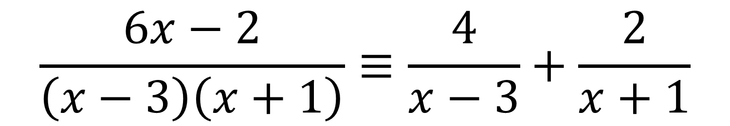
Partial Fractions - Introduction
The method of taking a fraction
and spiting it into multiple fractions
is known as ‘Partial Fraction Decomposition’.
$$\frac{6x−2}{\left(x−3\right)\left(x+1\right)}≡\frac{4}{x−3}+\frac{2}{x+1}$$

Slide 4

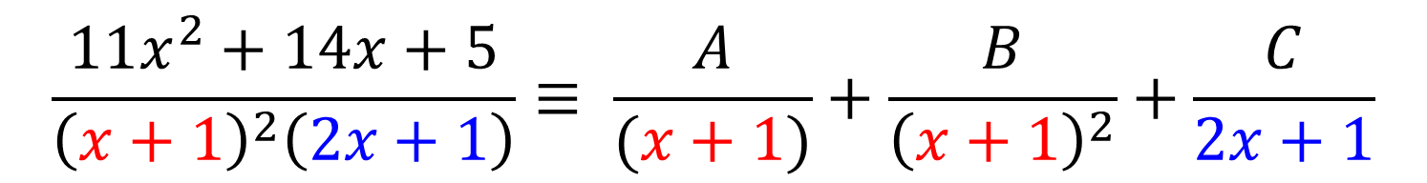
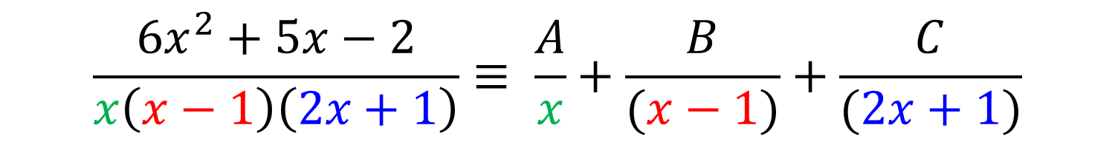
Partial Fractions – Types of Questions
There are 3 main types of questions you could be asked.
$$\frac{6x−2}{\left(x−3\right)\left(x+1\right)}≡ \frac{A}{x−3}+\frac{B}{x+1}$$
$$\frac{6x^{2}+5x−2}{x\left(x−1\right)\left(2x+1\right)}≡ \frac{A}{x}+\frac{B}{(x−1)}+\frac{C}{(2x+1)}$$
$$\frac{11x^{2}+14x+5}{{\left(x+1\right)}^{2}\left(2x+1\right)}≡ \frac{A}{(x+1)}+\frac{B}{{\left(x+1\right)}^{2}}+\frac{C}{2x+1}$$

Slide 5
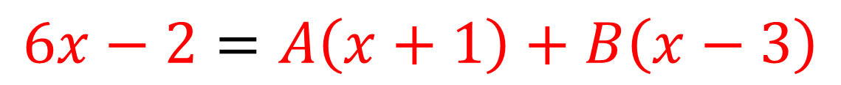
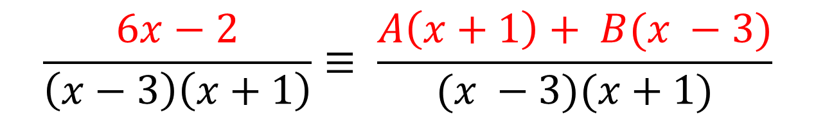
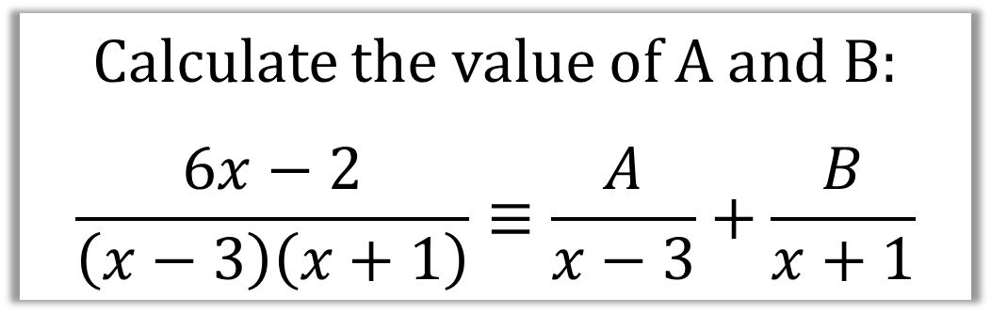
Partial Fractions - Example
Calculate the value of A and B:
$$\frac{6x−2}{\left(x−3\right)\left(x+1\right)}≡\frac{A}{x−3}+\frac{B}{x+1}$$
Step 1: Turn the partial fractions back into a single fraction
$$\frac{6x−2}{\left(x−3\right)\left(x+1\right)}≡ \frac{A\left(x+1\right)+ B(x −3)}{(x −3)(x+1)}$$
Step 2: Make the numerators equal to each other
$$6x−2=A\left(x+1\right)+B\left(x−3\right)$$

Slide 6

Partial Fractions – Example continued
$$6x−2=A\left(x+1\right)+B\left(x−3\right)$$
Step 3: Eliminate A by making x = -1
$$6(−1)−2=A\left(−1+1\right)+B\left(−1−3\right)$$
$$−8=−4B$$
$$B=2$$

Slide 7

Partial Fractions - Example continued
$$6x−2=A\left(x+1\right)+B\left(x−3\right)$$
Step 4: Eliminate B by making x = 3
$$6(3)−2=A\left(3+1\right)+B\left(3−3\right)$$
$$16=4A$$
$A$ $=4$

Slide 8
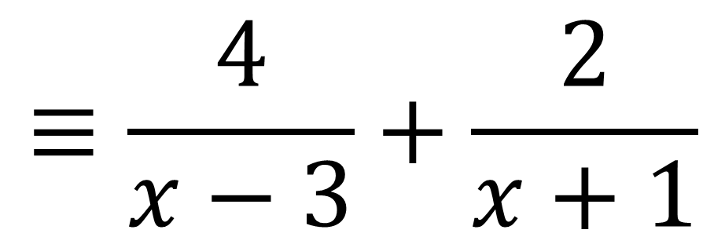

Partial Fractions - Example Answer
Calculate the value of A and B:
$$\frac{6x−2}{\left(x−3\right)\left(x+1\right)}≡\frac{A}{x−3}+\frac{B}{x+1}$$
$$≡\frac{4}{x−3}+\frac{2}{x+1}$$

Slide 9
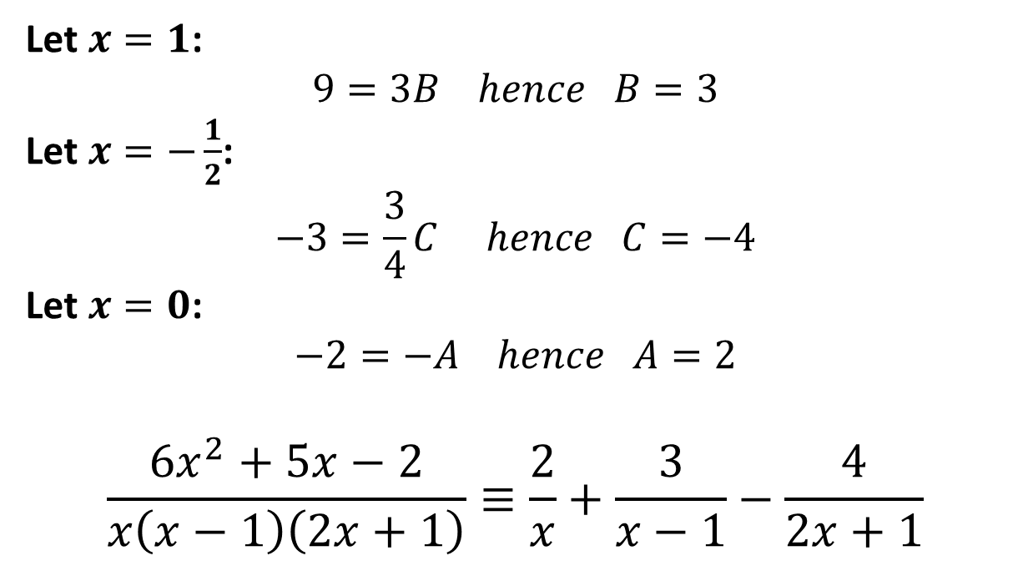
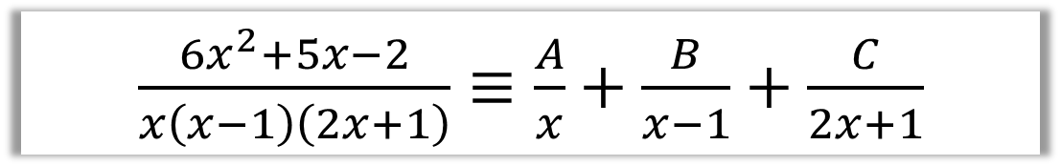
Partial Fractions – Practice
$\frac{6x^{2}+5x−2}{x\left(x−1\right)\left(2x+1\right)}≡\frac{A}{x}+\frac{B}{x−1}+\frac{C}{2x+1}$
$$6x^{2}+5x−2=A\left(x−1\right)\left(2x+1\right)+Bx\left(2x+1\right)+Cx\left(x−1\right)$$
Let $x=1$:
$$9=3B hence B=3$$
Let $x=−\frac{1}{2}$:
$$−3=\frac{3}{4}C hence C=−4$$
Let $x=0$:
$$−2=−A hence A=2$$
$$\frac{6x^{2}+5x−2}{x\left(x−1\right)\left(2x+1\right)}≡\frac{2}{x}+\frac{3}{x−1}−\frac{4}{2x+1}$$

Slide 10

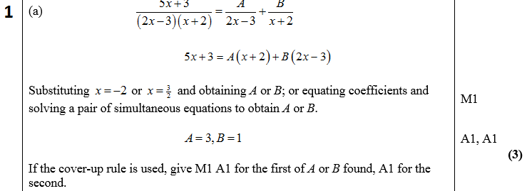
Partial Fractions – Exam Question

Slide 11
Exercise 1D
Pearson Pure Mathematics Year 2/AS
Page 11
Complete before the lesson Q1-2
In Class:
Green Q3&4
Amber Q5&6
Red Q7 & Challenge

Slide 12
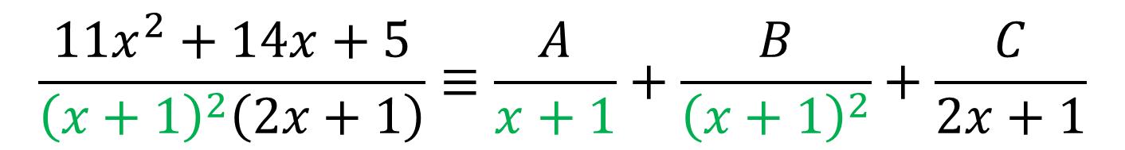
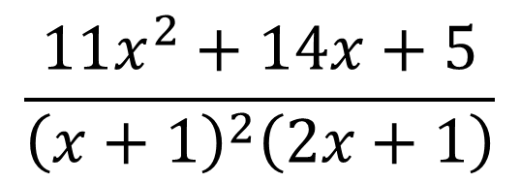
Partial Fractions - Repeated factors
$$\frac{11x^{2}+14x+5}{{\left(x+1\right)}^{2}\left(2x+1\right)}$$
Repeated factors
$$\frac{11x^{2}+14x+5}{{\left(x+1\right)}^{2}\left(2x+1\right)}≡\frac{A}{x+1}+\frac{B}{{\left(x+1\right)}^{2}}+\frac{C}{2x+1}$$

Slide 13

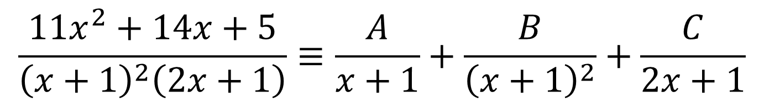
Partial Fractions - Repeated Factors Example
Split $\frac{11x^{2}+14x+5}{{\left(x+1\right)}^{2}\left(2x+1\right)}$ into partial fractions.
$$\frac{11x^{2}+14x+5}{{\left(x+1\right)}^{2}\left(2x+1\right)}≡\frac{A}{x+1}+\frac{B}{{\left(x+1\right)}^{2}}+\frac{C}{2x+1}$$
$$11x^{2}+14x+5= A\left(x+1\right)\left(2x+1\right)+B\left(2x+1\right)+C{\left(x+1\right)}^{2}$$

Slide 14

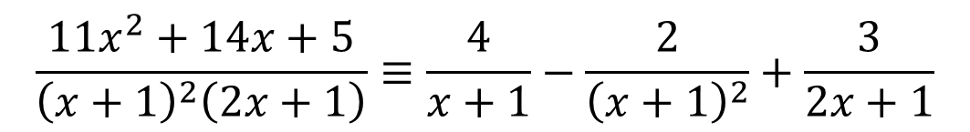
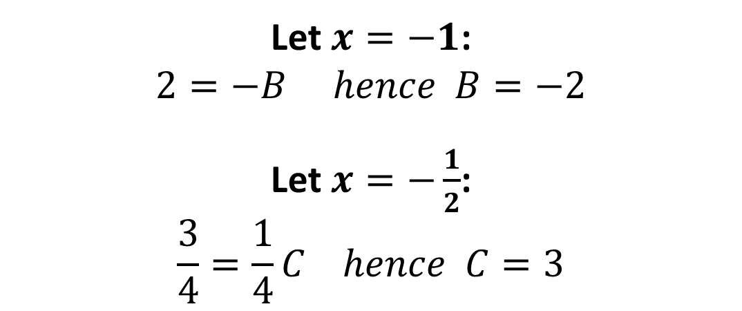
Partial Fractions - Repeated Factors Example
$$11x^{2}+14x+5≡A\left(x+1\right)\left(2x+1\right)+B\left(2x+1\right)+C{\left(x+1\right)}^{2}$$
Let $x=−1$:
$$2=−B hence B=−2$$
Let $x=−\frac{1}{2}$:
$$\frac{3}{4}=\frac{1}{4}C hence C=3$$
Let $x=0$:
5 = $A$ + $B$ + $C$
5 = $A$ – 2 + 3
$A$ = 4
$$\frac{11x^{2}+14x+5}{{\left(x+1\right)}^{2}\left(2x+1\right)}≡\frac{4}{x+1}−\frac{2}{{\left(x+1\right)}^{2}}+\frac{3}{2x+1}$$

Slide 15
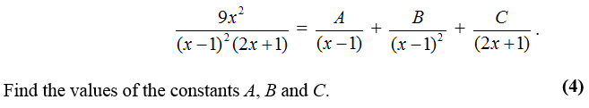
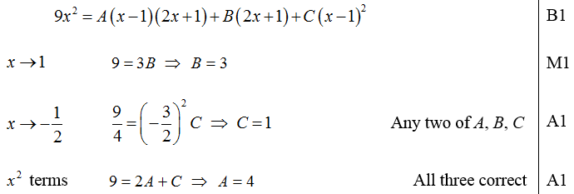
Partial Fractions – Repeated Factors Exam Question

Slide 16
Exercise 1E
Pearson Pure Mathematics Year 2/AS
Page 13
Complete before the lesson Q1-2
In Class:
Green Q3
Amber Q4&5
Red Q6-8

