Slide 1
Year 2 Pure Mathematics
Radians
- Small Angle Approximation
Chapter 5
(Part 5 of 5)

Slide 2
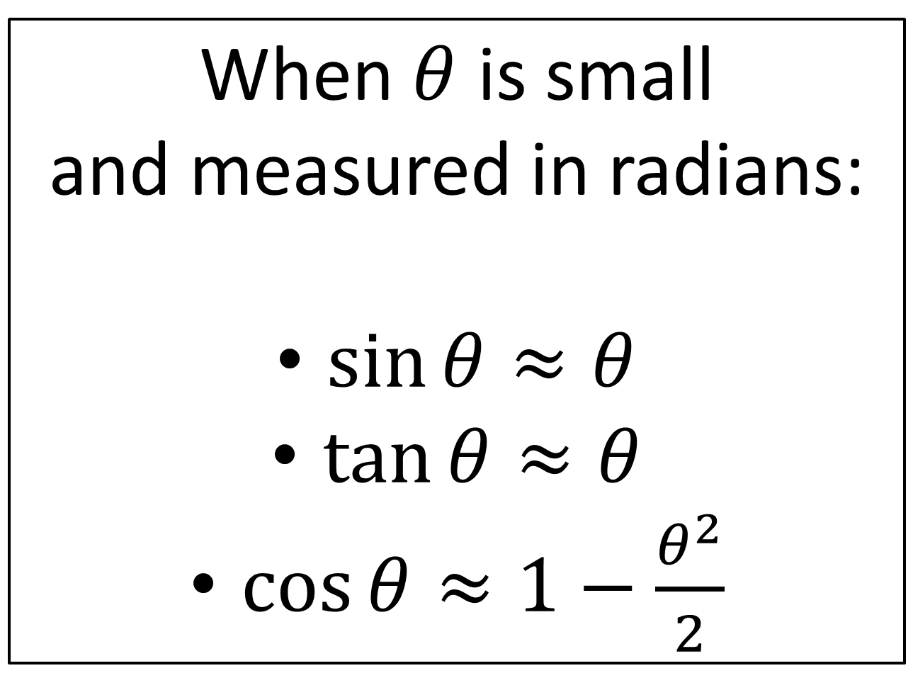
Small Angle Approximations
When $θ$ is small
and measured in radians:
$\sin{θ}≈θ$
$\tan{θ}≈θ$
$\cos{θ}≈1−\frac{θ^{2}}{2}$

Slide 3
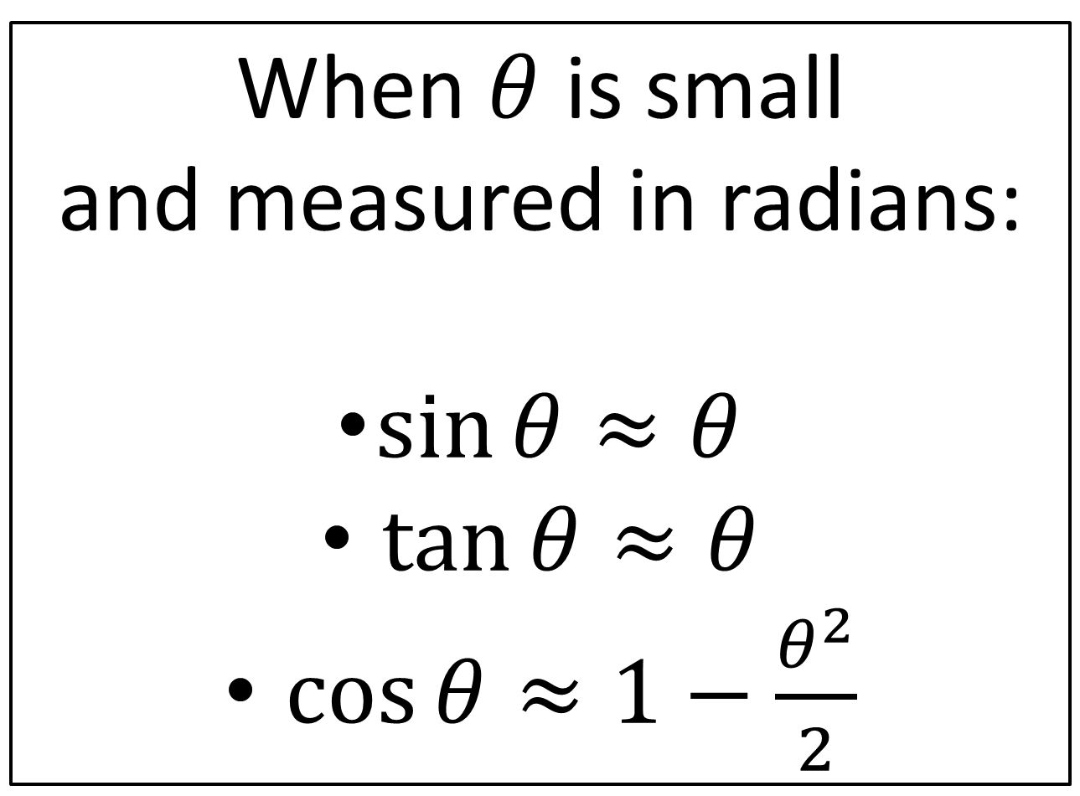
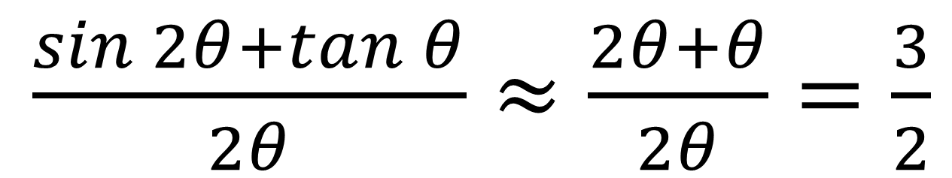
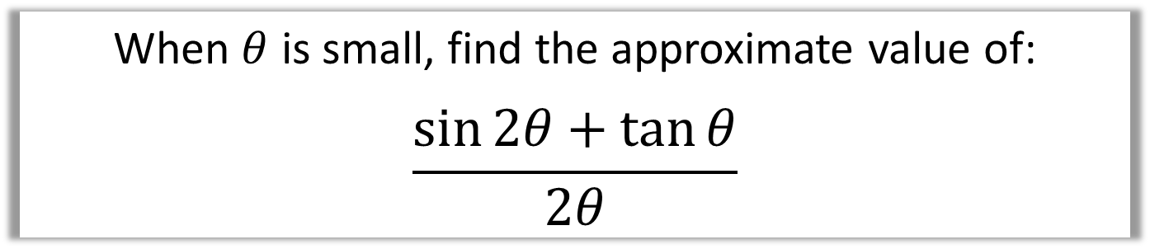
Small Angle Approximations
When $θ$ is small, find the approximate value of:
$$\frac{\sin{2θ}+\tan{θ}}{2θ}$$
$\frac{\sin{2θ}+\tan{θ}}{2θ}≈\frac{2θ+θ}{2θ}=\frac{3}{2}$

Slide 4
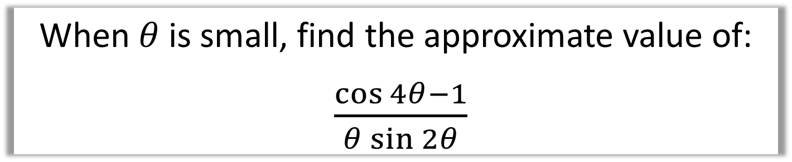
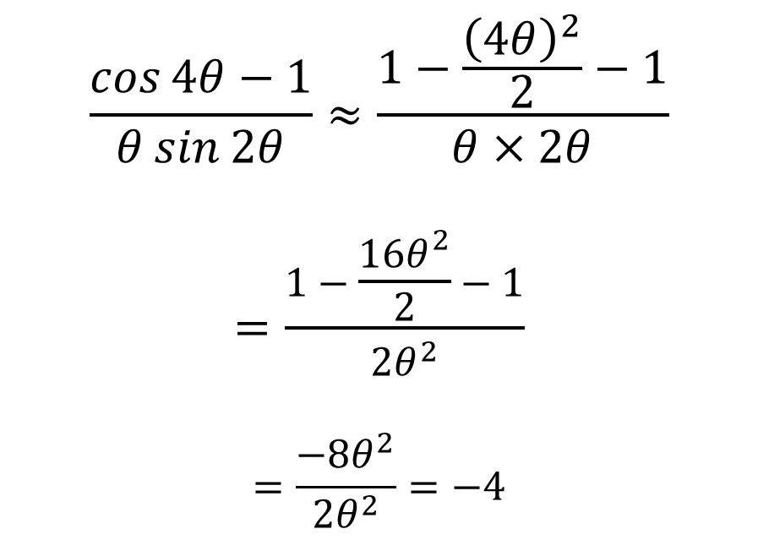
Small Angle Approximations
When $θ$ is small, find the approximate value of:
$\frac{\cos{4θ}−1}{θ\sin{2θ}}$
$$\frac{\cos{4θ}−1}{θ\sin{2θ}}≈\frac{1−\frac{{\left(4θ\right)}^{2}}{2}−1}{θ×2θ}$$
$$=\frac{1−\frac{16θ^{2}}{2}−1}{2θ^{2}}$$
$$=\frac{−8θ^{2}}{2θ^{2}}=−4$$

Slide 5
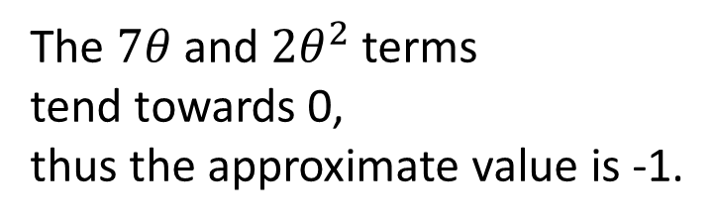
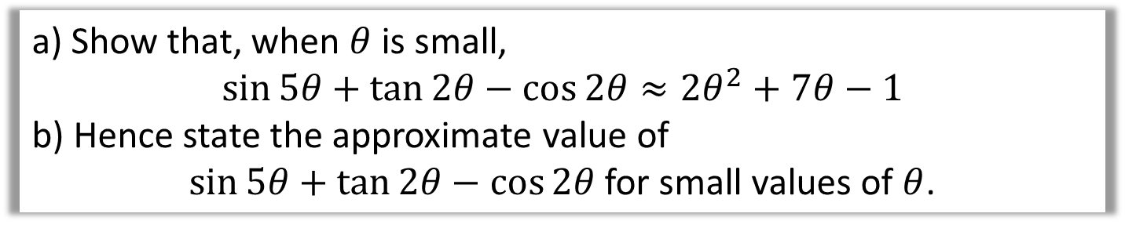
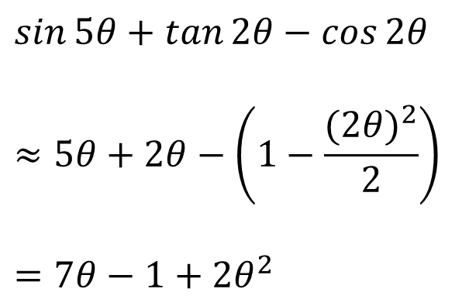
Small Angle Approximations
a) Show that, when $θ$ is small,
$$\sin{5θ}+\tan{2θ}−\cos{2θ}≈2θ^{2}+7θ−1$$
b) Hence state the approximate value of
$\sin{5θ}+\tan{2θ}−\cos{2θ}$ for small values of $θ$.
$$\sin{5θ}+\tan{2θ}−\cos{2θ}$$
$$≈5θ+2θ−\left(1−\frac{(2{θ)}^{2}}{2}\right)$$
$$=7θ−1+2θ^{2}$$
The $7θ$ and $2θ^{2}$ terms
tend towards 0,
thus the approximate value is -1.

Slide 6
Exercises 5F
Pearson Pure Mathematics Year 2/AS
Page 134
Complete before the lesson Q1-2
In Class:
Green Q3
Amber Q4
Red Q5 & Challenge

