Slide 1
Year 1 Applied Mathematics
Modelling in Mechanics
- Vectors
Chapter 8
(Part 4 of 4)

Slide 2
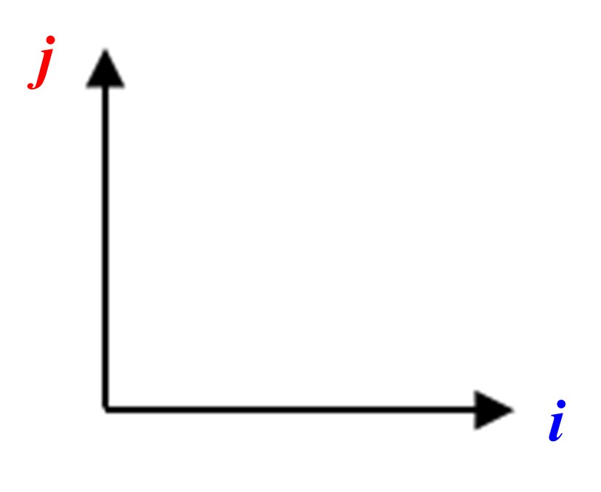
Vectors
A vector describes how to get from A to B.
3i + 4j
B
A

Slide 3
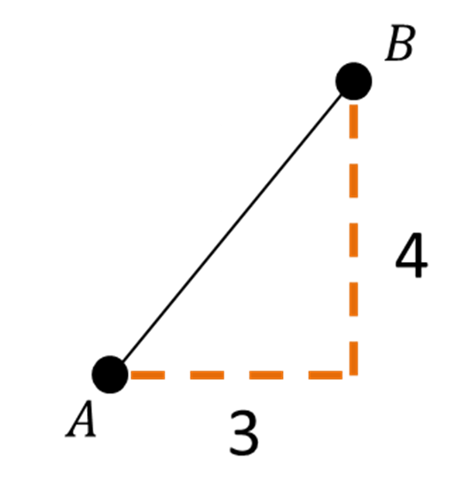
Vectors $and$ Scalars
Vector – Velocity | Magnitude - Speed
3i + 4j ms⁻¹
5 ms⁻¹
Using Pythagoras

Slide 4
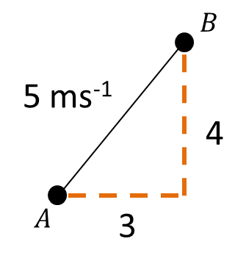

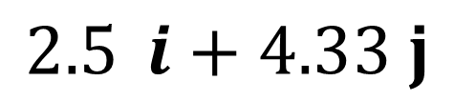


Vectors $and$ Scalars
Vector – Velocity | Magnitude - Speed
 | 5 ms⁻¹
$$2.5{ i+4.33 j}$$
Using Trigonomtry
$$5\cos{60°}$$
$$60°$$
$$5\sin{60°}$$

Slide 5

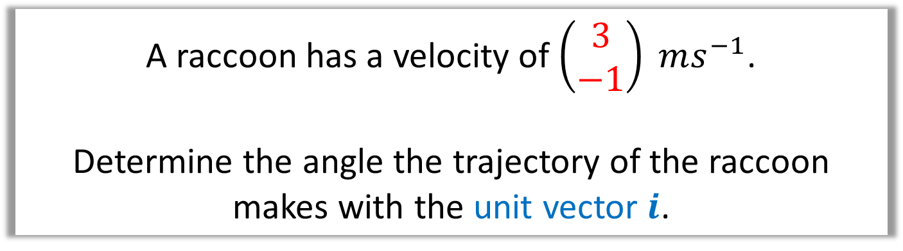

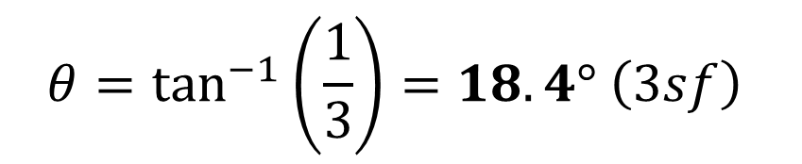
Vectors $−$ Direction of a Vector
A raccoon has a velocity of $\left(\begin{matrix}3 \\ −1\end{matrix}\right) ms^{−1}$.
Determine the angle the trajectory of the raccoon
makes with the unit vector $i$.
1i
3
$$θ$$
$$θ$$
1
$$θ=\tan^{−1}\left(\frac{1}{3}\right)=18.4° \left(3sf\right)$$

Slide 6

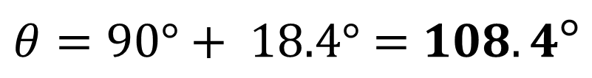
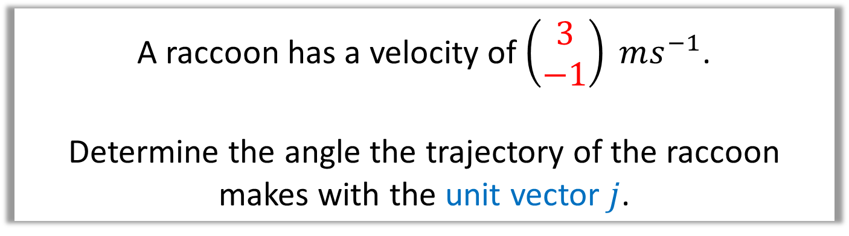

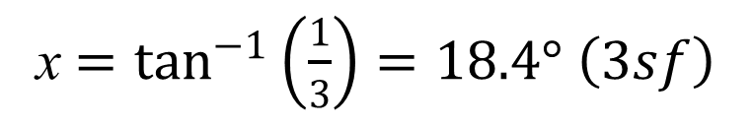
Vectors $−$ Direction of a Vector
A raccoon has a velocity of $\left(\begin{matrix}3 \\ −1\end{matrix}\right) ms^{−1}$.
Determine the angle the trajectory of the raccoon
makes with the unit vector $j$.
3
1j
$$x$$
1
$$θ$$
x $=\tan^{−1}\left(\frac{1}{3}\right)=18.4° \left(3sf\right)$
$θ=90°+ 18.4°=$ $108.4°$

Slide 7

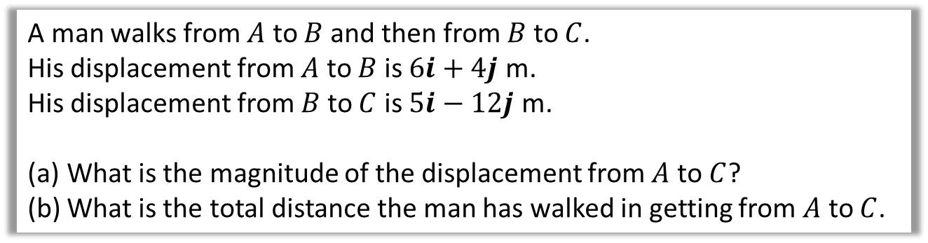



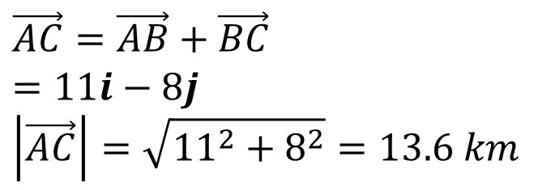

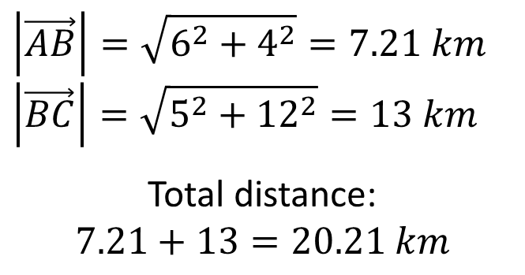
Vectors $and$ Scalars - Questions
A man walks from $A$ to $B$ and then from $B$ to $C$.
His displacement from $A$ to $B$ is $6i+4j$ m.
His displacement from $B$ to $C$ is $5i−12j$ m.
What is the magnitude of the displacement from $A$ to $C$?
What is the total distance the man has walked in getting from $A$ to $C$.
a
$$\vec{AC}=\vec{AB}+\vec{BC} \\ =11i−8j \\ \left|\vec{AC}\right|=\sqrt{{11}^{2}+8^{2}}=13.6 km$$
$$6i+4j$$
$$B$$
$$A$$
$$5i−12j$$
$$\left|\vec{AB}\right|=\sqrt{6^{2}+4^{2}}=7.21 km \\ \left|\vec{BC}\right|=\sqrt{5^{2}+{12}^{2}}=13 km$$
Total distance:
$$7.21+13=20.21 km$$
b
$$C$$

Slide 8
Exercise 8D
Pearson Stats/Mechanics Year 2
Pages 127-129
Complete before the lesson Q1
In Class:
Green Q2-4

