Slide 1
Year 1 Pure Mathematics
Algebraic Methods
- Simplifying Fractions
Chapter 7
(Part 1 of 4)

Slide 2
Simplifying Algebraic Fractions
The golden rule to
simplifying algebraic fractions is to factorise.
Never expand the brackets!

Slide 3

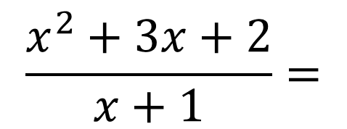

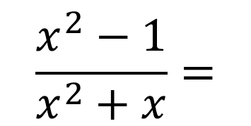
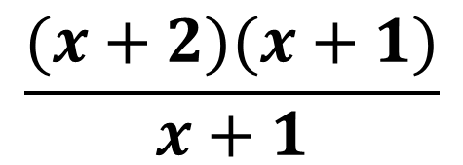
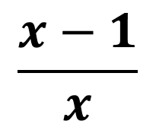
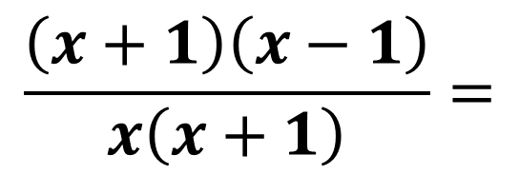
Simplifying Algebraic Fractions
Simplify fractions by dividing the numerator and denominator
by a common factor.
$$\frac{x^{2}−1}{x^{2}+x}=$$
$$\frac{\left(x+1\right)\left(x−1\right)}{x\left(x+1\right)}=$$
$$\frac{x−1}{x}$$
$$\frac{x^{2}+3x+2}{x+1}=$$
$$\frac{(x+2)(x+1)}{x+1}$$
$$=$$
$$x+2$$

Slide 4
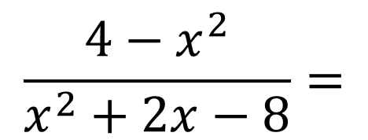
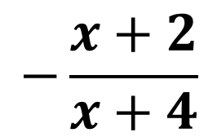
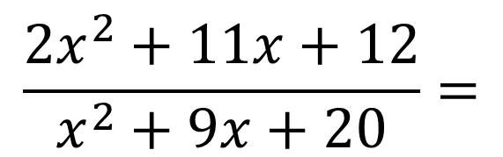
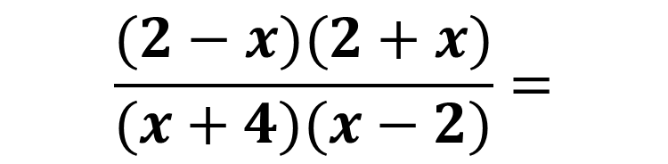
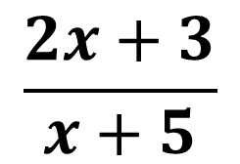
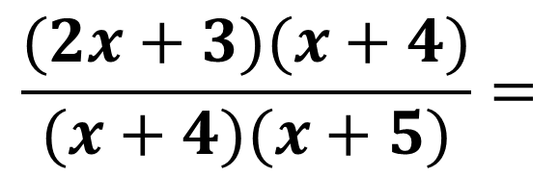
Simplifying Algebraic Fractions
$$\frac{2x^{2}+11x+12}{x^{2}+9x+20}=$$
$$\frac{(2x+3)(x+4)}{(x+4)(x+5)}=$$
$$\frac{2x+3}{x+5}$$
$$\frac{4−x^{2}}{x^{2}+2x−8}=$$
$$\frac{(2−x)(2+x)}{(x+4)(x−2)}=$$
$$−\frac{x+2}{x+4}$$

Slide 5
Exercise 7A
Pearson Pure Mathematics Year 1/AS
Pages 138-139
Complete before the lesson Q1
Green Q2
Amber Q3

