Slide 1

MechYr2 Chapter 5 :: Friction
jfrost@tiffin.kingston.sch.uk
www.drfrostmaths.com
@DrFrostMaths
Last modified: 31st July 2018

Slide 2








www.drfrostmaths.com
Everything is completely free.
Why not register?
Register now to interactively practise questions on this topic, including past paper questions and extension questions (including MAT + UKMT).
Teachers: you can create student accounts (or students can register themselves), to set work, monitor progress and even create worksheets.
With questions by:
Dashboard with points, trophies, notifications and student progress.
Questions organised by topic, difficulty and past paper.
Teaching videos with topic tests to check understanding.

Slide 3

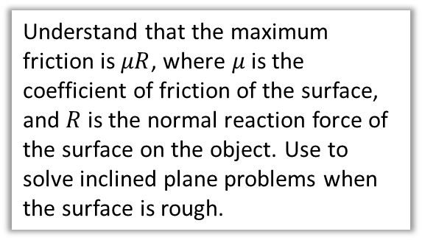

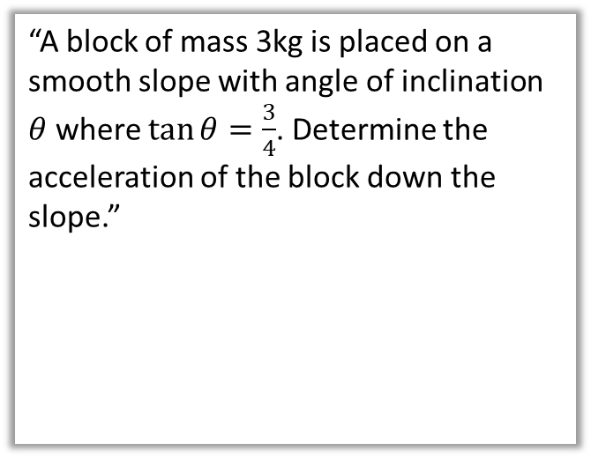





Overview
In Year 1 any frictional forces were stated. In this chapter, we will be able to calculate the frictional force using the normal reaction force acting on the object.
1:: Resolving components
2:: Inclined Planes
“Determine the magnitude and direction of the resultant force.”
“A block of mass 3kg is placed on a smooth slope with angle of inclination $θ$ where $\tan{θ}=\frac{3}{4}$. Determine the acceleration of the block down the slope.”
$5$N
$$30°$$
$2$N
$$R$$
3:: $F≤μR$
3kg
Understand that the maximum friction is $μR$, where $μ$ is the coefficient of friction of the surface, and $R$ is the normal reaction force of the surface on the object. Use to solve inclined plane problems when the surface is rough.
$$θ$$
$$3g$$

Slide 4
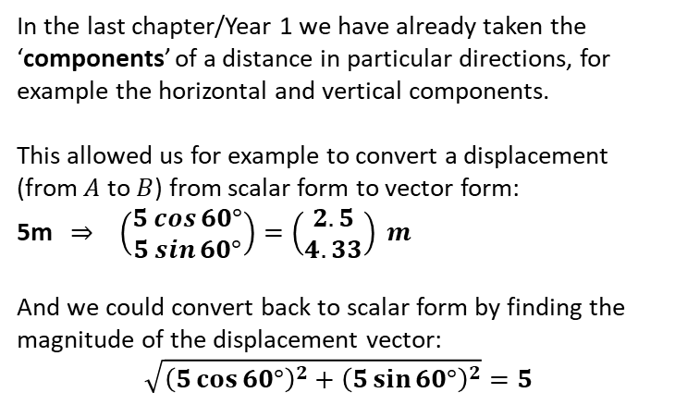




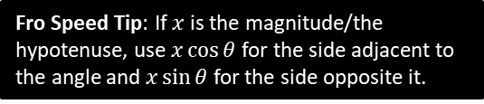




Resolving Forces
In the last chapter/Year 1 we have already taken the ‘components’ of a distance in particular directions, for example the horizontal and vertical components.
This allowed us for example to convert a displacement (from $A$ to $B$) from scalar form to vector form:
5m $⇒ \left(\begin{matrix}5\cos{60°} \\ 5\sin{60°}\end{matrix}\right)=\left(\begin{matrix}2.5 \\ 4.33\end{matrix}\right) m$
And we could convert back to scalar form by finding the magnitude of the displacement vector:
$$\sqrt{{\left(5\cos{60°}\right)}^{2}+{\left(5\sin{60°}\right)}^{2}}=5$$
$$B$$
5m
?
$$5\sin{60°}$$
$$60°$$
$$A$$
$$5\cos{60°}$$
?
Fro Speed Tip: If $x$ is the magnitude/the hypotenuse, use $x\cos{θ}$ for the side adjacent to the angle and $x\sin{θ}$ for the side opposite it.
7 N
$$60°$$
?
We can use exactly the same principle to find the components of a force, and convert between vector and scalar form.
$$7 cos 60° N$$
$$7 sin 60° N$$
?

Slide 5








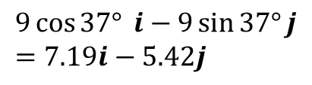




Quickfire Questions
Convert each force to the form $ai+bj$, where $i$ and $j$ are the positive $x$ and $y$ directions respectively.
1
$$8N$$
?
?
$$4\sqrt{3} i+4j$$
$$8\sin{30°}$$
3
$$30°$$
$$8\cos{30°}$$
?
$$37°$$
?
$$9\cos{37°} i−9\sin{37°}j \\ =7.19i−5.42j$$
2
$$9N$$
?
$$6\sin{45°}$$
$$6N$$
?
?
$$−3\sqrt{2} i+3\sqrt{2}j$$
$$45°$$
$$6\cos{45°}$$

Slide 6



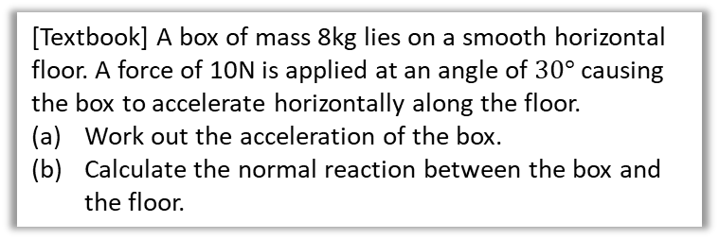


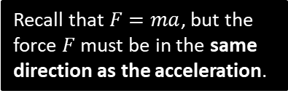


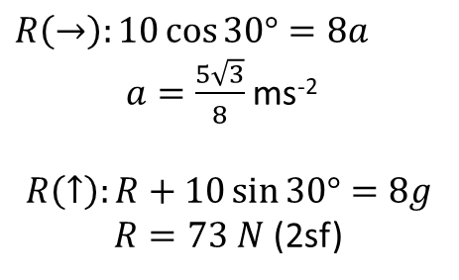
Applied Example
[Textbook] A box of mass 8kg lies on a smooth horizontal floor. A force of 10N is applied at an angle of $30°$ causing the box to accelerate horizontally along the floor.
Work out the acceleration of the box.
Calculate the normal reaction between the box and the floor.
$$10N$$
8 kg
$$30°$$
Recall that $F=ma$, but the force $F$ must be in the same direction as the acceleration.
Draw a clear force diagram, obviously!
? Diagram
$$R$$
$$10N$$
a
$R\left(→\right):10\cos{30°}=8a$
$a=\frac{5\sqrt{3}}{8}$ ms⁻²
$$R\left(↑\right):R+10\sin{30°}=8g$$
$R=73 N$ (2sf)
?
8 kg
$$30°$$
$$10\sin{30}$$
$$10\cos{30}$$
b
?
$$8g$$
HIGHLY RECOMMENDED Fro Tips:
Use dotted lines for components of a force, to distinguish from solid lines for full forces.
Make sure the direction of your components is clear in the diagram, to ensure you get the sign right in calculations.
Write the values of your components in the diagram (as above).

Slide 7








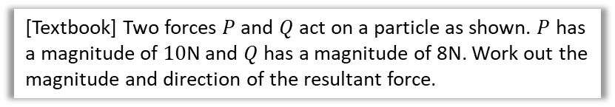











Combining Forces
$$P$$
[Textbook] Two forces $P$ and $Q$ act on a particle as shown. $P$ has a magnitude of $10$N and $Q$ has a magnitude of 8N. Work out the magnitude and direction of the resultant force.
$$45°$$
$$30°$$
Method 1: Finding total $x$ and $y$ components of force.
$$Q$$
Method 2: Using Triangle Law for vector addition.
?
Resultant force:
$$\left(\begin{matrix}10\cos{45°}+8\cos{30°} \\ 10\sin{45°}−8\sin{30°}\end{matrix}\right)=\left(\begin{matrix}13.999 \\ 3.071\end{matrix}\right)$$
Magnitude: $\sqrt{{13.999}^{2}+{3.071}^{2}}$
$$=14.3 N$$
Fropinion: Hell no.
?
$$R$$
We can avoid resolving components by drawing the force vectors in a chain, then finding the vector from the start to end point. The resultant vector (orange) geometrically represents the same of the vectors.
$$θ$$
$$10$$
$$30°$$
$$8$$
$$105°$$
$$45°$$
$$30°$$
Use cosine rule to get magnitude of $R$:
$$R^{2}=8^{2}+{10}^{2}−2×8×10×\cos\left(105°\right) \\ R=14.3 N$$
Use sine rule to get $θ$:
$$\frac{\sin\left(θ+30°\right)}{10}=\frac{\sin\left(105°\right)}{14.332} \\ \sin\left(θ+30°\right)=\frac{10\sin\left(105°\right)}{14.332} … \\ θ=12.4°$$
Do a quick sketch of the force vector to get the direction:
$$θ=\tan^{−1}\left(\frac{3.071}{13.999}\right)=12.4°$$
$$3.071$$
$$θ$$
$$13.999$$

Slide 8



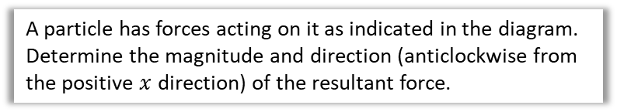





Test Your Understanding
$3$N
A particle has forces acting on it as indicated in the diagram. Determine the magnitude and direction (anticlockwise from the positive $x$ direction) of the resultant force.
$$25°$$
$$32°$$
?
Resultant force:
$$\left(\begin{matrix}4\cos{32°}−3\sin{25°} \\ 3\cos{25°}−4\sin{32°}\end{matrix}\right)=\left(\begin{matrix}2.1243 \\ 0.5992\end{matrix}\right)$$
Magnitude: $\sqrt{{2.1243}^{2}+{0.5992}^{2}}$
$$=2.21 N$$
Direction:
$θ=\tan^{−1}\left(\frac{0.5992}{2.1243}\right)$
$$=15.8°$$
$4$N
$$0.5992$$
$$θ$$
$$2.1243$$

Slide 9
Exercise 5A
Pearson Stats/Mechanics Year 2
Pages 94-96
Complete before the lesson Q1-3*
In Class:
Green Q4-5
Amber Q6-7
Red Q8-9 & Challenge

Slide 10



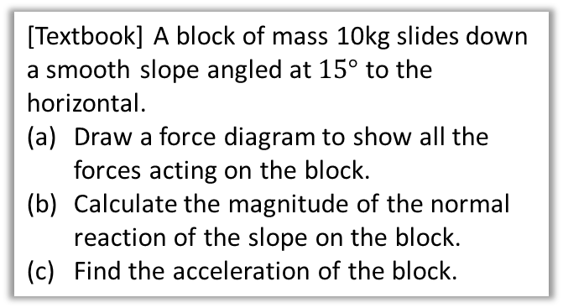





Inclined Planes
! For problems involving inclined planes, resolve forces parallel and perpendicular to the plane.
? Diagram
[Textbook] A block of mass 10kg slides down a smooth slope angled at $15°$ to the horizontal.
Draw a force diagram to show all the forces acting on the block.
Calculate the magnitude of the normal reaction of the slope on the block.
Find the acceleration of the block.
Indicate direction of acceleration with double arrow.
$$R$$
$$a$$
10kg
Recall that I recommended you do components of a force as labelled dotted arrows.
$$10g\cos{15}$$
$$15°$$
$$15°$$
$$10g\sin{15}$$
? Working
This means “resolving forces in the indicated direction”.
$$R\left(↖\right): R=10g\cos{15} \\ R\left(↙\right): Force=ma \\ 10g\sin{15}=10a$$
$a=2.5$ms⁻²
Recall that because we used $g=9.8$, which is only accurate to 2sf, we should only give the final answer to 2sf. In past mark schemes 3sf was condoned but 4 or more penalised.

Slide 11













Inclined Plane with an additional force
[Textbook] A particle of mass $m$ is pushed up a smooth slope, inclined at $30°$ by a force of magnitude $5g$ N acting at angle of $60°$ to the slope, causing the particle to accelerate up the slope at 0.5 ms⁻². Show that the mass of the particle is $\left(\frac{5g}{1+g}\right)$ kg
? Diagram
$$0.5 ms^{−2}$$
$$R$$
$$5g$$
$$5g\sin{60}$$
$m$ kg
$$60°$$
$$5g\cos{60}$$
$$mg\cos{30}$$
$$mg$$
$$30°$$
$$30°$$
$$mg\sin{30}$$
$$R\left(↗\right): 5g\cos{60°}−mg\sin{30°}=0.5m \\ 2.5g−0.5mg=0.5m \\ 2.5g=0.5m+0.5mg \\ 5g=m+mg \\ 5g=m\left(1+g\right)$$
$m=\left(\frac{5g}{1+g}\right)$ kg
? Working

Slide 12
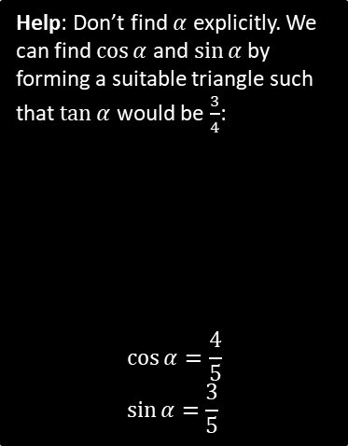







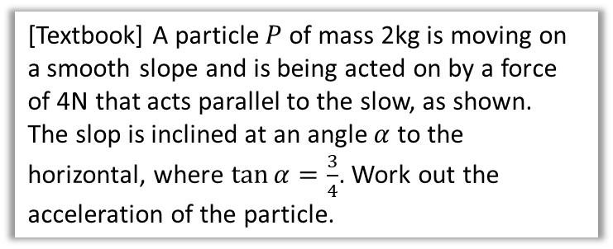






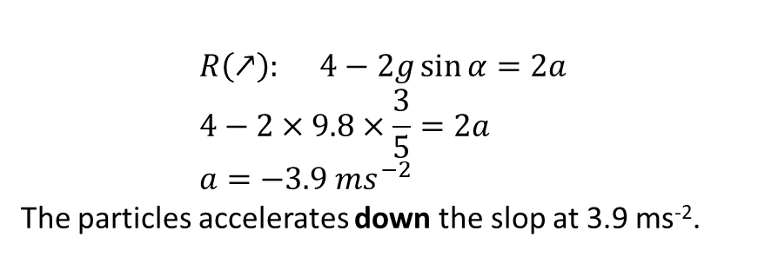






Test Your Understanding
[Textbook] A particle $P$ of mass 2kg is moving on a smooth slope and is being acted on by a force of 4N that acts parallel to the slow, as shown.
The slop is inclined at an angle $α$ to the horizontal, where $\tan{α}=\frac{3}{4}$. Work out the acceleration of the particle.
$$a$$
$$P$$
$2$ kg
$$4N$$
$$α$$
$$a$$
? Diagram
$$R$$
Help: Don’t find $α$ explicitly. We can find $\cos{α}$ and $\sin{α}$ by forming a suitable triangle such that $\tan{α}$ would be $\frac{3}{4}$:
$$\cos{α}=\frac{4}{5} \\ \sin{α}=\frac{3}{5}$$
$$P$$
$2$ kg
$$4$$
$$2g\cos{α}$$
$$α$$
$$2g$$
?
$$α$$
$$2g\sin{α}$$
$$5$$
$$3$$
$$R\left(↗\right): 4−2g\sin{α}=2a \\ 4−2×9.8×\frac{3}{5}=2a \\ a=−3.9 ms^{−2}$$
The particles accelerates down the slop at 3.9 ms⁻².
$$α$$
? Working
$$4$$
?
?

Slide 13
Exercise 5B
Pearson Stats/Mechanics Year 2
Pages 98-99
Complete before the lesson Q1&3
In Class:
Green Q4-5
Amber Q6-7
Red Q8 & Challenge

Slide 14








Friction
Scenario 1: A block is on a horizontal rough surface with no forces (other than gravity) acting on it.
$$R$$
Comment regarding friction:
No frictional force.
?
$$mg$$
Scenario 2: A cable is attached to the block and a force applied. The block doesn’t move.
Comment regarding friction:
There must be a force left (i.e. friction, which acts parallel to the plane) to counteract the tension force acting right. Note that as the tension increases but the block doesn’t move, the frictional force increases.
?
$$R$$
$$T$$
$$F$$
$$mg$$
Scenario 3: The tension is increased until the block starts to move.
Comment regarding friction:
The friction reaches a maximum. Therefore if the tension increases further, there will be an overall force right and therefore the block accelerates. The friction is in the opposite direction to motion.
$$R$$
?
$$T$$
$$F$$
$$mg$$

Slide 15
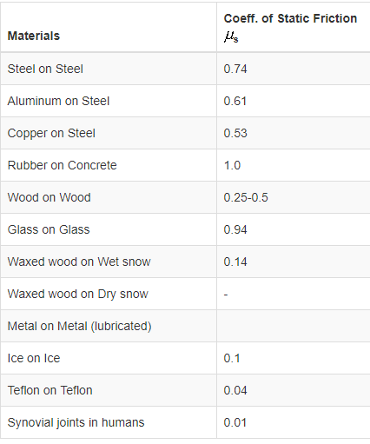
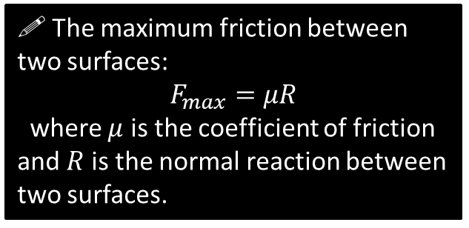
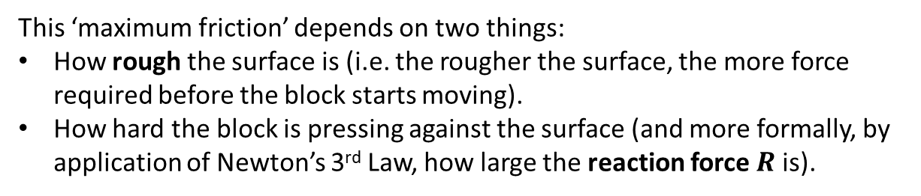

Friction
This ‘maximum friction’ depends on two things:
How rough the surface is (i.e. the rougher the surface, the more force required before the block starts moving).
How hard the block is pressing against the surface (and more formally, by application of Newton’s 3rd Law, how large the reaction force $R$ is).
?
?
Example $μ$: (source physlink.com)
! The maximum friction between two surfaces:
$$F_{max}=μR$$
where $μ$ is the coefficient of friction and $R$ is the normal reaction between two surfaces.

Slide 16
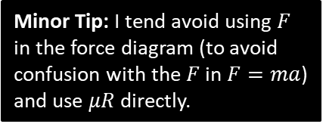


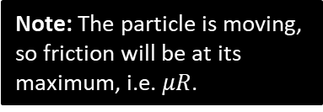

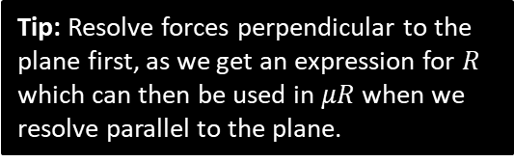


Example
[Textbook] A particle of mass 5kg is pulled along a rough horizontal surface by a horizontal force of magnitude 20N. The coefficient of friction between the particle and the floor is 0.2. Calculate:
the magnitude of frictional force
the acceleration of the particle.
Note: The particle is moving, so friction will be at its maximum, i.e. $μR$.
? Diagram
? Working
$$a$$
Tip: Resolve forces perpendicular to the plane first, as we get an expression for $R$ which can then be used in $μR$ when we resolve parallel to the plane.
$$R$$
$$μR$$
$$20$$
$R\left(↑\right): R=5g$
$R\left(→\right): 20−μR=5a$
$20−0.2\left(5g\right)=5a$
$a=2.0 ms^{−2}$
$$5g$$
Minor Tip: I tend avoid using $F$ in the force diagram (to avoid confusion with the $F$ in $F=ma$) and use $μR$ directly.

Slide 17




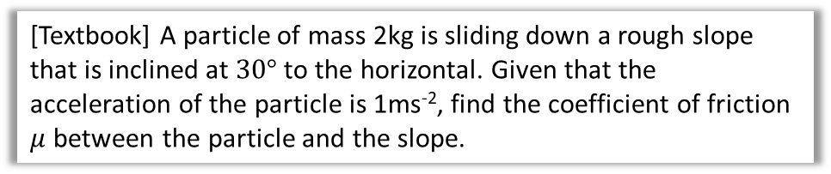




Inclined Plane with Friction Example
[Textbook] A particle of mass 2kg is sliding down a rough slope that is inclined at $30°$ to the horizontal. Given that the acceleration of the particle is 1ms⁻², find the coefficient of friction $μ$ between the particle and the slope.
Recall that friction acts in opposite direction to motion.
? Working
? Diagram
$R\left(↖\right): R=2g\cos{30°}$
$$R\left(↙\right): 2g\sin{30°}−μR=2a \\ g−2μg\cos{30°}=2a \\ …$$
$μ=\frac{7.8}{16.974…}=0.46$
$$R$$
$$1 ms^{−2}$$
$$μR$$
$$5g$$
$2$ kg
$$2g\cos{30}$$
$$2g$$
$$30°$$
$$30°$$
$$2g\sin{30}$$

Slide 18
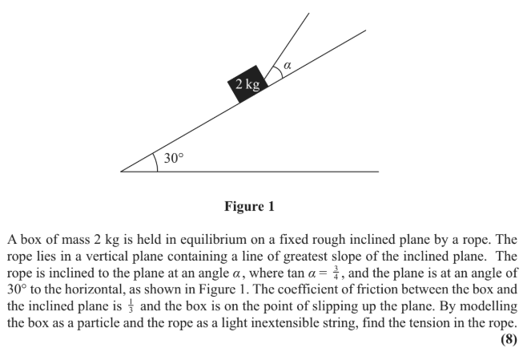
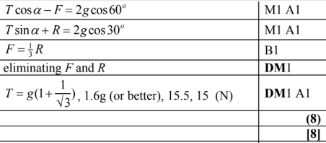
Test Your Understanding
Edexcel M1(Old) May 2013 Q3
?

Slide 19
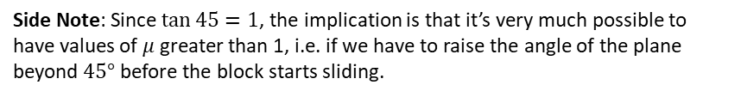

Exercise 5C
Pearson Stats/Mechanics Year 2
Pages 103-104
Additional question:
Before Q1 all parts
In Class:
Green Q2-3
Amber Q4-5
Red Q6-7 & Ext & Challenge
1
A block lies on a rough plane at an incline of $θ$. The coefficient of friction between the block and plane is $μ$. If the block is on the verge of sliding down the plane, prove that $μ=\tan{θ}$.
Let mass of block be $m$.
$$R\left(↖\right): R=mg\cos{θ} \\ R\left(↙\right): mg\sin{θ}=μR \\ mg\sin{θ}=μmg\cos{θ} \\ μ=\frac{mg\sin{θ}}{mg\cos{θ}}=\tan{θ}$$
?
Side Note: Since $\tan{45}=1$, the implication is that it’s very much possible to have values of $μ$ greater than 1, i.e. if we have to raise the angle of the plane beyond $45°$ before the block starts sliding.

