Slide 1
Polar Coordinates
Twitter: @Owen134866
www.mathsfreeresourcelibrary.com

Slide 2
Teachings for
Exercise 5D

Slide 3
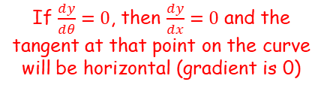


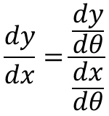



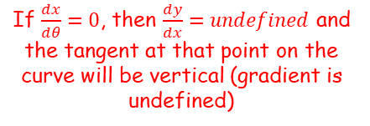
Polar Coordinates
You can use the Polar equation to find tangents to a curve that are parallel or perpendicular to the original line
We have looked at integration to find areas beneath polar curves
This final section looks at differentiating to find tangents to polar curves
It is very similar to what you have done already – ie) Differentiating and setting the expression equal to 0
With polar equations we use them in a parametric form to make the process more straightforward…
If you are given $r=f(θ)$ in polar form, you can write it parametrically in cartesian form, in terms of $θ$
$$x=rcosθ$$
$$x=f(θ)cosθ$$
$$y=rsinθ$$
$$y=f(θ)sinθ$$
We can now differentiate as with parametric equations…
If $\frac{dy}{dθ}=0$, then $\frac{dy}{dx}=0$ and the tangent at that point on the curve will be horizontal (gradient is 0)
$$\frac{dy}{dx}=\frac{\frac{dy}{dθ}}{\frac{dx}{dθ}}$$
If $\frac{dx}{dθ}=0$, then $\frac{dy}{dx}=undefined$ and the tangent at that point on the curve will be vertical (gradient is undefined)
5D

Slide 4
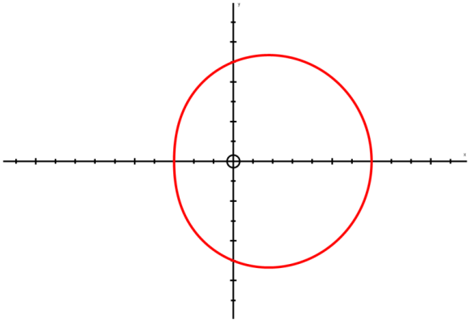





Polar Coordinates
$$\frac{dy}{dθ}=0$$
$$Parallel to the initial line$$
You can use the Polar equation to find tangents to a curve that are parallel or perpendicular to the original line
We have looked at integration to find areas beneath polar curves
This final section looks at differentiating to find tangents to polar curves
It is very similar to what you have done already – ie) Differentiating and setting the expression equal to 0
With polar equations we use them in a parametric form to make the process more straightforward…
$$y=rsinθ$$
$$x=rcosθ$$
The line from the origin at an angle of 0 is called the ‘initial line’
$$\frac{dy}{dθ}=0$$
$$\frac{dy}{dθ}=0$$
The equation y = rsinθ represents changes in the vertical direction
When ^{dy}/_{dθ} is 0, that means that there is no movement in the vertical direction (the change in y with respect to a change in θ is 0)
→ Therefore, if ^{dy}/_{dθ} is 0, the curve is parallel to the ‘initial line’
5D

Slide 5



Polar Coordinates
$$\frac{dy}{dθ}=0$$
$$Parallel to the initial line$$
$$\frac{dx}{dθ}=0$$
$$Perpendicular to the initial line$$
You can use the Polar equation to find tangents to a curve that are parallel or perpendicular to the original line
We have looked at integration to find areas beneath polar curves
This final section looks at differentiating to find tangents to polar curves
It is very similar to what you have done already – ie) Differentiating and setting the expression equal to 0
With polar equations we use them in a parametric form to make the process more straightforward…
$$y=rsinθ$$
$$x=rcosθ$$
The line from the origin at an angle of 0 is called the ‘initial line’
$$\frac{dx}{dθ}=0$$
$$\frac{dx}{dθ}=0$$
The equation x = rcosθ represents changes in the horizontal direction
When ^{dx}/_{dθ} is 0, that means that there is no movement in the horizontal direction (the change in x with respect to a change in θ is 0)
→ Therefore, if ^{dx}/_{dθ} is 0, the curve is perpendicular to the ‘initial line’
5D

Slide 6
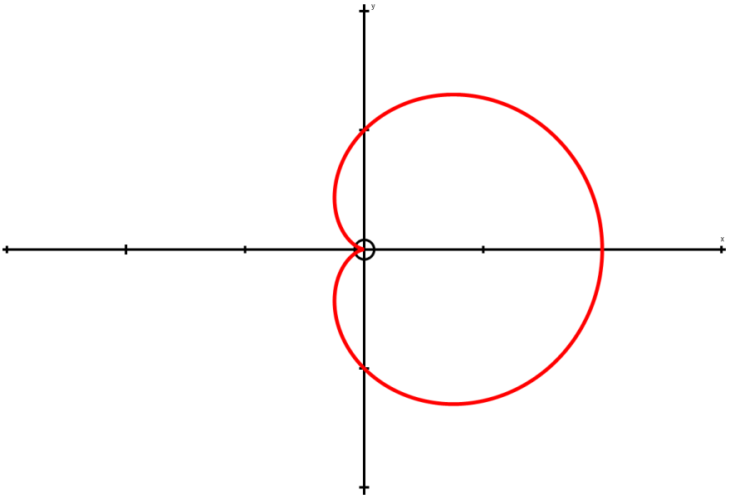









Polar Coordinates
$$\frac{dy}{dθ}=0$$
$$Parallel to the initial line$$
$$\frac{dx}{dθ}=0$$
$$Perpendicular to the initial line$$
$$x=rcosθ$$
$$y=rsinθ$$
You can use the Polar equation to find tangents to a curve that are parallel or perpendicular to the original line
Find the coordinates of the points on:
r = a(1 + cosθ)
Where the tangents are parallel to the initial line θ = 0.
You need to find an expression for y in terms of θ, before you can use the rules above
$$r=a(1+cosθ)$$
Rearrange
$$\frac{y}{sinθ}=r$$
$$y=rsinθ$$
You can substitute this into the equation of the curve to eliminate r
$$r=a(1+cosθ)$$
Replace r with a term in y and θ
$$\frac{y}{sinθ}=a(1+cosθ)$$
Multiply by sinθ
$$y=asinθ(1+cosθ)$$
Leave ‘a’ outside the bracket (it is a constant)
$$y=a(sinθ+sinθcosθ)$$
5D

Slide 7













Polar Coordinates
$$\frac{dy}{dθ}=0$$
$$Parallel to the initial line$$
$$\frac{dx}{dθ}=0$$
$$Perpendicular to the initial line$$
$$x=rcosθ$$
$$y=rsinθ$$
$$y=a(sinθ+sinθcosθ)$$
Differentiate, using the product rule where necessary
→ (alternatively, sinθcosθ could be written as ¹/₂sin2θ first, which then avoids the need for the product rule)
You can use the Polar equation to find tangents to a curve that are parallel or perpendicular to the original line
Find the coordinates of the points on:
r = a(1 + cosθ)
Where the tangents are parallel to the initial line θ = 0.
Now differentiate
You can just differentiate the terms inside the bracket, since a is a constant and will just remain the same!
$$\frac{dy}{dθ}=a( )$$
$$cosθ$$
$$+ \cos^{2}θ$$
$$− \sin^{2}θ$$
Product rule for sinθcosθ
If ^{dy}/_{dθ} is 0, then the expression in the brackets must be 0 (‘a’ cannot be as it is a constant)
$$sinθ$$
$$cosθ$$
$$c{os}^{2}θ+cosθ−s{in}^{2}θ=0$$
Replace the term in sin with one in cos (from C2)
$$cosθ$$
$$−sinθ$$
$$c{os}^{2}θ+cosθ−(1−c{os}^{2}θ)=0$$
Group terms
$$2c{os}^{2}θ+cosθ−1=0$$
Factorise
$$(2cosθ−1)(cosθ+1)=0$$
$$cosθ=\frac{1}{2} or cosθ=−1$$
5D

Slide 8








Polar Coordinates
$$\frac{dy}{dθ}=0$$
$$Parallel to the initial line$$
$$\frac{dx}{dθ}=0$$
$$Perpendicular to the initial line$$
$$x=rcosθ$$
$$y=rsinθ$$
$$cosθ=\frac{1}{2} or cosθ=−1$$
You can use the Polar equation to find tangents to a curve that are parallel or perpendicular to the original line
Find the coordinates of the points on:
r = a(1 + cosθ)
Where the tangents are parallel to the initial line θ = 0.
Find θ in the range 0 ≤ θ < 2π
Find θ in the range 0 ≤ θ < 2π
$$θ=\frac{π}{3} or −\frac{π}{3}$$
Use these to find r so you have the full coordinates
$$θ=π$$
$$r=0$$
$$r=\frac{3a}{2} (for both)$$
So the curve is parallel to the initial line in these positions:
$$\left(\frac{3a}{2},±\frac{π}{3}\right) and \left(0,π\right)$$
(^{3a}/₂,^{π}/₃)
$$r=a(1+cosθ)$$
(0,π)
(^{3a}/₂,-^{π}/₃)
5D

Slide 9
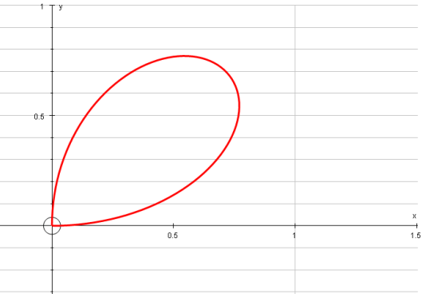


Polar Coordinates
$$\frac{dy}{dθ}=0$$
$$Parallel to the initial line$$
$$\frac{dx}{dθ}=0$$
$$Perpendicular to the initial line$$
$$x=rcosθ$$
$$y=rsinθ$$
You can use the Polar equation to find tangents to a curve that are parallel or perpendicular to the original line
Find the coordinates and the equations of the tangents to the curve:
r = asin2θ, 0 ≤ θ ≤ ^{π}/₂
Where the tangents are:
Parallel to the initial line
Perpendicular to the initial line
Give answers to 3 s.f where appropriate:
→ Sketch it to get an idea of where the tangents will be…
So we need to find the equations of the tangents that are parallel to the initial line
^{dy}/_{dθ} = 0
As in the previous example, we will need to find an expression for y
$$y=rsinθ$$
You can actually substitute r straight in if you want to (this was also an option on the previous example!)
$$y=asin2θsinθ$$
5D

Slide 10




















Polar Coordinates
$$\frac{dy}{dθ}=0$$
$$Parallel to the initial line$$
$$\frac{dx}{dθ}=0$$
$$Perpendicular to the initial line$$
$$x=rcosθ$$
$$y=rsinθ$$
You can use the Polar equation to find tangents to a curve that are parallel or perpendicular to the original line
Find the coordinates and the equations of the tangents to the curve:
r = asin2θ, 0 ≤ θ ≤ ^{π}/₂
Where the tangents are:
Parallel to the initial line
Perpendicular to the initial line
Give answers to 3 s.f where appropriate:
→ Now we can differentiate
$$y=a(sin2θsinθ)$$
Product rule for sinθcosθ
$$\frac{dy}{dθ}=$$
$$a($$
$$)$$
$$sin2θ$$
$$sinθ$$
$$sin2θcosθ$$
$$+ 2cos2θsinθ$$
If ^{dy}/_{dθ} = 0, then the part in the bracket must be 0
$$2cos2θ$$
$$cosθ$$
$$sin2θcosθ+2cos2θsinθ=0$$
Replace sin2θ and cos2θ with equivalent expressions from C3
$$2sinθcosθcosθ$$
$$+ 2\left(2\cos^{2}θ−1\right)sinθ=0$$
Simplify/Multiply out brackets
$$2sinθcos^{2}θ+4\cos^{2}θsinθ−2sinθ=0$$
Group terms
$$6sinθcos^{2}θ−2sinθ=0$$
Factorise
$$2sinθ(3cos^{2}θ−1)=0$$
Solve in the range you’re given
$$2sinθ=0$$
$$\cos^{2}θ=\frac{1}{3}$$
$$θ=0$$
$$cosθ=\frac{1}{\sqrt{3}}$$
$$θ=0.955$$
5D

Slide 11




Polar Coordinates
$$\frac{dy}{dθ}=0$$
$$Parallel to the initial line$$
$$\frac{dx}{dθ}=0$$
$$Perpendicular to the initial line$$
$$x=rcosθ$$
$$y=rsinθ$$
You can use the Polar equation to find tangents to a curve that are parallel or perpendicular to the original line
Find the coordinates and the equations of the tangents to the curve:
r = asin2θ, 0 ≤ θ ≤ ^{π}/₂
Where the tangents are:
Parallel to the initial line
Perpendicular to the initial line
Give answers to 3 s.f where appropriate:
→ You can find the value of r for each, and use the sketch to find the equation of the tangent
$$θ=0 or θ=0.955$$
(^{2a√2}/₃,0.955)
$$r=0 or r=\frac{2a\sqrt{2}}{3}$$
$$θ=0$$
(0,0)
The equation of this line is just:
$$θ=0$$
5D

Slide 12






Polar Coordinates
$$\frac{dy}{dθ}=0$$
$$Parallel to the initial line$$
$$\frac{dx}{dθ}=0$$
$$Perpendicular to the initial line$$
$$x=rcosθ$$
$$y=rsinθ$$
You can use the Polar equation to find tangents to a curve that are parallel or perpendicular to the original line
Find the coordinates and the equations of the tangents to the curve:
r = asin2θ, 0 ≤ θ ≤ ^{π}/₂
Where the tangents are:
Parallel to the initial line
Perpendicular to the initial line
Give answers to 3 s.f where appropriate:
$$θ=0 or θ=0.955$$
(^{2a√2}/₃,0.955)
$$r=0 or r=\frac{2a\sqrt{2}}{3}$$
$$θ=0$$
$$cosθ=\frac{1}{\sqrt{3}}$$
$$sinθ=\frac{\sqrt{2}}{\sqrt{3}}$$
We need to find the equation of the dotted line above (in polar form…)
→ A couple of trig ratios will be useful to us here. We already know that for this point:
$$cosθ=\frac{1}{\sqrt{3}}$$
$$\left(\frac{Adj}{Hyp}\right)$$
Hyp
√3
√2
Opp
$$sinθ=\frac{\sqrt{2}}{\sqrt{3}}$$
$$\left(\frac{Opp}{Hyp}\right)$$
θ
1
Adj
5D

Slide 13




Polar Coordinates
$$\frac{dy}{dθ}=0$$
$$Parallel to the initial line$$
$$\frac{dx}{dθ}=0$$
$$Perpendicular to the initial line$$
$$x=rcosθ$$
$$y=rsinθ$$
You can use the Polar equation to find tangents to a curve that are parallel or perpendicular to the original line
Find the coordinates and the equations of the tangents to the curve:
r = asin2θ, 0 ≤ θ ≤ ^{π}/₂
Where the tangents are:
Parallel to the initial line
Perpendicular to the initial line
Give answers to 3 s.f where appropriate:
$$θ=0 or θ=0.955$$
(^{2a√2}/₃,0.955)
$$r=0 or r=\frac{2a\sqrt{2}}{3}$$
^{2a√2}/₃
Opp
$$θ=0$$
θ
$$cosθ=\frac{1}{\sqrt{3}}$$
$$sinθ=\frac{\sqrt{2}}{\sqrt{3}}$$
You can find the equation of the line in Cartesian form, then substitute it into the link between y and r above
The Cartesian form will just be y = a, where a is the height of the line
$$Opp=Hyp×Sinθ$$
$$Opp=\frac{2a\sqrt{2}}{3}×\frac{\sqrt{2}}{\sqrt{3}}$$
Sub in values
Calculate
$$Opp=\frac{4a}{3\sqrt{3}}$$
So this is the Cartesian equation of the tangent…
$$y=\frac{4a}{3\sqrt{3}}$$
5D

Slide 14






Polar Coordinates
$$\frac{dy}{dθ}=0$$
$$Parallel to the initial line$$
$$\frac{dx}{dθ}=0$$
$$Perpendicular to the initial line$$
$$x=rcosθ$$
$$y=rsinθ$$
You can use the Polar equation to find tangents to a curve that are parallel or perpendicular to the original line
Find the coordinates and the equations of the tangents to the curve:
r = asin2θ, 0 ≤ θ ≤ ^{π}/₂
Where the tangents are:
Parallel to the initial line
Perpendicular to the initial line
Give answers to 3 s.f where appropriate:
$$θ=0 or θ=0.955$$
(^{2a√2}/₃,0.955)
$$r=\frac{4a}{3\sqrt{3}}cosecθ$$
$$r=0 or r=\frac{2a\sqrt{2}}{3}$$
$$θ=0$$
$$r=\frac{4a}{3\sqrt{3}}cosecθ$$
$$y=\frac{4a}{3\sqrt{3}}$$
$$θ=0$$
Now use the link between y and r above to turn the equation into a polar form…
$$y=rsinθ$$
Replace y with the expression we calculated
$$\frac{4a}{3\sqrt{3}}=rsinθ$$
$$\frac{4a}{3\sqrt{3}sinθ}=r$$
Divide by sinθ
$$r=\frac{4a}{3\sqrt{3}}cosecθ$$
Alternative form…
5D

Slide 15


Polar Coordinates
$$\frac{dy}{dθ}=0$$
$$Parallel to the initial line$$
$$\frac{dx}{dθ}=0$$
$$Perpendicular to the initial line$$
$$x=rcosθ$$
$$y=rsinθ$$
You can use the Polar equation to find tangents to a curve that are parallel or perpendicular to the original line
Find the coordinates and the equations of the tangents to the curve:
r = asin2θ, 0 ≤ θ ≤ ^{π}/₂
Where the tangents are:
Parallel to the initial line
Perpendicular to the initial line
Give answers to 3 s.f where appropriate:
→ Now we need to do the same for the tangents perpendicular to the initial line…
So we now need to find the equations of the tangents that are perpendicular to the initial line
^{dx}/_{dθ} = 0
We will need to find an expression for x in terms of θ
$$x=rcosθ$$
Substitute the expression for r in
$$x=asin2θcosθ$$
5D

Slide 16

















Polar Coordinates
$$\frac{dy}{dθ}=0$$
$$Parallel to the initial line$$
$$\frac{dx}{dθ}=0$$
$$Perpendicular to the initial line$$
$$x=rcosθ$$
$$y=rsinθ$$
You can use the Polar equation to find tangents to a curve that are parallel or perpendicular to the original line
Find the coordinates and the equations of the tangents to the curve:
r = asin2θ, 0 ≤ θ ≤ ^{π}/₂
Where the tangents are:
Parallel to the initial line
Perpendicular to the initial line
Give answers to 3 s.f where appropriate:
→ Now we can differentiate
$$x=a(sin2θcosθ)$$
Product rule for sinθcosθ
$$\frac{dy}{dθ}=$$
$$a($$
$$)$$
$$2cos2θcosθ$$
$$− sin2θsinθ$$
$$sin2θ$$
$$cosθ$$
If ^{dx}/_{dθ} = 0, then the part in the bracket must be 0
$$2cos2θ$$
$$−sinθ$$
$$2cos2θcosθ−sin2θsinθ=0$$
Replace cos2θ and sin2θ with equivalent expressions from C3
$$2(1−2\sin^{2}θ)cosθ−2sinθcosθsinθ=0$$
Simplify/Multiply out brackets
$$2cosθ−4\sin^{2}θcosθ−2sin^{2}θcosθ=0$$
Group terms
$$2cosθ−6\sin^{2}θcosθ=0$$
Factorise
$$2cosθ(1−3\sin^{2}θ)=0$$
Solve in the range you’re given
$$2cosθ=0$$
$$\sin^{2}θ=\frac{1}{3}$$
$$θ=\frac{π}{2}$$
$$sinθ=\frac{1}{\sqrt{3}}$$
$$θ=0.615$$
5D

Slide 17



Polar Coordinates
$$\frac{dy}{dθ}=0$$
$$Parallel to the initial line$$
$$\frac{dx}{dθ}=0$$
$$Perpendicular to the initial line$$
$$x=rcosθ$$
$$y=rsinθ$$
$$θ=\frac{π}{2} or θ=0.615$$
You can use the Polar equation to find tangents to a curve that are parallel or perpendicular to the original line
Find the coordinates and the equations of the tangents to the curve:
r = asin2θ, 0 ≤ θ ≤ ^{π}/₂
Where the tangents are:
Parallel to the initial line
Perpendicular to the initial line
Give answers to 3 s.f where appropriate:
You can find the value of r for each, and use the sketch to find the equation of the tangent
$$r=0 or r=\frac{2a\sqrt{2}}{3}$$
(^{2a√2}/₃,0.615)
$$θ=\frac{π}{2}$$
(0,^{π}/₂)
The equation of this line is just:
$$θ=\frac{π}{2}$$
5D

Slide 18






Polar Coordinates
$$\frac{dy}{dθ}=0$$
$$Parallel to the initial line$$
$$\frac{dx}{dθ}=0$$
$$Perpendicular to the initial line$$
$$x=rcosθ$$
$$y=rsinθ$$
$$θ=\frac{π}{2} or θ=0.615$$
You can use the Polar equation to find tangents to a curve that are parallel or perpendicular to the original line
Find the coordinates and the equations of the tangents to the curve:
r = asin2θ, 0 ≤ θ ≤ ^{π}/₂
Where the tangents are:
Parallel to the initial line
Perpendicular to the initial line
Give answers to 3 s.f where appropriate:
$$r=0 or r=\frac{2a\sqrt{2}}{3}$$
(^{2a√2}/₃,0.615)
$$θ=\frac{π}{2}$$
$$sinθ=\frac{1}{\sqrt{3}}$$
$$cosθ=\frac{\sqrt{2}}{\sqrt{3}}$$
We need to find the equation of the line above (in polar form…)
→ A couple of trig ratios will be useful to us here (as before). We already know that for this point:
$$sinθ=\frac{1}{\sqrt{3}}$$
$$\left(\frac{Opp}{Hyp}\right)$$
Hyp
√3
1
Opp
$$cosθ=\frac{\sqrt{2}}{\sqrt{3}}$$
$$\left(\frac{Adj}{Hyp}\right)$$
θ
√2
Adj
5D

Slide 19




Polar Coordinates
$$\frac{dy}{dθ}=0$$
$$Parallel to the initial line$$
$$\frac{dx}{dθ}=0$$
$$Perpendicular to the initial line$$
$$x=rcosθ$$
$$y=rsinθ$$
$$θ=\frac{π}{2} or θ=0.615$$
You can use the Polar equation to find tangents to a curve that are parallel or perpendicular to the original line
Find the coordinates and the equations of the tangents to the curve:
r = asin2θ, 0 ≤ θ ≤ ^{π}/₂
Where the tangents are:
Parallel to the initial line
Perpendicular to the initial line
Give answers to 3 s.f where appropriate:
$$r=0 or r=\frac{2a\sqrt{2}}{3}$$
(^{2a√2}/₃,0.615)
^{2a√2}/₃
$$θ=\frac{π}{2}$$
θ
$$sinθ=\frac{1}{\sqrt{3}}$$
$$cosθ=\frac{\sqrt{2}}{\sqrt{3}}$$
Adj
You can find the equation of the line in Cartesian form, then substitute it into the link between y and r above
The Cartesian form will just be x = a, where a is the horizontal distance of the line from the origin
$$Adj=Hyp×Cosθ$$
$$Adj=\frac{2a\sqrt{2}}{3}×\frac{\sqrt{2}}{\sqrt{3}}$$
Sub in values
Calculate
$$Adj=\frac{4a}{3\sqrt{3}}$$
So this is the Cartesian equation of the tangent…
$$x=\frac{4a}{3\sqrt{3}}$$
5D

Slide 20








Polar Coordinates
$$\frac{dy}{dθ}=0$$
$$Parallel to the initial line$$
$$\frac{dx}{dθ}=0$$
$$Perpendicular to the initial line$$
$$x=rcosθ$$
$$y=rsinθ$$
$$θ=\frac{π}{2} or θ=0.615$$
You can use the Polar equation to find tangents to a curve that are parallel or perpendicular to the original line
Find the coordinates and the equations of the tangents to the curve:
r = asin2θ, 0 ≤ θ ≤ ^{π}/₂
Where the tangents are:
Parallel to the initial line
Perpendicular to the initial line
Give answers to 3 s.f where appropriate:
$$r=0 or r=\frac{2a\sqrt{2}}{3}$$
$$θ=\frac{π}{2}$$
(^{2a√2}/₃,0.615)
$$θ=\frac{π}{2}$$
$$r=\frac{4a}{3\sqrt{3}}secθ$$
$$x=\frac{4a}{3\sqrt{3}}$$
$$r=\frac{4a}{3\sqrt{3}}secθ$$
Now use the link between x and r above to turn the equation into a polar form…
$$x=rcosθ$$
Replace y with the expression we calculated
$$\frac{4a}{3\sqrt{3}}=rcosθ$$
Divide by sinθ
$$\frac{4a}{3\sqrt{3}cosθ}=r$$
$$r=\frac{4a}{3\sqrt{3}}secθ$$
Alternative form…
5D

Slide 21
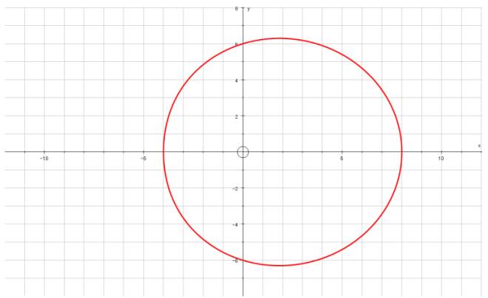
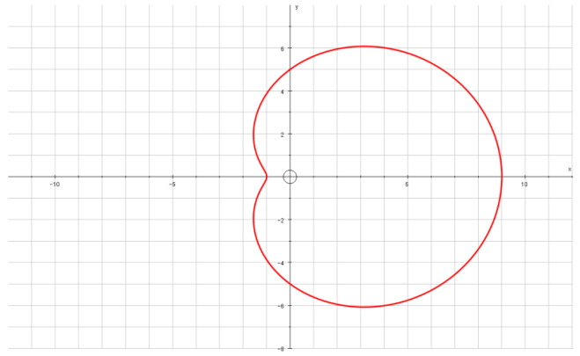
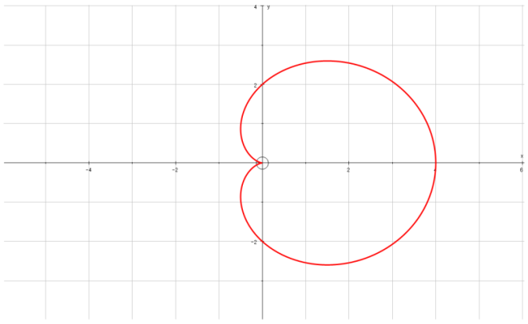
Polar Coordinates
$$\frac{dy}{dθ}=0$$
$$Parallel to the initial line$$
$$\frac{dx}{dθ}=0$$
$$Perpendicular to the initial line$$
$$x=rcosθ$$
$$y=rsinθ$$
You can use the Polar equation to find tangents to a curve that are parallel or perpendicular to the original line
Prove that for:
r = (p + qcosθ), p and q both > 0 and p ≥ q
to have a ‘dimple’, p < 2q and also
p ≥ q.
(so q ≤ p < 2q)
→ We can use the ideas we have just seen for finding tangents here…
If the graph is convex, there will be 2 tangents that are perpendicular to the initial line
If the graph has a ‘dimple’, there will be 4 solutions
If the graph is a cardioid, there will be 3 solutions (the curve does not go vertical at the origin here)
5D

Slide 22

















Polar Coordinates
$$\frac{dy}{dθ}=0$$
$$Parallel to the initial line$$
$$\frac{dx}{dθ}=0$$
$$Perpendicular to the initial line$$
$$x=rcosθ$$
$$y=rsinθ$$
You can use the Polar equation to find tangents to a curve that are parallel or perpendicular to the original line
Prove that for:
r = (p + qcosθ), p and q both > 0 and p ≥ q
to have a ‘dimple’, p < 2q and also
p ≥ q.
→ We can find ^{dx}/_{dθ} for the above curve, and set it equal to 0 (as we did previously)
→ We can then consider the number of solutions, based on the sine or cos graphs – we need 4 for a ‘dimple’ to exist
$$x=rcosθ$$
Replace r using the equation
$$x=(p+qcosθ)cosθ$$
Multiply out the bracket
$$x=pcosθ+q\cos^{2}θ$$
Differentiate (using the Chain rule where needed)
$$\frac{dx}{dθ}=$$
$$−psinθ$$
$$−2qcosθsinθ$$
Chain rule for qcos²θ
$${qcos}^{2}θ$$
We are looking for places where the curve is perpendicular to the initial line, so ^{dx}/_{dθ} = 0
$$−psinθ−2qcosθsinθ=0$$
$${q\left(cosθ\right)}^{2}$$
Factorise
$$sinθ(−p−2qcosθ)=0$$
$${2q(cosθ)}^{1}$$
$$\left(sinθ\right)$$
$$sinθ=0$$
$$−p−2qcosθ=0$$
$$θ=0 or π$$
$$2qcosθsinθ$$
Add -2qcosθ
$$−p=2qcosθ$$
We don’t need to include 2π as it is a repeat of the solution for 0
→ This gives us 2 solutions so far…
$$−\frac{p}{2q}=cosθ$$
Divide by 2q
Solving this equation can give us 0, 1 or 2 answers depending on p and q…
5D

Slide 23




Polar Coordinates
$$\frac{dy}{dθ}=0$$
$$Parallel to the initial line$$
$$\frac{dx}{dθ}=0$$
$$Perpendicular to the initial line$$
$$x=rcosθ$$
$$y=rsinθ$$
$$sinθ(−p−2qcosθ)=0$$
You can use the Polar equation to find tangents to a curve that are parallel or perpendicular to the original line
Prove that for:
r = (p + qcosθ), p and q both > 0 and p ≥ q
to have a ‘dimple’, p < 2q and also
p ≥ q.
As the value for cosθ is negative, it must be between ^{π}/₂ and ^{3π}/₂
$$sinθ=0$$
$$−\frac{p}{2q}=cosθ$$
$$θ=0 or π$$
If p > 2q
Eg) p = 5, q = 1
The fraction will be top-heavy
(in this case -⁵/₂)
Cosθ will be less than -1
No solutions in this range
If p < 2q
Eg) p = 3, q = 2
The fraction will be ‘regular’
(in this case -³/₄)
Cosθ will be between 0 and -1
2 solutions in this range
1
Cosθ
0
If p = 2q
Eg) p = 6, q = 3
Cos θ = -1
1 solution (θ = π)
So p ≥ q
-1
^{π}/₂
π
^{3π}/₂
2π
and
p < 2q
Therefore:
q ≤ p <2q
5D

Slide 24
Polar Coordinates
$$\frac{dy}{dθ}=0$$
$$Parallel to the initial line$$
$$\frac{dx}{dθ}=0$$
$$Perpendicular to the initial line$$
$$x=rcosθ$$
$$y=rsinθ$$
You can use the Polar equation to find tangents to a curve that are parallel or perpendicular to the original line
Prove that for:
r = (p + qcosθ), p and q both > 0 and p ≥ q
to have a ‘dimple’, p < 2q and also
p ≥ q.
Yes, you were actually just given this part of the solution!
→ If p was not greater than q, there would be a lot of undefined areas on the graph, and hence the full shape would not exist (there may actually be no defined areas at all)
5D

Slide 25
Exercise 5D
Pearson Core Pure Year 2
Page 115-116
(Note: I have included an Edexcel FP2 (Old Spec) compilation of Polar Coordinate questions with the download for these slides)
Complete before the lesson Q1
In Class:
Green Q2-3
Amber Q4-6
Red Q7-8

