Slide 1

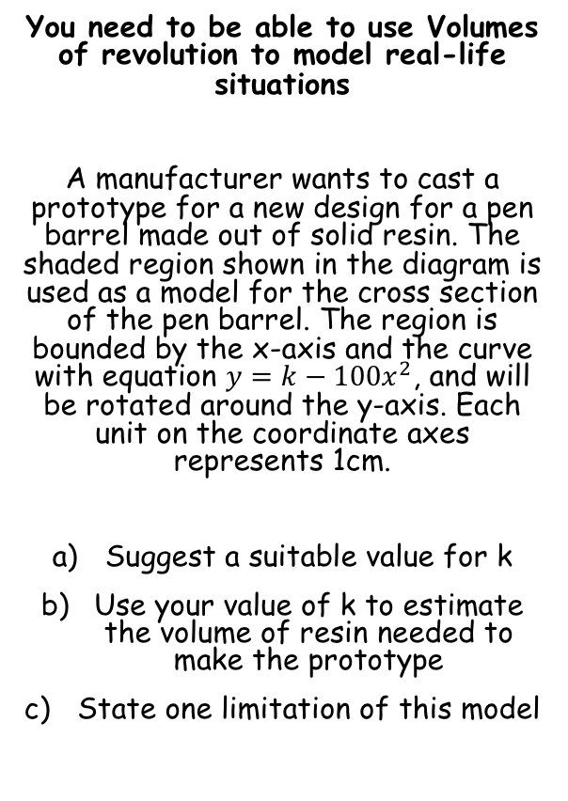
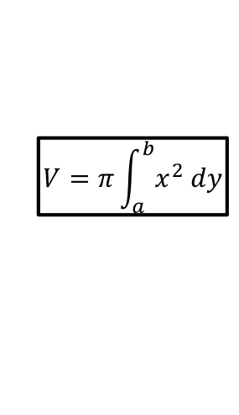


Volumes of Revolution
$$V=π\int_{a}^{b}{y^{2} dx}$$
$$V=π\int_{a}^{b}{x^{2} dy}$$
For rotation about the x axis
For rotation about the y axis
y
You need to be able to use Volumes of revolution to model real-life situations
A manufacturer wants to cast a prototype for a new design for a pen barrel made out of solid resin. The shaded region shown in the diagram is used as a model for the cross section of the pen barrel. The region is bounded by the x-axis and the curve with equation $y=k−100x^{2}$, and will be rotated around the y-axis. Each unit on the coordinate axes represents 1cm.
Suggest a suitable value for k
Use your value of k to estimate the volume of resin needed to make the prototype
State one limitation of this model
$$y=k−100x^{2}$$
x
O
a) Most pens are around 10-15cm long so anything in this range would be sensible
$$k=10$$
5D

Slide 2
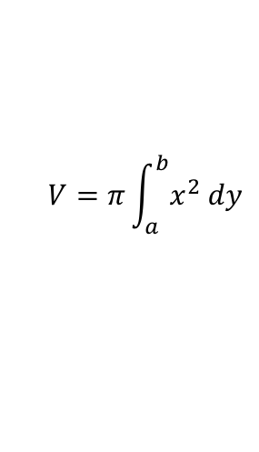
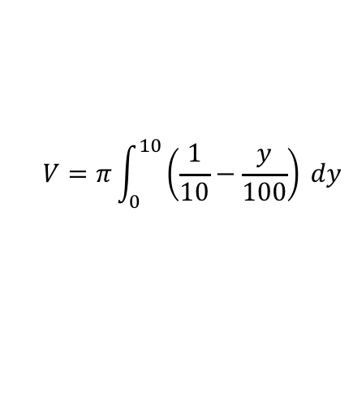





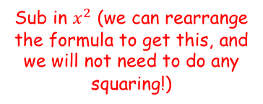
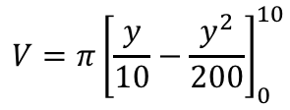
Volumes of Revolution
$$V=π\int_{a}^{b}{y^{2} dx}$$
$$V=π\int_{a}^{b}{x^{2} dy}$$
For rotation about the x axis
For rotation about the y axis
y
$$y=10−100x^{2}$$
10
$$y=10−100x^{2}$$
You need to be able to use Volumes of revolution to model real-life situations
A manufacturer wants to cast a prototype for a new design for a pen barrel made out of solid resin. The shaded region shown in the diagram is used as a model for the cross section of the pen barrel. The region is bounded by the x-axis and the curve with equation $y=k−100x^{2}$, and will be rotated around the y-axis. Each unit on the coordinate axes represents 1cm.
Suggest a suitable value for k
Use your value of k to estimate the volume of resin needed to make the prototype
State one limitation of this model
$$y=k−100x^{2}$$
$$100x^{2}=10−y$$
$$x^{2}=\frac{1}{10}−\frac{y}{100}$$
0
x
O
→ Note that we are rotating about the y-axis, and the horizontal limits will be 0 and 10
$$V=π\int_{a}^{b}{x^{2} dy}$$
Sub in $x^{2}$ (we can rearrange the formula to get this, and we will not need to do any squaring!)
$$V=π\int_{0}^{10}{\left(\frac{1}{10}−\frac{y}{100}\right) dy}$$
$$k=10$$
Integrate and use a square bracket
$$V=π{\left[\frac{y}{10}−\frac{y^{2}}{200}\right]}_{0}^{10}$$
Sub in limits and subtract (you need to show this)
$$V=\frac{π}{2}$$
5D

Slide 3

Volumes of Revolution
$$V=π\int_{a}^{b}{y^{2} dx}$$
$$V=π\int_{a}^{b}{x^{2} dy}$$
For rotation about the x axis
For rotation about the y axis
y
You need to be able to use Volumes of revolution to model real-life situations
A manufacturer wants to cast a prototype for a new design for a pen barrel made out of solid resin. The shaded region shown in the diagram is used as a model for the cross section of the pen barrel. The region is bounded by the x-axis and the curve with equation $y=k−100x^{2}$, and will be rotated around the y-axis. Each unit on the coordinate axes represents 1cm.
Suggest a suitable value for k
Use your value of k to estimate the volume of resin needed to make the prototype
State one limitation of this model
10
$$y=10−100x^{2}$$
0
x
O
$$k=10$$
$$V=\frac{π}{2}$$
It is unlikely that the cross-section of the pen will match the curve exactly, the pen might have other parts to it that affect the shape etc…
5D

Slide 4
Exercise 5D
Pearson Further Core Mathematics Year 1/AS
Complete before the lesson Q1-2
In Class:
Green Q3-4
Amber Q5-6
Red Q7 & challenge

