Slide 1

Further Mechanics 1 :
Elastic Strings and Springs
Mr Ingall
(the boss of www.drfrostmaths.com)
Last modified: 24th Jan 2019

Slide 2



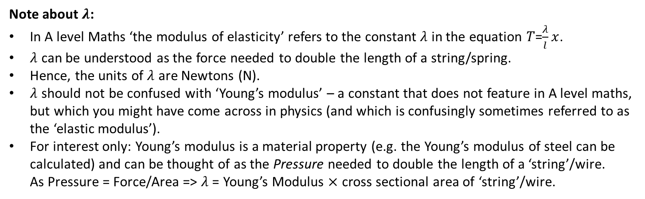
Hooke’s Law
ceiiinosssttuu
Tip: It’s an anagram
Ut tensio, sic vis.
2nd Tip: Don’t worry if you couldn’t solve it - it’s Latin. Can you translate?
As the extension, so the force.
3rd Tip: Don’t worry if you couldn’t translate it – or understand it!
Robert Hooke first stated his law in 1676 as a Latin anagram – and in 1678 with the solution. It will be presented sensibly in a click.
Hooke’s Law: When an elastic string or spring is stretched, the Tension, $T$, produced is proportional to the extension, $x$.
$T=kx$
The constant of proportionality, $k$, can be written as $\frac{λ}{l}$, where:
$λ$ is known as ‘the modulus of elasticity’ (see note)
$l$ is the ‘natural (upstretched) length’ of the string/spring.
$T=\frac{λ}{l}x$
Note about $λ$:
In A level Maths ‘the modulus of elasticity’ refers to the constant $λ$ in the equation 𝑇=$\frac{λ}{l}x$.
$λ$ can be understood as the force needed to double the length of a string/spring.
Hence, the units of $λ$ are Newtons (N).
$λ$ should not be confused with ‘Young’s modulus’ – a constant that does not feature in A level maths, but which you might have come across in physics (and which is confusingly sometimes referred to as the ‘elastic modulus’).
For interest only: Young’s modulus is a material property (e.g. the Young’s modulus of steel can be calculated) and can be thought of as the Pressure needed to double the length of a ‘string’/wire.
As Pressure = Force/Area => $λ$ = Young’s Modulus $×$ cross sectional area of ‘string’/wire.

Slide 3
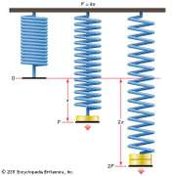
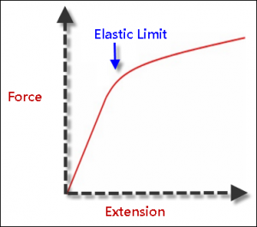
Hooke’s Law: When it Applies
Many springs, strings, wires and solids obey Hooke’s Law in a limited range.
Hooke’s law only ever applies up to a maximum force known as the elastic limit which varies for each spring etc. Under very large forces springs deform and break.
If a string or spring obeys Hooke’s Law it is called elastic¹.
An elastic spring can also be compressed (producing thrust instead of tension). However, elastic strings don’t resist compression (think about how string behaves).
All string/springs (in A Level Maths) are light => they don’t extend under their own weight.
Graph showing the extension of a Spring as the weight hung from it, and hence the tension in the spring, increases.
The variables are in direct proportion (obeying Hooke’s Law) up to the ‘elastic limit’ beyond which the law doesn’t hold.
1. In A Level maths an elastic string/spring can always be assumed to be one which obeys Hooke’s law. Beyond A Level Maths (e.g. a rubber band) elastic behaviour can be observed (i.e. it returns to its original position when the deforming load is removed) but Hooke’s Law is not obeyed. Hence the ‘limit of proportionality’ can be different to the ‘elastic limit’ – you do not need to worry about these cases!

Slide 4


A Simple Example
[Textbook] An elastic string of natural length 2m and modulus of elasticity 29.4N has one end fixed. A particle of mass 4kg is attached to the other end and hangs at rest. Find the extension of the string.
($↕$) $T=4g$
$T=\frac{λx}{l}$
$4g=\frac{29.4x}{2}$
$x=\frac{8}{3}$m
?
2
T
$$x$$
4g

Slide 5
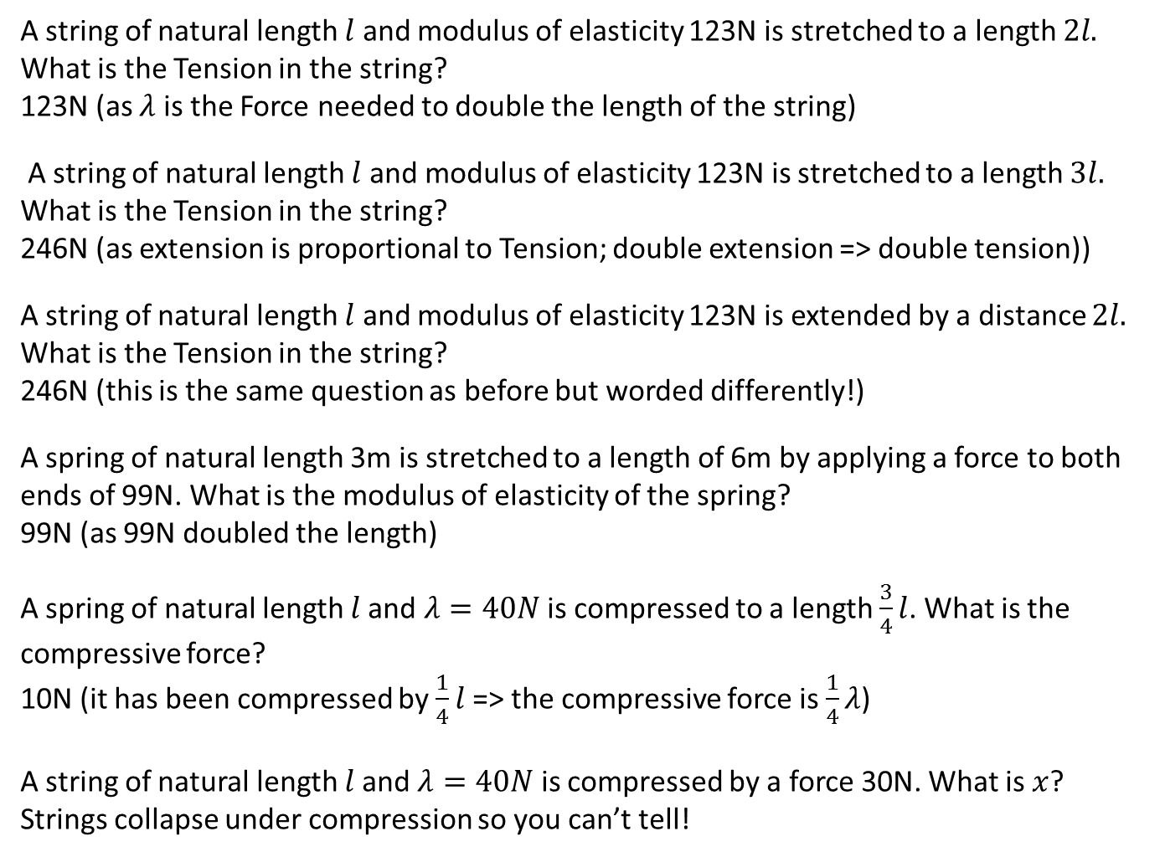
Quickfire $λ$
A string of natural length $l$ and modulus of elasticity 123N is stretched to a length $2l.$
What is the Tension in the string?
123N (as $λ$ is the Force needed to double the length of the string)
A string of natural length $l$ and modulus of elasticity 123N is stretched to a length $3l.$
What is the Tension in the string?
246N (as extension is proportional to Tension; double extension => double tension))
A string of natural length $l$ and modulus of elasticity 123N is extended by a distance $2l.$
What is the Tension in the string?
246N (this is the same question as before but worded differently!)
A spring of natural length 3m is stretched to a length of 6m by applying a force to both ends of 99N. What is the modulus of elasticity of the spring?
99N (as 99N doubled the length)
A spring of natural length $l$and $λ=40N$ is compressed to a length $\frac{3}{4}l$. What is the compressive force?
10N (it has been compressed by $\frac{1}{4}l$ => the compressive force is $\frac{1}{4}λ$)
A string of natural length $l$and $λ=40N$ is compressed by a force 30N. What is $x$?
Strings collapse under compression so you can’t tell!
?
?
?
?
?
?

Slide 6


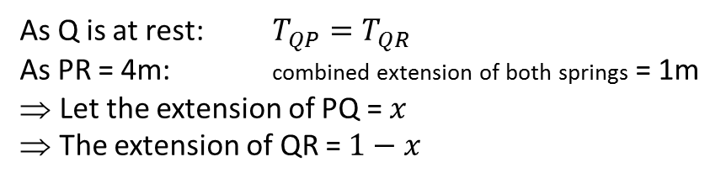




Combining strings/ springs
[Textbook] The elastic springs PQ and QR are joined together at Q to form one long spring. The spring PQ has natural length 1.6m and modulus of elasticity 20N. The spring QR has natural length 1.4m and modulus of elasticity 28N. The ends P and R, of the long string are attached to two fixed points which are 4m apart on the same horizontal plane. [Assume Q is at rest and in equilibrium]. Find the Tension in the combined spring.
$PQ: λ=$20, $l$=1.6
$QR:λ=$28, $l$=1.4
Diagram?
Tip: Read very carefully to check whether the string(s) is horizontal/ vertical or in some other orientation
P
$$T$$
Q
$$T$$
R
$$1.6+x$$
Variables?
As Q is at rest: $T_{QP}=T_{QR}$
As PR = 4m: combined extension of both springs = 1m
Let the extension of PQ = $x$
The extension of QR = $1−x$
Tip: For two-spring problems think about how the variables in each string are linked.
Solution?
PQ: $T=\frac{20x}{1.6}$
QR: $T=\frac{28(1−x)}{1.4}$
$⇒\frac{20x}{1.6}=\frac{28(1−x)}{1.4}$ … $⇒x=\frac{8}{13}$ … $⇒T=\frac{100}{13}=7.69N(3SF)$

Slide 7
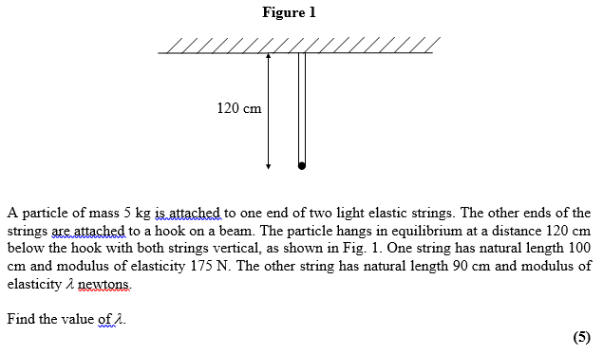
Test Your Understanding
Edexcel M3 Jan 2003 Q1

Slide 8
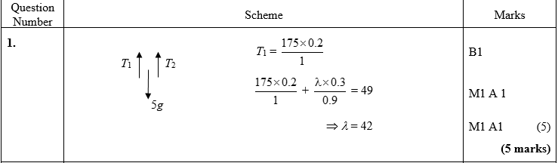
Test Your Understanding
Edexcel M3 Jan 2003 Q1
?

Slide 9
Exercise 3A (part 1)
Pearson Further Mechanics 1
Pages 44-45 questions 1-7
Complete before the lesson Q1-4
In Class:
Green Q5-7
Amber Q8-9
Red Q10-11

Slide 10
Slopes, Friction, Moments, Resolving Forces, etc.
Elastic Strings and Springs can be introduced into similar problems to those encountered in A level Mechanics. e.g.
Ch4: Moments
Ch5: Forces and friction
Ch7: Applications of forces
The next few examples will also serve as useful revision of these ideas.
Key ideas to Remember
If an object is in equilibrium:
For any given point: The sum of the moments of all forces about that point = 0
In any chosen direction: The sum of all component forces in that direction = 0

Slide 11

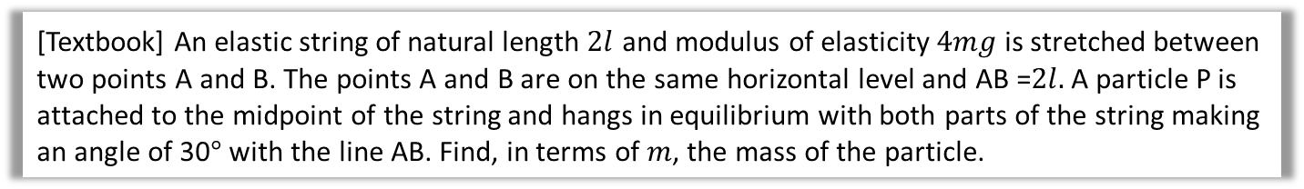

Slopes, Friction, Moments, Resolving Forces, etc.
[Textbook] An elastic string of natural length $2l$ and modulus of elasticity $4mg$ is stretched between two points A and B. The points A and B are on the same horizontal level and AB =$2l.$A particle P is attached to the midpoint of the string and hangs in equilibrium with both parts of the string making an angle of 30$°$ with the line AB. Find, in terms of $m$, the mass of the particle.
The thinking behind the problem
When a particle is attached to the midpoint of a string the two halves of the string act like two independent strings.
The natural length of each half is half the natural length of the original string.
The modulus of elasticity of each half is THE SAME as the original string. This is because the force required to double the length of a string ($λ$) is the same as the force required to double the length of each half.
The next stem is, as always, A big, clear diagram.
Let’s call the mass M to differentiate it from $m.$
You will not always be told ‘in terms of m’ sometimes you just have to deduce that the answer must be in terms of a variable given in the question.

Slide 12

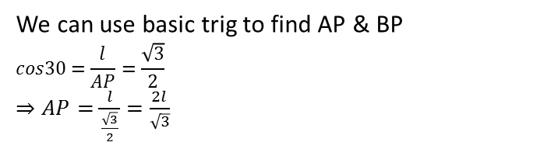






Slopes, Friction, Moments, Resolving Forces, etc.
[Textbook] An elastic string of natural length $2l$ and modulus of elasticity $4mg$ is stretched between two points A and B. The points A and B are on the same horizontal level and AB =$2l.$A particle P is attached to the midpoint of the string and hangs in equilibrium with both parts of the string making an angle of 30$°$ with the line AB. Find, in terms of $m$, the mass of the particle.
Both strings$: λ=4mg, natural length=$ $l$
$$T=\frac{λx}{l}=\frac{4mg(\frac{2l}{\sqrt{3}}−l)}{l}=\frac{8mg}{\sqrt{3}}−4mg=4mg(\frac{2\sqrt{3}}{3}−1)$$
$$R\left(↕\right) 2Tsin30=Mg$$
$$⇒T=Mg$$
$$⇒M=\frac{T}{g}$$
Subbing in for T gives:
$M=4m\left(\frac{2\sqrt{3}}{3}−1\right)=0.619$kg (3SF)
Diagram?
Complete solution?
$$l$$
$$l$$
A
C
B
$$30°$$
$$30°$$
Tip: You often need to work out some more detail for the diagram
By symmetry the tension in both strings is the same.
$$T$$
$$T$$
P
Mg
We can use basic trig to find AP & BP
$$cos30=\frac{l}{AP}=\frac{\sqrt{3}}{2}$$
$⇒AP=\frac{l}{\frac{\sqrt{3}}{2}}=\frac{2l}{\sqrt{3}}$
AP?

Slide 13



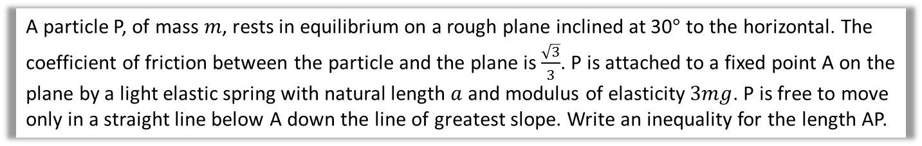




Test Your Understanding
One I made up
A particle P, of mass $m$, rests in equilibrium on a rough plane inclined at 30$°$ to the horizontal. The coefficient of friction between the particle and the plane is $\frac{\sqrt{3}}{3}$. P is attached to a fixed point A on the plane by a light elastic spring with natural length $a$ and modulus of elasticity $3mg$. P is free to move only in a straight line below A down the line of greatest slope. Write an inequality for the length AP.
If P is on the point of moving up the plane:
Extension: If the coefficient of friction was $μ$, write you inequality in terms of a and $μ$
First Part of Solution
$$R$$
$$T$$
R($↖) R=mgcos30=\frac{\sqrt{3}mg}{2}$
$$T=\frac{λx}{l}=\frac{3mgx}{a}$$
$$F_{r_{max}}=μR=\frac{\sqrt{3}}{3}×\frac{\sqrt{3}mg}{2}=\frac{mg}{2}$$
R($↙) F_{r}+mgsin30=T$
$$⇒\frac{mg}{2}+\frac{mg}{2}=\frac{3mgx}{a}$$
$$⇒x=\frac{a}{3}⇒{AP}_{max}=\frac{a}{3}+a=\frac{4a}{3}$$
$$F_{r}$$
$$30°$$
$$mg$$
…continued

Slide 14



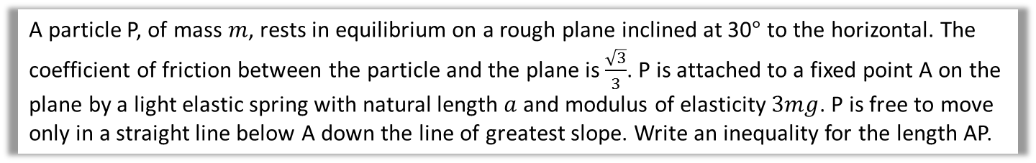

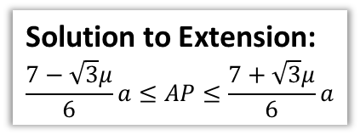

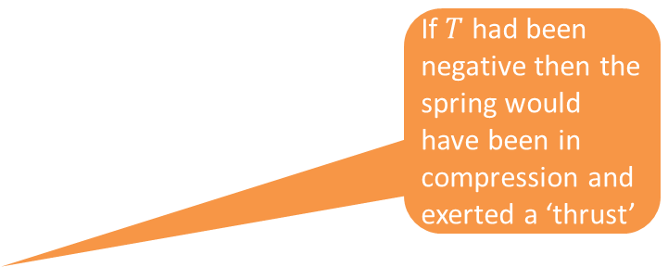

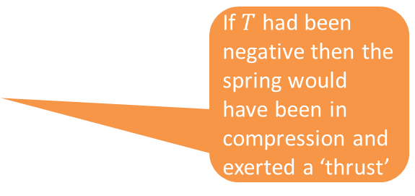
Test Your Understanding
One I made up
A particle P, of mass $m$, rests in equilibrium on a rough plane inclined at 30$°$ to the horizontal. The coefficient of friction between the particle and the plane is $\frac{\sqrt{3}}{3}$. P is attached to a fixed point A on the plane by a light elastic spring with natural length $a$ and modulus of elasticity $3mg$. P is free to move only in a straight line below A down the line of greatest slope. Write an inequality for the length AP.
Second part of Solution
Solution to Extension:
$$\frac{7−\sqrt{3}μ}{6}a≤AP≤\frac{7+\sqrt{3}μ}{6}a$$
If P is on the point of moving down the plane:
Solution
to extension
$$R$$
$$T$$
R($↖) R=mgcos30=\frac{\sqrt{3}mg}{2}$
$$T=\frac{λx}{l}=\frac{3mgx}{a}$$
$$F_{r_{max}}=μR=\frac{\sqrt{3}}{3}×\frac{\sqrt{3}mg}{2}=\frac{mg}{2}$$
R($↙) mgsin30=T{+ F}_{r}$
$$⇒\frac{mg}{2}=T+\frac{mg}{2}$$
$$⇒T=0⇒x=0⇒ {AP}_{min}=a+0=a$$
Final answer is: $a≤AP≤\frac{4a}{3}$
$$F_{r}$$
$$30°$$
If $T$ had been negative then the spring would have been in compression and exerted a ‘thrust’
If $T$ had been negative then the spring would have been in compression and exerted a ‘thrust’
$$mg$$

Slide 15
Exercise 3A (Part 2)
Pearson Further Mechanics 1
Pages 44-45 questions 8-11
Complete before the lesson Q1-4
In Class:
Green Q5-7
Amber Q8-9
Red Q10-11

Slide 16
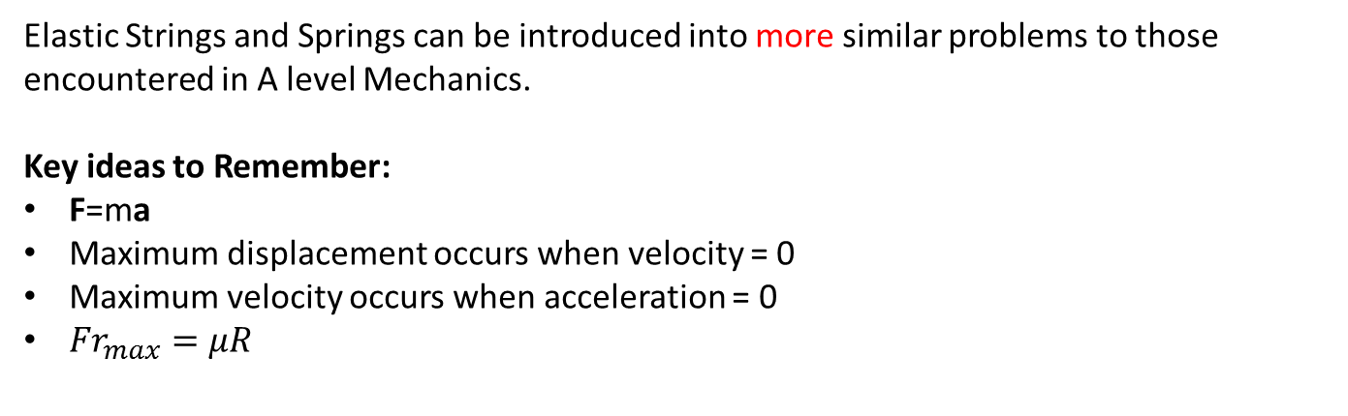
Dynamics Problems
Elastic Strings and Springs can be introduced into more similar problems to those encountered in A level Mechanics.
Key ideas to Remember:
F=ma
Maximum displacement occurs when velocity = 0
Maximum velocity occurs when acceleration = 0
${Fr}_{max}=μR$
(in a given direction)

Slide 17


Hooke’s Law and Dynamic Problems
[Textbook] One end of a light elastic string, of natural length 0.5m and modulus of elasticity 20N, is attached to a fixed point A. The other end is attached to a particle of mass 2kg. The particle is held at a point which is 1.5m below A and released from rest. Find:
The initial acceleration of the particle
The length of the string when the particle reaches its maximum speed.
A
a?
Diagram?
($↑$) $T−2g=2a$
$T=\frac{λx}{l}=\frac{20×1}{0.5}=40$
$⇒40−2g=2a$
$$⇒a=10.2ms^{−2}$$
Max velocity when a=0
$$⇒T−2g=0$$
$$⇒T=2g=\frac{λx}{l}$$
$$⇒2g=\frac{20x}{0.5}$$
$$⇒x=0.49$$
$$λ=20 \\ l=0.5$$
1.5
T
a
2g
b?
Maximum velocity occurs at the equilibrium position.
=> length of the string is 0.5m (original length) + 0.49m = 0.99m

Slide 18
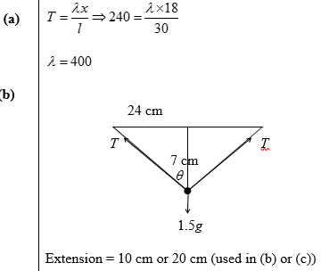

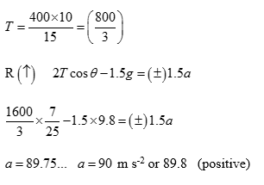

Test Your Understanding
Edexcel M3 Jan 2013 Q7
A particle P of mass 1.5 kg is attached to the mid-point of a light elastic string of natural length 0.30 m and modulus of elasticity λ newtons. The ends of the string are attached to two fixed points A and B, where AB is horizontal and AB = 0.48 m. Initially P is held at rest at the mid-point, M, of the line AB and the tension in the string is 240 N.
(a) Show that λ = 400. (3)
The particle is now held at rest at the point C, where C is 0.07 m vertically below M. The particle is released from rest at C.
(b) Find the magnitude of the initial acceleration of P. (6)
a?
b?

Slide 19
Exercise 3B
Pearson Further Mechanics 1
Pages 47-48
Complete before the lesson Q1-2
In Class:
Green Q3
Amber Q4
Red Q5 & challenge

Slide 20
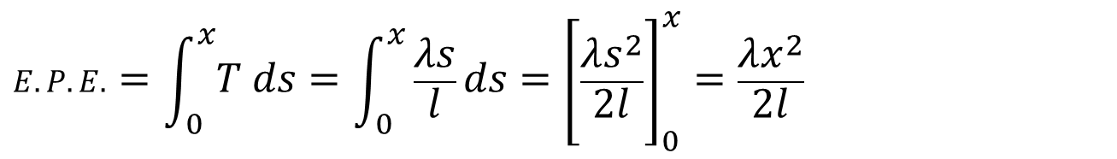
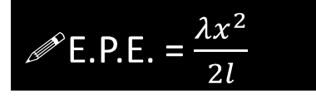
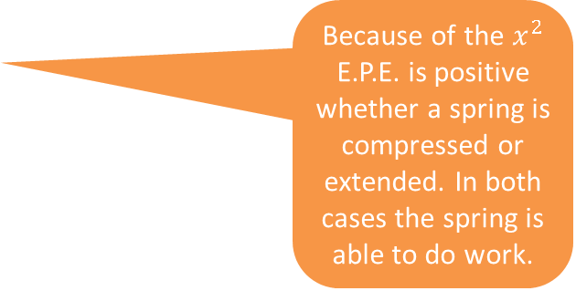
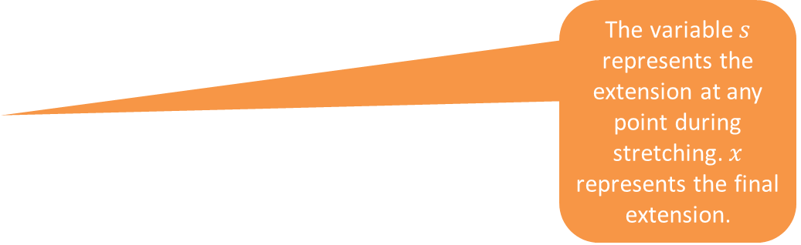
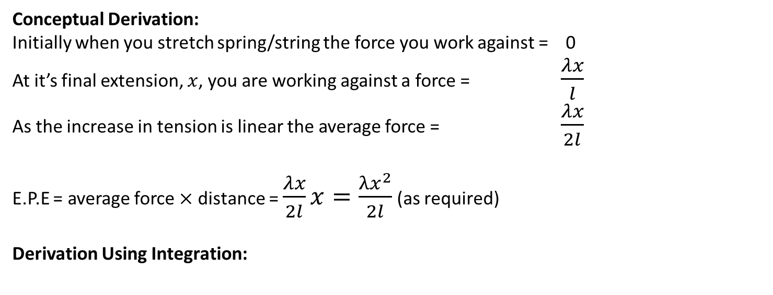
Energy
The Elastic Potential Energy (E.P.E.) stored in a spring or string is equal to the work done in stretching /compressing it.
Because of the $x^{2}$ E.P.E. is positive whether a spring is compressed or extended. In both cases the spring is able to do work.
E.P.E. = $\frac{λx^{2}}{2l}$
Conceptual Derivation:
Initially when you stretch spring/string the force you work against = 0
At it’s final extension, $x$, you are working against a force = $\frac{λx}{l}$
As the increase in tension is linear the average force = $\frac{λx}{2l}$
E.P.E = average force $×$ distance = $\frac{λx}{2l}x=\frac{λx^{2}}{2l}$ (as required)
Derivation Using Integration:
The variable $s$ represents the extension at any point during stretching. $x$ represents the final extension.
$$E.P.E. =\int_{0}^{x}{T ds}=\int_{0}^{x}{\frac{λs}{l}ds}={\left[\frac{λs^{2}}{2l}\right]}_{0}^{x}=\frac{λx^{2}}{2l}$$

Slide 21

A (Simple) Example
[Textbook] An elastic string has natural length 1.4m and modulus of elasticity 6N. Find the energy stored in the string when its length is 1.6m
?
E.P.E = $\frac{λx^{2}}{2l}=\frac{6{\left(0.2\right)}^{2}}{2×1.4}=0.0857J (3SF)$

Slide 22
Exercise 3C
Pearson Further Mechanics 1
Pages 50-51
Complete before the lesson Q1-3
In Class:
Green Q4
Amber Q5
Red Q6-7

Slide 23
The law of Conservation of Energy (expanded)
The law of Conservation of Energy: the total energy of an isolated system remains constant
Initial Energy = Final Energy
Work in+Initial K.E.+Initial G.P.E.+Initial E.P.E=Final K.E.+Final G.P.E.+Final E.P.E+Work out
Using the formulae we get:
driving force x distance + $\frac{1}{2}mu^{2}$+ $mgh_{1}$+$\frac{λx_{1}^{2}}{2l}$= $\frac{1}{2}mv^{2}$+ $mgh_{2}$ + $\frac{λx_{2}^{2}}{2l}$ + resistance x distance

Slide 24
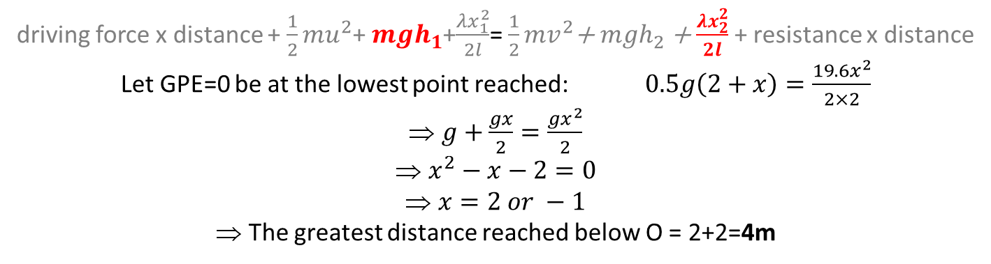
An Example
[Textbook] A particle of mass 0.5kg is attached to one end of an elastic string, of natural length 2m and modulus of elasticity 19.6N. The other end of the elastic string is attached to a point O. The particle is released from the point O. Find the greatest distance it will reach below O.
The problem involves finding a distance travelled => best to start using energy:
driving force x distance + $\frac{1}{2}mu^{2}$+ $mgh_{1}$+$\frac{λx_{1}^{2}}{2l}$= $\frac{1}{2}mv^{2}$+ $mgh_{2}$ + $\frac{λx_{2}^{2}}{2l}$ + resistance x distance
Let GPE=0 be at the lowest point reached: $0.5g\left(2+x\right)=\frac{19.6x^{2}}{2×2}$
$g+\frac{gx}{2}=\frac{gx^{2}}{2}$
$x^{2}−x−2=0$
$x=2 or −1$
The greatest distance reached below O = 2+2=4m
?

Slide 25
Problem Solving Considerations
At the start of any problem consider carefully which approach to use:
Approach 1: Hooke’s Law and F=ma
  Most equilibrium problems
  Problems linked to acceleration and forces
Approach 2: Energy
  Most problems linked to distance travelled and velocity

Slide 26
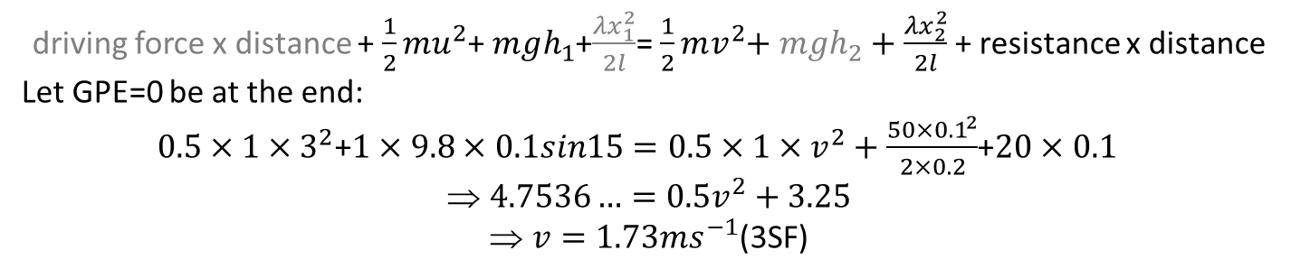
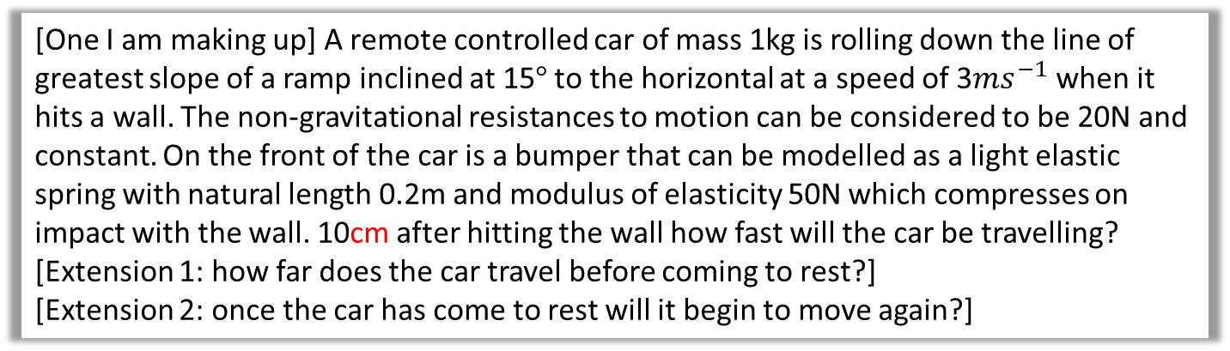
An More complicated Example
[One I am making up] A remote controlled car of mass 1kg is rolling down the line of greatest slope of a ramp inclined at 15$°$ to the horizontal at a speed of 3$ms^{−1}$ when it hits a wall. The non-gravitational resistances to motion can be considered to be 20N and constant. On the front of the car is a bumper that can be modelled as a light elastic spring with natural length 0.2m and modulus of elasticity 50N which compresses on impact with the wall. 10cm after hitting the wall how fast will the car be travelling?
[Extension 1: how far does the car travel before coming to rest?]
[Extension 2: once the car has come to rest will it begin to move again?]
?
The problem involves finding a distance travelled => best to start using energy:
driving force x distance + $\frac{1}{2}mu^{2}$+ $mgh_{1}$+$\frac{λx_{1}^{2}}{2l}$= $\frac{1}{2}mv^{2}$+ $mgh_{2}$ + $\frac{λx_{2}^{2}}{2l}$ + resistance x distance
Let GPE=0 be at the end:
$0.5×1×3^{2}$+$1×9.8×0.1sin15=0.5×1×v^{2}+\frac{50×{0.1}^{2}}{2×0.2}$+$20×0.1$
$4.7536…=0.5v^{2}+3.25$
$v=1.73ms^{−1}$(3SF)
Extension 1 Answer
Extension 1 answer: 0.132m (3SF)

Slide 27
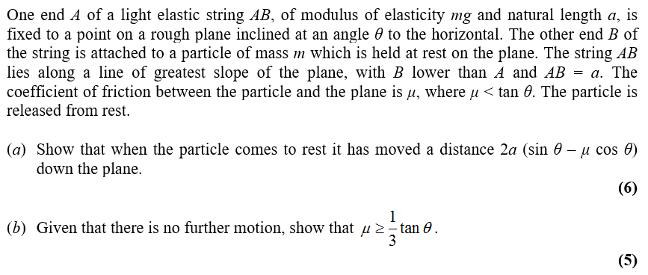
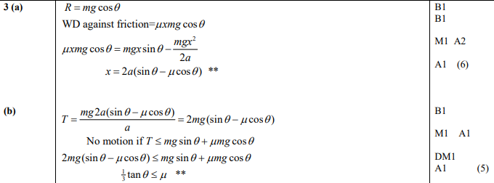
Test Your Understanding
Edexcel M3 June 2014(R) Qu3
?

Slide 28
Exercise 3D
Pearson Further Mechanics 1
Pages 54-55
Complete before the lesson Q1-2
In Class:
Green Q3-4
Amber Q5-6
Red Q7-8 & challenge & Ext
root

Slide 29
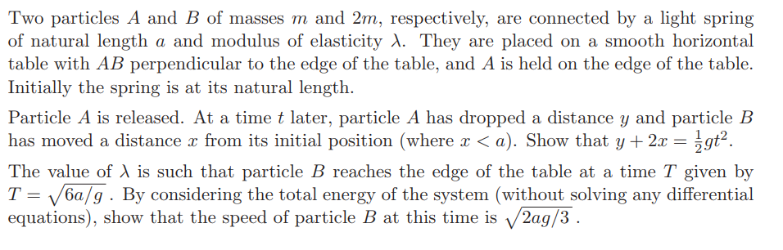
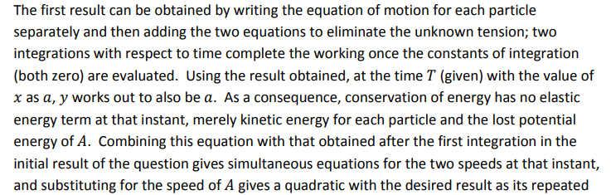
Exercise 3D
Pearson Further Mechanics 1
Pages 54-55
Extension
[STEP III 2017 Q9]
Guidance
root

