Slide 1
Year 2 Pure Mathematics
Algebraic Methods
- Algebraic Fractions
Chapter 1
(Part 2 of 4)

Slide 2
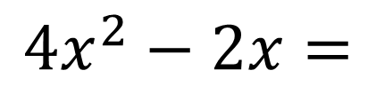
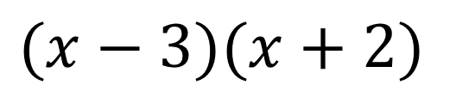
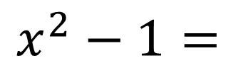
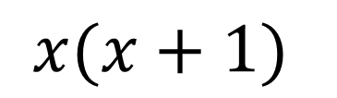
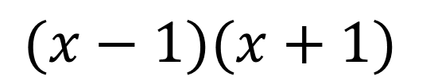
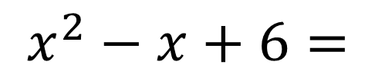
Algebraic Fractions
When calculating with fractions
before you do anything else
FACTORISE anything that you can factorise!
$$x^{2}−1=$$
$$(x−1)(x+1)$$
$${4x}^{2}−2x=$$
$$x(x+1)$$
$$x^{2}−x+6=$$
$$(x−3)(x+2)$$

Slide 3
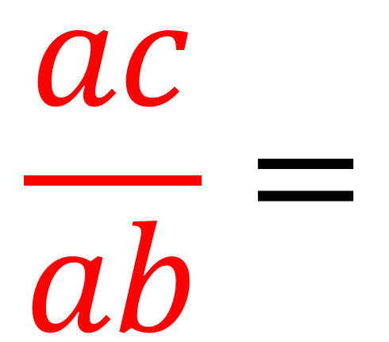
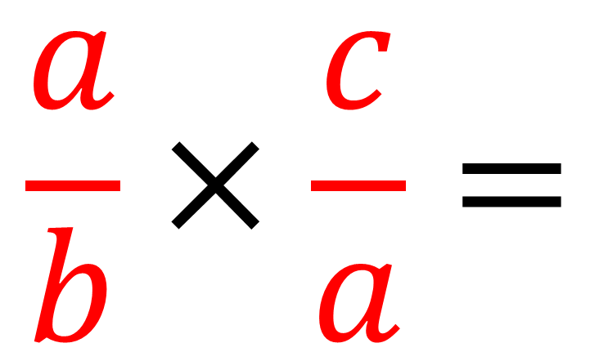
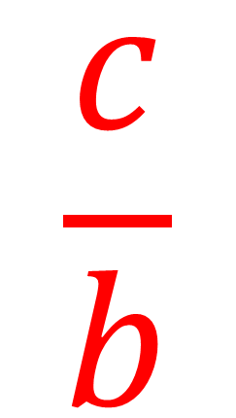
Algebraic Fractions - Multiplying
Write as a single fraction in its simplest form.
$$\frac{a}{b}×\frac{c}{a}=$$
$$\frac{ac}{ab}=$$
$$\frac{c}{b}$$

Slide 4
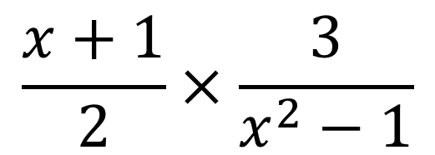
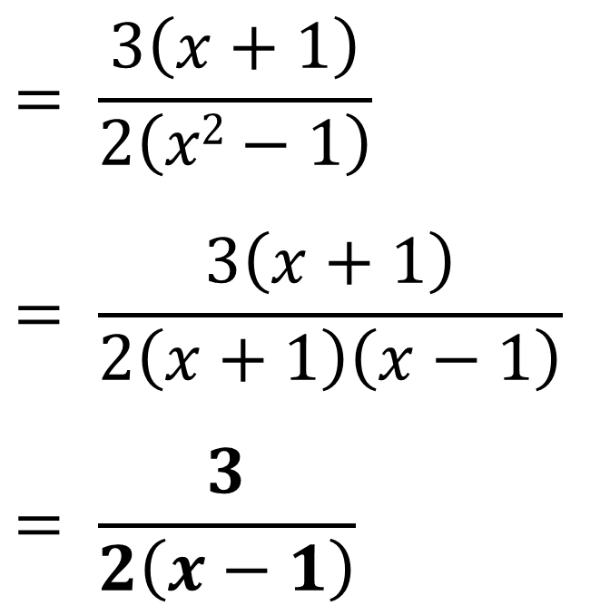
Algebraic Fractions - Multiplying
Write as a single fraction in its simplest form.
$$= \frac{3\left(x+1\right)}{2\left(x2−1\right)}$$
$$= \frac{3\left(x+1\right)}{2\left(x+1\right)\left(x−1\right)}$$
$$= \frac{3}{2\left(x−1\right)}$$
$$\frac{x+1}{2}×\frac{3}{x^{2}−1}$$

Slide 5
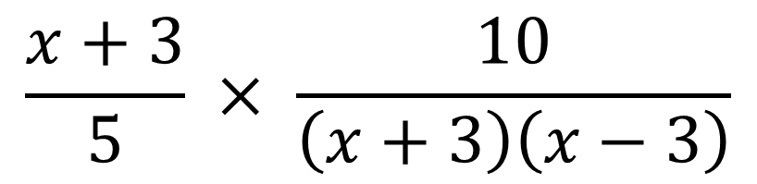
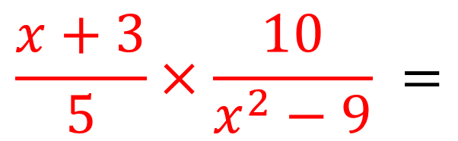
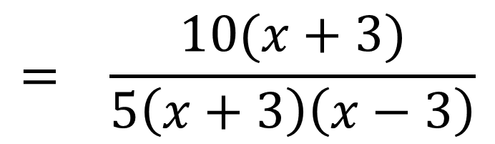
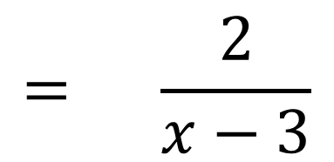
Algebraic Fractions - Multiplying
$$\frac{x+3}{5}×\frac{10}{x^{2}−9} =$$
$$\frac{x+3}{5} × \frac{10}{\left(x+3\right)\left(x−3\right)}$$
$$= \frac{10(x+3)}{5\left(x+3\right)\left(x−3\right)}$$
$$= \frac{2}{x−3}$$

Slide 6
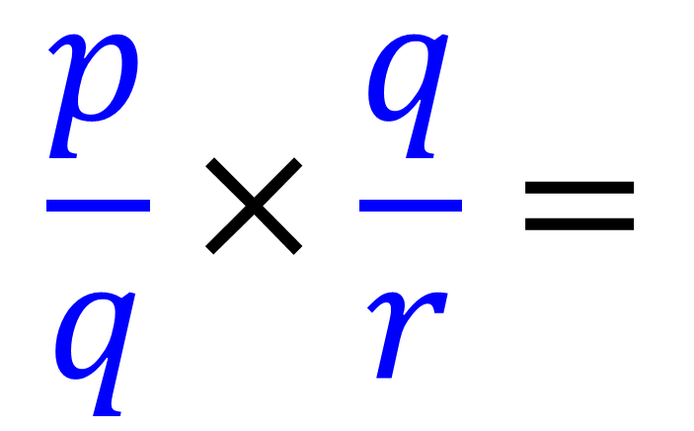
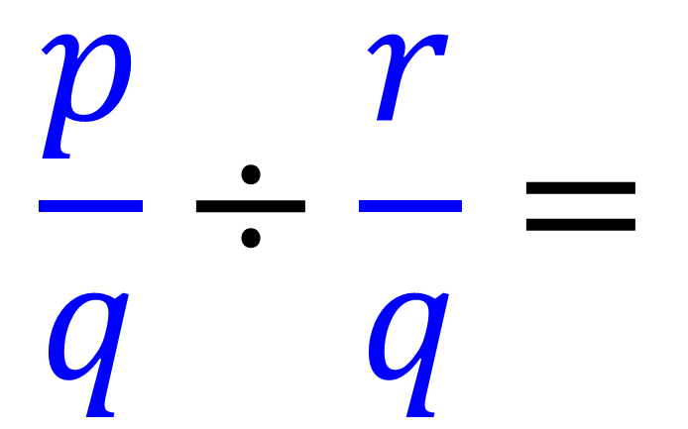
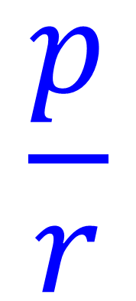
Algebraic Fractions - Dividing
$$\frac{p}{q}÷\frac{r}{q}=$$
$$\frac{p}{q}×\frac{q}{r}=$$
$$\frac{p}{r}$$

Slide 7
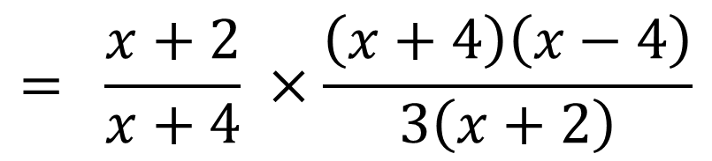
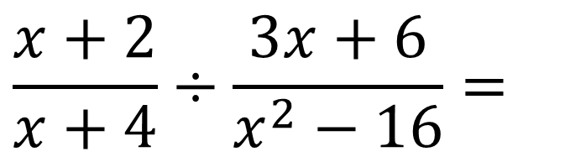
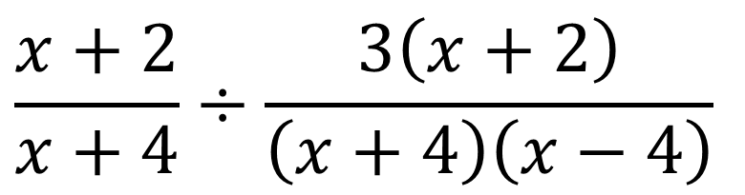
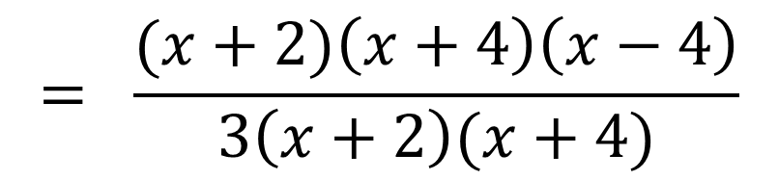
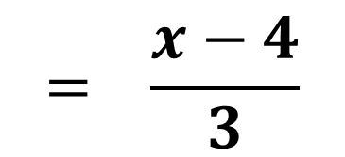
Algebraic Fractions - Dividing
Write as a single fraction in its simplest form.
$$\frac{x+2}{x+4}÷\frac{3x+6}{x^{2}−16}=$$
$$\frac{x+2}{x+4}÷\frac{3\left(x+2\right)}{\left(x+4\right)\left(x−4\right)}$$
$$= \frac{x+2}{x+4} ×\frac{\left(x+4\right)\left(x−4\right)}{3\left(x+2\right)}$$
$$= \frac{(x+2)\left(x+4\right)\left(x−4\right)}{3\left(x+2\right)(x+4)}$$
$$= \frac{x−4}{3}$$

Slide 8
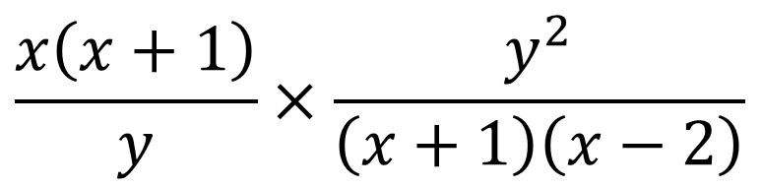
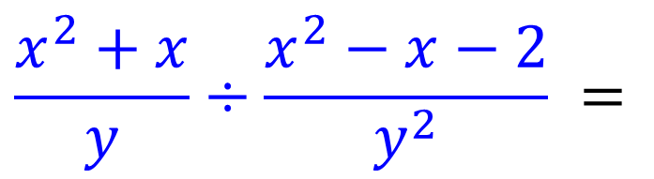
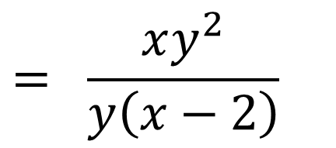
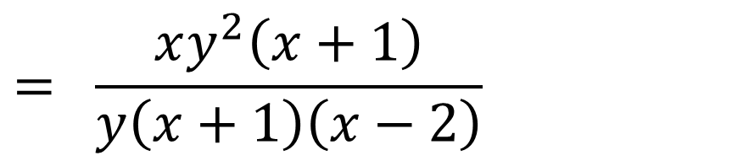
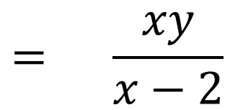
Algebraic Fractions – Division
$$\frac{x^{2}+x}{y}÷\frac{x^{2}−x−2}{y^{2}} =$$
$$\frac{x\left(x+1\right)}{y}×\frac{y^{2}}{\left(x+1\right)\left(x−2\right)}$$
$$= \frac{xy^{2}\left(x+1\right)}{y\left(x+1\right)\left(x−2\right)}$$
$$= \frac{xy^{2}}{y\left(x−2\right)}$$
$$= \frac{xy}{x−2}$$

Slide 9
Exercise 1B
Pearson Pure Mathematics Year 2/AS
Pages 6-7
Complete before the lesson Q1-2
In Class:
Green Q3
Amber Q4
Red Q5&6

Slide 10


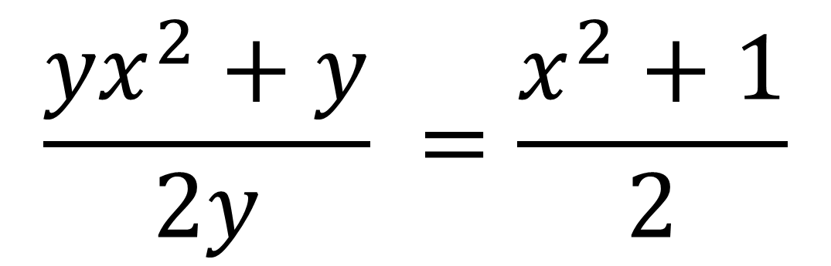
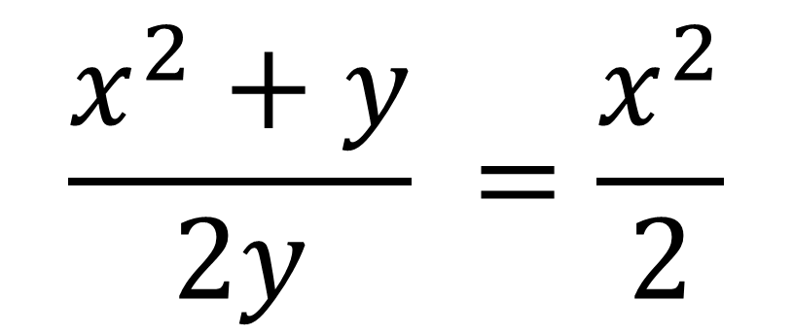
Adding and Subtracting - Common Mistake
Common student mistakes
“Crime against Mathematics”:
$$\frac{x^{2}+y}{2y} =\frac{x^{2}}{2}$$
$$\frac{{yx}^{2}+y}{2y} =\frac{x^{2}+1}{2}$$

Slide 11
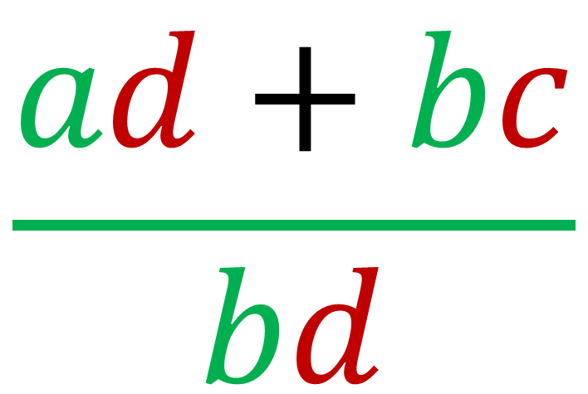
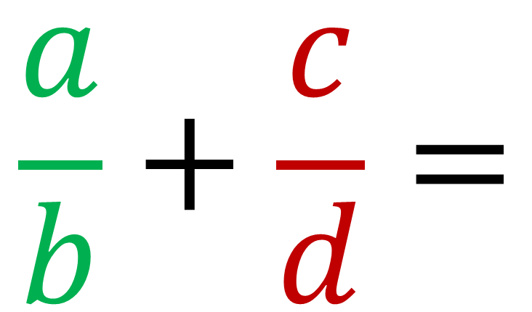
Algebraic Fractions - Adding
Write as a single fraction.
$$\frac{a}{b}+\frac{c}{d}=$$
$$\frac{ad+bc}{bd}$$

Slide 12
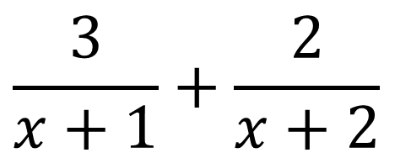
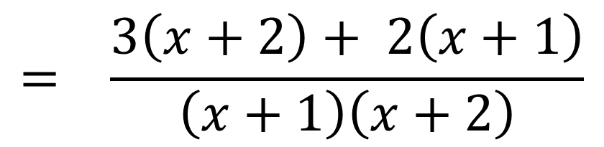
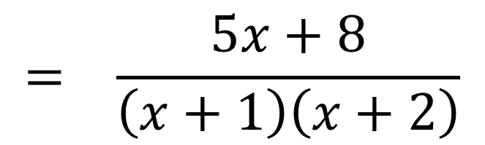
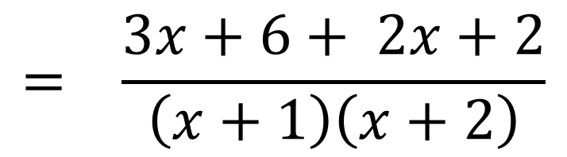
Algebraic Fractions - Addition
To subtract two fractions, find a common denominator.
$$\frac{3}{x+1}+\frac{2}{x+2}$$
$$= \frac{3\left(x+2\right)+ 2\left(x+1\right)}{\left(x+1\right)\left(x+2\right)}$$
$$= \frac{3x+6+ 2x+2}{\left(x+1\right)\left(x+2\right)}$$
$$= \frac{5x+8}{\left(x+1\right)\left(x+2\right)}$$

Slide 13

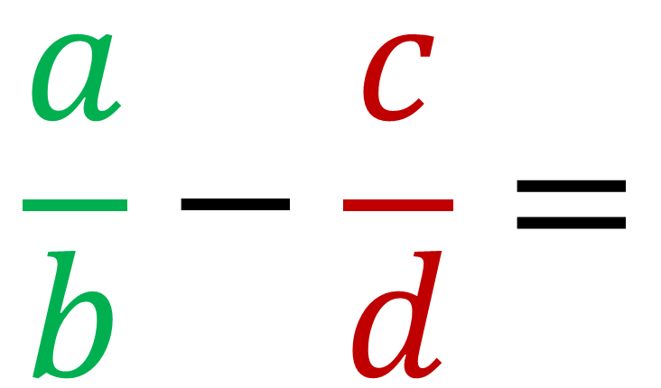
Algebraic Fractions - Adding
Write as a single fraction.
$$\frac{a}{b}−\frac{c}{d}=$$
$$\frac{ad−bc}{bd}$$

Slide 14
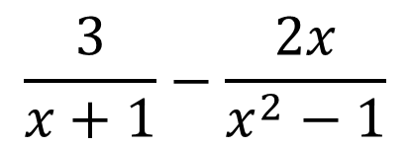
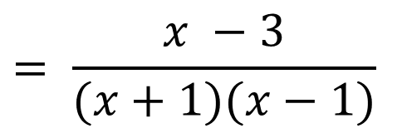

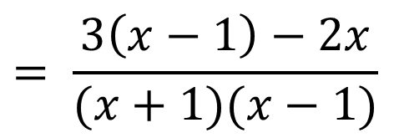
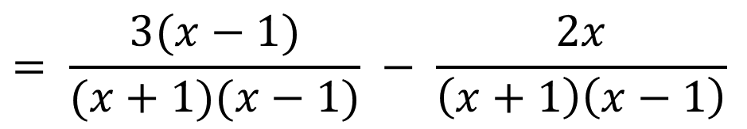
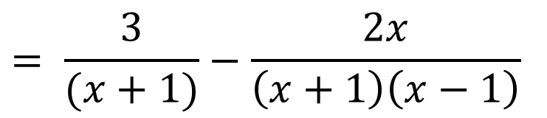
Algebraic Fractions - Subtraction
To add two fractions, find a common denominator.
$$\frac{3}{x+1}−\frac{2x}{x^{2}−1}$$
$$= \frac{3}{(x+1)}−\frac{2x}{\left(x+1\right)\left(x−1\right)}$$
$$= \frac{3(x−1)}{(x+1)(x−1)} − \frac{2x}{\left(x+1\right)\left(x−1\right)}$$
$$= \frac{3\left(x−1\right)−2x}{(x+1)(x−1)}$$
$$= \frac{x −3}{(x+1)(x−1)}$$
$$=\frac{−x−3}{\left(x+1\right)\left(x−1\right)}$$

Slide 15
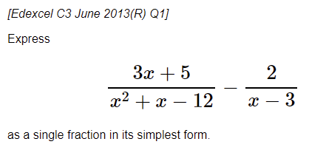
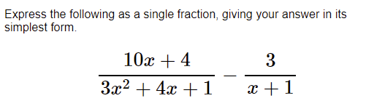
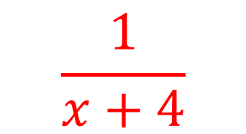
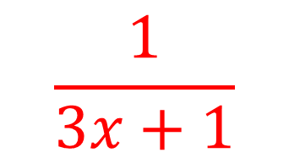
Algebraic Fractions - Exam Questions
$$\frac{1}{x+4}$$
$$\frac{1}{3x+1}$$

Slide 16
Exercise 1C
Pearson Pure Mathematics Year 2/AS
Page 8
Complete before the lesson Q1a, g, h
In Class:
Green Q2&3
Amber Q4&5
Red Q6&7

