Slide 1
Year 2 Pure Mathematics
Trig Functions
- Identities sec² cosec²
Chapter 6
(Part 3 of 5)

Slide 2
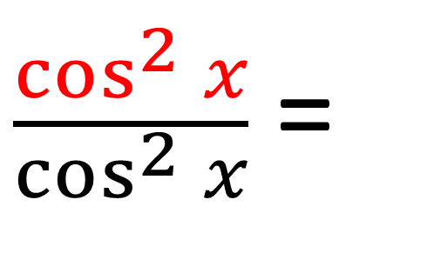

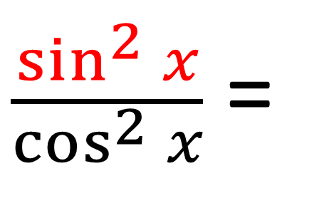
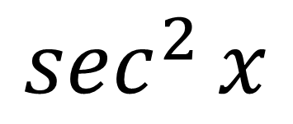
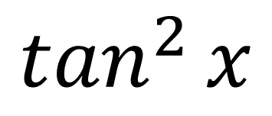
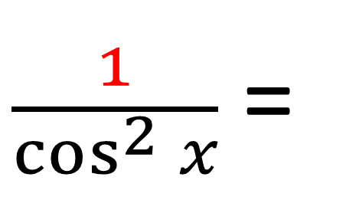
New Identities
$\frac{\cos^{2}{x}}{\cos^{2}{x}}$ =
$$1$$
$\frac{\sin^{2}{x}}{\cos^{2}{x}}$ =
$$\tan^{2}{x}$$
$\frac{1}{\cos^{2}{x}}$ =
$$\sec^{2}{x}$$

Slide 3
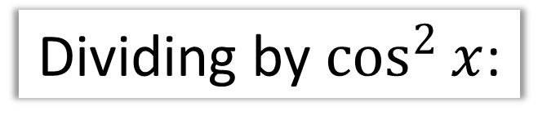
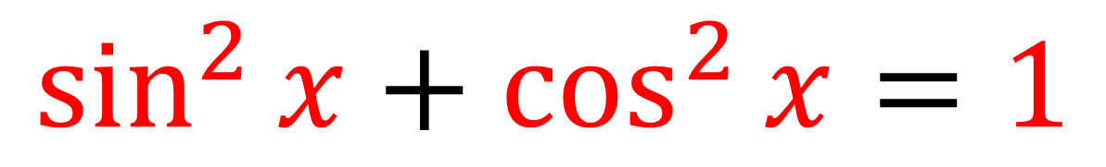
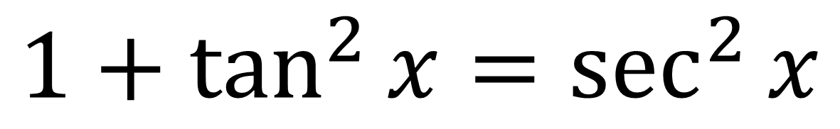
New Identities
An old identity:
$$\sin^{2}{x}+\cos^{2}{x}=1$$
Dividing by $\cos^{2}{x}$:
$$1+\tan^{2}{x}=\sec^{2}{x}$$

Slide 4
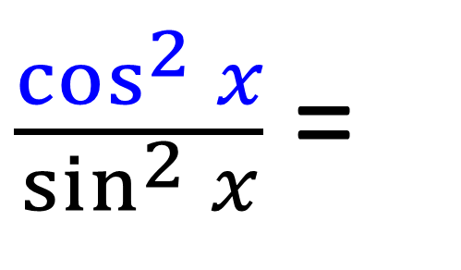

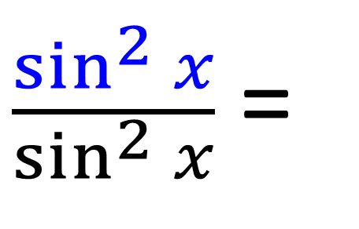
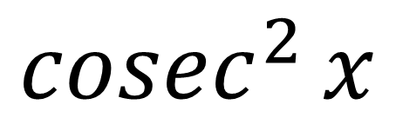
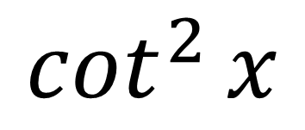
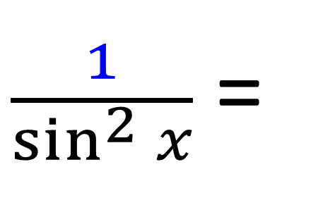
New Identities
$\frac{\sin^{2}{x}}{\sin^{2}{x}}$ =
$$1$$
$\frac{\cos^{2}{x}}{\sin^{2}{x}}$ =
$$\cot^{2}{x}$$
$\frac{1}{\sin^{2}{x}}$ =
$${cosec}^{2}{x}$$

Slide 5
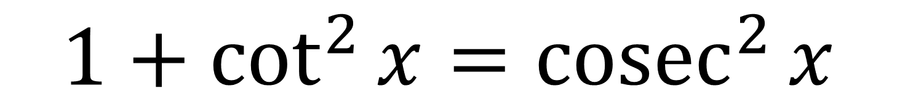
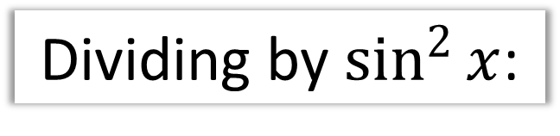
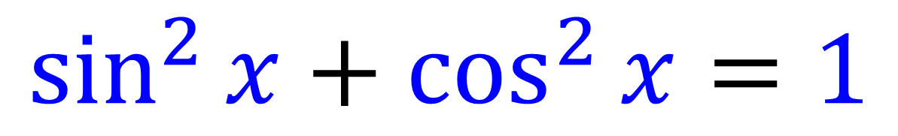
New Identities
An old identity:
$$\sin^{2}{x}+\cos^{2}{x}=1$$
Dividing by $\sin^{2}{x}$:
$$1+\cot^{2}{x}={cosec}^{2}{x}$$

Slide 6
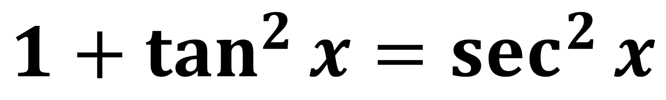

New Identities
$$1+\tan^{2}{x}=\sec^{2}{x}$$
$$1+\cot^{2}{x}={cosec}^{2}{x}$$

Slide 7
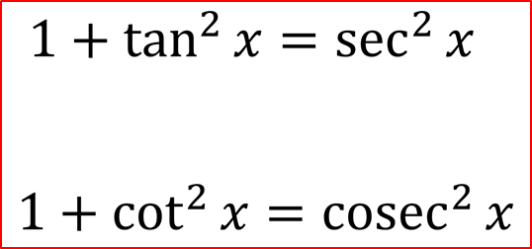
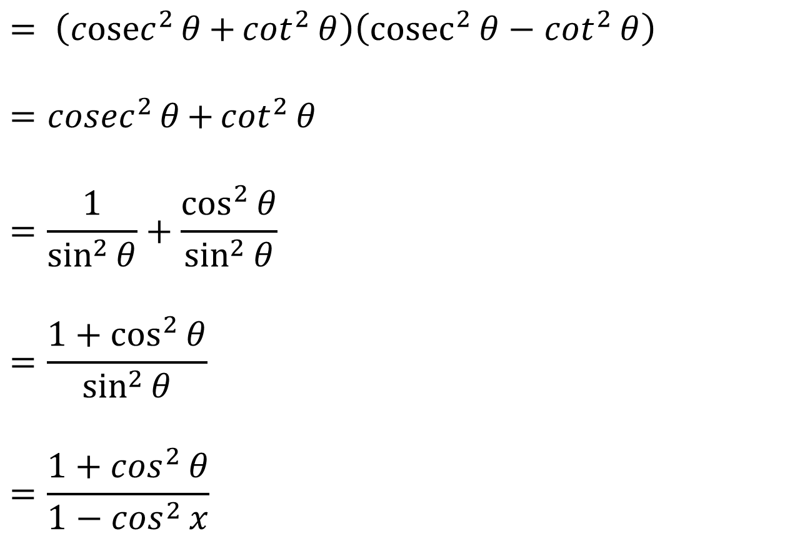
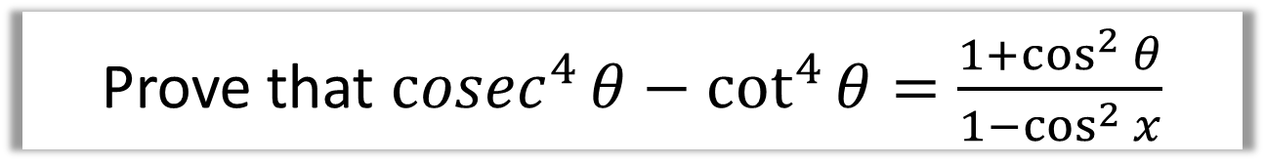
Examples
Prove that ${cosec}^{4}{θ}−\cot^{4}{θ}=\frac{1+\cos^{2}{θ}}{1−\cos^{2}{x}}$
$$= \left({cosec}^{2}{θ}{+\cot^{2}{θ}}\right)\left({cosec}^{2}{θ}−\cot^{2}{θ}\right)$$
$$={cosec}^{2}{θ}{+\cot^{2}{θ}}$$
$$=\frac{1}{\sin^{2}{θ}}+\frac{\cos^{2}{θ}}{\sin^{2}{θ}}$$
$$=\frac{1+\cos^{2}{θ}}{\sin^{2}{θ}}$$
$$=\frac{1+\cos^{2}{θ}}{1−\cos^{2}{x}}$$

Slide 8
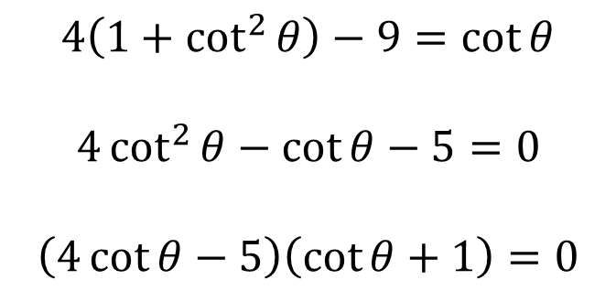
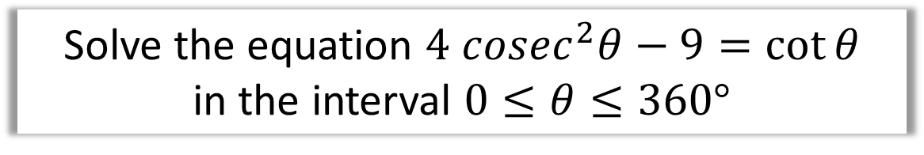
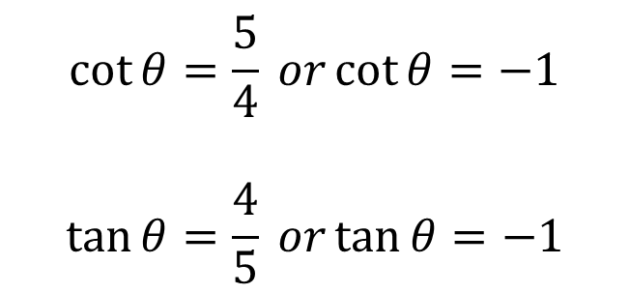

Examples
Solve the equation $4 cosec^{2}θ−9=\cot{θ}$
in the interval $0≤θ≤360°$
$$4\left(1+\cot^{2}{θ}\right)−9=\cot{θ}$$
$$4\cot^{2}{θ}−\cot{θ}−5=0$$
$$\left(4\cot{θ}−5\right)\left(\cot{θ}+1\right)=0$$
$$\cot{θ}=\frac{5}{4} or\cot{θ}=−1$$
$$\tan{θ}=\frac{4}{5} or\tan{θ}=−1$$
$$θ=38.7, 218.7,135°, 315°$$

Slide 9
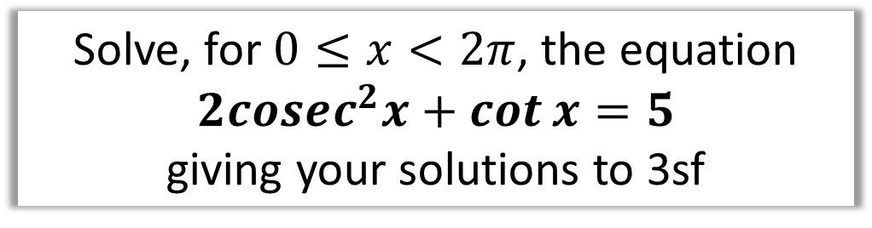
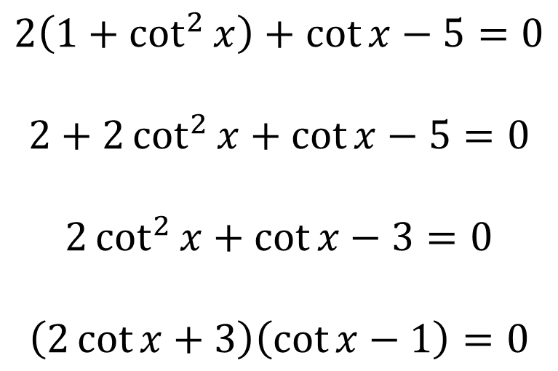
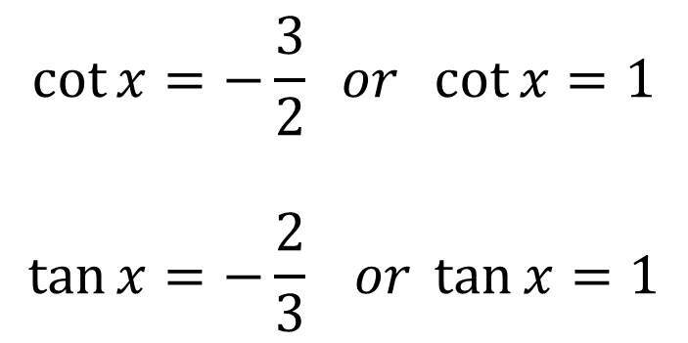
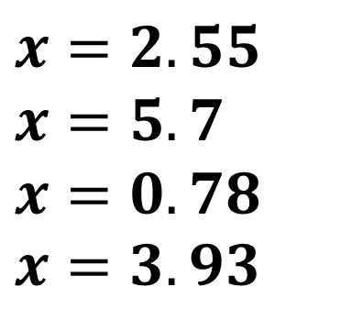
New Identities
Solve, for $0≤x<2π$, the equation
$$2cosec^{2}x+\cot{x}=5$$
giving your solutions to 3sf
$$\cot{x}=−\frac{3}{2} or \cot{x}=1$$
$$\tan{x}=−\frac{2}{3} or \tan{x}=1$$
$$2\left(1+\cot^{2}{x}\right)+\cot{x}−5=0$$
$$2+2\cot^{2}{x}+\cot{x}−5=0$$
$$2\cot^{2}{x}+\cot{x}−3=0$$
$$\left(2\cot{x}+3\right)\left(\cot{x}−1\right)=0$$
$$x=2.55$$
$$x=5.7$$
$$x=0.78$$
$$x=3.93$$

Slide 10
Exercises 6D
Pearson Pure Mathematics Year 2/AS
Pages 156-157
Complete before the lesson Q1
In Class:
Green Q2-5
Amber Q6-8
Red Q9-12

