Slide 1
Year 1 Applied Mathematics
Modelling in Mechanics
- Quantities and Units
Chapter 8
(Part 3 of 4)

Slide 2
SI Units
The SI units are a standard system of units,
used internationally (“Système International d’unités”).
These are the ones you will use:
Quantity | Unit | Symbol
Mass | kilogram | kg
Length/Displacement | metre | m
Time | Seconds | s
Speed/Velocity | metres per second | ms⁻¹
Acceleration | metres per second per second | ms⁻²
Force/Weight | newton | N

Slide 3
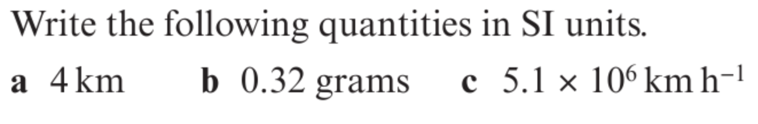
Converting Units
a) SI unit of length is metres
4km = 4000 m
b) SI unit of weight is kilograms
0.32g = 0.32 ÷ 1000 = 0.00032 kg
c) SI unit of speed/velocity is metres per second.
5.1 x 10⁶ km h⁻¹ = 1420000 ms⁻¹
x 1000 converts to km to meters
÷ 3600 converts to hours to seconds

Slide 4
Exercise 8C
Pearson Stats/Mechanics Year 2
Pages 127-129
Complete before the lesson Q1
In Class:
Green Q2

