Slide 1
Year 1 Applied Mathematics
Constant Acceleration
- Velocity-Time Graphs
Chapter 9
(Part 2 of 4)

Slide 2
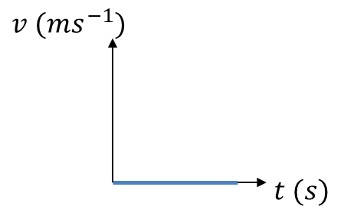
Velocity-Time Graphs
Describe the motion of each object:
Object is stationary.

Slide 3
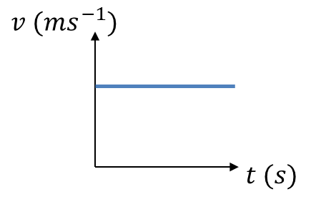
Velocity-Time Graphs
Describe the motion of each object:
Object is moving with constant velocity.

Slide 4
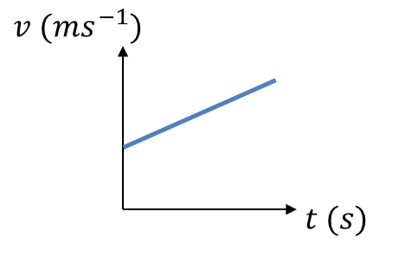
Velocity-Time Graphs
Describe the motion of each object:
Object has constant acceleration.

Slide 5
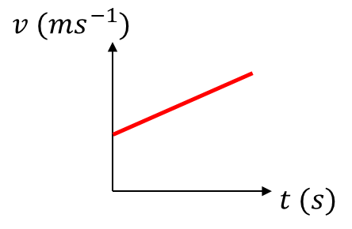
Velocity-Time Graphs
Acceleration is the gradient of the line.

Slide 6
Velocity-Time Graphs
Distance travelled is
the area under the graph.

Slide 7


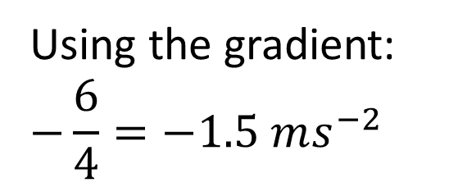
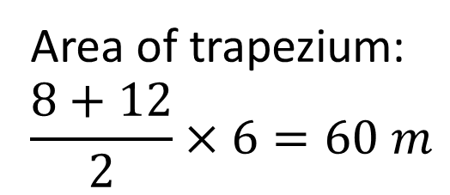
Velocity-Time Graphs – One Vehicle
The figure shows a velocity-time graph illustrating the motion of a cyclist moving along a straight road for a period of 12 seconds. For the first 8 seconds, she moves at a constant speed of 6 m s⁻¹. She then decelerates at a constant rate, stopping after a further 4 seconds.
Find the displacement from the starting point of the cyclist after this 12 second period.
Work out the rate at which the cyclist decelerates.
$$v (ms^{−1})$$
6
$$t (s)$$
8
12
Area of trapezium:
$$\frac{8+12}{2}×6=60 m$$
b
Using the gradient:
$$−\frac{6}{4}=−1.5 ms^{−2}$$
a

Slide 8



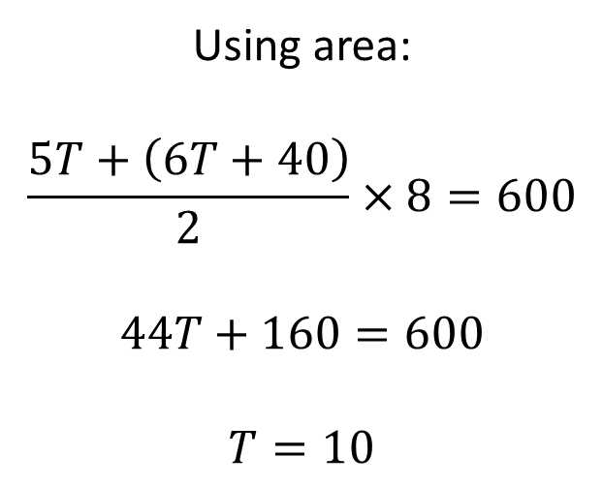
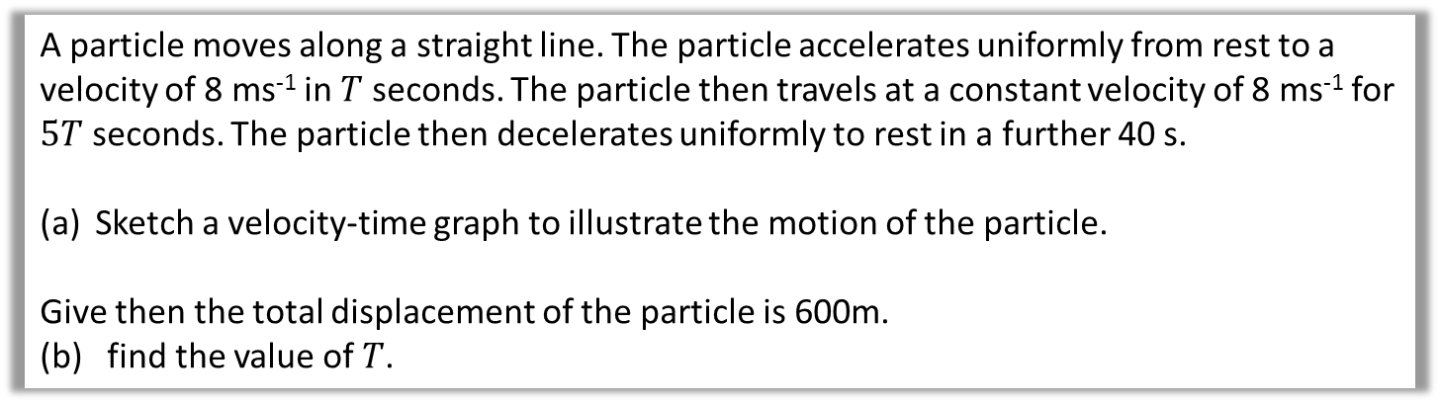






Velocity-Time Graphs – One Vehicle
A particle moves along a straight line. The particle accelerates uniformly from rest to a velocity of 8 ms⁻¹ in $T$ seconds. The particle then travels at a constant velocity of 8 ms⁻¹ for $5T$ seconds. The particle then decelerates uniformly to rest in a further 40 s.
Sketch a velocity-time graph to illustrate the motion of the particle.
Give then the total displacement of the particle is 600m.
(b) find the value of $T$.
a
$$v (ms^{−1})$$
b
Using area:
$$\frac{5T+\left(6T+40\right)}{2}×8=600$$
$$44T+160=600$$
$$T=10$$
$$A$$
$$B$$
8
$$O$$
$$C$$
$$t (s)$$
$$T$$
$$5T$$
$$40$$
Sometimes it’s easier to indicate the period of time that has passed rather than the time at the end of the interval.

Slide 9
Constant Acceleration - Two Vehicles
Two trains M and N are moving in the same direction along parallel straight horizontal tracks.
At time t = 0, M overtakes N whilst they are travelling with speeds 40 m s^{–1} and 30 m s^{–1} respectively.
Train M overtakes train N as they pass a point X at the side of the tracks.
After overtaking N, train M maintains its speed of 40 m s^{–1} for T seconds and then decelerates uniformly, coming to rest next to a point Y at the side of the tracks.
After being overtaken, train N maintains its speed of 30 m s^{–1} for 25 s and then decelerates uniformly, also coming to rest next to the point Y.
The times taken by the trains to travel between X and Y are the same.
(a) Sketch, on the same diagram, the speed-time graphs for the motions of the two trains between X and Y.
(4)
Given that XY = 975 m,
(b) find the value of T.
(8)

Slide 10
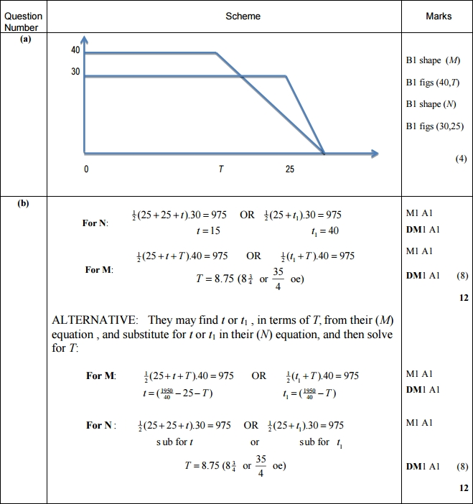
Constant Acceleration – Two Vehicles
(a)
(b)

Slide 11
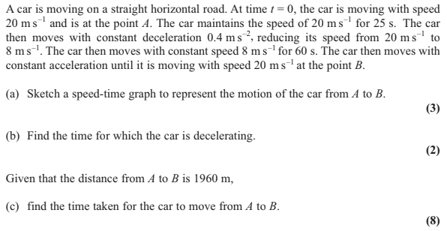
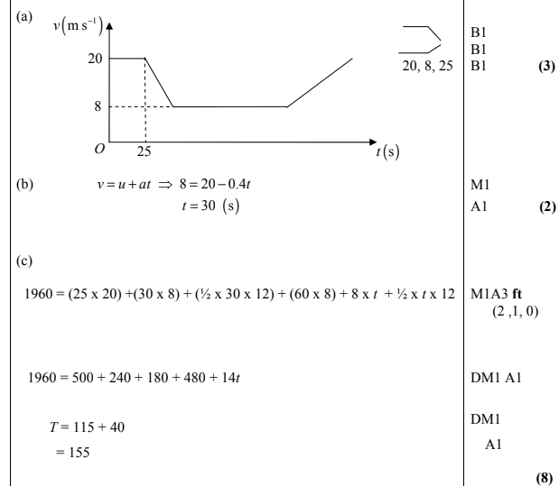
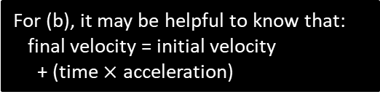
Exercise 9B
Complete before the lesson Q1-2
In Class:
Green Q3-4
Amber Q5-6
Red Q7-8 & Challenge
Pearson Stats/Mechanics
Pages 135-136
Edexcel M1 May 2012 Q4
?
?
?
For (b), it may be helpful to know that:
final velocity = initial velocity
+ (time $×$ acceleration)

