Slide 1
Year 2 Pure Mathematics
Functions and Graphs
- Sketching Modulus Graphs
Chapter 2
(Part 5 of 6)

Slide 2
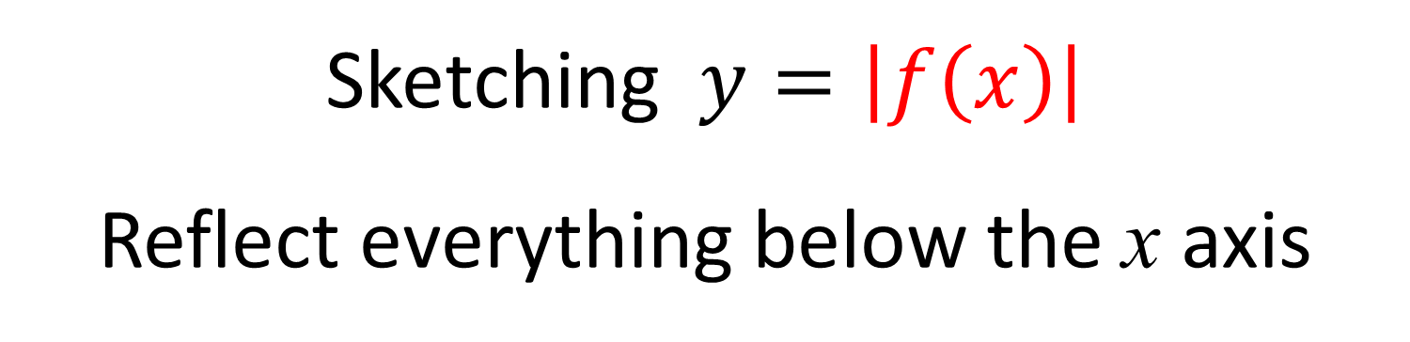
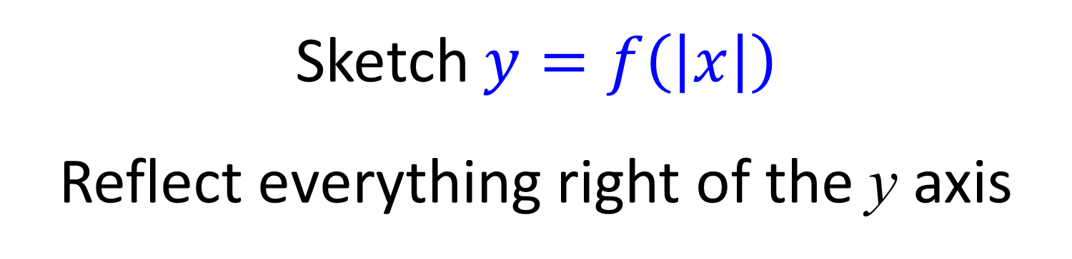
Sketching $y=|f\left(x\right)|$ and $y=f\left(\left|x\right|\right)$
Sketching $y=\left|f\left(x\right)\right|$
Reflect everything below the x axis
Sketch $y=f\left(\left|x\right|\right)$
Reflect everything right of the y axis

Slide 3
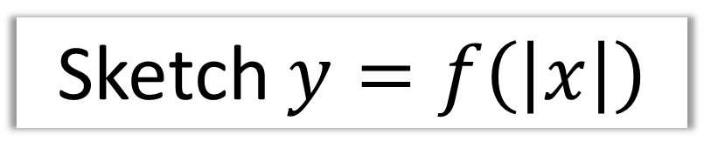








Sketching $y=|f\left(x\right)|$ and $y=f\left(\left|x\right|\right)$
$$y$$
$$y=f(x)$$
$$x$$
$$−3$$
$$−1$$
$$3$$
$$y=f\left(\left|x\right|\right)$$
$$−3$$
Sketch $y=f\left(\left|x\right|\right)$

Slide 4
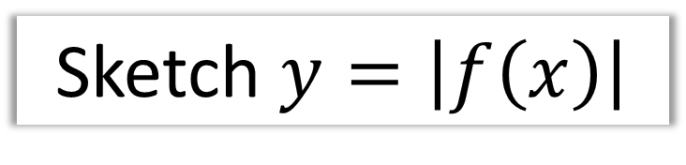








Sketching $y=|f\left(x\right)|$ and $y=f\left(\left|x\right|\right)$
$$y$$
$$y=f(x)$$
$$y=|f\left(x\right)|$$
$$3$$
$$x$$
$$−1$$
$$3$$
$$−3$$
Sketch $y=\left|f\left(x\right)\right|$

Slide 5


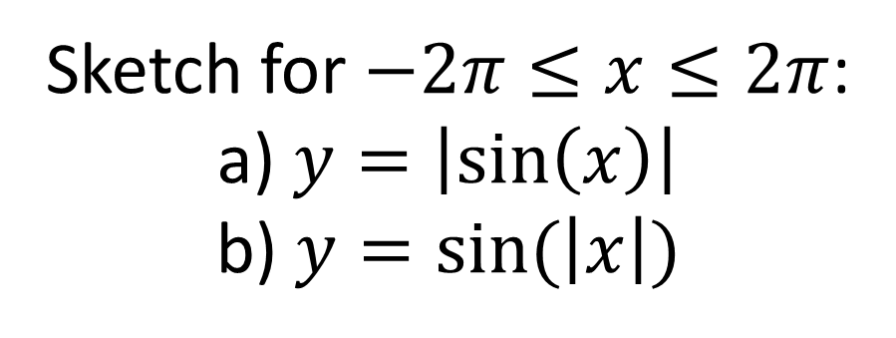










Sketching $y=|f\left(x\right)|$ and $y=f\left(\left|x\right|\right)$
Sketch for $−2π≤x≤2π$:
a) $y=\left|\sin\left(x\right)\right|$
b) $y=sin⁡(\left|x\right|)$
a
b
$$y$$
$$y$$
$$x$$
$$x$$
$$−360°$$
$$−180°$$
$$180°$$
$$360°$$
$$−360°$$
$$−180°$$
$$180°$$
$$360°$$

Slide 6








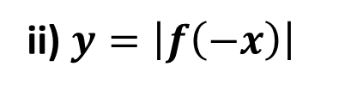



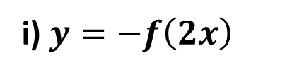









Sketching $y=|f\left(x\right)|$ and $y=f\left(\left|x\right|\right)$
$$y$$
$$y=f(x)$$
i) $y=−f\left(2x\right)$
$$y$$
$$B\left(6,4\right)$$
$$y=f(x)$$
$$x$$
$$O$$
$$\left(1,1\right)$$
$$A\left(2,−1\right)$$
$$x$$
$$O$$
ii) $y=\left|f\left(−x\right)\right|$
$$\left(3,−4\right)$$
$$y$$
Halve $x$ values.$y$ values negated.
$$B\left(−6,4\right)$$
$$A\left(−2,1\right)$$
$$y=f(x)$$
$$x$$
$$O$$
$x$ values negated. Negative $y$ flipped up.

Slide 7
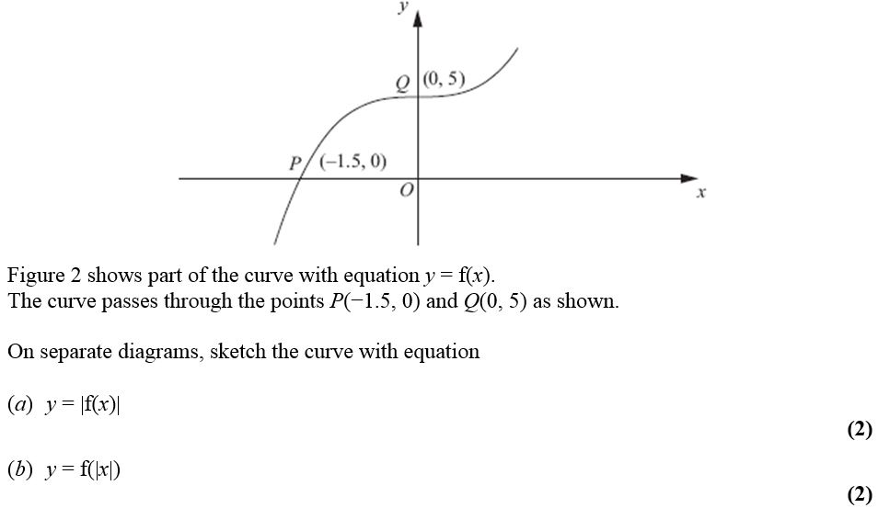
Sketching $y=|f\left(x\right)|$ and $y=f\left(\left|x\right|\right)$

Slide 8
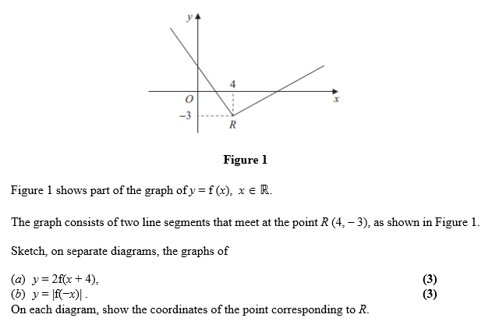
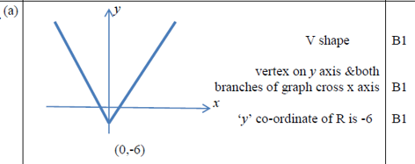
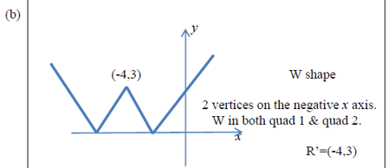
Sketching $y=|f\left(x\right)|$ and $y=f\left(\left|x\right|\right)$

Slide 9
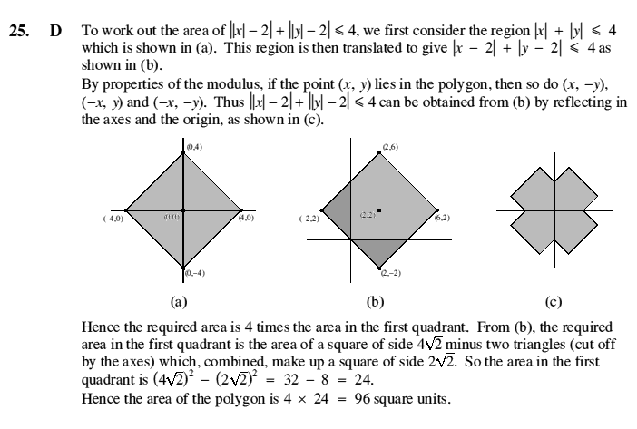
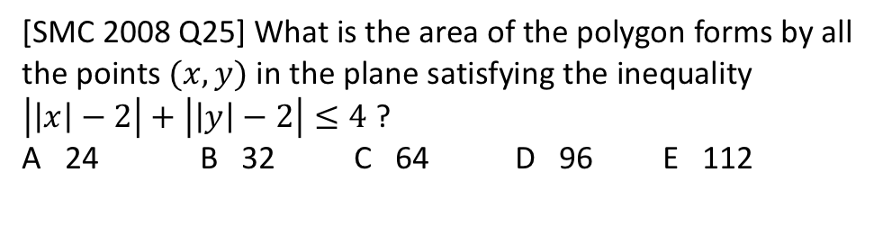
Exercise 2E
Pearson Pure Mathematics Year 2/AS
Pages 42-44
Extension
[SMC 2008 Q25] What is the area of the polygon forms by all the points $(x,y)$ in the plane satisfying the inequality $\left|\left|x\right|−2\right|+\left|\left|y\right|−2\right|≤4$ ?
A 24 B 32 C 64 D 96 E 112
Complete before
the lesson Q1-3
In Class:
Green Q4
Amber Q5-6
Red Q7-10 & Ext
?

