Slide 1
Year 1 Pure Mathematics
Exponentials and Logs
- Natural Logs
Chapter 14
(Part 6 of 7)

Slide 2
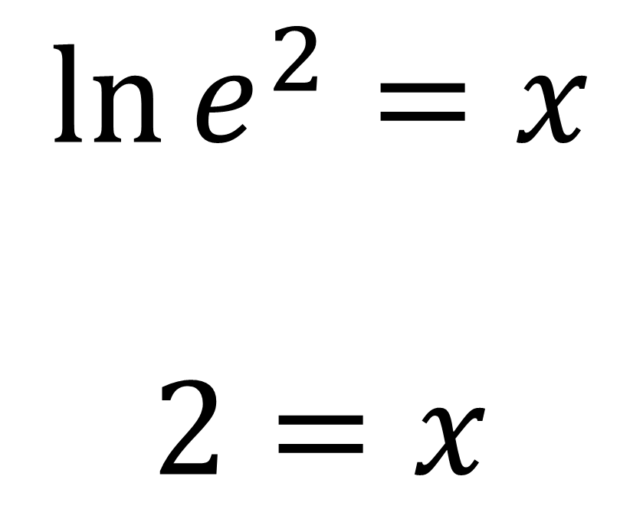
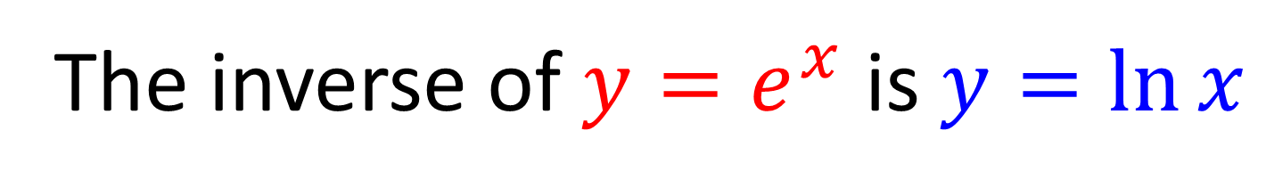
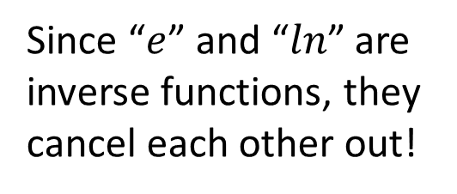
Natural Logarithms
The inverse of $y=e^{x}$ is $y=\ln{x}$
$$\ln{e^{2}}=x$$
$$2=x$$
Since “$e$” and “$ln$” are inverse functions, they cancel each other out!

Slide 3
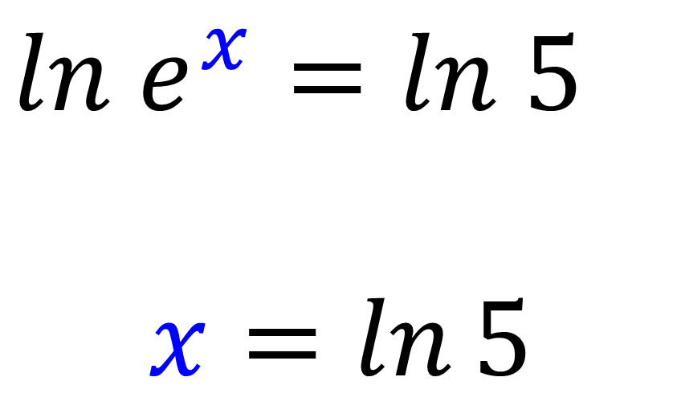
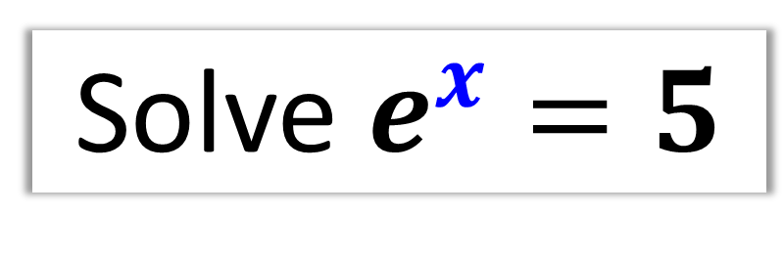
Natural Logarithms
Solve $e^{x}=5$
$ln$ $e^{x}=ln 5$
$$x=\ln{5}$$

Slide 4
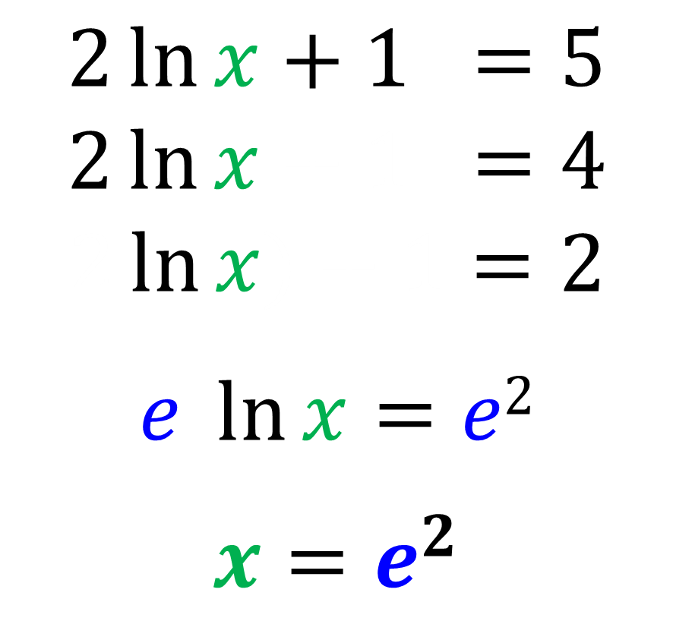
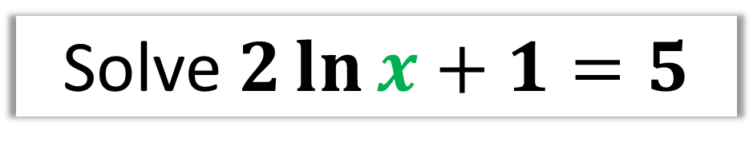
Natural Logarithms
Solve $2\ln{x}+1=5$
$$2\ln{x}+1 =5$$
$$2\ln{x}+1 =4$$
$$2\ln{x)}+1=2$$
$$e \ln{x}=e2$$
$$x=e^{2}$$

Slide 5
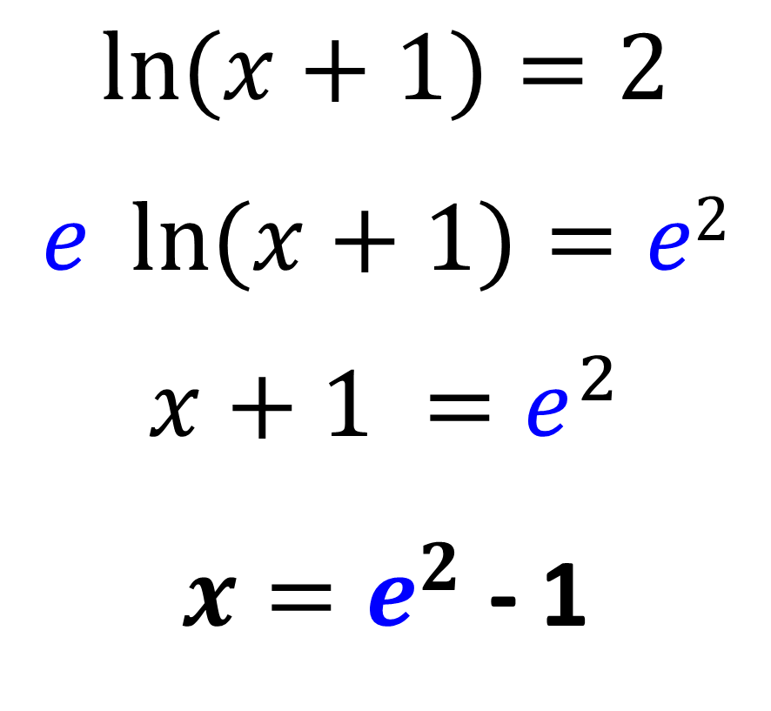
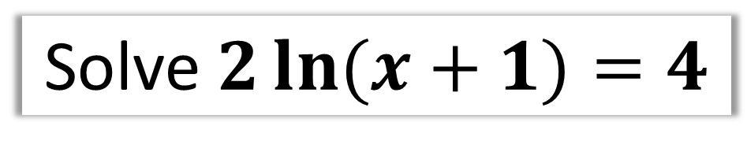
Natural Logarithms
Solve $2\ln{(x}+1)=4$
$$\ln{(x}+1)=2$$
$$e \ln{(x+1)}=e2$$
$$x+1 =e^{2}$$
$x=e^{2}$ - 1

Slide 6
Year 1 Pure Mathematics
Exponentials and Logs
- Quadratic Equations
Chapter 14
(Part 6 of 9)

Slide 7
Natural Logarithms - Quadratics
Solve $e^{2x}+2e^{x}−15=0$
$${(e}^{x})2+2{(e}^{x})−15=0$$
$\left(e^{x}+5\right)\left(e^{x}−3\right)=0$
$$e^{x}=−5 or e^{x}=3$$
x² + 2x – 15 = 0
$$x=\ln{3}$$
No solution ,
you cant log a negative

Slide 8
Natural Logarithms - Quadratics
Solve $e^{x}−2e^{−x}=1$
Multiply through by $e^{x}$
$$e^{2x}−2e^{0}=e^{x}$$
$$e^{2x}−2=e^{x}$$
$$e^{2x}−e^{x}−2=0$$
x² – x – 2 = 0
$$\left(e^{x}+1\right)\left(e^{x}−2\right)=0$$
$$e^{x}=−1 or e^{x}=2$$
$$no solutions$$
$$x=\ln{2}$$

Slide 9
Exercise 14G
Pearson Pure Mathematics Year 1/AS
Page 327-328
Complete before the lesson Ex3B Q2-4
Green Complete Ex3B
Amber Ex3C Q1-6
Red Ex3C Q7-9

