Slide 1

P2 Chapter 7 :: Trigonometry And Modelling
jfrost@tiffin.kingston.sch.uk
www.drfrostmaths.com
@DrFrostMaths
Last modified: 6th September 2018

Slide 2
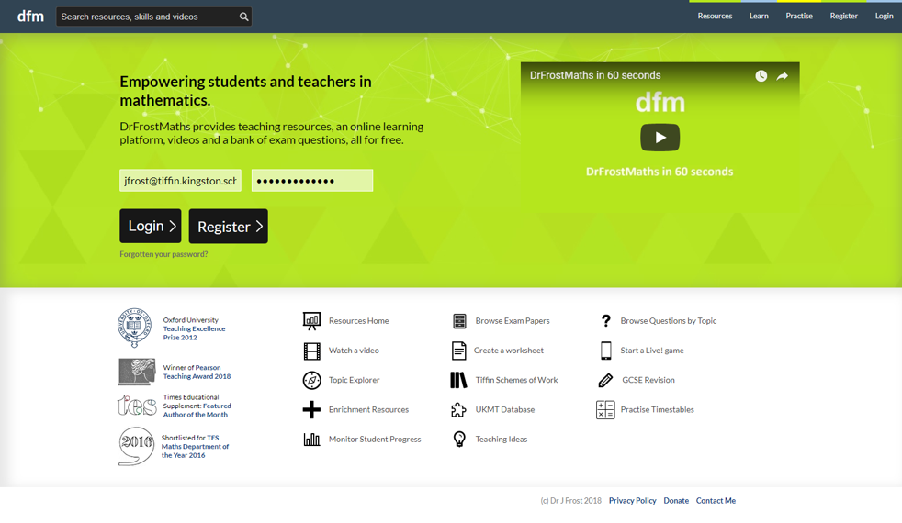







www.drfrostmaths.com
Everything is completely free.
Why not register?
Register now to interactively practise questions on this topic, including past paper questions and extension questions (including MAT + UKMT).
Teachers: you can create student accounts (or students can register themselves), to set work, monitor progress and even create worksheets.
With questions by:
Dashboard with points, trophies, notifications and student progress.
Questions organised by topic, difficulty and past paper.
Teaching videos with topic tests to check understanding.

Slide 3
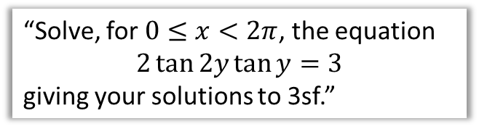


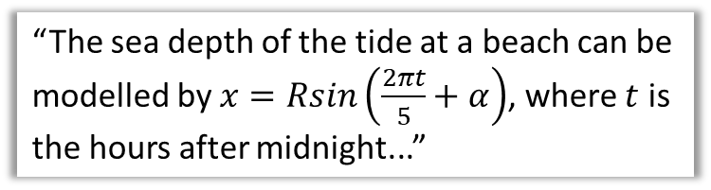
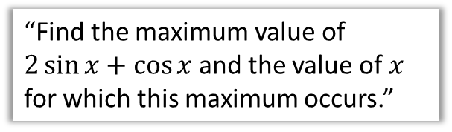
Chapter Overview
This chapter is very similar to the trigonometry chapters in Year 1. The only difference is that new trig functions: $sec, cosec$ and $cot$, are introduced.
1a:: Addition Formulae
1b:: Double Angle Formulae
$$\sin\left(a+b\right)=\sin{a}\cos{b}+\cos{a}\sin{b}$$
“Solve, for $0≤x<2π$, the equation
$$2\tan{2y}\tan{y}=3$$
giving your solutions to 3sf.”
3:: Simplifying $a\cos{x}±b\sin{x}$
4:: Modelling
“Find the maximum value of $2\sin{x}+\cos{x}$ and the value of $x$ for which this maximum occurs.”
“The sea depth of the tide at a beach can be modelled by $x=Rsin\left(\frac{2πt}{5}+α\right)$, where $t$ is the hours after midnight...”
Teacher Note: There is again no change in this chapter relative to the old pre-2017 syllabus.

Slide 4
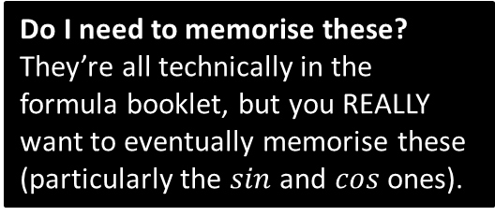
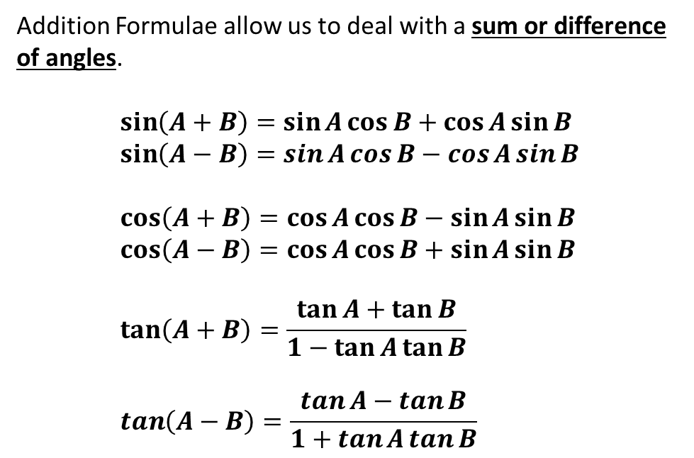
Addition Formulae
Addition Formulae allow us to deal with a sum or difference of angles.
$$\sin\left(A+B\right)=\sin{A}\cos{B}+\cos{A}\sin{B} \\ \sin\left(A−B\right)=\sin{A}\cos{B}−\cos{A}\sin{B} \\ \cos\left(A+B\right)=\cos{A}\cos{B}−\sin{A}\sin{B} \\ \cos\left(A−B\right)=\cos{A}\cos{B}+\sin{A}\sin{B} \\ \tan\left(A+B\right)=\frac{\tan{A}+\tan{B}}{1−\tan{A}\tan{B}} \\ \tan\left(A−B\right)=\frac{\tan{A}−\tan{B}}{1+\tan{A}\tan{B}}$$
How to memorise:
First notice that for all of these the first thing on the RHS is the same as the first thing on the LHS!
For sin, the operator in the middle is the same as on the LHS.
For cos, it’s the opposite.
For tan, it’s the same in the numerator, opposite in the denominator.
Do I need to memorise these?
They’re all technically in the formula booklet, but you REALLY want to eventually memorise these (particularly the $sin$ and $cos$ ones).
For sin, we mix sin and cos.
For cos, we keep the cos’s and sin’s together.

Slide 5
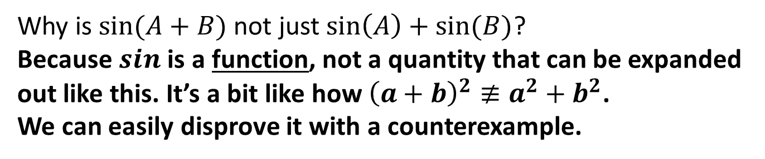
Common Schoolboy/Schoolgirl Error
Why is $sin⁡(A+B)$ not just $\sin\left(A\right)+sin⁡(B)$?
Because $sin$ is a function, not a quantity that can be expanded out like this. It’s a bit like how ${\left(a+b\right)}^{2}≢a^{2}+b^{2}$.
We can easily disprove it with a counterexample.
?

Slide 6

Addition Formulae
Now can you reproduce them without peeking at your notes?
$$\sin\left(A+B\right)≡\sin{A}\cos{B}+\cos{A}\sin{B} \\ \sin\left(A−B\right)\text{≡}\sin{A}\cos{B}−\cos{A}\sin{B} \\ \cos\left(A+B\right)\text{≡}\cos{A}\cos{B}−\sin{A}\sin{B} \\ \cos\left(A−B\right)≡\cos{A}\cos{B}+\sin{A}\sin{B} \\ \tan\left(A+B\right)≡\frac{\tan{A}+\tan{B}}{1−\tan{A}\tan{B}} \\ \tan\left(A−B\right)≡\frac{\tan{A}−\tan{B}}{1+\tan{A}\tan{B}}$$
How to memorise:
?
First notice that for all of these the first thing on the RHS is the same as the first thing on the LHS!
?
?
?
?
For sin, the operator in the middle is the same as on the LHS.
For cos, it’s the opposite.
For tan, it’s the same in the numerator, opposite in the denominator.
?
For sin, we mix sin and cos.
For cos, we keep the cos’s and sin’s together.

Slide 7

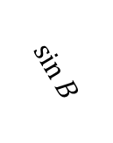


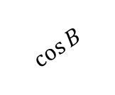
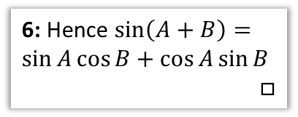








Proof of $\sin\left(A+B\right)≡\sin{A}\cos{B}+\cos{A}\sin{B}$
(Not needed for exam)
2: We can achieve this by forming two right-angled triangles.
3: Then we’re looking for the combined length of these two lines.
1: Suppose we had a line of length 1 projected an angle of $A+B$ above the horizontal.
Then the length of $XY=\sin\left(A+B\right)$
It would seem sensible to try and find this same length in terms of $A$ and $B$ individually.
$$Y$$
4: We can get the lengths of the top triangle…
$$\sin{B}$$
$$\cos{A} \sin{B}$$
$$A$$
5: Which in turn allows us to find the green and blue lengths.
$$1$$
$$sin⁡(A+B)$$
$$\cos{B}$$
6: Hence $\sin\left(A+B\right)=\sin{A}\cos{B}+\cos{A}\sin{B}$
$$□$$
$$\sin{A}\cos{B}$$
$$B$$
$$A$$
$$O$$
$$X$$

Slide 8
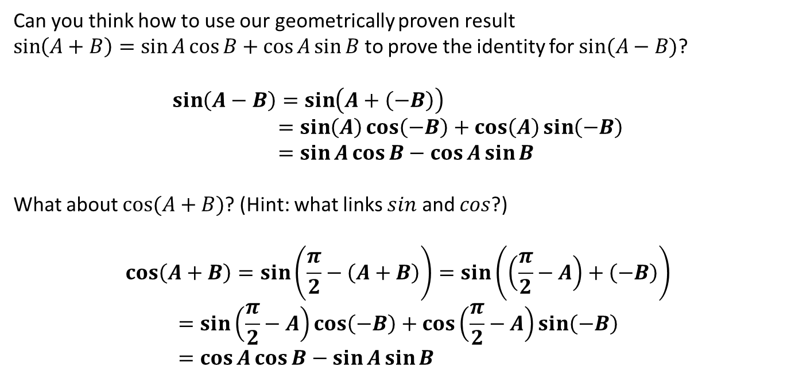
Proof of other identities
Can you think how to use our geometrically proven result
$\sin\left(A+B\right)=\sin{A}\cos{B}+\cos{A}\sin{B}$ to prove the identity for $sin⁡(A−B)$?
$$\sin\left(A−B\right)=\sin\left(A+\left(−B\right)\right) \\ =\sin\left(A\right)\cos\left(−B\right)+\cos\left(A\right)\sin\left(−B\right) \\ =\sin{A}\cos{B}−\cos{A}\sin{B}$$
What about $cos⁡(A+B)$? (Hint: what links $sin$ and $cos$?)
$$\cos\left(A+B\right)=\sin\left(\frac{π}{2}−\left(A+B\right)\right)=\sin\left(\left(\frac{π}{2}−A\right)+\left(−B\right)\right) \\ =\sin\left(\frac{π}{2}−A\right)\cos\left(−B\right)+\cos\left(\frac{π}{2}−A\right)\sin\left(−B\right) \\ =\cos{A}\cos{B}−\sin{A}\sin{B}$$
?
?
?
?

Slide 9
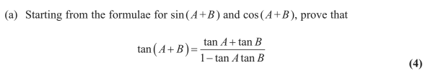
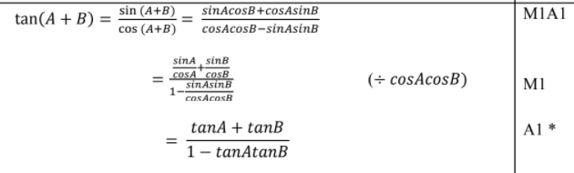
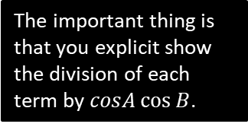
Proof of other identities
Edexcel C3 Jan 2012 Q8
?
The important thing is that you explicit show the division of each term by $cosA\cos{B}$.

Slide 10
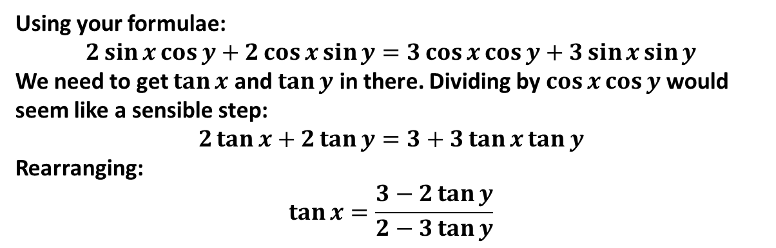
Examples
Q
Given that $2\sin{(x+y)}=3\cos\left(x−y\right)$ express $\tan{x}$ in terms of $\tan{y}$.
?
Using your formulae:
$$2\sin{x}\cos{y}+2\cos{x}\sin{y}=3\cos{x}\cos{y}+3\sin{x}\sin{y}$$
We need to get $\tan{x}$ and $\tan{y}$ in there. Dividing by $\cos{x}\cos{y}$ would seem like a sensible step:
$$2\tan{x}+2\tan{y}=3+3\tan{x}\tan{y}$$
Rearranging:
$$\tan{x}=\frac{3−2\tan{y}}{2−3\tan{y}}$$

Slide 11
Exercises 7A
Pearson Pure Mathematics Year 2/AS
Page 144
(Classes in a rush may wish to skip this exercise)
Complete before the lesson Q1-5
In Class:
Green Q6-9
Amber Q10-14
Red Q15 -16 & Challenge

Slide 12
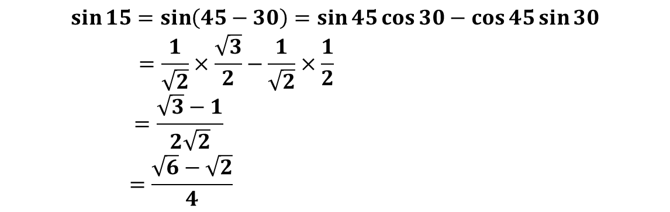
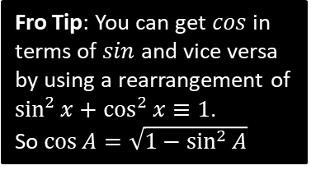
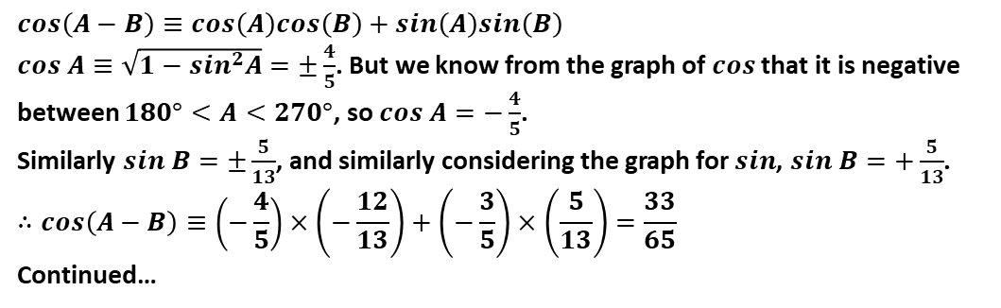
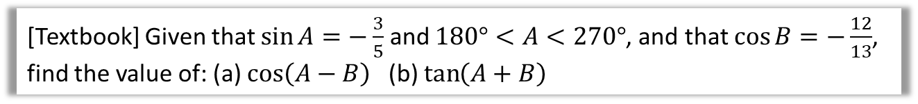
Uses of Addition Formulae
Q
[Textbook] Using a suitable angle formulae, show that $\sin{15°}=\frac{\sqrt{6}−\sqrt{2}}{4}$.
?
$$\sin{15}=\sin\left(45−30\right)=\sin{45}\cos{30}−\cos{45}\sin{30} \\ =\frac{1}{\sqrt{2}}×\frac{\sqrt{3}}{2}−\frac{1}{\sqrt{2}}×\frac{1}{2} \\ =\frac{\sqrt{3}−1}{2\sqrt{2}} \\ =\frac{\sqrt{6}−\sqrt{2}}{4}$$
Q
[Textbook] Given that $\sin{A}=−\frac{3}{5}$ and $180°<A<270°$, and that $\cos{B}=−\frac{12}{13}$, find the value of: (a) $\cos\left(A−B\right)$ (b) $\tan\left(A+B\right)$
$$cos\left(A−B\right)≡cos\left(A\right)cos\left(B\right)+sin\left(A\right)sin\left(B\right)$$
$cos A≡\sqrt{1−sin^{2}A}=±\frac{4}{5}$. But we know from the graph of $cos$ that it is negative between $180°<A<270°$, so $cos A=−\frac{4}{5}$.
Similarly $sin B=±\frac{5}{13}$, and similarly considering the graph for $sin$, $sin B=+\frac{5}{13}$.
$$∴cos\left(A−B\right)≡\left(−\frac{4}{5}\right)×\left(−\frac{12}{13}\right)+\left(−\frac{3}{5}\right)×\left(\frac{5}{13}\right)=\frac{33}{65}$$
Continued…
?
Fro Tip: You can get $cos$ in terms of $sin$ and vice versa by using a rearrangement of
$\sin^{2}{x}+\cos^{2}{x}≡1$.
So $\cos{A}=\sqrt{1−\sin^{2}{A}}$

Slide 13

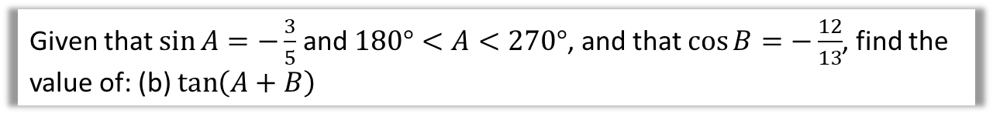
Continued…
Q
Given that $\sin{A}=−\frac{3}{5}$ and $180°<A<270°$, and that $\cos{B}=−\frac{12}{13}$, find the value of: (b) $\tan\left(A+B\right)$
?
$$\tan\left(A+B\right)=\frac{\tan\left(A\right)+tan⁡(B)}{1−\tan{A}\tan{B}}$$
We earlier found $\sin{A}=−\frac{3}{5},\sin{B}=\frac{5}{13},\cos{A}=−\frac{4}{5},\cos{B}=−\frac{12}{13}$
$∴\tan{A}=\left(−\frac{3}{5}\right)÷\left(−\frac{4}{5}\right)=\frac{3}{4}$ and $\tan{B}=\frac{5}{13}÷\left(−\frac{12}{13}\right)=−\frac{5}{12}$
By substitution:
$$\tan\left(A+B\right)=\frac{16}{63}$$

Slide 14

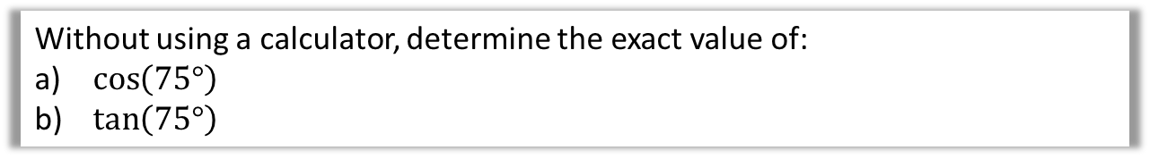
Test Your Understanding
Without using a calculator, determine the exact value of:
$\cos\left(75°\right)$
$\tan\left(75°\right)$
?
$$\cos\left(75°\right)=\cos\left(45°+30°\right)=\cos\left(45°\right)\cos\left(30°\right)−\sin\left(45°\right)\sin\left(30°\right) \\ =\frac{1}{\sqrt{2}}×\frac{\sqrt{3}}{2}−\frac{1}{\sqrt{2}}×\frac{1}{2} \\ =\frac{\sqrt{3}−1}{2\sqrt{2}}=\frac{\sqrt{6}−\sqrt{2}}{4}$$
$$\tan\left(75°\right)=\frac{\sin\left(75°\right)}{\cos\left(75°\right)}$$
$$\sin\left(75°\right)=\sin\left(45°+30°\right)=\sin\left(45°\right)\cos\left(30°\right)+\cos\left(45°\right)\sin\left(30°\right) \\ =\frac{1}{\sqrt{2}}×\frac{\sqrt{3}}{2}+\frac{1}{\sqrt{2}}×\frac{1}{2}=\frac{\sqrt{6}+\sqrt{2}}{4}$$
$$∴\tan\left(75°\right)=\left(\frac{\sqrt{6}+\sqrt{2}}{4}\right)÷\left(\frac{\sqrt{6}−\sqrt{2}}{4}\right)=\frac{\sqrt{6}+\sqrt{2}}{\sqrt{6}−\sqrt{2}}=2+\sqrt{3}$$
?

Slide 15
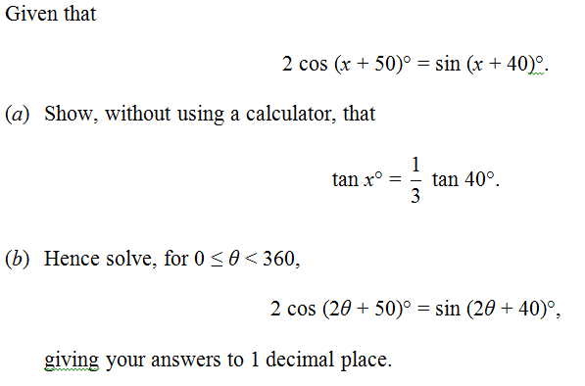

Challenging question
Edexcel June 2013 Q3
a
?
‘Expanding’ both sides:
$$2\cos{x}\cos{50}−2\sin{x}\sin{50} \\ =\sin{x}\cos{40}+\cos{x}\sin{40}$$
Since thing to prove only has 40 in it, use $\cos{50}=\sin{40}$ and $\sin{50}=\cos{40 }.$
$$2\cos{x}\sin{40}−2\sin{x}\cos{40 } \\ =\sin{x}\cos{40}+\cos{x}\sin{40}$$
As per usual, when we want tans, divide by $\cos{x}\cos{40}$:
$$2\tan{40}−2\tan{x}=\tan{x}+\tan{40} \\ \tan{40}=3\tan{x} \\ \frac{1}{3}\tan{40}=\tan{x}$$

Slide 16
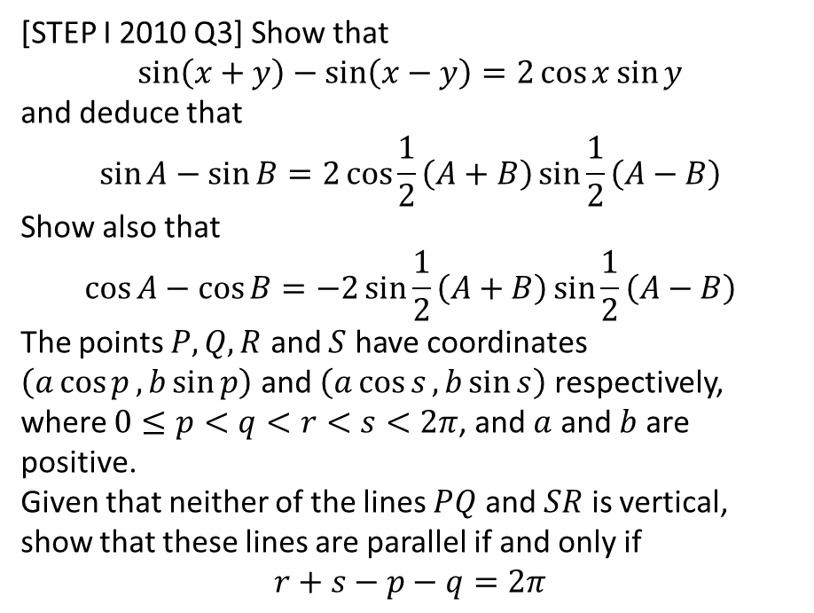
Exercise 7B
Pearson Pure Mathematics Year 2/AS
Pages 172-173
Extension
Complete before the lesson Q1-3
In Class:
Green Q4-6
Amber Q7-9
Red Q10
[STEP I 2010 Q3] Show that
$$\sin\left(x+y\right)−\sin\left(x−y\right)=2\cos{x}\sin{y}$$
and deduce that
$$\sin{A}−\sin{B}=2\cos{\frac{1}{2}\left(A+B\right)}\sin{\frac{1}{2}\left(A−B\right)}$$
Show also that
$$\cos{A}−\cos{B}=−2\sin{\frac{1}{2}\left(A+B\right)}\sin{\frac{1}{2}\left(A−B\right)}$$
The points $P, Q, R$ and $S$ have coordinates $\left(a\cos{p},b\sin{p}\right)$ and $\left(a\cos{s}, b\sin{s}\right)$ respectively, where $0≤p<q<r<s<2π$, and $a$ and $b$ are positive.
Given that neither of the lines $PQ$ and $SR$ is vertical, show that these lines are parallel if and only if
$$r+s−p−q=2π$$

Slide 17
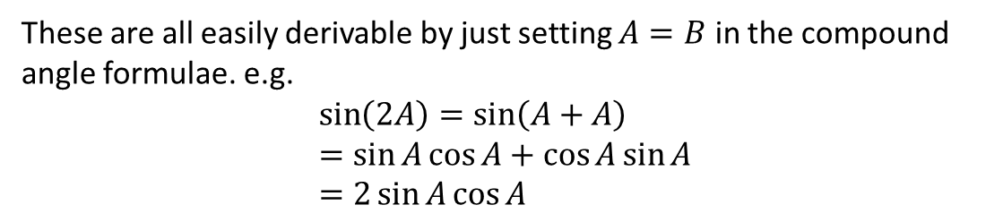
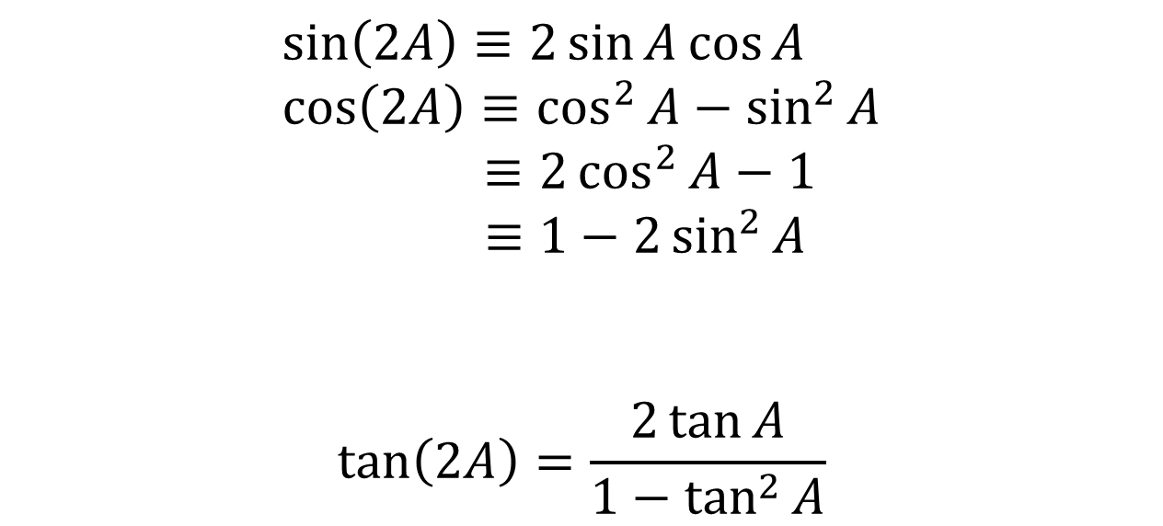
Double Angle Formulae
Double-angle formula allow you to halve the angle within a trig function.
!
This first form is relatively rare.
$$\sin\left(2A\right)≡2\sin{A}\cos{A} \\ \cos\left(2A\right)≡\cos^{2}{A}−\sin^{2}{A}$$
$≡2\cos^{2}{A}−1$
$$≡1−2\sin^{2}{A}$$
$$\tan\left(2A\right)=\frac{2\tan{A}}{1−\tan^{2}{A}}$$
Fro Tip: The way I remember what way round these go is that the cos on the RHS is ‘attracted’ to the cos on the LHS, whereas the sin is pushed away.
These are all easily derivable by just setting $A=B$ in the compound angle formulae. e.g.
$$\sin\left(2A\right)=\sin\left(A+A\right) \\ =\sin{A}\cos{A}+\cos{A}\sin{A} \\ =2\sin{A}\cos{A}$$

Slide 18

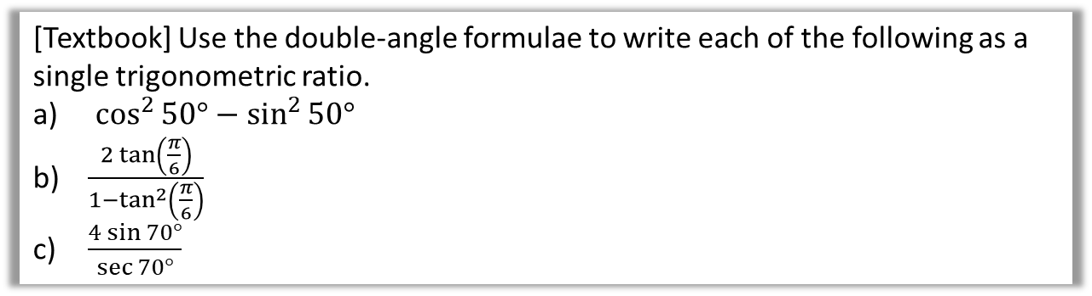

Examples
[Textbook] Use the double-angle formulae to write each of the following as a single trigonometric ratio.
$\cos^{2}{50°}−\sin^{2}{50° }$
$\frac{2\tan\left(\frac{π}{6}\right)}{1−\tan^{2}\left(\frac{π}{6}\right)}$
$\frac{4\sin{70°}}{\sec{70°}}$
$$\sin{2x}=2\sin{x}\cos{x} \\ \cos{2x}=\cos^{2}{x}−\sin^{2}{x} \\ =2\cos^{2}{x}−1 \\ =1−2\sin^{2}{x} \\ \tan{2x}=\frac{2\tan{x}}{1−\tan^{2}{x}}$$
a
This matches $\cos\left(2A\right)=\cos^{2}{A}−\sin^{2}{A}$:
$$\cos^{2}{50°}−\sin^{2}{50° }=\cos\left(100°\right)$$
This matches $\tan\left(2A\right)=\frac{2\tan{A}}{1−\tan^{2}{A}}$
$$\frac{2\tan\left(\frac{π}{6}\right)}{1−\tan^{2}\left(\frac{π}{6}\right)}=\tan\left(\frac{π}{3}\right)$$
$$\frac{4\sin{70°}}{\sec{70°}}=\frac{4\sin{70°}}{1÷\cos{70°}}=4\sin{70°}\cos{70°}$$
This matches $\sin\left(2A\right)=2\sin{A}\cos{A}$
$$4\sin{70°} cos70°=2\sin{140°}$$
?
b
?
c
?

Slide 19

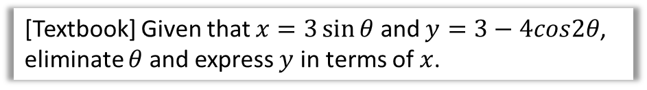

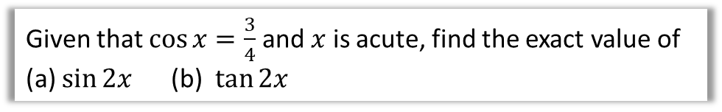

Examples
[Textbook] Given that $x=3\sin{θ}$ and $y=3−4cos2θ$, eliminate $θ$ and express $y$ in terms of $x$.
$$\sin{2x}=2\sin{x}\cos{x} \\ \cos{2x}=\cos^{2}{x}−\sin^{2}{x} \\ =2\cos^{2}{x}−1 \\ =1−2\sin^{2}{x} \\ \tan{2x}=\frac{2\tan{x}}{1−\tan^{2}{x}}$$
?
$$y=3−4\left(1−2\sin^{2}{θ}\right)$$
$$=8\sin^{2}{θ}−1$$
$$\sin{θ}=\frac{x}{3}$$
$$∴y=8{\left(\frac{x}{3}\right)}^{2}−1$$
Fro Note: This question is an example of turning a set of parametric equations into a single Cartesian one. You will cover this in the next chapter.
Given that $\cos{x}=\frac{3}{4}$ and $x$ is acute, find the exact value of
(a) $\sin{2x}$ (b) $\tan{2x}$
?
Since $sin^{2}x+cos^{2}x=1$, $sin x=±\sqrt{1−cos^{2}x}$
$sin x=\sqrt{1−{\left(\frac{3}{4}\right)}^{2}}=\frac{\sqrt{7}}{4}$ (and is positive given $0<x<90°$)
$$∴sin 2x=2sin x cos x=2×\frac{\sqrt{7}}{4}×\frac{3}{4}=\frac{3\sqrt{7}}{8}$$
$$tan x=\frac{sin x}{cos}=\frac{3\sqrt{7}/8}{3/4}=\frac{\sqrt{7}}{3} ∴tan2x=\frac{2×\frac{\sqrt{7}}{3}}{1−{\left(\frac{\sqrt{7}}{3}\right)}^{2}}=3\sqrt{7}$$

Slide 20
Exercise 7C
Pearson Pure Mathematics Year 2/AS
Pages 175-177
Complete before the lesson Q1-3
In Class:
Green Q4-7
Amber Q8-13
Red Q14-19

Slide 21

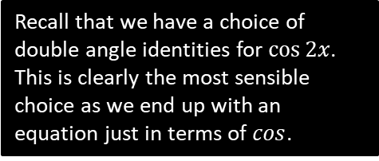
Solving Trigonometric Equations
This is effectively the same type of question you encountered in Chapter 6 and in Year 1, except you may need to use either the addition formulae or double angle formulae.
[Textbook] Solve $3\cos{2x}−\cos{x}+2=0$ for $0≤x≤360°$.
?
$$3\left(2\cos^{2}{x}−1\right)−\cos{x}+2=0 \\ 6\cos^{2}{x}−3−\cos{x}+2=0 \\ 6\cos^{2}{x}−\cos{x}−1=0 \\ \left(3\cos{x}+1\right)\left(2\cos{x}−1\right)=0 \\ \cos{x}=−\frac{1}{3} or\cos{x}=\frac{1}{2}$$
$$x=109.5°, 250.5° x=60°,300°$$
Recall that we have a choice of double angle identities for $\cos{2x}$. This is clearly the most sensible choice as we end up with an equation just in terms of $cos$.

Slide 22

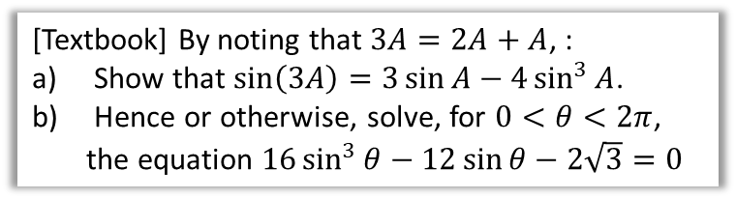

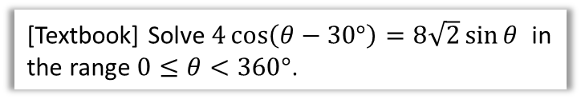
Further Examples
[Textbook] By noting that $3A=2A+A$, :
Show that $\sin\left(3A\right)=3\sin{A}−4\sin^{3}{A}$.
Hence or otherwise, solve, for $0<θ<2π$, the equation $16\sin^{3}{θ}−12\sin{θ}−2\sqrt{3}=0$
[Textbook] Solve $4\cos\left(θ−30°\right)=8\sqrt{2}\sin{θ}$ in the range $0≤θ<360°$.
?
Your instinct should be to use the addition formulae first to break up the $4\cos\left(θ−30°\right)$.
$$4\cos{θ}\cos{30°}+4\sin{θ}\sin{30°}=8\sqrt{2}\sin{θ} \\ 2\sqrt{3}\cos{θ}+2\sin{θ}=8\sqrt{2}\sin{θ} \\ 2\sqrt{3}\cos{θ}=8\sqrt{2}\sin{θ}−2\sin{θ} \\ 2\sqrt{3}\cos{θ}=\left(8\sqrt{2}−2\right)\sin{θ} \\ \frac{2\sqrt{3}}{8\sqrt{2}−2}=\frac{\sin{θ}}{\cos{θ}}=\tan{θ}$$
$θ=20.4°, 200.4°$
Fro Exam Note: A question pretty much just like this came up in an exam once.
$$\sin\left(2A+A\right) \\ =\sin{2A}\cos{A}+\cos{2A}\sin{A} \\ =2\sin{A}\cos{A}\cos{A}+\left(1−2\sin^{2}{A}\right)\sin{A} \\ =2\sin{A}\left(1−\sin^{2}{A}\right)+\sin{A}−2\sin^{3}{A} \\ =2\sin{A}−2\sin^{3}{A}+\sin{A}−2\sin^{3}{A} \\ =3\sin{A}−4\sin^{3}{A}$$
Note that $16\sin^{3}{θ}−12\sin{θ}$
$=−4\left(3\sin{A}−4\sin^{3}{A}\right)=−4\sin{3θ}$.
$$∴−4\sin{3θ}=2\sqrt{3} \\ \sin{3θ}=−\frac{\sqrt{3}}{2}$$
$$3θ=\frac{4π}{3},\frac{5π}{3},\frac{10π}{3},\frac{11π}{3},\frac{16π}{3},\frac{17π}{3} \\ θ=\frac{4π}{9},\frac{5π}{9},\frac{10π}{9},\frac{11π}{9},\frac{16π}{9},\frac{17π}{9}$$
?
?

Slide 23
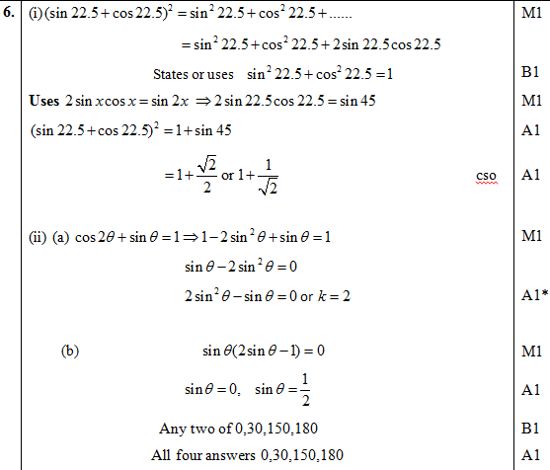
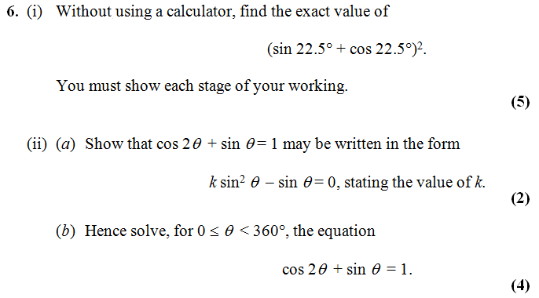


Test Your Understanding
Edexcel C3 Jan 2013 Q6
?
If you finish that quickly…
[Textbook] Solve $2\tan{2y}\tan{y}=3$ for $0≤y<2π$, giving your answer to 2dp.
?
$$2\tan{2y}\tan{y}=3 \\ 2\left(\frac{2\tan{y}}{1−\tan^{2}{y}}\right)\tan{y}=3 \\ … \\ 7\tan^{2}{y}=3 \\ \tan{y}=±\sqrt{\frac{3}{7}} \\ y=0.58, 2.56, 3.72, 5.70$$
Forgetting the $±$ is an incredibly common source of lost marks.

Slide 24
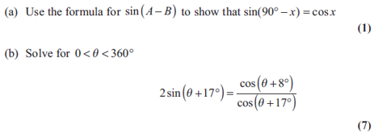
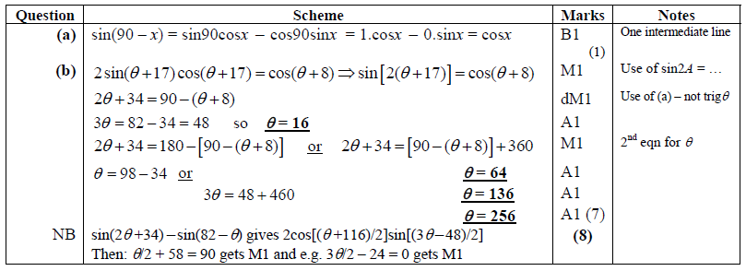
Exercise 7D
Pearson Pure Mathematics Year 2/AS
Pages 180-181
Extension
[AEA 2013 Q2]
Complete before the lesson Q1-3
In Class:
Green Q4-5
Amber Q6-9
Red Q10-14
1
?

Slide 25
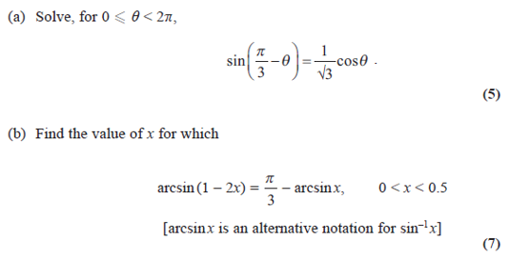
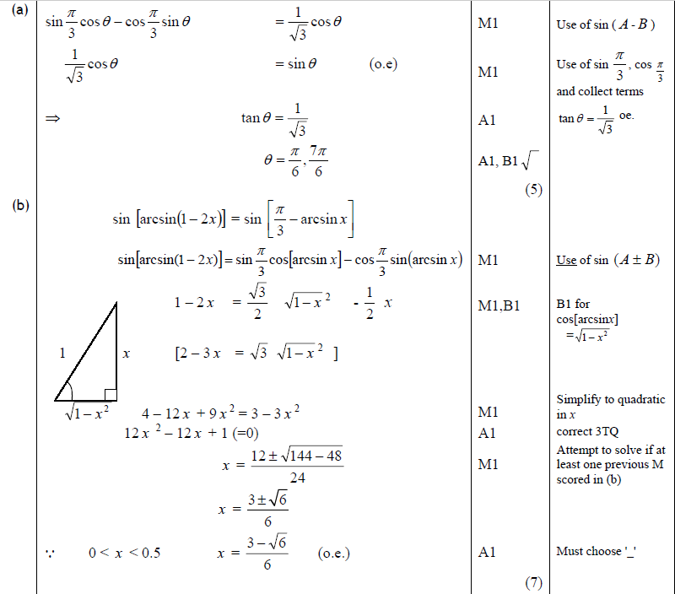
Solution to Extension Question 2

Slide 26



$$a\sin{θ}+b\cos{θ}$$
Here’s a sketch of $y=3\sin{x}+4\cos{x}$.
What do you notice?
?
It’s a sin graph that seems to be translated on the $x$-axis and stretched on the $y$ axis.
This suggests we can represent it as $y=R sin⁡(x+α)$, where $α$ is the horizontal translation and $R$ the stretch on the $y$-axis.

Slide 27


$$a\sin{θ}+b\cos{θ}$$
Q
Put $3\sin{x}+4\cos{x}$ in the form $R\sin\left(x+α\right)$ giving $α$ in degrees to 1dp.
STEP 1: Expanding:
$$R\sin\left(x+α\right)=R\sin{x}\cos{α}+R\cos{x}\sin{α}$$
STEP 2: Comparing coefficients:
$$R\cos{α}=3 R\sin{α}=4$$
STEP 3: Using the fact that $R^{2}\sin^{2}{α}+R^{2}\cos^{2}{α}=R^{2}$:
$$R=\sqrt{3^{2}+4^{2}}=5$$
STEP 4: Using the fact that $\frac{R\sin{α}}{R\cos{α}}=\tan{α}$:
$$\tan{α}=\frac{4}{3}$$
$$α=53.1°$$
STEP 5: Put values back into original expression.
$$3\sin{x}+4\cos{x}≡5\sin\left(x+53.1°\right)$$
Fro Tip: I recommend you follow this procedure every time – I’ve tutored students who’ve been taught a ‘shortcut’ (usually skipping Step 1), and they more often than not make a mistake.
?
?
?
If $R\cos{α=3}$ and $R\sin{α=4}$ then $R^{2}\cos^{2}{α}=3^{2}$ and $R^{2}\sin^{2}{α=4^{2}}$.
$$R^{2}\sin^{2}{α}+R^{2}\cos^{2}{α}=3^{2}+4^{2} \\ R^{2}\left(\sin^{2}{α}+\cos^{2}{α}\right)=3^{2}+4^{2} \\ R^{2}=3^{2}+4^{2} \\ R=\sqrt{3^{2}+4^{2}}$$
(You can write just the last line in exams)
?
?

Slide 28


Test Your Understanding
Q
Put $\sin{x}+\cos{x}$ in the form $R\sin\left(x+α\right)$ giving $α$ in terms of $π$.
?
$$R\sin\left(x+α\right)≡R\sin{x}\cos{α}+R\cos{x}\sin{α}$$
$$R\cos{α}=1 R\sin{α}=1$$
$$R=\sqrt{1^{2}+1^{2}}=\sqrt{2}$$
$$\tan{α}=1$$
$$α=\frac{π}{4}$$
$$\sin{x}+\cos{x}≡\sqrt{2}\sin\left(x+\frac{π}{4}\right)$$
Q
Put $\sin{x}−\sqrt{3}\cos{x}$ in the form $R\sin\left(x−α\right)$ giving $α$ in terms of $π$.
?
$$R\sin\left(x−α\right)≡R\sin{x}\cos{α}−R\cos{x}\sin{α}$$
$$R\cos{α}=1 R\sin{α}=\sqrt{3} \\ R=2$$
$$\tan{α}=\sqrt{3} so α=\frac{π}{3}$$
$$sinx−\sqrt{3}\cos{x}≡2\sin\left(x−\frac{π}{3}\right)$$

Slide 29




Further Examples
Q
Put $2\cos{θ}+5\sin{θ}$ in the form $R\cos\left(θ−α\right)$ where $0<α<90°$
Hence solve, for $0<θ<360$, the equation $2\cos{θ}+5\sin{θ}=3$
?
$$2\cos{θ}+5\sin{θ}≡\sqrt{29}\cos\left(θ−68.2°\right)$$
Therefore:
$$\sqrt{29}\cos\left(θ−68.2°\right)=3 \\ \cos\left(θ−68.2°\right)=\frac{3}{\sqrt{29}} \\ θ−68.2°=−56.1…°, 56.1…° \\ θ=12.1°, 124.3°$$
Fro Tip: This is an exam favourite!
Q
(Without using calculus), find the maximum value of $12\cos{θ}+5\sin{θ}$, and give the smallest positive value of $θ$ at which it arises.
?
Use either $R\sin{(θ+α)}$ or $R\cos{(θ−α})$before that way the + sign in the middle matches up.
$$≡13\cos\left(θ−22.6°\right)$$
$cos$ is at most 1,thus the expression has value at most 13.
This occurs when $θ−22.6=0$ (as $\cos{0}=1$) thus $θ=22.6$

Slide 30


Quickfire Maxima
What is the maximum value of the expression and determine the smallest positive value of $θ$ (in degrees) at which it occurs.
Expression | Maximum | (Smallest) $θ$ at max
$$20\sin{θ}$$ | $$20$$ | $$90°$$
$$5−10\sin{θ}$$ | $$15$$ | $$270°$$
$$3\cos\left(θ+20°\right)$$ | $$3$$ | $$340°$$
$$\frac{2}{10+3\sin\left(θ−30\right)}$$ | $$\frac{2}{7}$$ | $$300°$$
?
?
?
?
?
?
?
?

Slide 31


Further Test Your Understanding
Edexcel C3 Jan 2013 Q4
?

Slide 32
Exercise 7E
Pearson Pure Mathematics Year 2/AS
Pages 184-186
Complete before the lesson Q1-4
In Class:
Green Q5-9
Amber Q10-12
Red Q13-15

Slide 33




Proving Trigonometric Identities
Just like Chapter 6 had ‘provey’ and ‘solvey’ questions, we also get the ‘provey’ questions in Chapter 7. Just use the appropriate double angle or addition formula.
Prove that $\tan{2θ}≡\frac{2}{\cot{θ}−\tan{θ}}$
?
$$\tan{2θ}≡\frac{2\tan{θ}}{1−\tan^{2}{θ}}≡\frac{2}{\frac{1}{\tan{θ}}−\tan{θ}} \\ ≡\frac{2}{\cot{θ}−\tan{θ}}$$
Prove that $\frac{1−\cos{2θ}}{\sin{2θ}}≡\tan{θ}$
?
$$\frac{1−\left(1−2\sin^{2}{θ}\right)}{2\sin{θ}\cos{θ}}≡\frac{2\sin^{2}{θ}}{2\sin{θ}\cos{θ}} \\ ≡\tan{θ}$$

Slide 34



Test Your Understanding
[OCR] Prove that $\cot{2x}+cosec 2x≡\cot{x}$
?
$$\frac{\cos{2x}}{\sin{2x}}+\frac{1}{\sin{2x}} \\ ≡\frac{\cos{2x}+1}{\sin{2x}}≡\frac{2\cos^{2}{x}−1+1}{2sin{x}\cos{x}} \\ ≡\frac{2\cos^{2}{x}}{2\sin{x}\cos{x}}≡\frac{\cos{x}}{\sin{x}}≡\cot{x}$$
[OCR] By writing $\cos{x}=\cos\left(2×\frac{x}{2}\right)$ or otherwise, prove the identity $\frac{1−\cos{x}}{1+\cos{x}}≡\tan^{2}\left(\frac{x}{2}\right)$
?
$$\cos{x}≡\cos\left(2×\frac{x}{2}\right)≡2\cos^{2}\left(\frac{x}{2}\right)−1 \\ ∴ \frac{1−\cos{x}}{1+\cos{x}}≡\frac{1−\left(2\cos^{2}\left(\frac{x}{2}\right)−1\right)}{1+\left(2\cos^{2}\left(\frac{x}{2}\right)−1\right)} \\ ≡\frac{2\left(1−\cos^{2}\left(\frac{x}{2}\right)\right)}{2\cos^{2}\left(\frac{x}{2}\right)}≡\frac{\sin^{2}\left(\frac{x}{2}\right)}{\cos^{2}\left(\frac{x}{2}\right)}≡\tan^{2}\left(\frac{x}{2}\right)$$

Slide 35


Exercise 7F
Pearson Pure Mathematics Year 2/AS
Pages 187-188
Extension:
[STEP I 2005 Q4]
Complete before the lesson Q1-2
In Class:
Green Q3-5
Amber Q6-7
Red Q8-10
?
?
(a) $−\frac{117}{125}$ (b) $tan θ=8+\sqrt{75}$

Slide 36





Very Challenging Exam Example
Edexcel C3 June 2015 Q8
We eventually want $\cos{A}−\sin{A}$ so $\cos^{2}{A}−\sin^{2}{A}$ is best choice of double-angle formula because this can be factorise to give $\cos{A}−\sin{A}$ as a factor.
? a
? b
This is even less obvious. Knowing that we’ll have $\left(\cos{A}−\sin{A}\right)\left(\cos{A}+\sin{A}\right)$ in the denominator and that the $\cos{A}+\sin{A}$ will cancel, we might work backwards from the final result and multiply by $\cos{A}+\sin{A}$! Working backwards from the thing we’re trying to prove is occasionally a good strategy (provided the steps are reversible!)

Slide 37




Modelling
When trigonometric equations are in the form $Rsin\left(ax±b\right)$ or $Rcos\left(ax±b\right)$, they can be used to model various things which have an oscillating behaviour, e.g. tides, the swing of a pendulum and sound waves.
? c
? a
? b
? d

Slide 38



Test Your Understanding
Tip: Reflect carefully on the substitution you use to allow (bii) to match your identity in (a). $θ=?$
? a
? bi
? bii
? c
? d

Slide 39
Exercise 7G
Pearson Pure Mathematics Year 2/AS
Pages 190-191
Complete before the lesson Q1-2
In Class:
Amber Q3-5
Red Q6-7 & Challenge

