Slide 1
Year 1 Pure Mathematics
Equations and Inequalities
- Set Notation
Chapter 3
(Part 3 of 3)

Slide 2

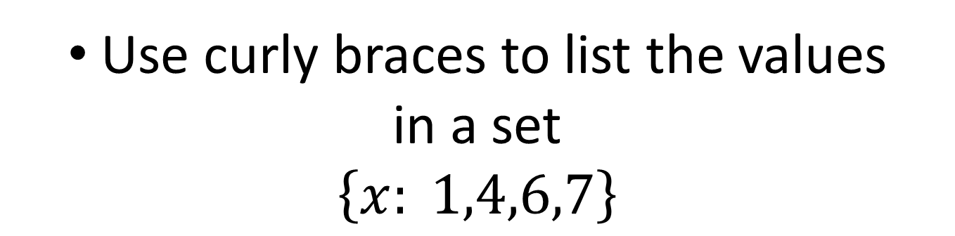
Set Notation
Sets are a list of numbers
Use curly braces to list the values
in a set
$$\left\{x: 1,4,6,7\right\}$$
The list can be infinite
$$\left\{x:x<7\right\}$$

Slide 3
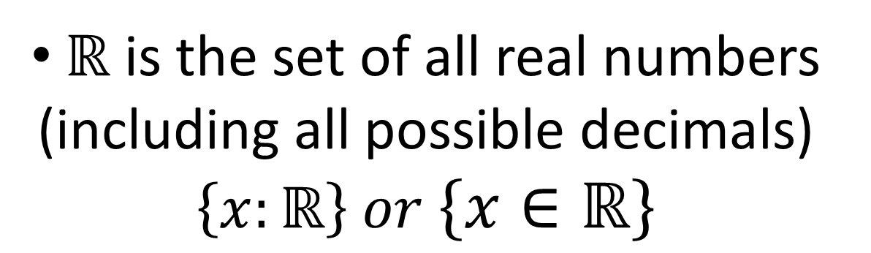
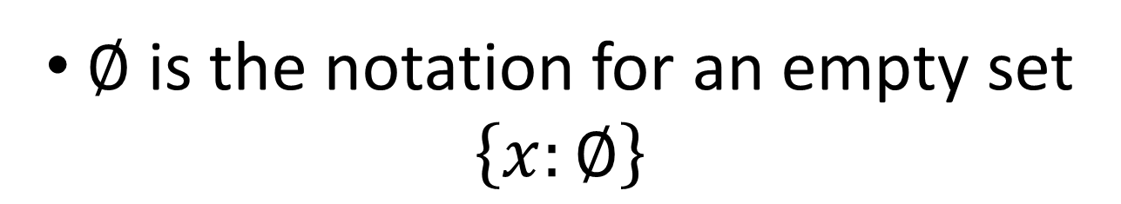
Set Notation
$∅$ is the notation for an empty set
$$\left\{x:∅\right\}$$
$ℝ$ is the set of all real numbers
(including all possible decimals)
$$\left\{x:ℝ\right\} or \left\{x∈ℝ\right\}$$

Slide 4

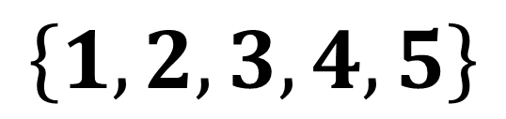

Set Notation
$$\left\{1,2,3\right\}∩\left\{3,4,5\right\}=\left\{3\right\}$$
$$\left\{3\right\}$$
AND
$$\left\{1,2,3,4,5\right\}$$
$$\left\{1,2,3\right\}∪\left\{3,4,5\right\}=\left\{1,2,3,4,5\right\}$$
OR
$$∅$$
$$\left\{1,2\right\}∩\left\{3,4\right\} = ∅$$
Nothing in the set

Slide 5



Set Builder Notation
Can you use set notation to specify the following sets?
All (real) numbers greater than 5.
$$\{x: x>5\}$$
All (real) numbers less than 5 or greater than 7.
$$\left\{x: x<5\right\}∪\{x:x>7\}$$
All (real) numbers between 5 and 7 inclusive.
$$\left\{x: 5≤x≤7\right\}$$

Slide 6
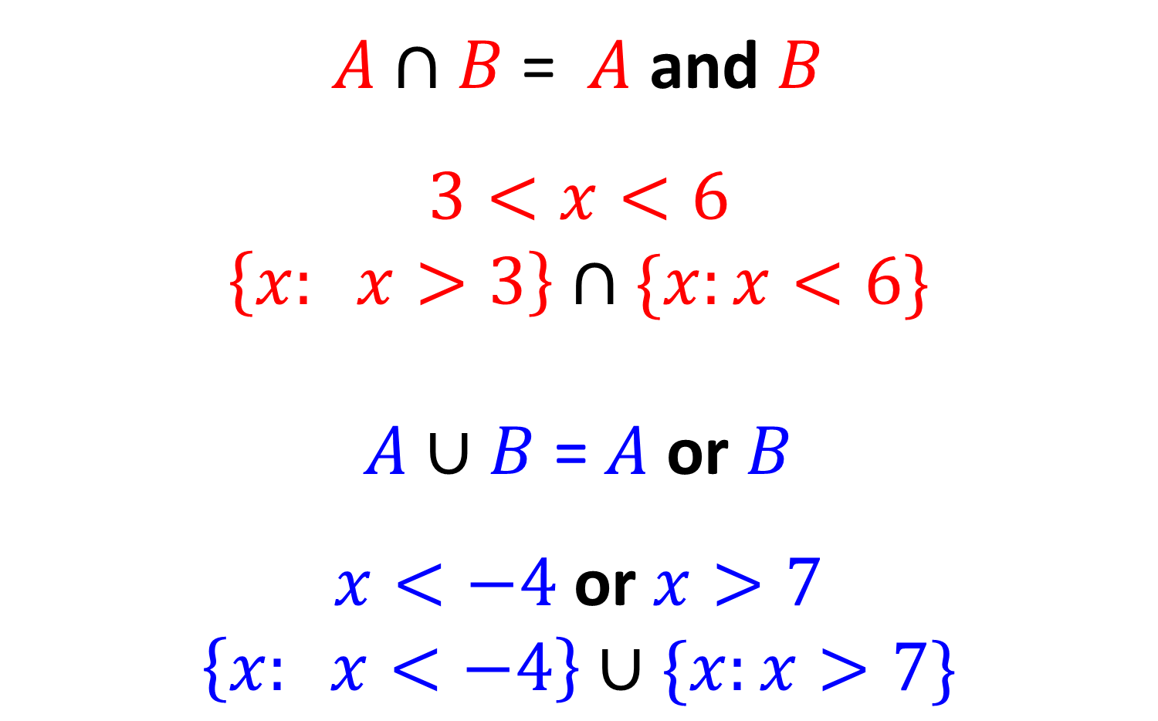
Set Notation
$A∩B$= $A$ and $B$
$$3<x<6$$
$$\left\{x: x>3\right\}∩\{x:x<6\}$$
$A∪B$ = $A$ or $B$
$x<−4$ or $x>7$
$$\left\{x: x<−4\right\}∪\{x:x>7\}$$

Slide 7
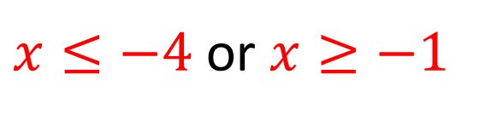






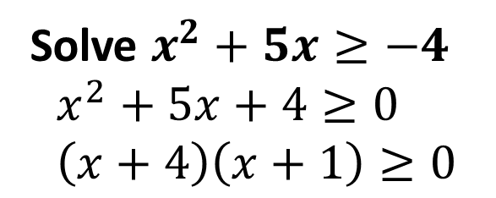
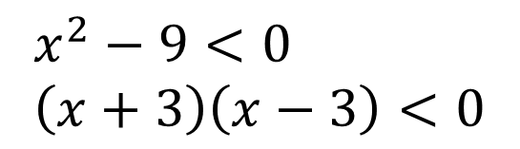








Solving Quadratic Inequalities
Solve $x^{2}+5x≥−4$
$$x^{2}+5x+4≥0 \\ \left(x+4\right)\left(x+1\right)≥0$$
Solve $x^{2}<9$
$$x^{2}−9<0 \\ \left(x+3\right)\left(x−3\right)<0$$
$$y$$
$$y$$
$$y=(x+4)(x+1)$$
$$y=(x+3)(x−3)$$
$$x$$
$$3$$
$$x$$
$$−4$$
$$−1$$
$$−3$$
$x≤−4$ or $x≥−1$
$$−3<x<3$$
Answer written in set notation
Answer written in set notation
$$\left\{x: x≤−4\right\}∪\{x:x≥−1\}$$
$$\left\{x: x>−3\right\}∩\{x:x<3\}$$

