Slide 1
Year 1 Applied Mathematics
Hypothesis Testing
- Critical Regions
Chapter 7
(Part 3 of 5)

Slide 2
Hypothesis Test – One Tailed
When the event is biased ‘to happen less’,
you have one critical region at the bottom tail.
Significant Level 5%
Probability
5%
Successful Outcomes
0
1
2
3
4
5
6
7
8
Critical region
Acceptance region

Slide 3
Hypothesis Test – One Tailed
When the event is biased ‘to happen more’,
you have one critical region at the top tail.
Significant Level 5%
Probability
In other words,
there is 95% or greater chance of happening.
5%
0
1
2
3
4
6
7
8
Successful Outcomes
5
Acceptance region
Critical region

Slide 4
Hypothesis Test – Two Tailed
When the event is biased ‘either way’,
you have two critical regions, and therefore
you have to split the significance level at each end.
Significant Level 5%
Probability
2.5%
2.5%
0
1
2
3
4
5
6
7
8
Critical region
Acceptance region
Critical region

Slide 5

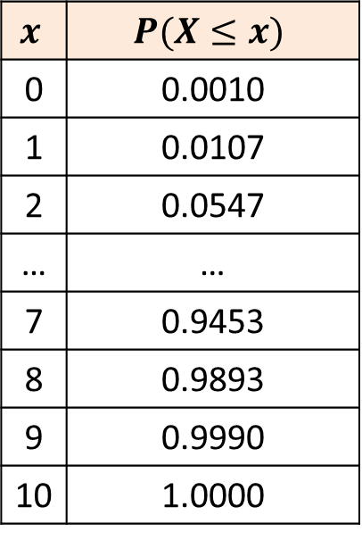

Critical Regions and Values
Coin thrown 10 times.
Number of heads are recorded.
Trying to establish if biased towards tails.
$$p=0.5, n=10$$
$$x$$ | $$P(X≤x)$$
0 | 0.0010
1 | 0.0107
2 | 0.0547
… | …
7 | 0.9453
8 | 0.9893
9 | 0.9990
10 | 1.0000
What is the critical region if the significance level is 5%?
$$0≤X≤1$$
Number of Heads
0
1
2
3
4
5
6
7
8
9
10
Critical region
Acceptance region

Slide 6

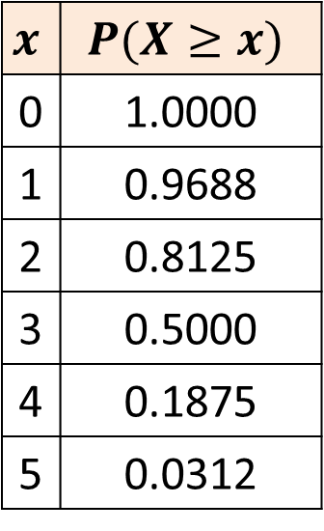
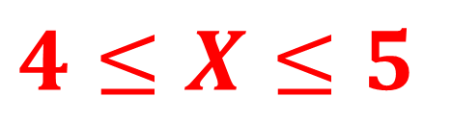
Critical Regions and Values
A coin is thrown 5 times.
The number of heads are recorded.
You try to establish if the coin is biased towards heads.
$$p=0.5, n=5$$
What is the critical region if the significance level is 5%?
$$x$$ | $$P(X≥x)$$
0 | 1.0000
1 | 0.9688
2 | 0.8125
3 | 0.5000
4 | 0.1875
5 | 0.0312
$$4≤X≤5$$
Number of Heads
0
1
2
3
4
5
Acceptance region
Critical region

Slide 7

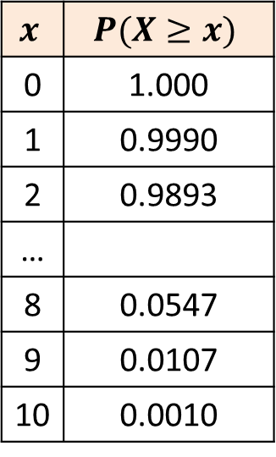
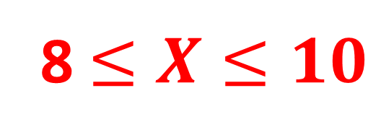
Critical Regions and Values
Coin thrown 10 times.
Number of heads are recorded.
Trying to establish if biased towards heads.
$$p=0.5, n=10$$
What is the critical region if the significance level is 5%?
$$x$$ | $$P(X≥x)$$
0 | 1.000
1 | 0.9990
2 | 0.9893
…
8 | 0.0547
9 | 0.0107
10 | 0.0010
8 $≤X≤10$
Number of Heads
0
1
2
3
4
5
6
7
8
9
10
Acceptance region
Critical region

Slide 8
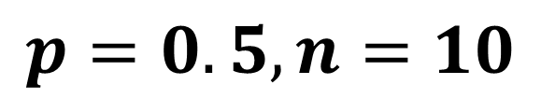
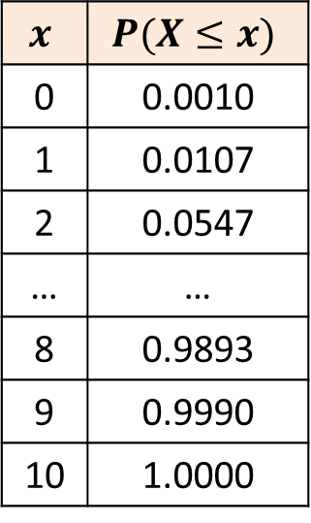
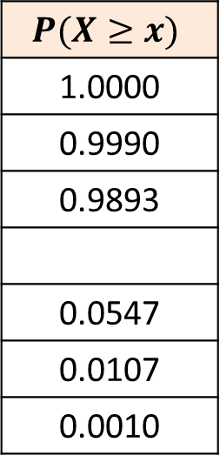
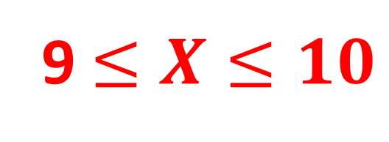
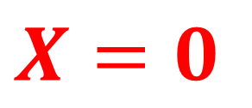
Critical Regions and Values
Coin thrown 10 times.
Number of heads are recorded.
Trying to establish if the coin is biased.
$$p=0.5, n=10$$
What are the critical regions if the significance level is 2%?
$$x$$ | $$P(X≤x)$$
0 | 0.0010
1 | 0.0107
2 | 0.0547
… | …
8 | 0.9893
9 | 0.9990
10 | 1.0000
$$P(X≥x)$$
1.0000
0.9990
0.9893
0.0547
0.0107
0.0010
$$X=0$$
and
9 $≤X≤10$
Number of Heads
0
1
2
3
4
5
6
7
8
9
10
Critical region
Acceptance
region
Critical region

Slide 9
Exercise 7B
Pearson Pure Mathematics Year 1/AS
Pages 103-105
Complete before the lesson Q1-3
In Class:
Green Q4-5
Amber Q6
Red Q7-9 & Challenge

