Slide 1
Year 2 Pure Mathematics
Functions and Graphs
- Composite Functions
Chapter 2
(Part 3 of 6)

Slide 2
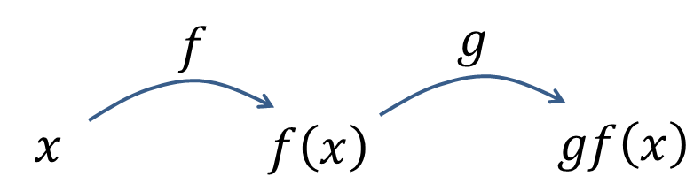
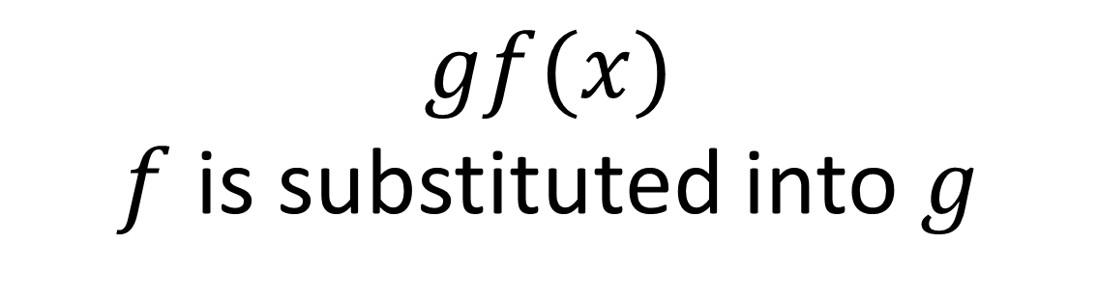
Composite Functions
Multiple functions in succession
are known as a composite function.
$$gf(x)$$
$f$ is substituted into $g$

Slide 3
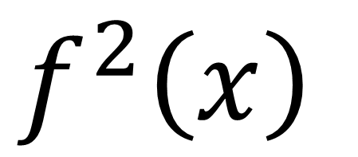
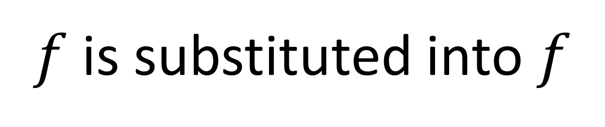
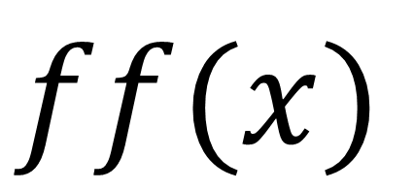
Composite Functions
$$f^{2}\left(x\right)$$
means
$$ff(x)$$
$f$ is substituted into $f$

Slide 4
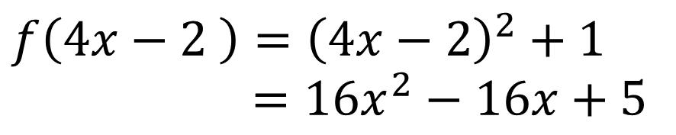
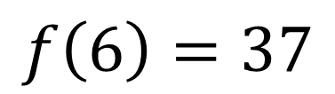
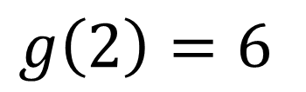
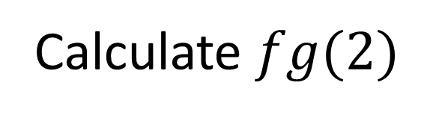
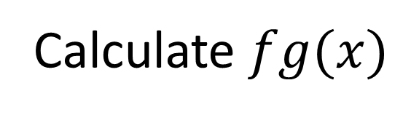
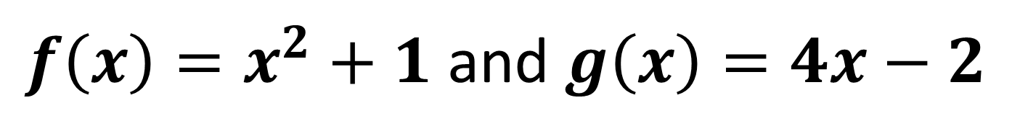

Composite Functions
$f\left(x\right)=x^{2}+1$ and $g\left(x\right)=4x−2$
Calculate $fg(2)$
$$g\left(2\right)=6$$
$$f\left(6\right)=37$$
Calculate $fg(x)$
$$g\left(x\right)=4x−2$$
$$f\left(4x−2 \right)={\left(4x−2\right)}^{2}+1$$
$=16x^{2}−16x+5$

Slide 5
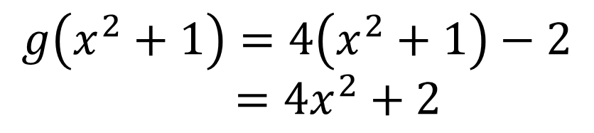
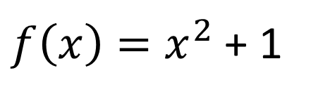
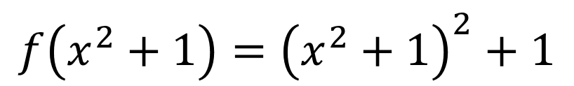
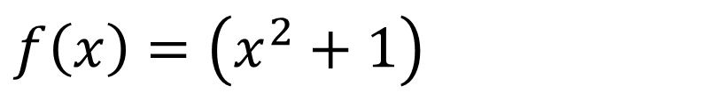
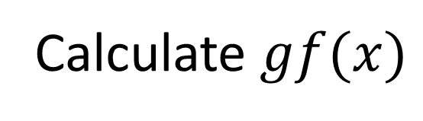
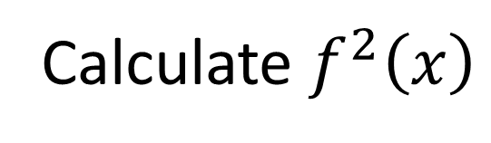
Composite Functions
$f\left(x\right)=x^{2}+1$ and $g\left(x\right)=4x−2$
Calculate $gf(x)$
$$f\left(x\right)=\left(x^{2}+1\right)$$
$$g\left(x^{2}+1\right)=4\left(x^{2}+1\right)−2$$
$=4x^{2}+2$
Calculate $f^{2}\left(x\right)$
$f\left(x\right)=x^{2}$ + 1
$${f\left(x^{2}+1\right)=\left(x^{2}+1\right)}^{2}+1$$

Slide 6
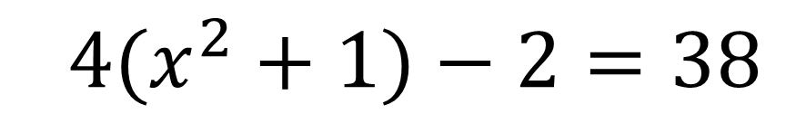
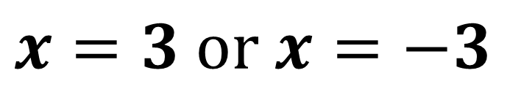
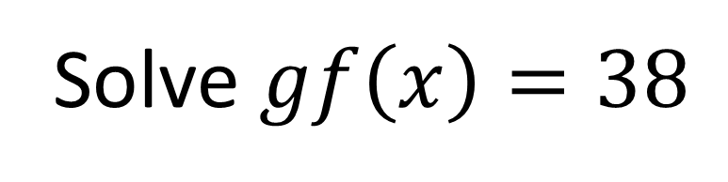
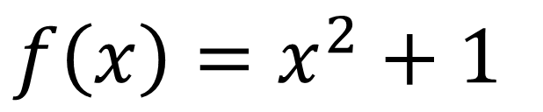
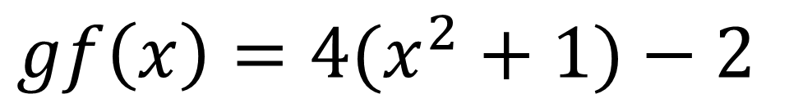
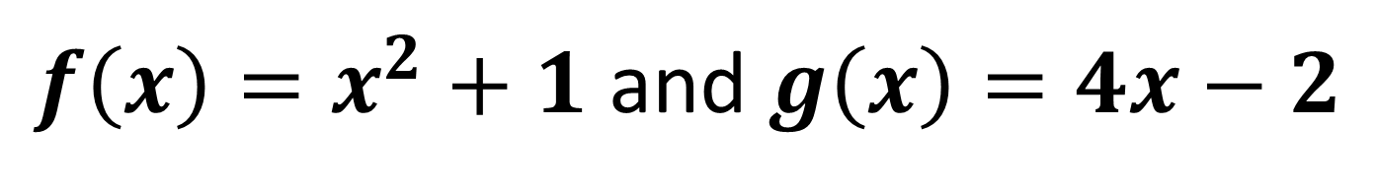
Composite Functions
$f\left(x\right)=x^{2}+1$ and $g\left(x\right)=4x−2$
Solve $gf\left(x\right)=38$
$f\left(x\right)=x^{2}+1$
$$gf\left(x\right)=4(x^{2}+1)−2$$
$$4(x^{2}+1)−2=38$$
$$x=3 or x=−3$$

Slide 7
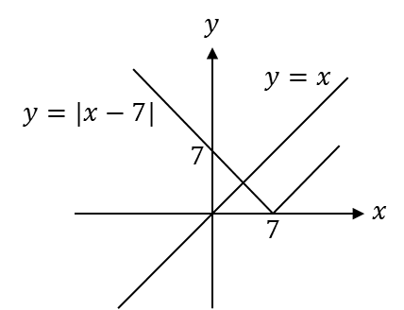


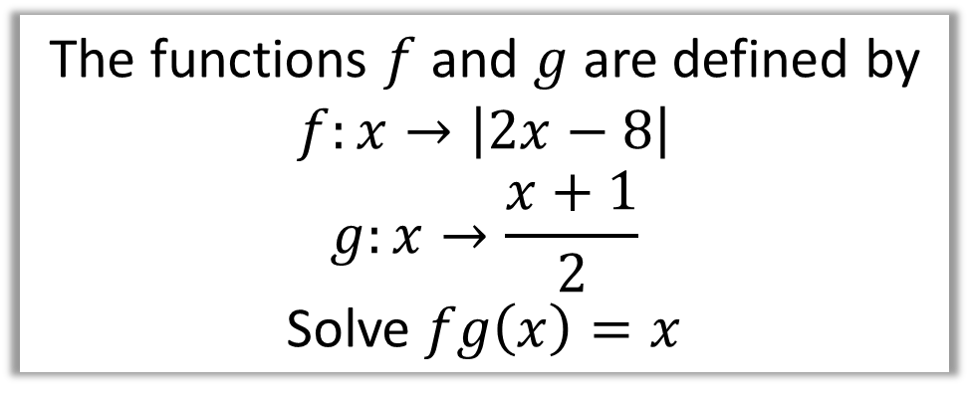
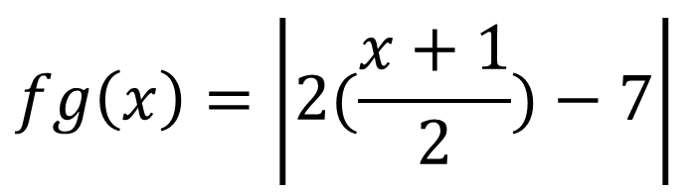
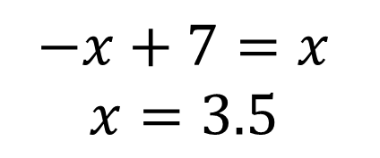
Composite Functions
The functions $f$ and $g$ are defined by
$$f:x→\left|2x−8\right|$$
$$g:x→\frac{x+1}{2}$$
Solve $fg\left(x\right)=x$
$$\left|x−7\right|=x$$
$$fg\left(x\right)=\left|2(\frac{x+1}{2})−7\right|$$
$$fg\left(x\right)= \left|x−7\right|$$
$$−x+7=x \\ x=3.5$$

Slide 8

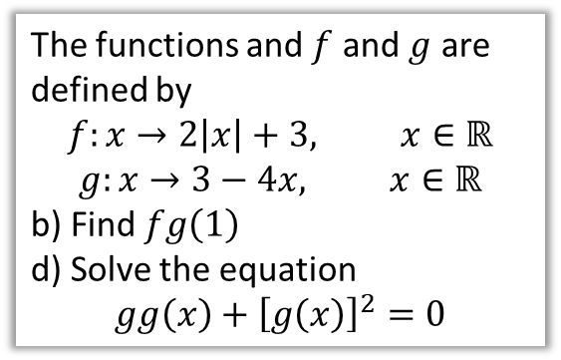
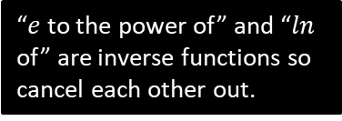
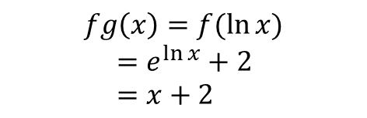
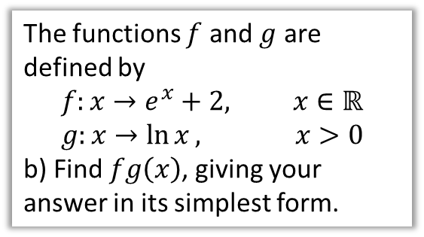
Test Your Understanding
Edexcel C4 June 2013(R) Q4
Edexcel C4 June 2012 Q6
The functions and $f$ and $g$ are defined by
$$f:x→2\left|x\right|+3, x∈ℝ$$
$$g:x→3−4x, x∈ℝ$$
b) Find $fg\left(1\right)$
d) Solve the equation
$$gg\left(x\right)+{\left[g\left(x\right)\right]}^{2}=0$$
The functions $f$ and $g$ are defined by
$$f:x→e^{x}+2, x∈ℝ \\ g:x→\ln{x}, x>0$$
b) Find $fg\left(x\right)$, giving your answer in its simplest form.
? b
?
$$fg\left(1\right)=f\left(−1\right) \\ =2\left|−1\right|+3=5$$
$$3−4\left(3−4x\right)+{\left(3−4x\right)}^{2}=0 \\ 3−12+16x+9−24x+16x^{2}=0 \\ 16x^{2}−8x=0 \\ 2x^{2}−x=0 \\ x\left(2x−1\right)=0 \\ x=0, 0.5$$
$$fg\left(x\right)=f(\ln{x)} \\ =e^{\ln{x}}+2 \\ =x+2$$
? d
“$e$ to the power of” and “$ln$ of” are inverse functions so cancel each other out.

Slide 9

Exercise 2C
Pearson Pure Mathematics Year 2/AS
Pages 34-35
Extension
[MAT 2014 1F]
The functions $S$ and $T$ are defined for real numbers by $S\left(x\right)=x+1$ and $T\left(x\right)=−x$.
The function $S$ is applied $s$ times and the function $T$ is applied $t$ times, in some order, to produce the function
$$F\left(x\right)=8−x$$
It is possible to deduce that:
$s=8$ and $t=1$
$s$ is odd and $t$ is even.
$s$ is even and $t$ is odd.
$s$ and $t$ are powers of 2.
none of the above.
Each application of $T$ will oscillate the sign of $x$, so clearly $t$ is odd, eliminating (ii) and (iv). Each application of $T$ doesn’t change the magnitude of the constant term.
If $t=0$ we’d need 8 applications of $S$ to get to 8. An application of $T$ might get us from say 3 to -3. We’d then require and even number of applications of $S$ to get back up to 3 (in this case 6). So $s$ must be even. This leaves (i) and (iii), but there is more than one way, so the answer is (iii).
Complete before the lesson Q1-2
In Class:
Green Q3-4
Amber Q5-7
Red Q8-11
?

