Slide 1
Year 2 Applied Mathematics
Moments
- Introduction
Chapter 4
(Part 1 of 5)

Slide 2

Moments
The ‘moment’ of a force:
… measures the turning effect of the force on the body on which it is acting.

Slide 3
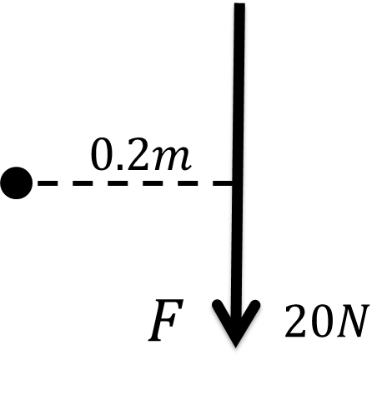
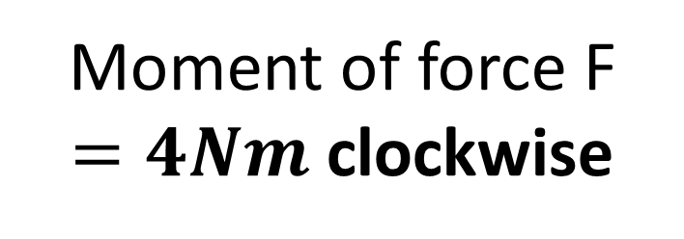
Moments
Moment of force F
$=4Nm$ clockwise

Slide 4
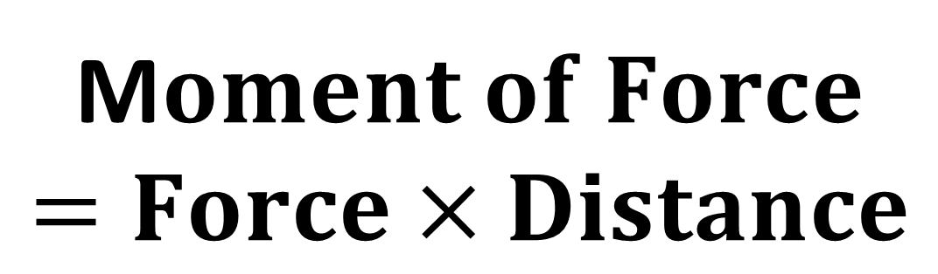
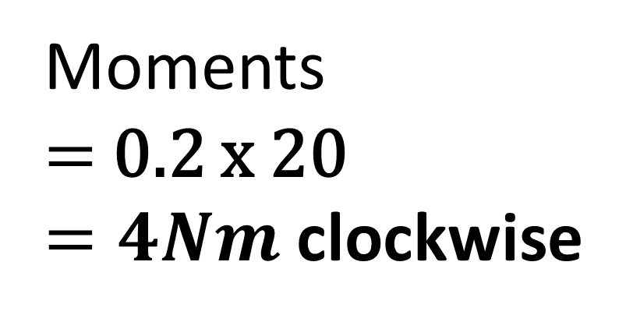
Moments
M$oment of Force$
$$=Force×Distance$$
perpendicular distance
(shortest distance to the pivot point)
Moments
$=$ 0.2 x 20
$=4Nm$ clockwise

Slide 5
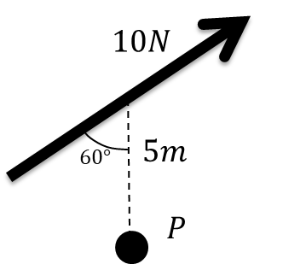
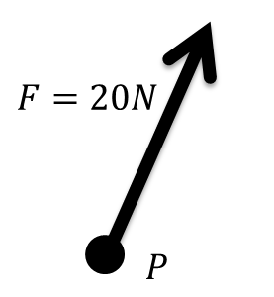
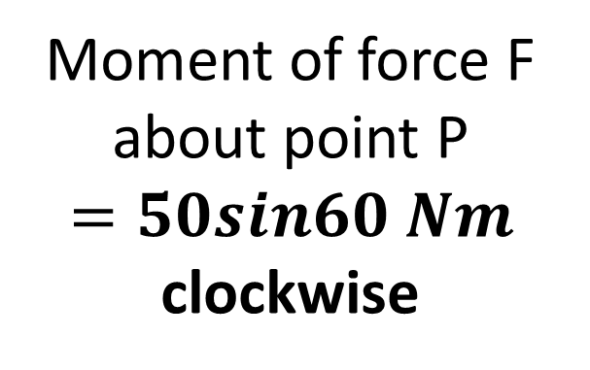
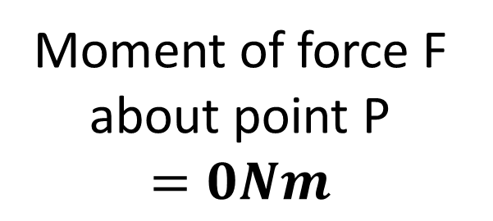

Moments
$$5sin60$$
Moment of force F about point P
$$=0Nm$$
Moment of force F about point P
$$=50sin60 Nm$$
clockwise

Slide 6
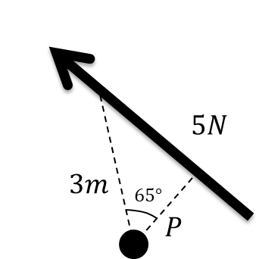
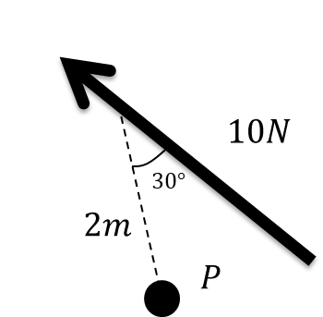
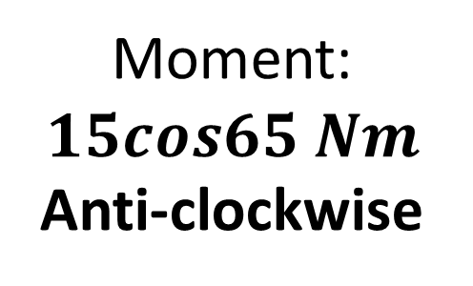
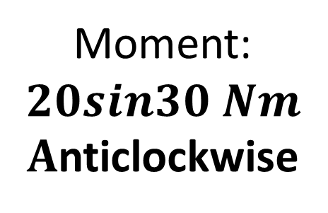
Moments
Moment:
$$15cos65 Nm$$
Anti-clockwise
Moment:
$$20sin30 Nm$$
$A$nticlockwise

Slide 7



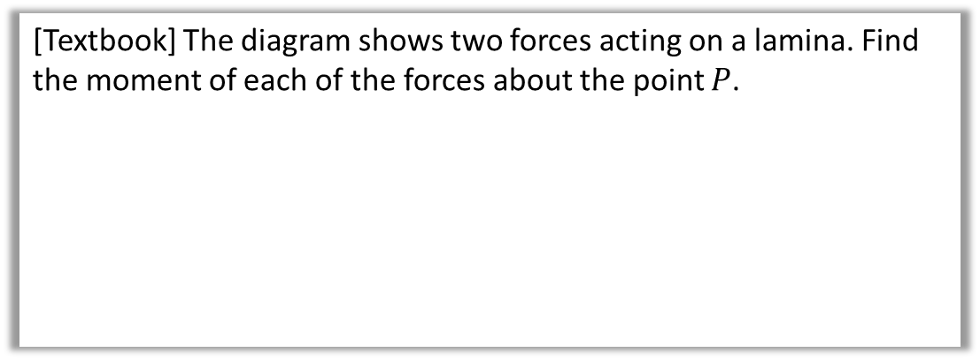



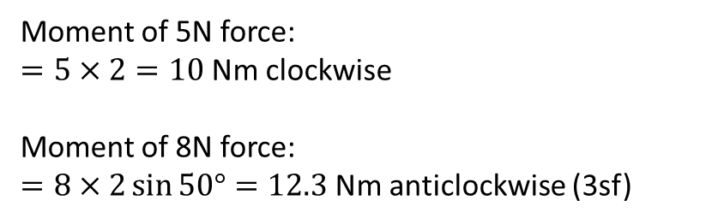
Test Your Understanding
[Textbook] The diagram shows two forces acting on a lamina. Find the moment of each of the forces about the point $P$.
$$5N$$
$2$m
$$P$$
$$8N$$
$2$m
$$50°$$
Terminology: A lamina is a 2D object whose thickness can be ignored.
Moment of 5N force:
$=5×2=10$Nm clockwise
Moment of 8N force:
$=8×2\sin{50°}=12.3$Nm anticlockwise (3sf)
?
?

Slide 8
Exercise 4A
Pearson Stats/Mechanics Year 2
Page 72
(Classes in a rush may wish to skip this exercise)
Complete before the lesson Q1-2
In Class:
Green Q3
Amber Q4
Red Q5

