Slide 1
Methods in Calculus
Twitter: @Owen134866
www.mathsfreeresourcelibrary.com

Slide 2



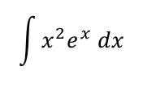



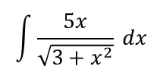








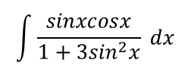


Prior Knowledge Check
1) Find:
3) Express in partial fractions:
$$\int{\frac{5x}{\sqrt{3+x^{2}}} dx}$$
$$5\sqrt{3+x^{2}}+c$$
$$\frac{1}{x(x+1)}$$
$$\frac{1}{x}−\frac{1}{x+1}$$
a)
a)
$$\int{x^{2}e^{x} dx}$$
$$\left(x^{2}−2x+2\right)e^{x}+c$$
$$\frac{2x−1}{x^{2}−4}$$
$$\frac{5}{4(x+2)}+\frac{3}{4(x−2)}$$
b)
b)
$$\int{\frac{sinxcosx}{1+{3sin}^{2}x} dx}$$
$$\frac{1}{6}ln\left(1+3\sin^{2}x\right)+c$$
$$\frac{3x−2}{{2x}^{2}+3x+1}$$
$$\frac{5}{x+1}−\frac{7}{2x+1}$$
c)
c)
2) Find $\frac{dy}{dx}$ in terms of $x$ and $y$ for the following:
a)
$$x^{2}+y^{2}=1$$
$$−\frac{x}{y}$$
$${5x}^{2}+xy+2y^{2}=11$$
$$−\frac{10x+y}{x+4y}$$
b)
$$x=tany$$
$$\frac{1}{\sec^{2}y}$$
c)

Slide 3
Teachings for
Exercise 3A

Slide 4


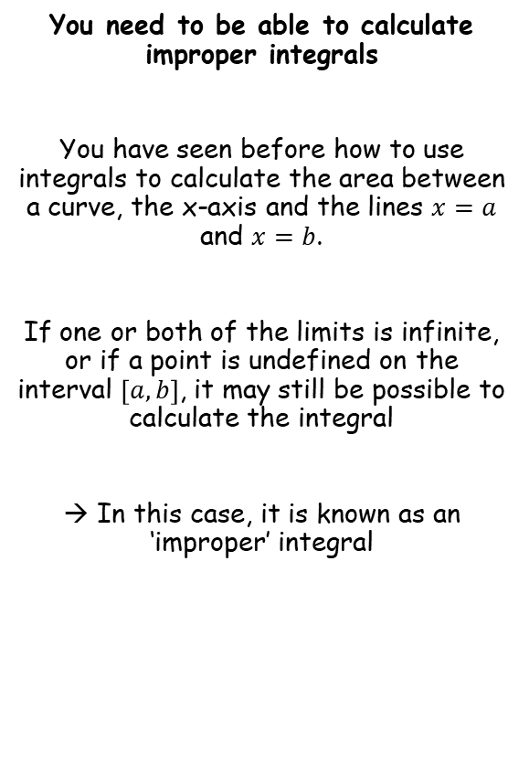


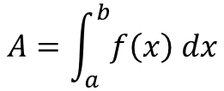

Methods in Calculus
$$y$$
You need to be able to calculate improper integrals
You have seen before how to use integrals to calculate the area between a curve, the x-axis and the lines $x=a$ and $x=b$.
If one or both of the limits is infinite, or if a point is undefined on the interval $\left[a,b\right]$, it may still be possible to calculate the integral
→ In this case, it is known as an ‘improper’ integral
$$y=f(x)$$
$$A$$
$$O$$
$$a$$
$$b$$
$$x$$
$$A=\int_{a}^{b}{f\left(x\right) dx}$$
3A

Slide 5


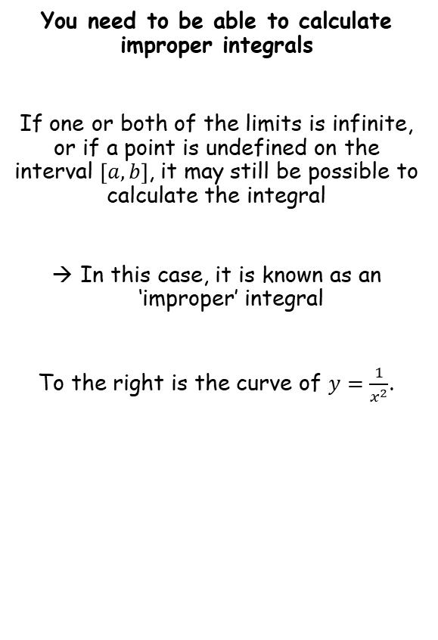

Methods in Calculus
$$y$$
You need to be able to calculate improper integrals
If one or both of the limits is infinite, or if a point is undefined on the interval $\left[a,b\right]$, it may still be possible to calculate the integral
In this case, it is known as an ‘improper’ integral
To the right is the curve of $y=\frac{1}{x^{2}}$.
$$y=\frac{1}{x^{2}}$$
$$A$$
$$O$$
$$x$$
$$1$$
The area indicated is finite and given by the integral:
$$A=\int_{1}^{∞}{\frac{1}{x^{2}} dx}$$
3A

Slide 6


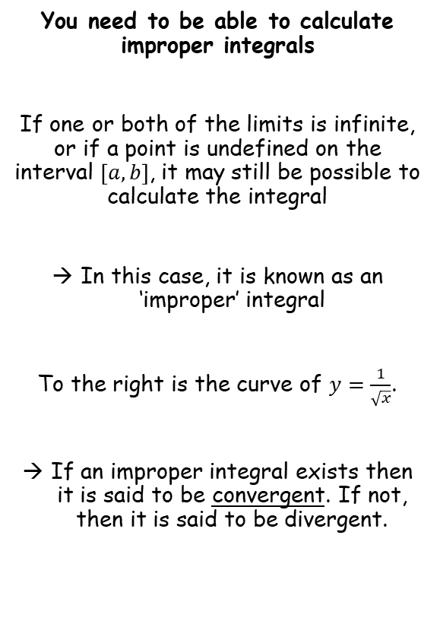
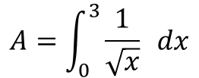
Methods in Calculus
$$y$$
You need to be able to calculate improper integrals
If one or both of the limits is infinite, or if a point is undefined on the interval $\left[a,b\right]$, it may still be possible to calculate the integral
In this case, it is known as an ‘improper’ integral
To the right is the curve of $y=\frac{1}{\sqrt{x}}$.
If an improper integral exists then it is said to be convergent. If not, then it is said to be divergent.
$$A$$
$$y=\frac{1}{\sqrt{x}}$$
$$O$$
$$x$$
$$3$$
The area indicated is finite and given by the integral:
$$A=\int_{0}^{3}{\frac{1}{\sqrt{x}} dx}$$
3A

Slide 7





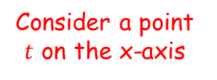

Methods in Calculus
$$y$$
You need to be able to calculate improper integrals
Calculate the area indicated to the right.
$$y=e^{−x}$$
$$A$$
$$O$$
$$x$$
$$y$$
$$y$$
$$y=e^{−x}$$
$$y=e^{−x}$$
As $t→∞$,
$$\int_{0}^{t}{e^{−x}} dx→\int_{0}^{∞}{e^{−x} dx}$$
Consider a point $t$ on the x-axis
$$A$$
$$A$$
$$O$$
$$t$$
$$x$$
$$O$$
$$t$$
$$x$$
Increasing the value of $t$…
3A

Slide 8





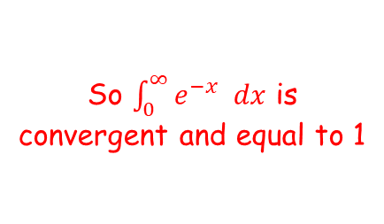



Methods in Calculus
$$y$$
You need to be able to calculate improper integrals
Calculate the area indicated to the right.
$$y=e^{−x}$$
$$\int_{0}^{∞}{e^{−x} dx}=$$
$$\lim_{t→∞}{\int_{0}^{t}{e^{−x} dx}}$$
$$A$$
Integrate and use a square bracket
$$x$$
$$O$$
$$=\lim_{t→∞}{{\left[{−e}^{−x}\right]}_{0}^{t}}$$
Substitute limits and subtract
$$=\lim_{t→∞}\left(\left(−e^{−t}\right)−\left({−e}^{−0}\right)\right)$$
So $\int_{0}^{∞}{e^{−x} dx}$ is convergent and equal to 1
Simplify/calculate if possible
$$=\lim_{t→∞}\left({−e}^{−t}+1\right)$$
Rewrite (if it helps!)
$$=\lim_{t→∞}\left(−\frac{1}{e^{t}}+1\right)$$
Apply the limit
As $t→∞$, $\frac{1}{e^{t}}→0$
$$=1$$
3A

Slide 9
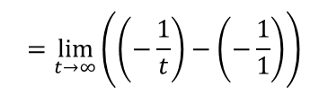
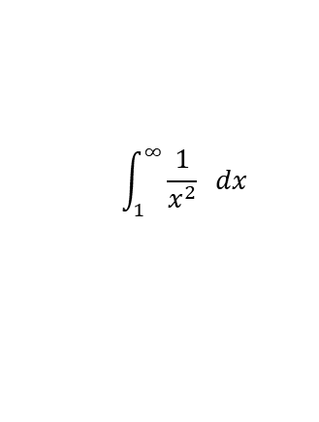

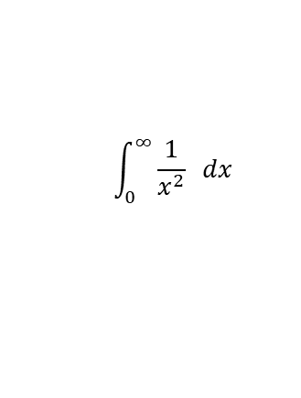
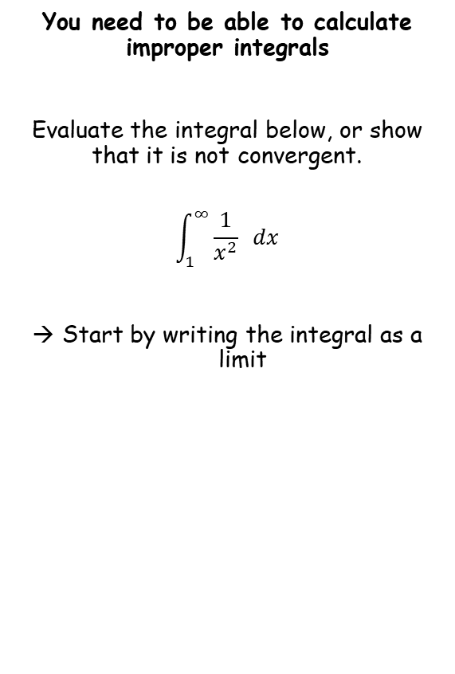






Methods in Calculus
You need to be able to calculate improper integrals
Evaluate the integral below, or show that it is not convergent.
$$\int_{1}^{∞}{\frac{1}{x^{2}} dx}$$
Start by writing the integral as a limit
$$\int_{1}^{∞}{\frac{1}{x^{2}} dx}$$
$$=\lim_{t→∞}{\int_{1}^{t}{\frac{1}{x^{2}} dx}}$$
Rewrite the RHS for integration (if needed)
$$=\lim_{t→∞}{\int_{1}^{t}{x^{−2} dx}}$$
Integrate and use a square bracket
$$=\lim_{t→∞}{{\left[{−x}^{−1}\right]}_{1}^{t}}$$
Rewrite for substitution (if needed)
$$=\lim_{t→∞}{{\left[−\frac{1}{x}\right]}_{1}^{t}}$$
Sub in limits and subtract
$$=\lim_{t→∞}\left(\left(−\frac{1}{t}\right)−\left(−\frac{1}{1}\right)\right)$$
Simplify
$$\int_{0}^{∞}{\frac{1}{x^{2}} dx}$$
$$=\lim_{t→∞}\left(−\frac{1}{t}+1\right)$$
So converges and is equal to 1
Apply the limit
As $t→∞$, $\frac{1}{t}→0$
$$=1$$
3A

Slide 10

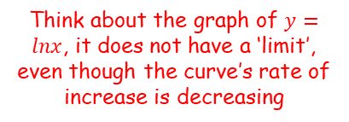
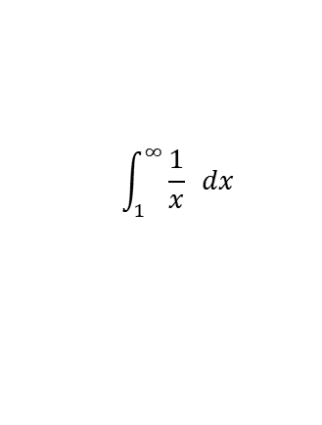








Methods in Calculus
You need to be able to calculate improper integrals
Evaluate the integral below, or show that it is not convergent.
$$\int_{1}^{∞}{\frac{1}{x} dx}$$
$$\int_{1}^{∞}{\frac{1}{x} dx}$$
$$=\lim_{t→∞}{\int_{1}^{t}{\frac{1}{x} dx}}$$
Rewrite the RHS for integration (if needed)
$$=\lim_{t→∞}{\int_{1}^{t}{x^{−1} dx}}$$
Integrate and use a square bracket
$$=\lim_{t→∞}{{\left[lnx\right]}_{1}^{t}}$$
Sub in limits and subtract
$$=\lim_{t→∞}\left(\left(lnt\right)−\left(ln1\right)\right)$$
Simplify
$$y$$
$$=\lim_{t→∞}\left(lnt\right)$$
$$y=lnx$$
The problem here is that as $t→∞$, $lnt→∞$
So $\int_{1}^{∞}{\frac{1}{x} dx}$ does not converge
$$x$$
Think about the graph of $y=lnx$, it does not have a ‘limit’, even though the curve’s rate of increase is decreasing
(The graph of $y=+\sqrt{x}$ is another good example of this)
3A

Slide 11
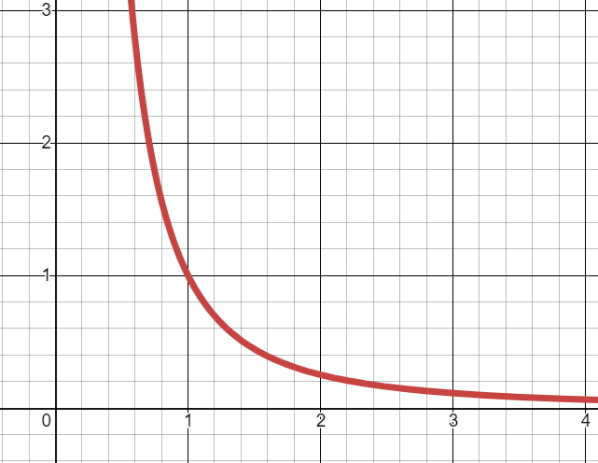
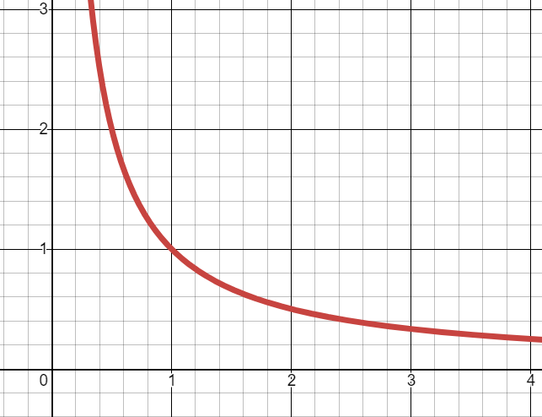


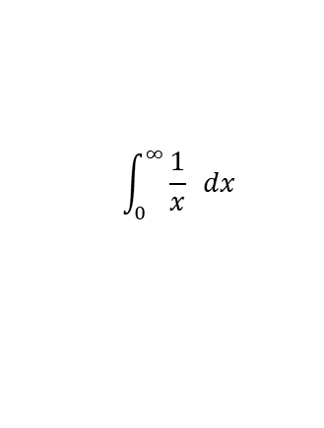
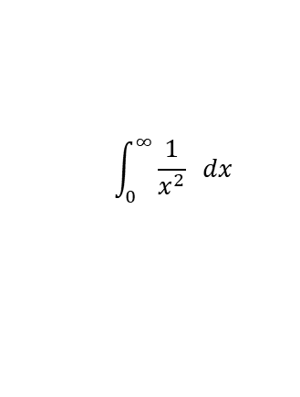

Methods in Calculus
You need to be able to calculate improper integrals
$$y$$
$$y$$
$$y=\frac{1}{x^{2}}$$
$$y=\frac{1}{x}$$
$$x$$
$$x$$
$$\int_{0}^{∞}{\frac{1}{x^{2}} dx}$$
$$\int_{0}^{∞}{\frac{1}{x} dx}$$
converges and is equal to 1
does not converge
But, it looks like this one should also converge, since the area added on as the upper limit keeps increasing is getting less and less…
→ Not always…
3A

Slide 12




Methods in Calculus
You need to be able to calculate improper integrals
Consider this series:
$$\frac{1}{2}+\frac{1}{3}+\frac{1}{4}+\frac{1}{5}+\frac{1}{6}+\frac{1}{7}+\frac{1}{8}+\frac{1}{9}+..$$
Each term decreases in size, so it feels like the sum should have an upper limit as the number of terms tends to infinity...
There would be 8 of the $\frac{1}{16}$ terms
Now consider this series:
$$\frac{1}{2}+\frac{1}{4}+\frac{1}{4}+\frac{1}{8}+\frac{1}{8}+\frac{1}{8}+\frac{1}{8}+\frac{1}{16}+..$$
$$=\frac{1}{2}+\frac{1}{2}+\frac{1}{2}+\frac{1}{2}+..$$
This sequence will continue adding halves infinitely, so its sum is infinite
But if we compare the two sequences, all the terms in the first one are equal to, or larger than their equivalents in the second one…
→ So the top sequence must also have a sum of infinity, even though the terms decrease in size!
3A

Slide 13
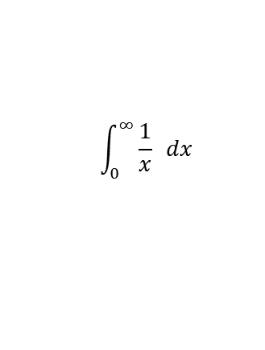
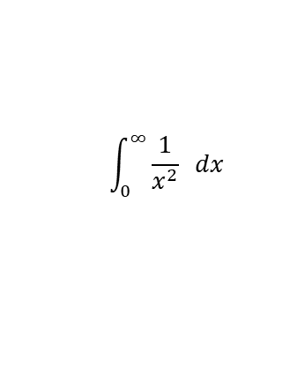
Methods in Calculus
You need to be able to calculate improper integrals
$$y$$
$$y$$
$$y=\frac{1}{x^{2}}$$
$$y=\frac{1}{x}$$
$$x$$
$$x$$
$$\int_{0}^{∞}{\frac{1}{x^{2}} dx}$$
$$\int_{0}^{∞}{\frac{1}{x} dx}$$
converges and is equal to 1
does not converge
→ For example, on this graph, it is possible to choose a value for the upper limit that would make the area enclosed equal to 0.8
→ It is also possible to do the same on this graph, to choose a value for the upper limit to give an area of 0.8
→ However, on this graph, it is not possible to choose a value for the upper limit that would make the area enclosed equal to 2
→ It would be possible to do so on this graph though (although the value chosen might have to be huge!)
3A

Slide 14
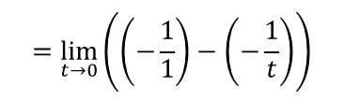


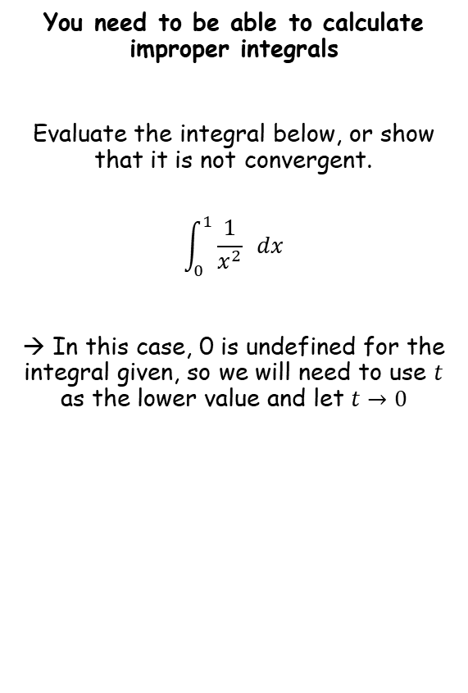

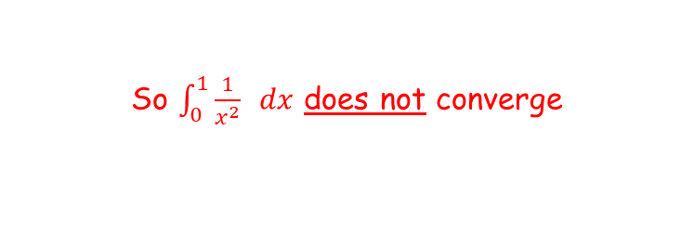




Methods in Calculus
You need to be able to calculate improper integrals
Evaluate the integral below, or show that it is not convergent.
$$\int_{0}^{1}{\frac{1}{x^{2}} dx}$$
→ In this case, 0 is undefined for the integral given, so we will need to use $t$ as the lower value and let $t→0$
$$\int_{0}^{1}{\frac{1}{x^{2}} dx}$$
$$=\lim_{t→0}{\int_{t}^{1}{\frac{1}{x^{2}} dx}}$$
Rewrite the RHS for integration (if needed)
$$=\lim_{t→0}{\int_{t}^{1}{x^{−2} dx}}$$
Integrate and use a square bracket
$$=\lim_{t→0}{{\left[{−x}^{−1}\right]}_{t}^{1}}$$
Rewrite for substitution (if needed)
$$=\lim_{t→0}{{\left[−\frac{1}{x}\right]}_{t}^{1}}$$
Sub in limits and subtract
$$=\lim_{t→0}\left(\left(−\frac{1}{1}\right)−\left(−\frac{1}{t}\right)\right)$$
Simplify
$$=\lim_{t→0}\left(−1+\frac{1}{t}\right)$$
The problem here is that as $t→0$, $\frac{1}{t}→∞$
So $\int_{0}^{1}{\frac{1}{x^{2}} dx}$ does not converge
3A

Slide 15


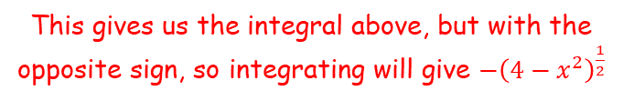
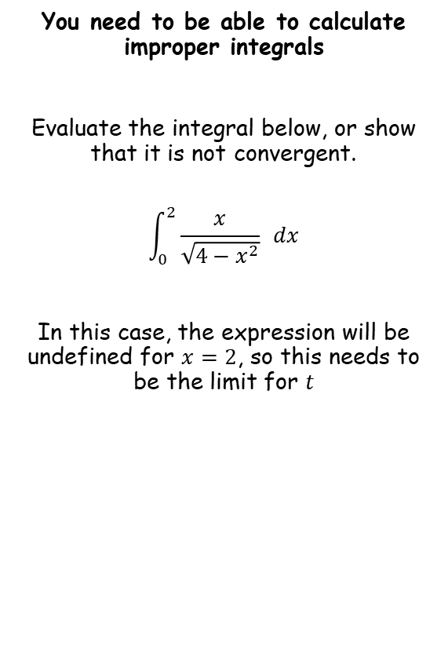





Methods in Calculus
You need to be able to calculate improper integrals
Evaluate the integral below, or show that it is not convergent.
$$\int_{0}^{2}{\frac{x}{\sqrt{4−x^{2}}} dx}$$
In this case, the expression will be undefined for $x=2$, so this needs to be the limit for $t$
$$\int_{0}^{2}{\frac{x}{\sqrt{4−x^{2}}} dx}$$
$$=\lim_{t→2}{\int_{0}^{t}{\frac{x}{\sqrt{4−x^{2}}} dx}}$$
Rewrite the RHS for integration (if needed)
$$=\lim_{t→2}{\int_{0}^{t}{x{\left(4−x^{2}\right)}^{−\frac{1}{2}} dx}}$$
Integrate
Try differentiating $y={\left(4−x^{2}\right)}^{\frac{1}{2}}$
$$y={\left(4−x^{2}\right)}^{\frac{1}{2}}$$
Differentiate using the chain rule
$$\frac{dy}{dx}={\frac{1}{2}\left(4−x^{2}\right)}^{−\frac{1}{2}}\left(−2x\right)$$
Simplify
$$\frac{dy}{dx}={−x\left(4−x^{2}\right)}^{−\frac{1}{2}}$$
This gives us the integral above, but with the opposite sign, so integrating will give ${−\left(4−x^{2}\right)}^{\frac{1}{2}}$
3A

Slide 16







Methods in Calculus
You need to be able to calculate improper integrals
Evaluate the integral below, or show that it is not convergent.
$$\int_{0}^{2}{\frac{x}{\sqrt{4−x^{2}}} dx}$$
In this case, the expression will be undefined for $x=2$, so this needs to be the limit for $t$
$$\int_{0}^{2}{\frac{x}{\sqrt{4−x^{2}}} dx}$$
$$=\lim_{t→2}{\int_{0}^{t}{\frac{x}{\sqrt{4−x^{2}}} dx}}$$
Rewrite the RHS for integration (if needed)
$$=\lim_{t→2}{\int_{0}^{t}{x{\left(4−x^{2}\right)}^{−\frac{1}{2}} dx}}$$
Integrate
$$=\lim_{t→2}{{\left[{−\left(4−x^{2}\right)}^{\frac{1}{2}}\right]}_{0}^{t}}$$
Sub in limits and subtract
$$=\lim_{t→2}\left(\left({−\left(4−t^{2}\right)}^{\frac{1}{2}}\right)−\left({−\left(4−0^{2}\right)}^{\frac{1}{2}}\right)\right)$$
Rewrite/work out
$$=\lim_{t→2}\left(\left(−\sqrt{4−t^{2}}\right)−\left(−\sqrt{4}\right)\right)$$
Simplify
$$\int_{0}^{2}{\frac{x}{\sqrt{4−x^{2}}}dx}$$
$$=\lim_{t→2}\left(2−\sqrt{4−t^{2}}\right)$$
So converges and is equal to 2
Apply the limit
As $t→2$, $\sqrt{4−t^{2}}→0$
$$=2$$
3A

Slide 17
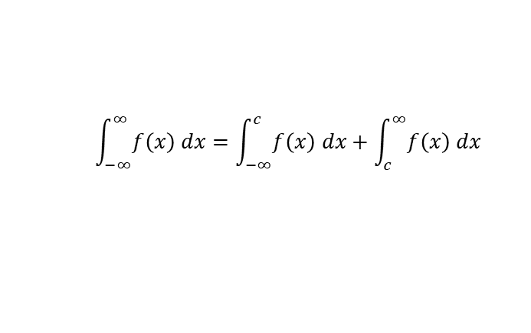
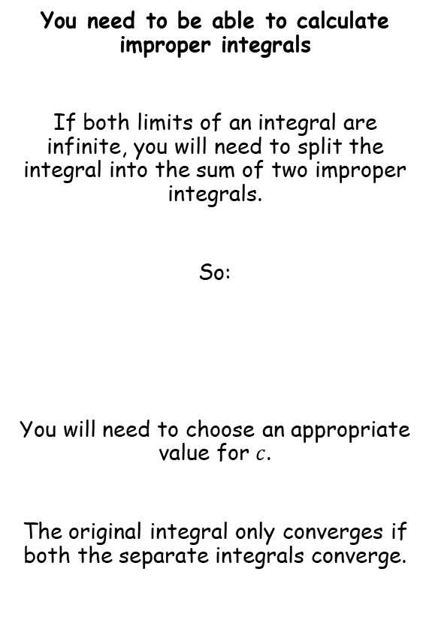

Methods in Calculus
You need to be able to calculate improper integrals
If both limits of an integral are infinite, you will need to split the integral into the sum of two improper integrals.
So:
You will need to choose an appropriate value for $c$.
The original integral only converges if both the separate integrals converge.
You need 2 integrals since you cannot let $t$ tend towards two different values at the same time…
$$\int_{−∞}^{∞}{f\left(x\right) dx}=\int_{−∞}^{c}{f\left(x\right) dx}+\int_{c}^{∞}{f\left(x\right) dx}$$
3A

Slide 18


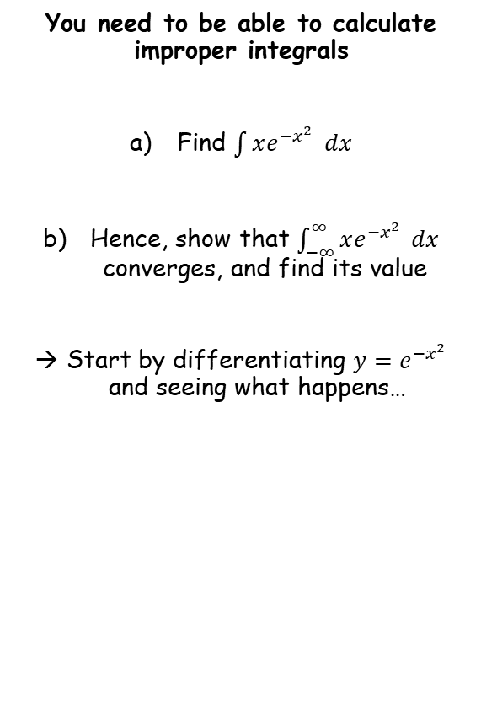
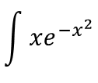


Methods in Calculus
You need to be able to calculate improper integrals
Find $\int{xe^{−x^{2}}} dx$
Hence, show that $\int_{−∞}^{∞}{xe^{−x^{2}}} dx$ converges, and find its value
Start by differentiating ${y=e}^{−x^{2}}$ and seeing what happens…
$$y=e^{−x^{2}}$$
Differentiate
$$\frac{dy}{dx}=−2xe^{−x^{2}}$$
So we need to divide the original expression by $−2$
Therefore:
$$\int{xe^{−x^{2}}}$$
Integrate
$$=−\frac{1}{2}e^{−x^{2}}+c$$
3A

Slide 19
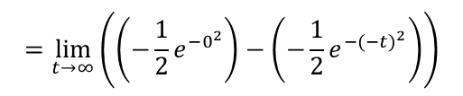



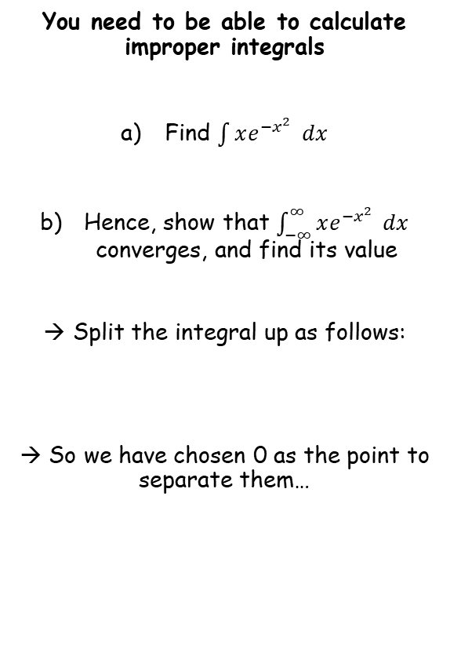




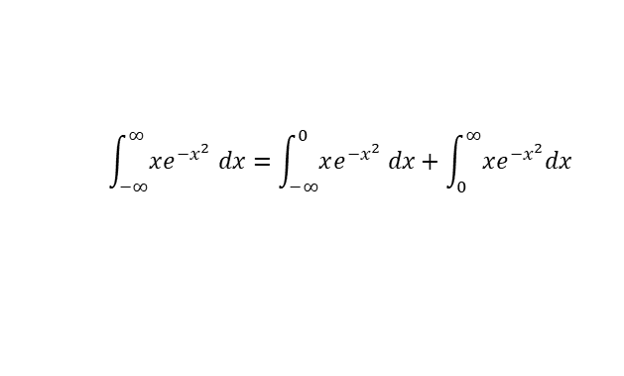

Methods in Calculus
You need to be able to calculate improper integrals
Find $\int{xe^{−x^{2}}} dx$
Hence, show that $\int_{−∞}^{∞}{xe^{−x^{2}}} dx$ converges, and find its value
Split the integral up as follows:
→ So we have chosen 0 as the point to separate them…
$$\int_{−∞}^{0}{xe^{−x^{2}}dx}$$
$$=\lim_{t→∞}{\int_{−t}^{0}{xe^{−x^{2}}dx}}$$
Integrate and use a square bracket, using our answer in a)
$$=\lim_{t→∞}{{\left[−\frac{1}{2}e^{−x^{2}}\right]}_{−t}^{0}}$$
$$−\frac{1}{2}e^{−x^{2}}+c$$
Sub in limits and subtract
$$=\lim_{t→∞}\left(\left(−\frac{1}{2}e^{−0^{2}}\right)−\left(−\frac{1}{2}e^{−(−{t)}^{2}}\right)\right)$$
Simplify/rewrite
$$=\lim_{t→∞}\left(−\frac{1}{2}+\frac{1}{2e^{t^{2}}}\right)$$
Apply the limit
As $t→∞$, $\frac{1}{2e^{t^{2}}}→0$
$$\int_{−∞}^{∞}{xe^{−x^{2}} dx}=\int_{−∞}^{0}{xe^{−x^{2}} dx}+\int_{0}^{∞}{xe^{−x^{2}}dx}$$
$$=−\frac{1}{2}$$
$$\lim_{t→∞}{\int_{−t}^{0}{xe^{−x^{2}}dx}=−\frac{1}{2}}$$
3A

Slide 20
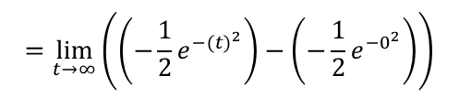



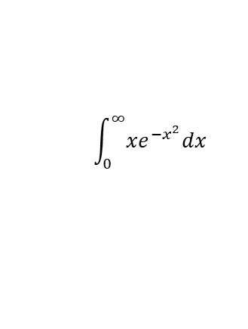



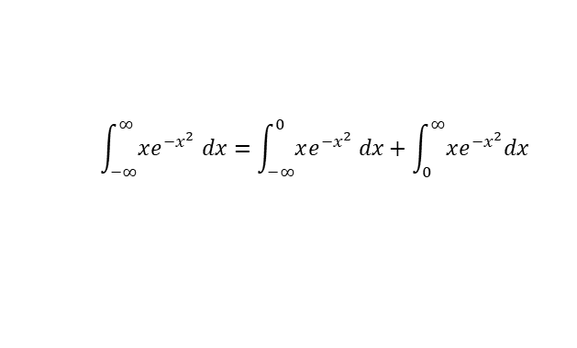
Methods in Calculus
You need to be able to calculate improper integrals
Find $\int{xe^{−x^{2}}} dx$
Hence, show that $\int_{−∞}^{∞}{xe^{−x^{2}}} dx$ converges, and find its value
Split the integral up as follows:
→ So we have chosen 0 as the point to separate them…
$$\int_{0}^{∞}{xe^{−x^{2}}dx}$$
$$=\lim_{t→∞}{\int_{0}^{t}{xe^{−x^{2}}dx}}$$
Integrate and use a square bracket, using our answer in a)
$$=\lim_{t→∞}{{\left[−\frac{1}{2}e^{−x^{2}}\right]}_{0}^{t}}$$
$$−\frac{1}{2}e^{−x^{2}}+c$$
Sub in limits and subtract
$$=\lim_{t→∞}\left(\left(−\frac{1}{2}e^{−{(t)}^{2}}\right)−\left(−\frac{1}{2}e^{−0^{2}}\right)\right)$$
Simplify/rewrite
$$=\lim_{t→∞}\left(−\frac{1}{2e^{t^{2}}}+\frac{1}{2}\right)$$
Apply the limit
As $t→∞$, $\frac{1}{2e^{t^{2}}}→0$
$$\int_{−∞}^{∞}{xe^{−x^{2}} dx}=\int_{−∞}^{0}{xe^{−x^{2}} dx}+\int_{0}^{∞}{xe^{−x^{2}}dx}$$
$$=\frac{1}{2}$$
→ Since both integrals converge, we know that
$$\lim_{t→∞}{\int_{−t}^{0}{xe^{−x^{2}}dx}=−\frac{1}{2}}$$
$$\int_{−∞}^{∞}{xe^{−x^{2}} dx}=\int_{−∞}^{0}{xe^{−x^{2}} dx}+\int_{0}^{∞}{xe^{−x^{2}}dx}$$
$$\lim_{t→∞}{\int_{0}^{t}{xe^{−x^{2}}dx}}=\frac{1}{2}$$
$$=−\frac{1}{2}+\frac{1}{2}=0$$
3A

Slide 21
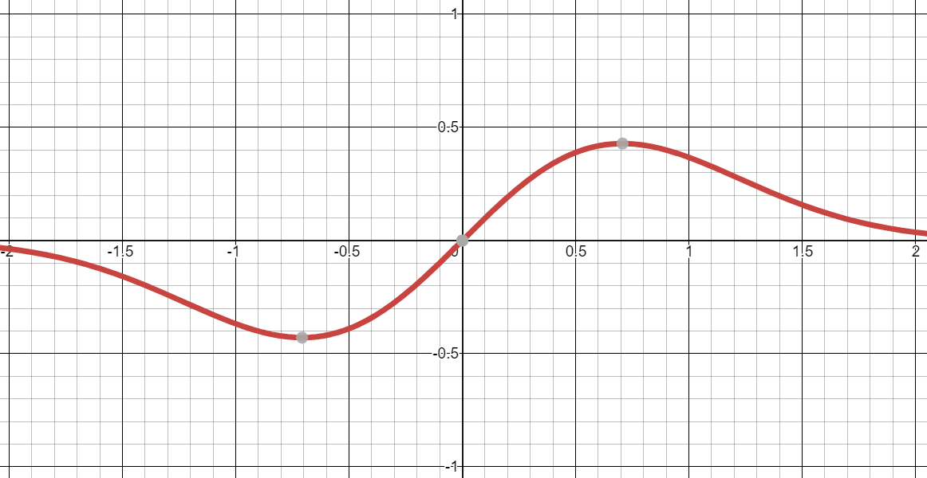
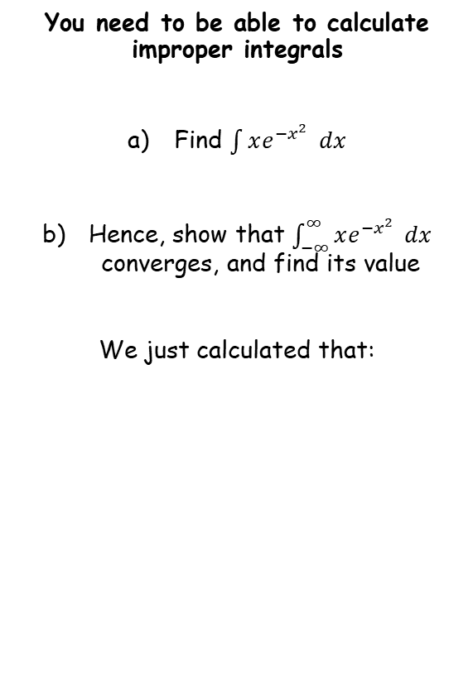
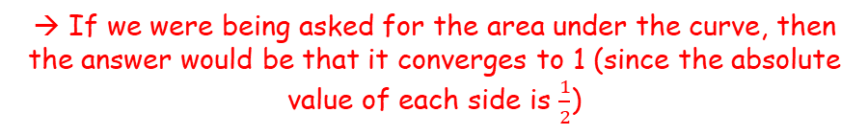


Methods in Calculus
You need to be able to calculate improper integrals
Find $\int{xe^{−x^{2}}} dx$
Hence, show that $\int_{−∞}^{∞}{xe^{−x^{2}}} dx$ converges, and find its value
We just calculated that:
$$y=xe^{−x^{2}}$$
Above is the graph we were working with, and the area under it is shaded…
$$\int_{−∞}^{∞}{xe^{−x^{2}}=0}$$
WARNING!
This question is not asking you for the area under the curve, it is just asking for the value of the integral. These are not the same thing!
→ If we were being asked for the area under the curve, then the answer would be that it converges to 1 (since the absolute value of each side is $\frac{1}{2}$)
3A

Slide 22
Exercise 3A
Pearson Core Pure Year 2
Pages 56-58
Complete before the lesson Q1-3
In Class:
Green Q4-6
Amber Q7-10
Red Q11-15 & Challenge

