Slide 1
Year 2 Pure Mathematics
Integration
- Parametric Equations
Chapter 11
(Part 10 of 11)

Slide 2
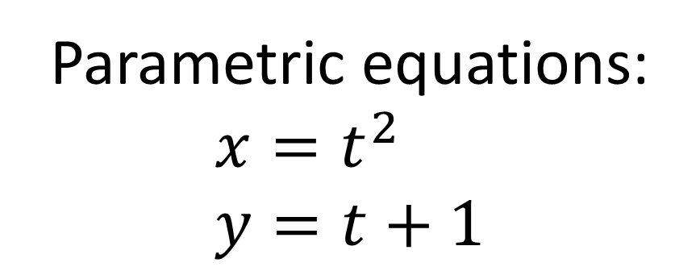
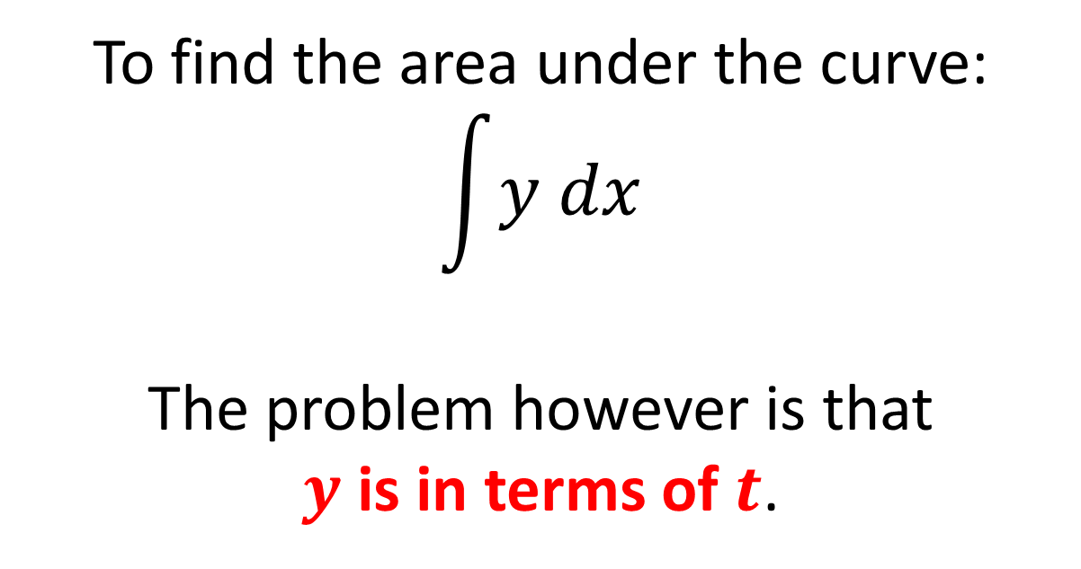
Integration with Parametric Equations
Parametric equations:
$$x=t^{2} \\ y=t+1$$
To find the area under the curve:
$$\int{y dx}$$
The problem however is that
$y$ is in terms of $t$.

Slide 3
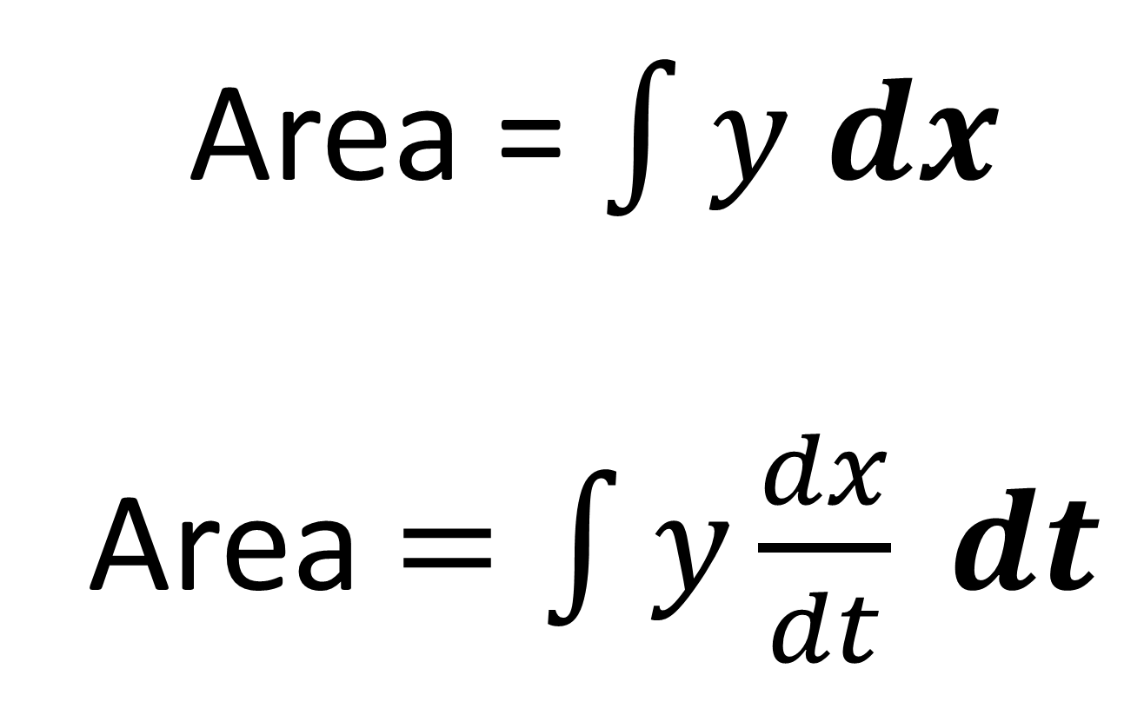
Integration with Parametric Equations
Area = $\int{y dx}$
Area $=\int{y\frac{dx}{dt} dt}$

Slide 4
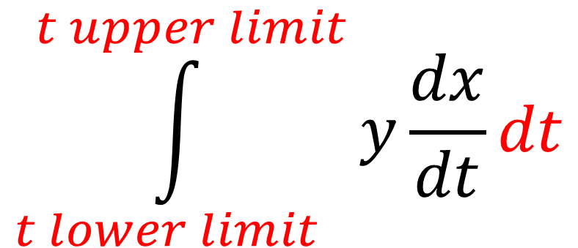
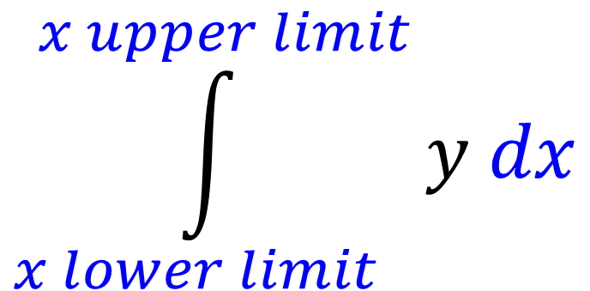
Integration with Parametric Equations
$$\int_{x lower limit}^{x upper limit}{y dx}$$
Don’t forget to change the limits!
$$\int_{t lower limit}^{t upper limit}{y\frac{dx}{dt}dt}$$

Slide 5
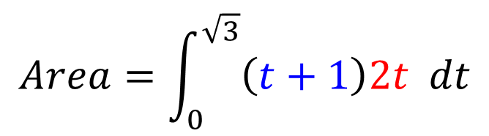
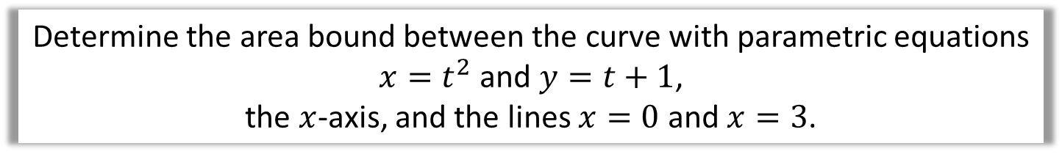

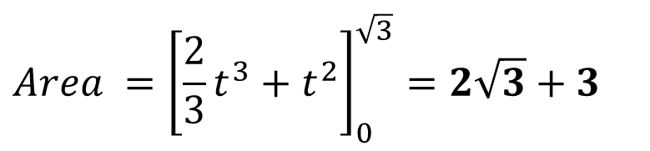
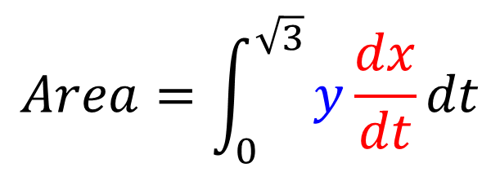
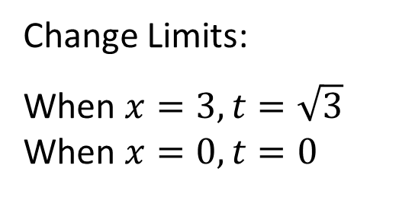
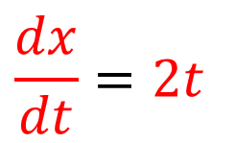
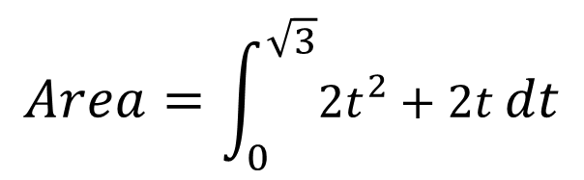
Integration with Parametric Equations
Determine the area bound between the curve with parametric equations
$x=t^{2}$ and $y=t+1$,
the $x$-axis, and the lines $x=0$ and $x=3$.
$$\frac{dx}{dt}=2t$$
Change Limits:
When $x=3, t=\sqrt{3}$
When $x=0, t=0$
$x=t^{2}$
$$Area=\int_{0}^{\sqrt{3}}{\left(t+1\right)2t dt}$$
$$Area=\int_{0}^{\sqrt{3}}{y\frac{dx}{dt}dt}$$
$$Area=\int_{0}^{\sqrt{3}}{2t^{2}+2t dt}$$
$$Area ={\left[\frac{2}{3}t^{3}+t^{2}\right]}_{0}^{\sqrt{3}}=2\sqrt{3}+3$$

Slide 6

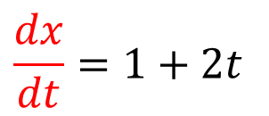
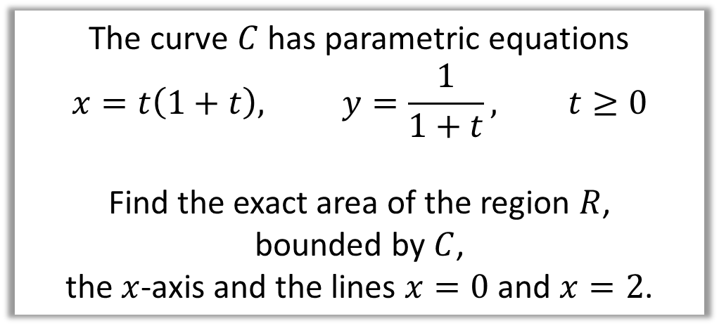
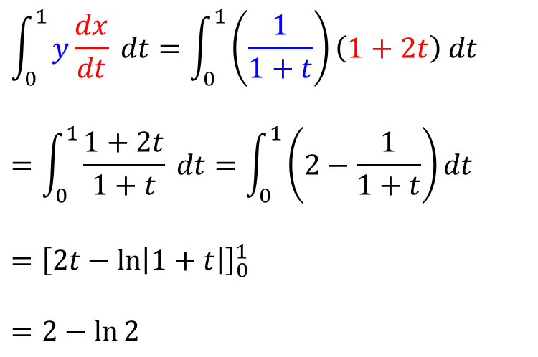
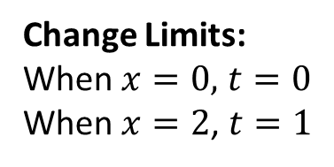

Integration with Parametric Equations
The curve $C$ has parametric equations
$$x=t\left(1+t\right), y=\frac{1}{1+t}, t≥0$$
Find the exact area of the region $R$,
bounded by $C$,
the $x$-axis and the lines $x=0$ and $x=2$.
$$R$$
$$C$$
2
Change Limits:
When $x=0,$ $t=0$
When $x=2$, $t=1$
$$\int_{0}^{1}{y\frac{dx}{dt} dt}=\int_{0}^{1}{\left(\frac{1}{1+t}\right)\left(1+2t\right) dt}$$
$$=\int_{0}^{1}{\frac{1+2t}{1+t} dt}=\int_{0}^{1}{\left(2−\frac{1}{1+t}\right)dt}$$
$$={\left[2t−\ln\left|1+t\right|\right]}_{0}^{1}$$
$$=2−\ln{2}$$
$$\frac{dx}{dt}=1+2t$$

Slide 7
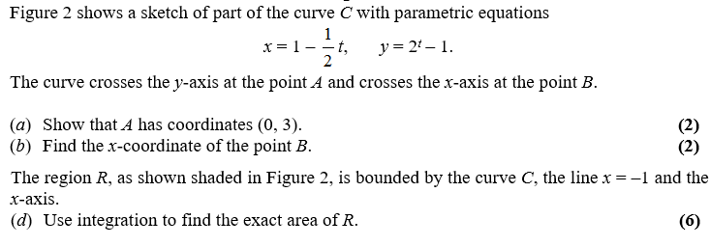
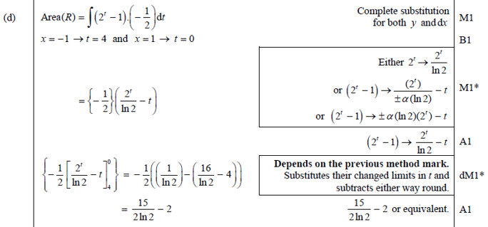
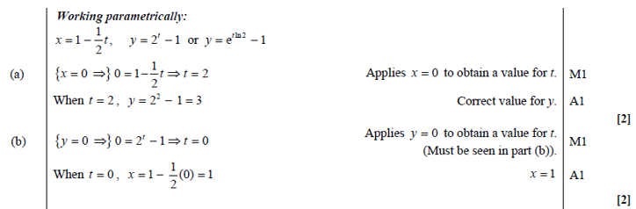
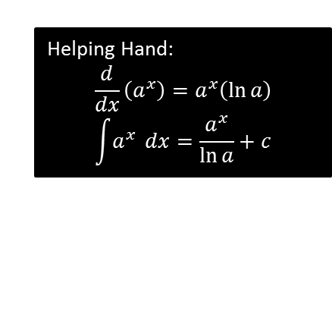
Test Your Understanding
Edexcel C4 Jan 2013 Q5
Helping Hand:
$$\frac{d}{dx}\left(a^{x}\right)=a^{x}\left(\ln{a}\right) \\ \int{a^{x}} dx=\frac{a^{x}}{\ln{a}}+c$$
?
?
?

Slide 8
Exercise
P334a-334b
Complete before the lesson Q1-2
In Class:
Green Q3-4
Amber Q5-7

