Slide 1
Year 1 Pure Mathematics
Exponentials and Logs
- Differentiation
Chapter 14
(Part 2 of 7)

Slide 2
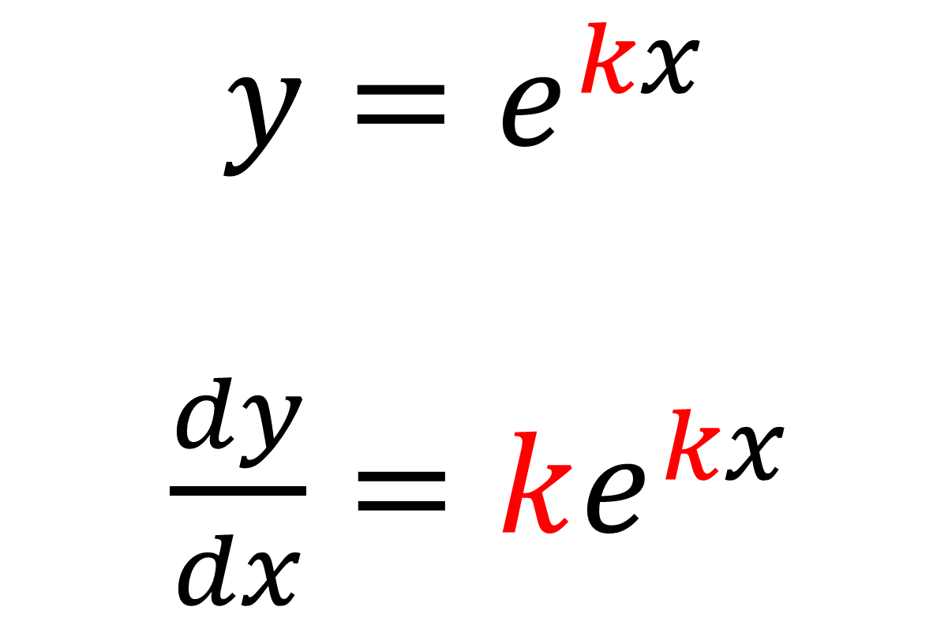
Modelling - Differentiating $y=ae^{kx}$
$y=e^{kx}$
$\frac{dy}{dx}=ke^{kx}$

Slide 3
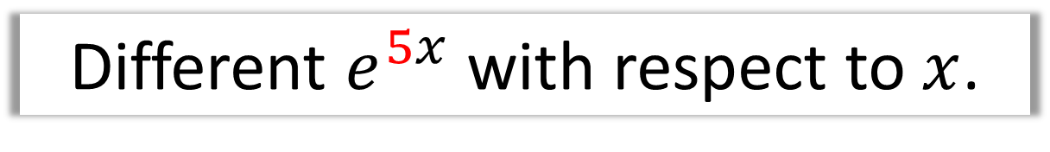
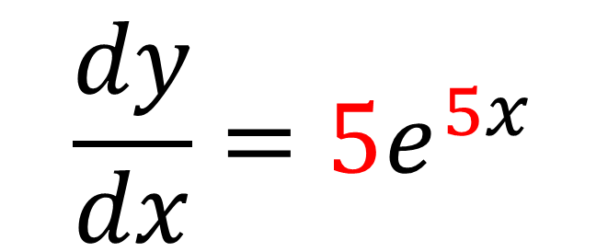
Modelling - Differentiating $y=ae^{kx}$
Different $e^{5x}$ with respect to $x$.
$$\frac{dy}{dx}=5e^{5x}$$

Slide 4
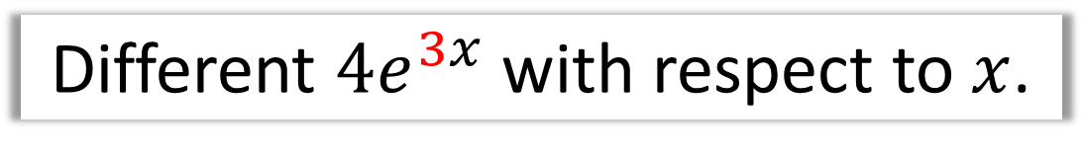
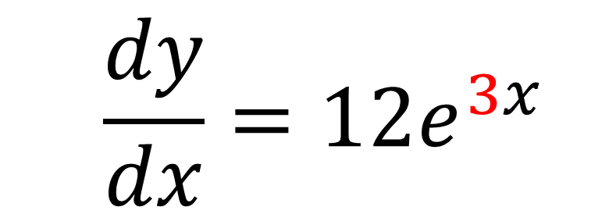
Modelling - Differentiating $y=ae^{kx}$
Different $4e^{3x}$ with respect to $x$.
$$\frac{dy}{dx}=12e^{3x}$$

Slide 5
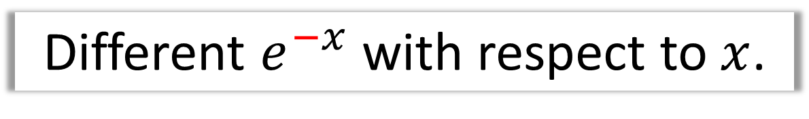
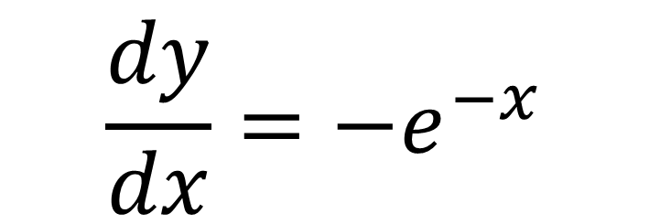
Modelling - Differentiating $y=ae^{kx}$
Different $e^{−x}$ with respect to $x$.
$$\frac{dy}{dx}=−e^{−x}$$

Slide 6
Exercise 14B
Pearson Pure Mathematics Year 1/AS
Pages 316-317
Complete before the lesson Ex3B Q2-4
Green Complete Ex3B
Amber Ex3C Q1-6
Red Ex3C Q7-9

