Slide 1
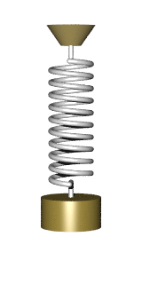
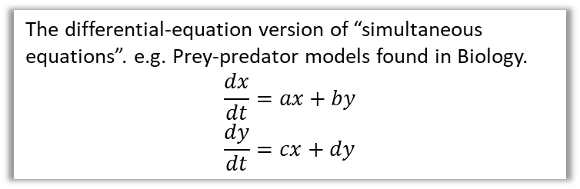


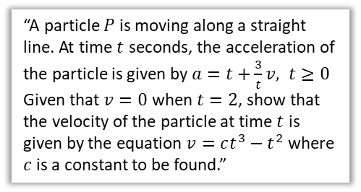
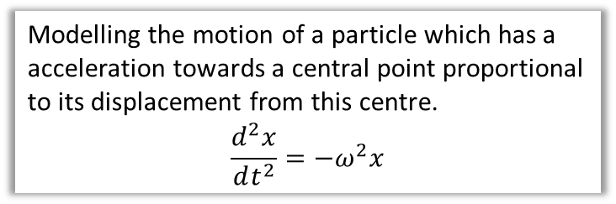
Chapter Overview
This chapter looks at applied settings in which 1st and 2nd order differential equations might emerge.
1:: Modelling with 1st order differential equations.
2:: Simple Harmonic Motion
Modelling the motion of a particle which has a acceleration towards a central point proportional to its displacement from this centre.
$$\frac{d^{2}x}{dt^{2}}=−ω^{2}x$$
“A particle $P$ is moving along a straight line. At time $t$ seconds, the acceleration of the particle is given by $a=t+\frac{3}{t}v, t≥0$
Given that $v=0$ when $t=2$, show that the velocity of the particle at time $t$ is given by the equation $v=ct^{3}−t^{2}$ where $c$ is a constant to be found.”
4:: Coupled First-Order Differential Equations
The differential-equation version of “simultaneous equations”. e.g. Prey-predator models found in Biology.
$$\frac{dx}{dt}=ax+by \\ \frac{dy}{dt}=cx+dy$$
3:: Damped and Force Harmonic Motion
How to model the damping force on a spring (damped harmonic motion) and how to model additional forces (forced harmonic motion).
$$x$$
Teacher Note: Most of this chapter is from the old M4, except without references to elasticity, and with the addition of coupled first-order differential equations.
$$t$$

Slide 2
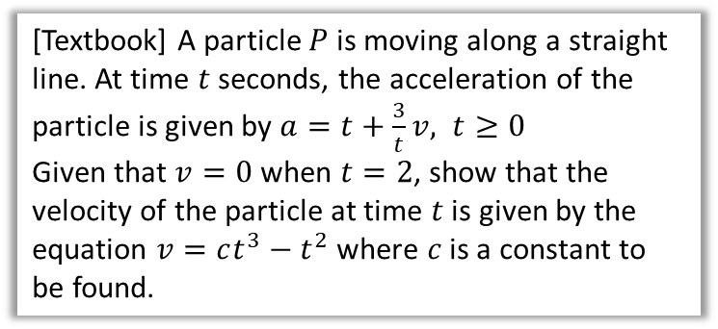
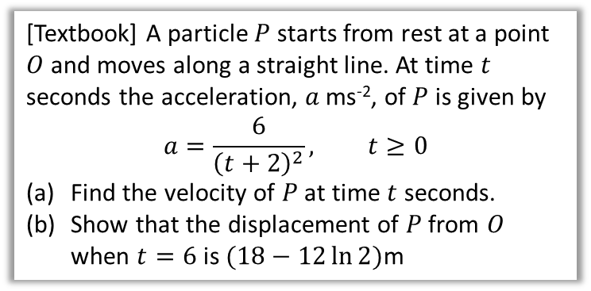
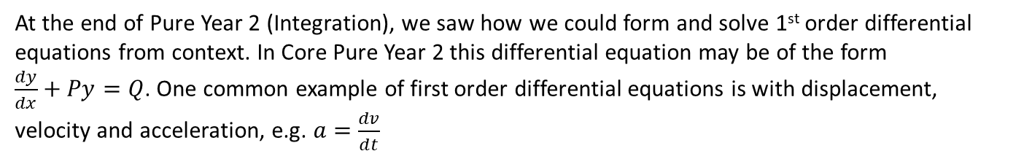


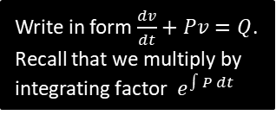
Modelling with 1st Order Differential Equations
At the end of Pure Year 2 (Integration), we saw how we could form and solve 1st order differential equations from context. In Core Pure Year 2 this differential equation may be of the form
$\frac{dy}{dx}+Py=Q$. One common example of first order differential equations is with displacement, velocity and acceleration, e.g. $a=\frac{dv}{dt}$
[Textbook] A particle $P$ starts from rest at a point $O$ and moves along a straight line. At time $t$ seconds the acceleration, $a$ ms⁻², of $P$ is given by
$$a=\frac{6}{{\left(t+2\right)}^{2}}, t≥0$$
Find the velocity of $P$ at time $t$ seconds.
Show that the displacement of $P$ from $O$ when $t=6$ is $(18−12\ln{2})$m
[Textbook] A particle $P$ is moving along a straight line. At time $t$ seconds, the acceleration of the particle is given by $a=t+\frac{3}{t}v, t≥0$
Given that $v=0$ when $t=2$, show that the velocity of the particle at time $t$ is given by the equation $v=ct^{3}−t^{2}$ where $c$ is a constant to be found.
?
Write in form $\frac{dv}{dt}+Pv=Q$. Recall that we multiply by integrating factor $e^{∫P dt}$
$$\frac{dv}{dt}=\frac{6}{{\left(t+2\right)}^{2}} \\ v=…=−\frac{6}{t+2}+c$$
When $t=0, v=0 ⇒ c=3$
So velocity $\left(3−\frac{6}{t+2}\right)$ ms⁻¹.
$$\frac{ds}{dt}=3−\frac{6}{t+2} \\ … \\ s=3t−6\ln\left(t+2\right)+6\ln{2}$$
When $t=6, s=18−6\ln{8}+6\ln{2}$
$$=18−6\ln\left(\frac{8}{2}\right)=18 −12\ln{2}$$
$$\frac{dv}{dt}−\frac{3}{t}v=t \\ IF=e^{\int{−\frac{3}{t}dt}}=e^{−3\ln{t}} \\ =e^{\ln{t^{−3}}}=t^{−3}$$
$$\frac{d}{dt}\left(t^{−3}v\right)=t^{−2} \\ t^{−3}v=−t^{−1}+c$$
When $v=0, t=2 ⇒ c=\frac{1}{2}$
$$∴v=\frac{1}{2}t^{3}−t^{2}$$
a
?
Form 1st order differential equation
b
?

Slide 3
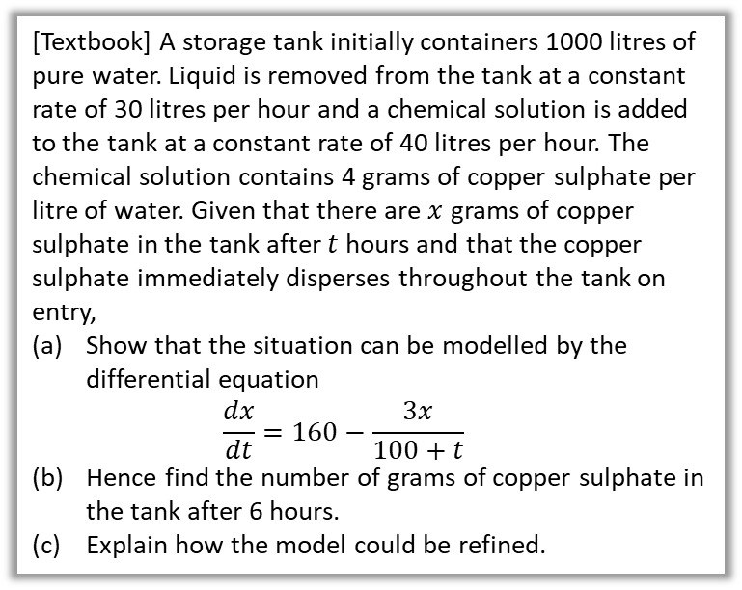


Classic ‘Filling a Container’ Example
[Textbook] A storage tank initially containers 1000 litres of pure water. Liquid is removed from the tank at a constant rate of 30 litres per hour and a chemical solution is added to the tank at a constant rate of 40 litres per hour. The chemical solution contains 4 grams of copper sulphate per litre of water. Given that there are $x$ grams of copper sulphate in the tank after $t$ hours and that the copper sulphate immediately disperses throughout the tank on entry,
Show that the situation can be modelled by the differential equation
$\frac{dx}{dt}=160−\frac{3x}{100+t}$
Hence find the number of grams of copper sulphate in the tank after 6 hours.
Explain how the model could be refined.
b
?
$$\frac{dx}{dt}+\frac{3}{100+t}x=160$$
$$IF=e^{\int{\frac{3}{100+t} dt}} \\ =…={\left(100+t\right)}^{3}$$
$${\left(100+t\right)}^{3}\frac{dx}{dt}+3{\left(100+t\right)}^{2}x=160{\left(100+t\right)}^{3} \\ \frac{d}{dt}\left({\left(100+t\right)}^{3}x\right)=160{\left(100+t\right)}^{3} \\ {\left(100+t\right)}^{3}x=40{\left(100+t\right)}^{4}+c$$
$$t=0,x=0 ⇒ c=−4×{10}^{9}$$
After 6 hours:
$${\left(106\right)}^{3}x=40×{\left(106\right)}^{4}−4×{10}^{9}$$
$⇒ x=882$ g (3sf)
The model could be refined to take into account the fact that the cupper sulphate does not disperse immediately on entering the tank.
c
?
a
Litres of liquid in tank after $t$ hours:
$$1000+40t−30t=1000+10t$$
Concentration of copper sulphate after $t$ hours $=\frac{x}{1000+10t}$ grams/litre
Rate copper sulphate in $=40×4=160$ grams/hour
Rate copper sulphate out $=30×\frac{x}{1000+10t}=\frac{3x}{100+t}$ grams/hour
Hence $\frac{dx}{dt}=160−\frac{3x}{100+t}$
?

Slide 4
Exercise 8A
Pearson Core Pure Year 2
Pages 174-175
Complete before the lesson Q1
In Class:
Amber Q2-4
Red Q5-7

Slide 5

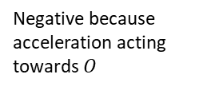
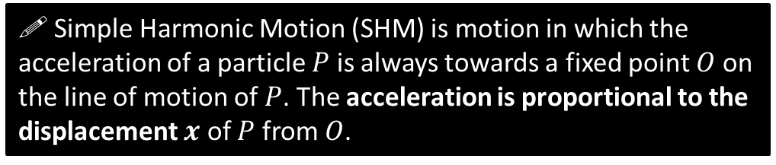
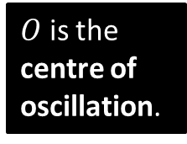
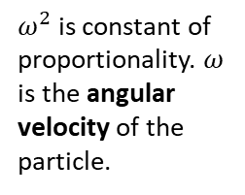

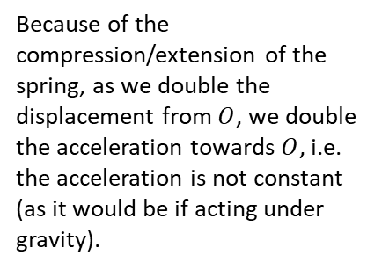

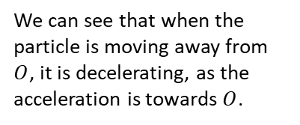

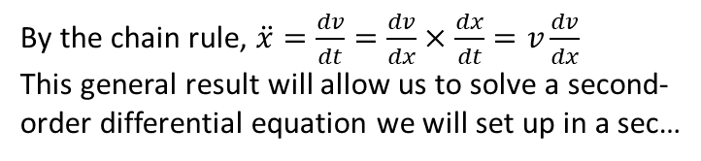
Simple Harmonic Motion
! Simple Harmonic Motion (SHM) is motion in which the acceleration of a particle $P$ is always towards a fixed point $O$ on the line of motion of $P$. The acceleration is proportional to the displacement $x$ of $P$ from $O$.
We can see that when the particle is moving away from $O$, it is decelerating, as the acceleration is towards $O$.
$$\ddot{x}=−ω^{2}x$$
$$O$$
Second derivative of displacement is acceleration (recall the dot notation differentiates with respect to time).
$ω^{2}$ is constant of proportionality. $ω$ is the angular velocity of the particle.
Because of the compression/extension of the spring, as we double the displacement from $O$, we double the acceleration towards $O$, i.e. the acceleration is not constant (as it would be if acting under gravity).
Negative because acceleration acting towards $O$
(i.e. the number of oscillations per $2π$ seconds)
$O$ is the centre of oscillation.
By the chain rule, $\ddot{x}=\frac{dv}{dt}=\frac{dv}{dx}×\frac{dx}{dt}=v\frac{dv}{dx}$
This general result will allow us to solve a second-order differential equation we will set up in a sec…
! $\ddot{x}=v\frac{dv}{dx}$

Slide 6


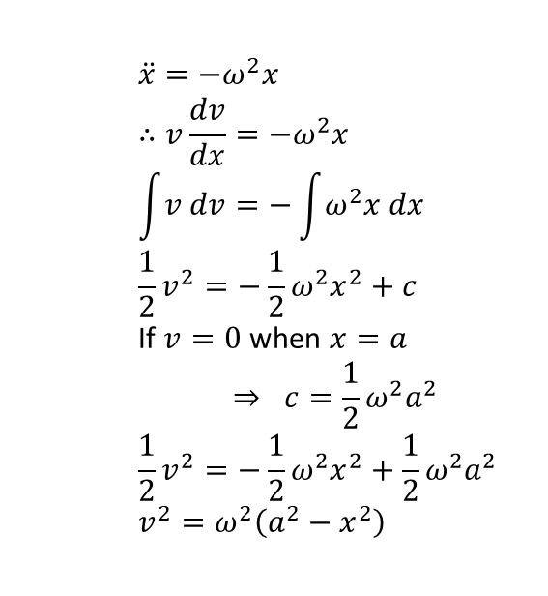





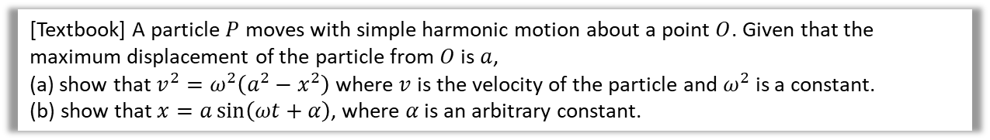

Solving the Differential Equation
[Textbook] A particle $P$ moves with simple harmonic motion about a point $O$. Given that the maximum displacement of the particle from $O$ is $a$,
(a) show that $v^{2}=ω^{2}\left(a^{2}−x^{2}\right)$ where $v$ is the velocity of the particle and $ω^{2}$ is a constant.
(b) show that $x=a\sin\left(ωt+α\right)$, where $α$ is an arbitrary constant.
a
$$\ddot{x}=−ω^{2}x \\ ∴v\frac{dv}{dx}=−ω^{2}x$$
$$\int{v dv}=−\int{ω^{2}x dx} \\ \frac{1}{2}v^{2}=−\frac{1}{2}ω^{2}x^{2}+c$$
If $v=0$ when $x=a$
$$⇒ c=\frac{1}{2}ω^{2}a^{2}$$
$$\frac{1}{2}v^{2}=−\frac{1}{2}ω^{2}x^{2}+\frac{1}{2}ω^{2}a^{2} \\ v^{2}=ω^{2}\left(a^{2}−x^{2}\right)$$
b
Starting again with $\ddot{x}=−ω^{2}x$ and noting this is a second order differential equation (which we know how to solve!)
$$\frac{dx^{2}}{dt^{2}}+ω^{2}x=0$$
Auxiliary equation: $m^{2}+ω^{2}=0 ⇒ m=±ωi$
$$∴x=A\cos{ωt}+B\sin{ωt} \\ =R\sin\left(ωt+α\right)$$
This has maximum amplitude $R$. But we said maximum amplitude is $a$, so
$$x=a\sin\left(ωt+α\right)$$
?
?
Using Pure Yr 2 trig techniques.
Holy Smokes Batman! That means the displacement of the particle follows a sine way (as we may have suspected)
$$x$$
The maximum displacement is known as the amplitude of the wave.
$$a$$
If $ω=1$ then the sin wave would repeat every $2π$, i.e. we’d have one oscillation per $2π$. Therefore $ω$ gives the number of oscillations per $2π$. The period is the time for one oscillation.
The reason why I find this particularly awesome is that it’s an applied practical use of complex numbers: these acted as a tool to solve the relevant differential equation.
$$\frac{2π}{ω}$$
$$t$$
$$−a$$
$α$ controls the horizontal translation. If $α=0$, we start at the equilibrium position.

Slide 7
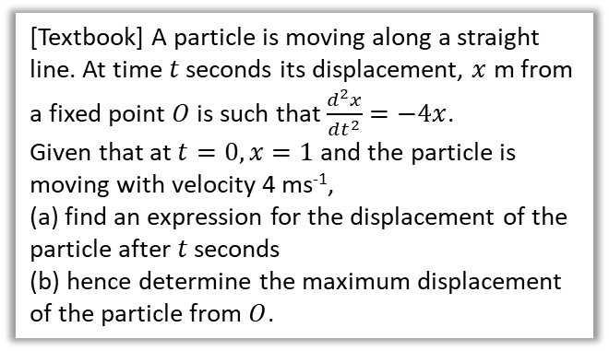


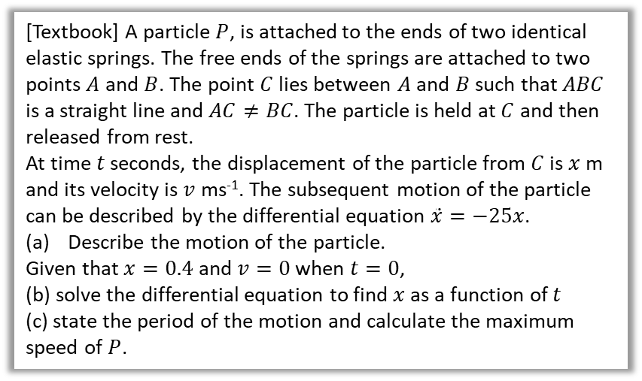

Examples
[Textbook] A particle is moving along a straight line. At time $t$ seconds its displacement, $x$ m from a fixed point $O$ is such that $\frac{d^{2}x}{dt^{2}}=−4x$.
Given that at $t=0, x=1$ and the particle is moving with velocity 4 ms⁻¹,
(a) find an expression for the displacement of the particle after $t$ seconds
(b) hence determine the maximum displacement of the particle from $O$.
[Textbook] A particle $P$, is attached to the ends of two identical elastic springs. The free ends of the springs are attached to two points $A$ and $B$. The point $C$ lies between $A$ and $B$ such that $ABC$ is a straight line and $AC≠BC$. The particle is held at $C$ and then released from rest.
At time $t$ seconds, the displacement of the particle from $C$ is $x$ m and its velocity is $v$ ms⁻¹. The subsequent motion of the particle can be described by the differential equation $\ddot{x}=−25x$.
Describe the motion of the particle.
Given that $x=0.4$ and $v=0$ when $t=0$,
(b) solve the differential equation to find $x$ as a function of $t$
(c) state the period of the motion and calculate the maximum speed of $P$.
a
$$\frac{d^{2}x}{dt^{2}}+4x=0 \\ m^{2}+4=0 ⇒ m=±2i \\ x=A\cos{2t}+B\sin{2t}$$
When $t=0, x=1 ⇒ A=1$
$$∴x=\cos{2t}+B\sin{2t}$$
$$v=\frac{dx}{dt}=−2\sin{2t}+2B\cos{2t}$$
When $t=0, v=4 ⇒ B=2$
$$∴x=\cos{2t}+2\sin{2t}$$
$$x=\sqrt{5}\sin\left(2t+0.4636…\right)$$
Hence maximum displacement is $\sqrt{5}$ m.
?
It’s easier to initially keep in form $A\cos{2t}+B\sin{2t}$ until we find the constants, the combine into one $sin$ later.
a
Moves with simple harmonic motion.
$$\frac{dx^{2}}{dt^{2}}+25x=0 \\ m^{2}+25=0 ⇒ m=±i \\ x=A\cos{5t}+B\sin{5t}$$
When $t=0, x=0.4 ⇒ A=0.4$
$$\frac{dx}{dt}=−2\sin{5t}+5B\cos{5t}$$
When $t=0, v=0 ⇒ B=0$
$$∴x=0.4\cos{5t}$$
Period $\frac{2π}{5}$ seconds. $\frac{dx}{dt}=−2\sin{5t}$ so maximum speed is 2 ms⁻¹.
?
b
?
b
?
c
?

Slide 8
Exercise 8B
Pearson Core Pure Year 2
Pages 178-180
Complete before the lesson Q1
In Class:
Green Q2
Amber Q3-6
Red Q7-9

Slide 9
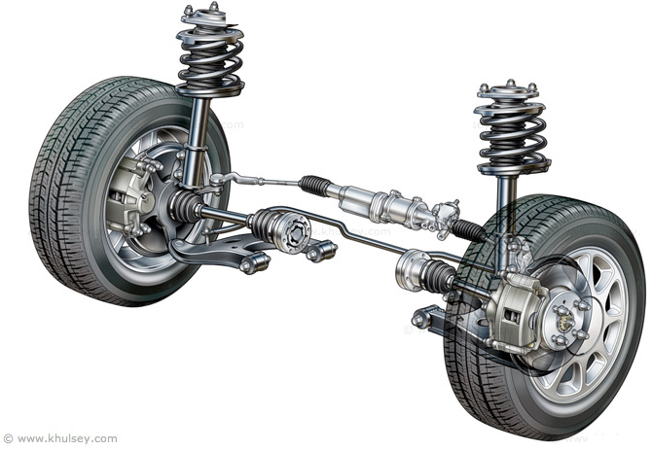
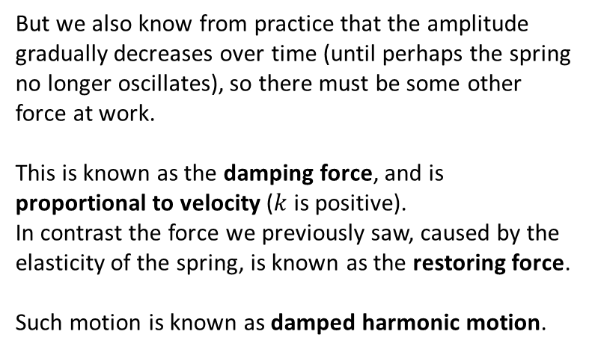
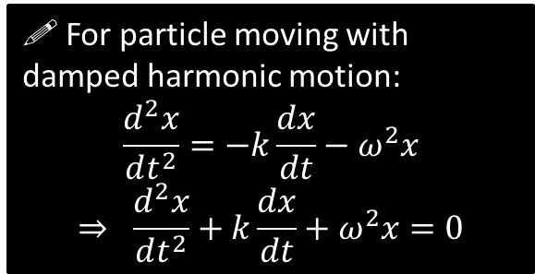
Damped and Force Harmonic Motion
We have seen so far that the extension/compression of the spring leads to a force, and hence an acceleration, which is proportional to the displacement from some central point, i.e. the more you stretch the spring, the greater the force, and hence the greater the acceleration.
With this force alone, we saw this resulted in the displacement that follows a sine curve as time increases.
But we also know from practice that the amplitude gradually decreases over time (until perhaps the spring no longer oscillates), so there must be some other force at work.
This is known as the damping force, and is proportional to velocity ($k$ is positive).
In contrast the force we previously saw, caused by the elasticity of the spring, is known as the restoring force.
Such motion is known as damped harmonic motion.
! For particle moving with damped harmonic motion:
$$\frac{d^{2}x}{dt^{2}}=−k\frac{dx}{dt}−ω^{2}x$$
$$⇒ \frac{d^{2}x}{dt^{2}}+k\frac{dx}{dt}+ω^{2}x=0$$
The type of motion seen will depend on the roots to the auxiliary equation…

Slide 10
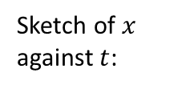




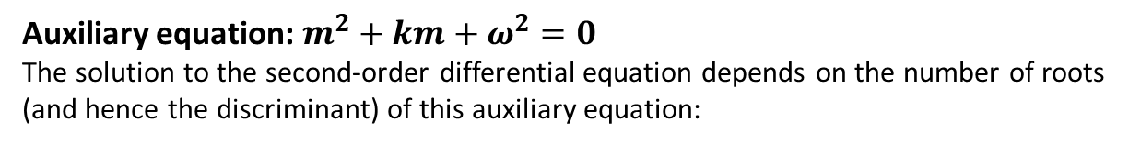





Types of Damped Harmonic Motion
$$\frac{d^{2}x}{dt^{2}}+k\frac{dx}{dt}+ω^{2}x=0$$
Auxiliary equation: $m^{2}+km+ω^{2}=0$
The solution to the second-order differential equation depends on the number of roots (and hence the discriminant) of this auxiliary equation:
Roots of auxiliary:
Distinct roots:
$$k^{2}−4ω^{2}>0$$
Equal roots:
$$k^{2}−4ω^{2}=0$$
No roots:
$$k^{2}−4ω^{2}<0$$
Form of resulting solution to differential equation:
?
?
?
$$x=Ae^{−αt}+Be^{−βt}$$
$$x=\left(A+Bt\right)e^{αt}$$
$${x=Ae}^{−ax}\sin{bx}$$
?
?
?
Type of damping:
Heavy damping
(no oscillations)
Critical damping
(the limit for which there are no oscillations)
Light damping
(oscillates)
$$x$$
$$x$$
$$x$$
?
?
?
Sketch of $x$ against $t$:
$$t$$
$$t$$
$$t$$

Slide 11


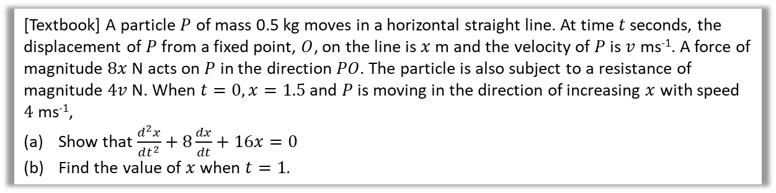



Using forces to derive the differential equation
[Textbook] A particle $P$ of mass 0.5 kg moves in a horizontal straight line. At time $t$ seconds, the displacement of $P$ from a fixed point, $O$, on the line is $x$ m and the velocity of $P$ is $v$ ms⁻¹. A force of magnitude $8x$ N acts on $P$ in the direction $PO$. The particle is also subject to a resistance of magnitude $4v$ N. When $t=0, x=1.5$ and $P$ is moving in the direction of increasing $x$ with speed $4$ ms⁻¹,
Show that $\frac{d^{2}x}{dt^{2}}+8\frac{dx}{dt}+16x=0$
Find the value of $x$ when $t=1$.
? Force Diagram
? a
$$a$$
$$F=ma \\ −\left(8x+4v\right)=0.5a \\ 0.5a+4v+8x=0 \\ \frac{d^{2}x}{dt^{2}}+8\frac{dx}{dt}+16 x=0$$
Auxiliary equation:
$$m^{2}+8m+16=0 \\ m=−4$$
General solution:
$$x=\left(A+Bt\right)e^{−4t}$$
When $t=0, x=1.5 ⇒ A=1.5$
$$v=\frac{dx}{dt}=Be^{−4t}−4\left(A+Bt\right)e^{−4t}$$
When $t=0, v=4 ⇒ B=10$
$$∴x=\left(1.5+10t\right)e^{−4t}$$
$t=1 ⇒ x=11.5e^{−1}=0.211$(3sf)
$$O$$
$$8x+4v$$
$$x$$
? b
Equal roots so example of critical damping.

Slide 12
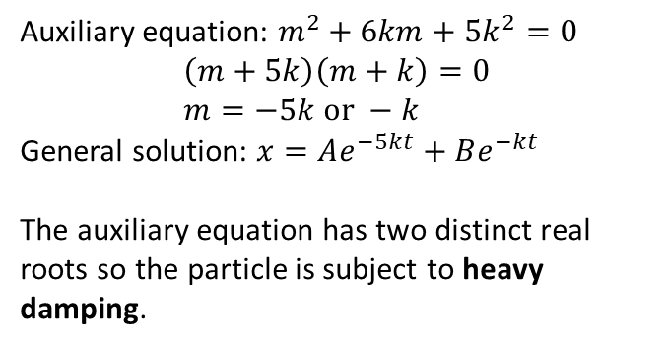
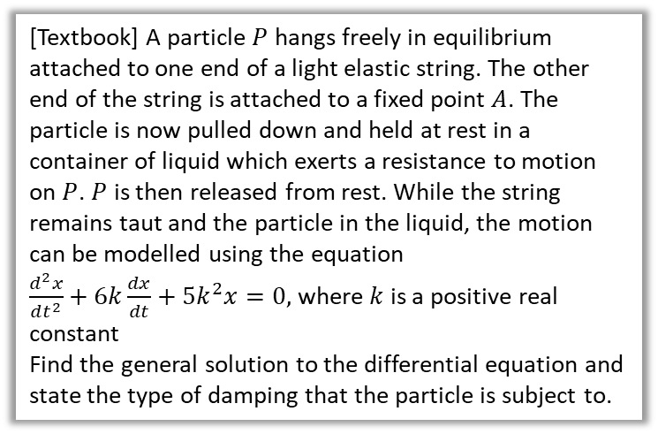
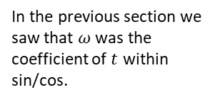

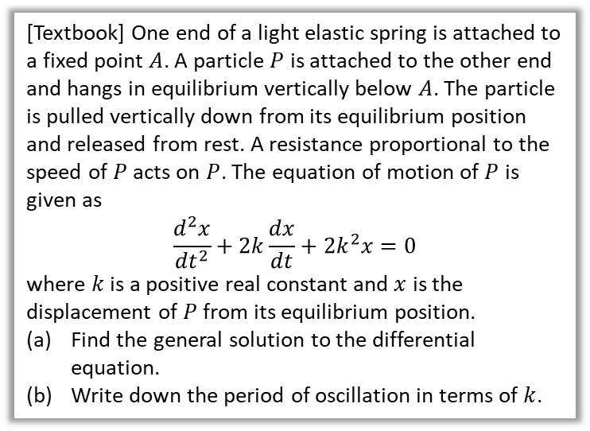
Further Examples
[Textbook] A particle $P$ hangs freely in equilibrium attached to one end of a light elastic string. The other end of the string is attached to a fixed point $A$. The particle is now pulled down and held at rest in a container of liquid which exerts a resistance to motion on $P$. $P$ is then released from rest. While the string remains taut and the particle in the liquid, the motion can be modelled using the equation
$\frac{d^{2}x}{dt^{2}}+6k\frac{dx}{dt}+5k^{2}x=0,$ where $k$ is a positive real constant
Find the general solution to the differential equation and state the type of damping that the particle is subject to.
[Textbook] One end of a light elastic spring is attached to a fixed point $A$. A particle $P$ is attached to the other end and hangs in equilibrium vertically below $A$. The particle is pulled vertically down from its equilibrium position and released from rest. A resistance proportional to the speed of $P$ acts on $P$. The equation of motion of $P$ is given as
$$\frac{d^{2}x}{dt^{2}}+2k\frac{dx}{dt}+2k^{2}x=0$$
where $k$ is a positive real constant and $x$ is the displacement of $P$ from its equilibrium position.
Find the general solution to the differential equation.
Write down the period of oscillation in terms of $k$.
?
?
Auxiliary equation: $m^{2}+6km+5k^{2}=0$
$$\left(m+5k\right)\left(m+k\right)=0 \\ m=−5k or −k$$
General solution: $x=Ae^{−5kt}+Be^{−kt}$
The auxiliary equation has two distinct real roots so the particle is subject to heavy damping.
Auxiliary equation: $m^{2}+2km+2k^{2}=0$
$$m=\frac{−2k±\sqrt{4k^{2}−4\left(2k^{2}\right)}}{2}=−k±ik \\ x=e^{−kt}\left(A\cos{kt}+B\sin{kt}\right)$$
Period $=\frac{2π}{k}$
In the previous section we saw that $ω$ was the coefficient of $t$ within sin/cos.

Slide 13

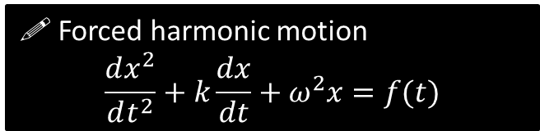
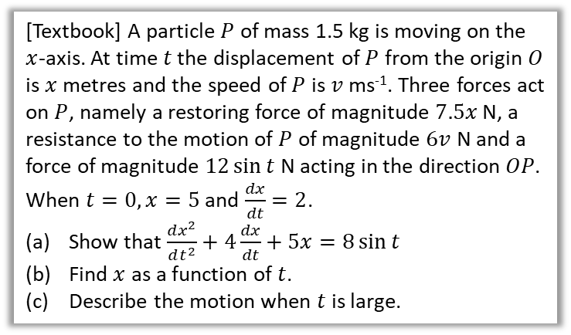
Forced Harmonic Motion
In addition to the ‘natural’ forces acting on the particle, i.e. damping force and restoring force, there may be a further a further force acting on the particle.
This is known as forced harmonic motion.
This is a non-homogeneous differential equation. We saw how to solve these in the last chapter.
$$F=ma$$
$$−7.5x−6\frac{dx}{dt}+12\sin{t}=1.5\frac{d^{2}x}{dt^{2}} \\ \frac{d^{2}x}{dt^{2}}+5x+4\frac{dx}{dt}=8\sin{t} ⇒ \frac{d^{2}x}{dt^{2}}+4\frac{dx}{dt}+5x=8\sin{t}$$
Auxiliary equation: $m^{2}+4m+5=0$
$$m=−2±i$$
Complementary function: $x_{c}=e^{−2t}(A\cos{t}+B\sin{t})$
Particular integral: Try $x=p\sin{t}+q\cos{t}$
$$\frac{dx}{dt}=p\cos{t}−q\sin{t}$$
$$\frac{d^{2}x}{dt^{2}}=−p\sin{t}−q\cos{t}$$
So $\left(−p\sin{t}−q\cos{t}\right)+4\left(p\cos{t}−q\sin{t}\right)+5\left(p\sin{t}+q\cos{t}\right)=8\sin{t}$
Equating coefficients of $\cos{t} ⇒ p+q=0$
Equating coefficients of $\sin{t} ⇒p−q=2$
So $p=1, q=−1$
General solution:
$$x=e^{−2t}\left(A\cos{t}+B\sin{t}\right)+\sin{t}−\cos{t}$$
Using boundary conditions, $A=6, B=13$
So $x=e^{−2t}\left(6\cos{t}+13\sin{t}\right)+\sin{t}−\cos{t}$
As $t→∞, e^{−2t}→0$
So $x→\sin{t}−\cos{t}=R\sin{(t−α})$
$$R=\sqrt{1+1}=\sqrt{2} \tan{α}=1 ⇒ α=\frac{π}{4}$$
$x=\sqrt{2}\sin\left(t−\frac{π}{4}\right)$ so motion is SHM with amplitude $\sqrt{2}$ and period $2π$.
a
?
! Forced harmonic motion
$$\frac{dx^{2}}{dt^{2}}+k\frac{dx}{dt}+ω^{2}x=f(t)$$
b
?
[Textbook] A particle $P$ of mass 1.5 kg is moving on the $x$-axis. At time $t$ the displacement of $P$ from the origin $O$ is $x$ metres and the speed of $P$ is $v$ ms⁻¹. Three forces act on $P$, namely a restoring force of magnitude $7.5x$ N, a resistance to the motion of $P$ of magnitude $6v$ N and a force of magnitude $12\sin{t}$ N acting in the direction $OP$. When $t=0, x=5$ and $\frac{dx}{dt}=2$.
Show that $\frac{dx^{2}}{dt^{2}}+4\frac{dx}{dt}+5x=8\sin{t}$
Find $x$ as a function of $t$.
Describe the motion when $t$ is large.
c
?

Slide 14
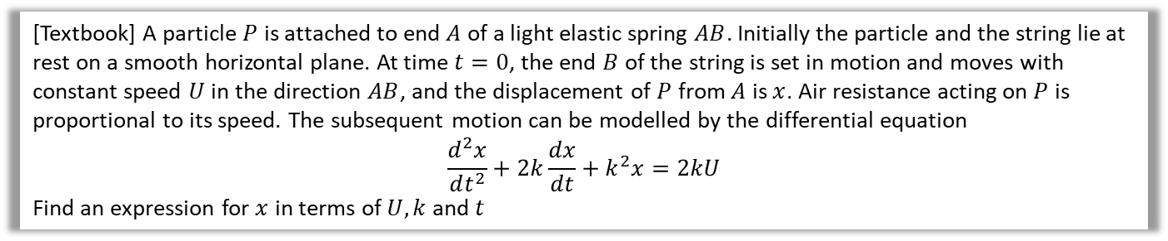

Further Example
[Textbook] A particle $P$ is attached to end $A$ of a light elastic spring $AB$. Initially the particle and the string lie at rest on a smooth horizontal plane. At time $t=0$, the end $B$ of the string is set in motion and moves with constant speed $U$ in the direction $AB$, and the displacement of $P$ from $A$ is $x$. Air resistance acting on $P$ is proportional to its speed. The subsequent motion can be modelled by the differential equation
$$\frac{d^{2}x}{dt^{2}}+2k\frac{dx}{dt}+k^{2}x=2kU$$
Find an expression for $x$ in terms of $U, k$ and $t$
?
Auxiliary equation: $m^{2}+2km+k^{2}=0$
$$m=−k$$
CF: $x=\left(a+Bt\right)e^{−kt}$
Particular integral: Try $x=a$
$$\frac{dx}{dt}=\frac{dx^{2}}{dt^{2}}=0$$
So $k^{2}a=2kU ⇒ a=\frac{2U}{k}$
General solution: $x=\left(A+Bt\right)e^{−kt}+\frac{2U}{k}$
$$t=0, x=0 ⇒ 0=A+\frac{2U}{k} ⇒ A=−\frac{2U}{k}$$
$$\frac{dx}{dt}=−k\left(A+Bt\right)e^{−kt}+Be^{−kt} \\ t=0 ⇒ \frac{dx}{dt}=U \\ U=−kA+B \\ B=U+kA=−U$$
So $x=\left(−\frac{2U}{k}−Ut\right)e^{−kt}+\frac{2U}{k}$
This is because the RHS is a constant.

Slide 15
Exercise 8C
Pearson Core Pure Year 2
Pages 184-186
Complete before the lesson Q1
In Class:
Green Q2
Amber Q3-5
Red Q6-8

Slide 16






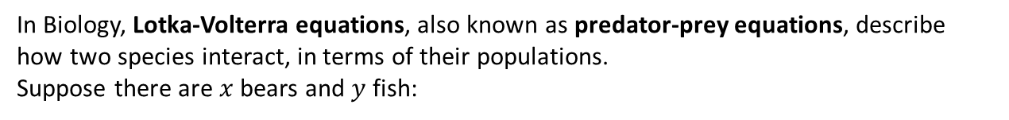








Coupled First-Order Linear Differential Equations
In Biology, Lotka-Volterra equations, also known as predator-prey equations, describe how two species interact, in terms of their populations.
Suppose there are $x$ bears and $y$ fish:
$$ax$$
…clearly depends on (and more specifically, is proportional to) the number of bears
(i.e. more bears leads to more baby bears)
$$+$$
$$by$$
…but also on the availability of prey
(i.e. more yummy fish, more bears)
$$\frac{dx}{dt}$$
$$+$$
…and possibly some other additional factor dependent on time
(e.g. bears more frisky in the summer, so more bear love and hence more baby bears)
$$f(t)$$
The population growth of bears…
$$cx$$
…clearly depends on the number of predators
(i.e. more bears, a greater rate of fish decline!)
$$\frac{dy}{dt}$$
$$dy$$
$$+$$
…but also on the number of fish
(i.e. more fish, more babies)
$$+$$
Similarly the population growth of fish…
…and again some other time-dependent
factor
$$g(t)$$

Slide 17

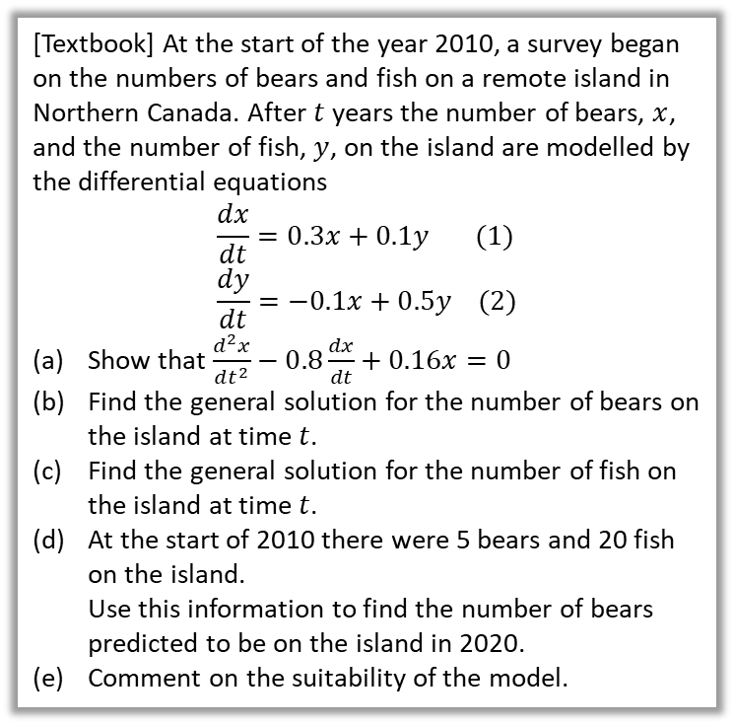



Coupled First-Order Linear Differential Equations
! Coupled first-order linear differential equations:
$$\frac{dx}{dt}=ax+by+f\left(t\right) \\ \frac{dy}{dt}=cx+dy+g(t)$$
Homogeneous if $f\left(t\right)=g\left(t\right)=0$ for all $t$.
Possible strategy to solve for $x$:
1. Make $y$ the subject of first equation then differentiate to find $\frac{dy}{dt}$.
2. Substitute into second equation to get single second-order differential equation just in terms of $x$, and solve.
3. To solve for $y$, no need to repeat whole process. Differentiate $x$ from Step 2 and sub $x$ and $\frac{dx}{dt}$ into $y$ from Step 1.
[Textbook] At the start of the year 2010, a survey began on the numbers of bears and fish on a remote island in Northern Canada. After $t$ years the number of bears, $x$, and the number of fish, $y$, on the island are modelled by the differential equations
$$\frac{dx}{dt}=0.3x+0.1y (1) \\ \frac{dy}{dt}=−0.1x+0.5y (2)$$
Show that $\frac{d^{2}x}{dt^{2}}−0.8\frac{dx}{dt}+0.16x=0$
Find the general solution for the number of bears on the island at time $t$.
Find the general solution for the number of fish on the island at time $t$.
At the start of 2010 there were 5 bears and 20 fish on the island.
Use this information to find the number of bears predicted to be on the island in 2020.
Comment on the suitability of the model.
?
a
As per strategy above:
$$y=10\frac{dx}{dt}−3x ⇒ \frac{dy}{dt}=10\frac{d^{2}x}{dt^{2}}−3\frac{dx}{dt} \\ 10\frac{d^{2}x}{dt^{2}}−3\frac{dx}{dt}=−0.1x+0.5\left(10\frac{dx}{dt}−3x\right) \\ 10\frac{d^{2}x}{dt^{2}}−8\frac{dx}{dt}+1.6x=0 \\ \frac{d^{2}x}{dt^{2}}−0.8\frac{dx}{dt}+0.16x=0$$
$$m^{2}−0.8m+0.16=0 ⇒ m=0.4$$
Therefore $x=Ae^{0.4t}+Bte^{0.4t}$
As per Step 3 in strategy above:
$$\frac{dx}{dt}=0.4Ae^{0.4t}+0.4Bte^{0.4t}+Be^{0.4t}$$
$$y=10\frac{dx}{dt}−3x \left(1\right) \\ ∴y=10\left(0.4Ae^{0.4t}+0.4Bte^{0.4t}+Be^{0.4t}\right)−3\left(Ae^{0.4t}+Bte^{0.4t}\right) \\ y=Ae^{0.4t}+10Be^{0.4t}+Bte^{0.4t}$$
At $t=0, x=5 ⇒ A=5$
At $t=0, y=20 ⇒ B=1.5$
$$x=5e^{0.4t}+1.5te^{0.4t} , t=10⇒x=1092$$
The model predicts the number of bears (and the number of fish) will grow without limit so it is unlikely to be realistic.
b
?
c
?
d
?
e
?

Slide 18



Test Your Understanding
[Textbook] Two barrels contain contaminated water. At time $t$ seconds, the amount of contaminant in barrel $A$ is $x$ ml and the amount of contaminant in barrel $B$ is $y$ ml. Additional contaminated water flows into barrel $A$ at a rate of 5ml per second. Contaminated water flows from barrel $A$ to barrel $B$ and from barrel $B$ to barrel $A$ through two connecting hoses, and drains out of barrel $A$ to leave the system completely.
The system is modelled using the differential equations
$$\frac{dx}{dt}=5+\frac{4}{9}y−\frac{1}{7}x \left(1\right) \\ \frac{dy}{dt}=\frac{3}{70}x−\frac{4}{9}y (2)$$
Show that $630\frac{d^{2}y}{dt^{2}}+370\frac{dy}{dt}+28y=135$
Use strategy as per previous slide, but now need to make $x$ subject in (2) and sub into (1).
?
$$\frac{dy}{dt}+\frac{4}{9}y=\frac{3}{70}x \\ x=\frac{70}{3}\frac{dy}{dt}+\frac{280}{27}y \\ \frac{dx}{dt}=\frac{70}{3}\frac{d^{2}y}{dt^{2}}+\frac{280}{27}\frac{dy}{dt}$$
Now substitute into (1):
$$\frac{70}{3}\frac{d^{2}y}{dt^{2}}+\frac{280}{27}\frac{dy}{dt}=5+\frac{4}{9}y−\frac{1}{7}\left(\frac{70}{3}\frac{dy}{dt}+\frac{280}{27}y\right) \\ 70\frac{d^{2}y}{dt^{2}}+\frac{280}{9}\frac{dy}{dt}=15+\frac{4}{3}y−10\frac{dy}{dt}−\frac{40}{9}y \\ 630\frac{d^{2}y}{dt^{2}}+280\frac{dy}{dt}=135+12y−90\frac{dy}{dt}−40y \\ ⇒630\frac{d^{2}y}{dt^{2}}+370\frac{dy}{dt}+28y=135$$

Slide 19
Exercise 8D
Pearson Core Pure Year 2
Pages 188-190
Complete before the lesson Q1
In Class:
Green Q2-3
Amber Q4-6
Red Q7-8 & Challenge

Slide 20


You have reached the end of maths.*
$$\frac{dx}{dt}=ax+by+f\left(t\right)$$
* At A Level.

