Slide 1
Year 2 Pure Mathematics
Sequences and Series
- Geometric Sequences
Chapter 3
(Part 3 of 7)

Slide 2


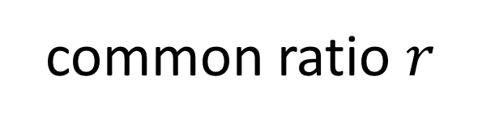

Geometric Sequences
Geometric Sequence
common ratio $r$
$$×2$$
$$×2$$
$$×2$$
3, 6, 12, 24, 48, …
A geometric sequence is one in which there is a common ratio (multiplier) between terms.

Slide 3
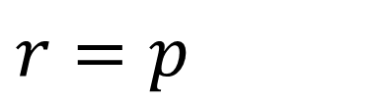
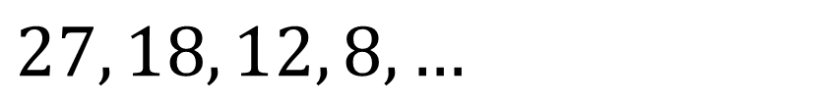
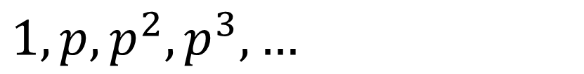
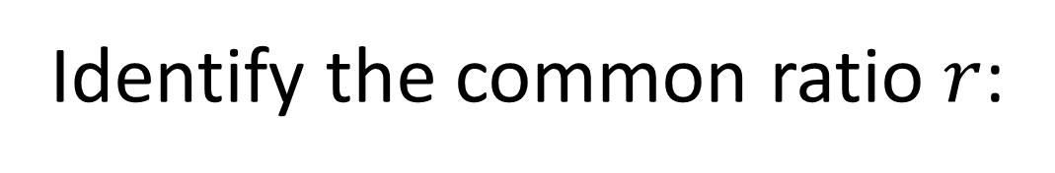
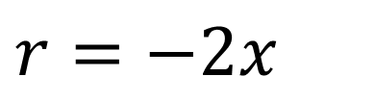
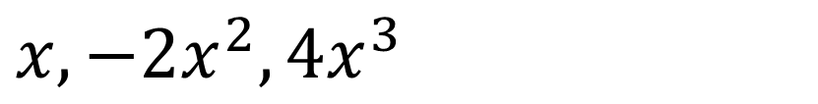
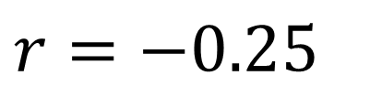
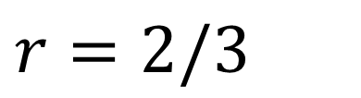
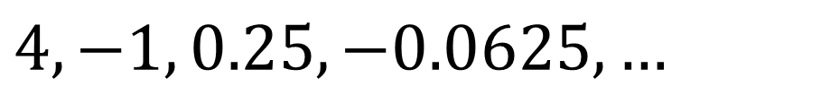
Geometric Sequences - Common Ratio
Identify the common ratio $r$:
$$27, 18, 12, 8, …$$
$$r=2/3$$
$$x, −2x^{2}, 4x^{3}$$
$$r=−2x$$
$$1, p, p^{2}, p^{3}, …$$
$$r=p$$
$$4, −1, 0.25, −0.0625, …$$
$$r=−0.25$$

Slide 4
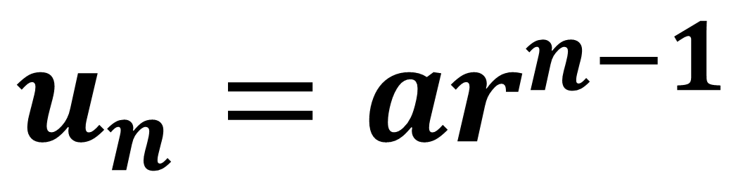
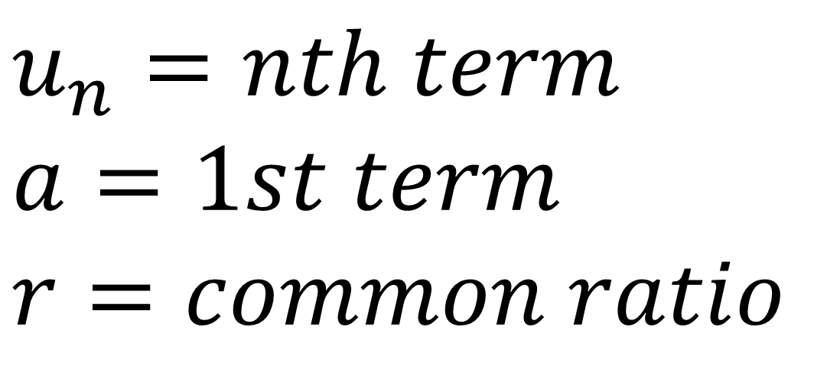
Geometric Sequences - $n$^{th} term
$$u_{n}=ar^{n−1}$$
$$u_{n}=nth term$$
$$a=1st term$$
$$r=common ratio$$

Slide 5
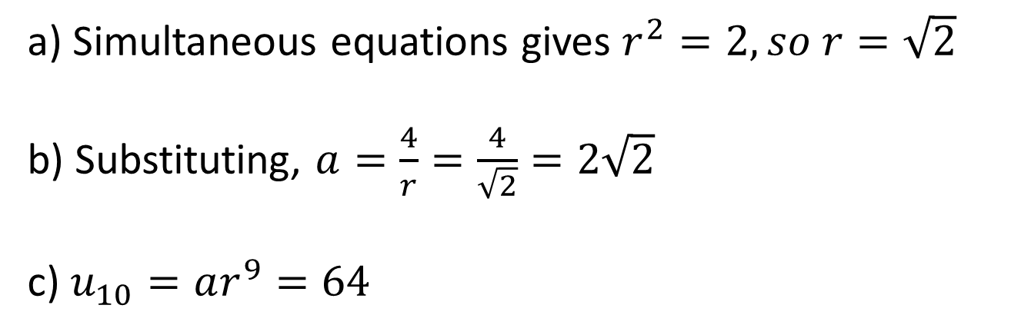
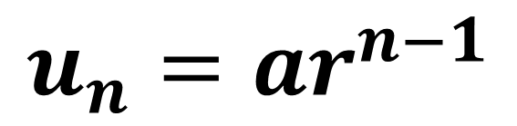
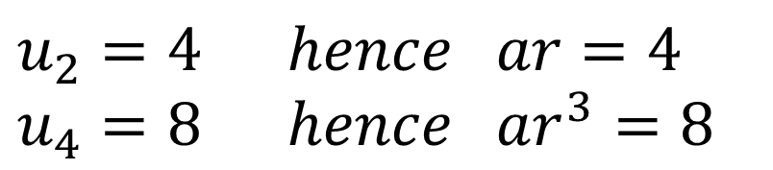
Geometric Sequences - $n$^{th} term
The second term of a geometric sequence is 4 and the 4th term is 8. The common ratio is positive. Find the exact values of:
The common ratio.
The first term.
The 10th term.
$$u_{n}=ar^{n−1}$$
$$u_{2}=4 hence ar=4 \\ u_{4}=8 hence ar^{3}=8$$
a) Simultaneous equations gives $r^{2}=2, so r=\sqrt{2}$
b) Substituting, $a=\frac{4}{r}=\frac{4}{\sqrt{2}}=2\sqrt{2}$
c) $u_{10}=ar^{9}=64$

Slide 6
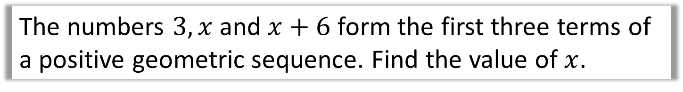
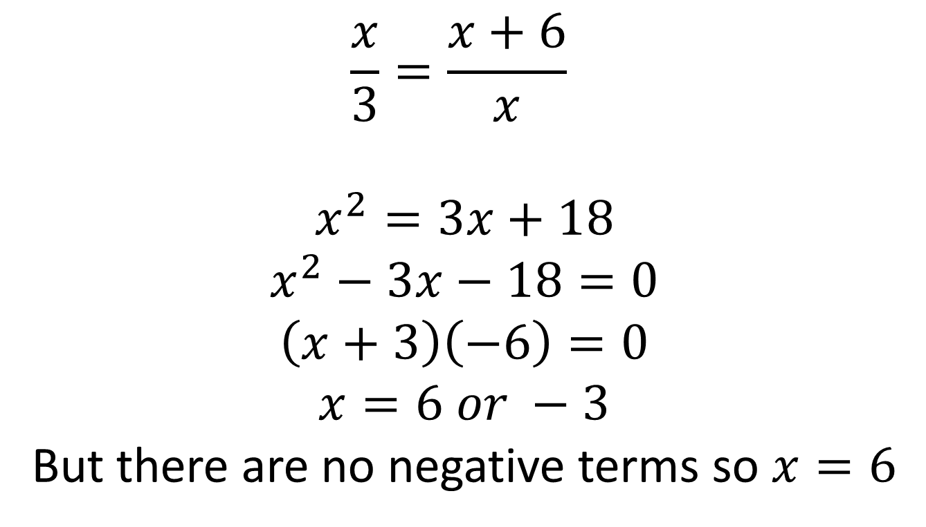
Geometric Sequences - $n$^{th} term
The numbers $3, x$ and $x+6$ form the first three terms of a positive geometric sequence. Find the value of $x$.
$$\frac{x}{3}=\frac{x+6}{x}$$
$$x^{2}=3x+18 \\ x^{2}−3x−18=0$$
$$\left(x+3\right)\left(−6\right)=0$$
$$x=6 or −3$$
But there are no negative terms so $x=6$

Slide 7
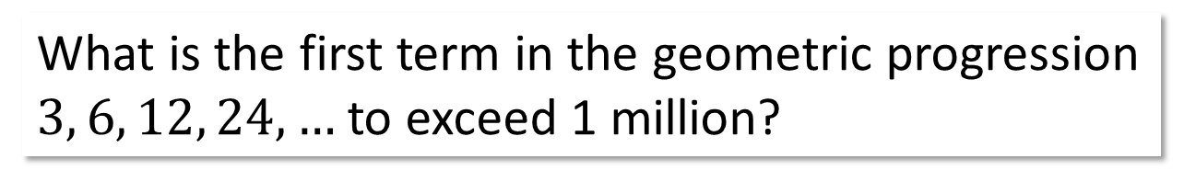
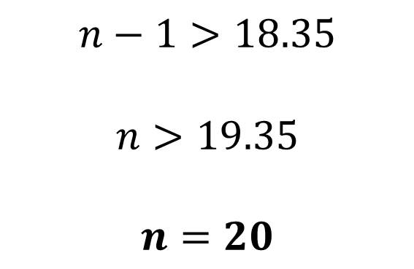
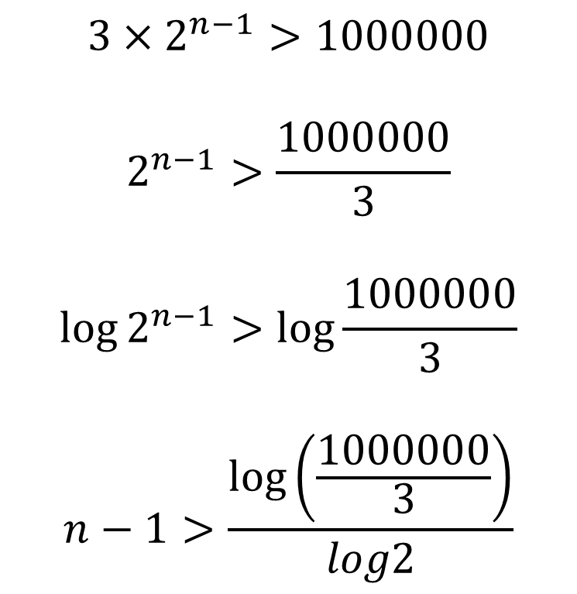
Geometric Sequences - $n$^{th} term with inequalities
What is the first term in the geometric progression
$3, 6, 12, 24, …$ to exceed 1 million?
$$3×2^{n−1}>1000000$$
$$2^{n−1}>\frac{1000000}{3}$$
$$\log{2^{n−1}>\log{\frac{1000000}{3}}}$$
$$n−1>\frac{\log\left(\frac{1000000}{3}\right)}{log2}$$
$$n−1>18.35$$
$$n>19.35$$
$$n=20$$

Slide 8
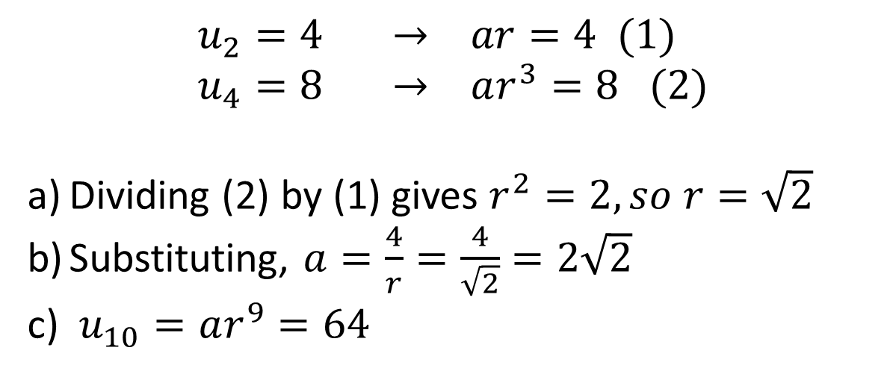
Further Example
[Textbook] The second term of a geometric sequence is 4 and the 4th term is 8. The common ratio is positive. Find the exact values of:
The common ratio.
The first term.
The 10th term.
?
$$u_{2}=4 → ar=4 (1) \\ u_{4}=8 → ar^{3}=8 (2)$$
Dividing (2) by (1) gives $r^{2}=2, so r=\sqrt{2}$
Substituting, $a=\frac{4}{r}=\frac{4}{\sqrt{2}}=2\sqrt{2}$
$u_{10}=ar^{9}=64$
Fro Tip: Explicitly writing $u_{2}=4$ first helps you avoid confusing the $n$^{th} term with the ‘sum of the first $n$ terms’ (the latter of which we’ll get onto).

Slide 9
Exercise 3C
Pearson Pure Mathematics Year 2/AS
Pages 69-70
Complete before the lesson Q1-4
In Class:
Green Q5-7
Amber Q8-9
Red Q10-13

