Slide 1
Year 2 Pure Mathematics
Measures of Location and Spread
- Median and Interpolation
Chapter 2
(Part 2 of 5)

Slide 2
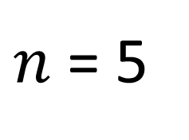
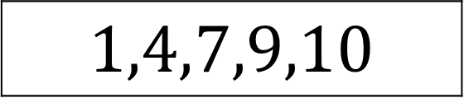
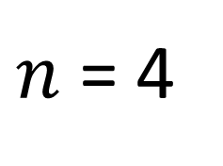
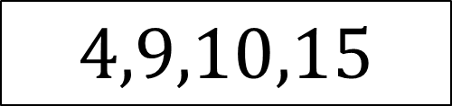
Median – Listed Data
What is the median?
$$1,4,7,9,10$$
$n$ = 5
Position of median = 3rd
Median = 7
What is the median?
$$4,9,10,15$$
$n$ = 4
Position of median = 2nd/3rd
Median = 9.5

Slide 3
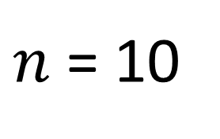
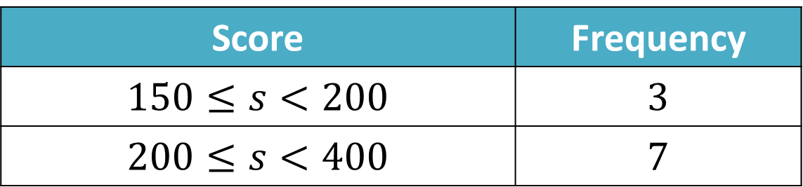
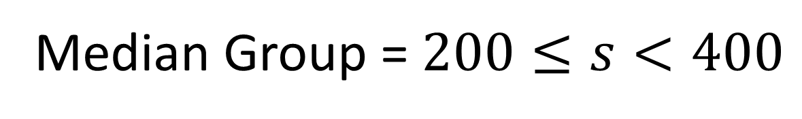
Median – Frequency Table
What is the median group?
Score | Frequency
$$150≤s<200$$ | $$3$$
$$200≤s<400$$ | $$7$$
$n$ = 10
Position of median = 5th/6th
Median Group = $200≤s<400$

Slide 4
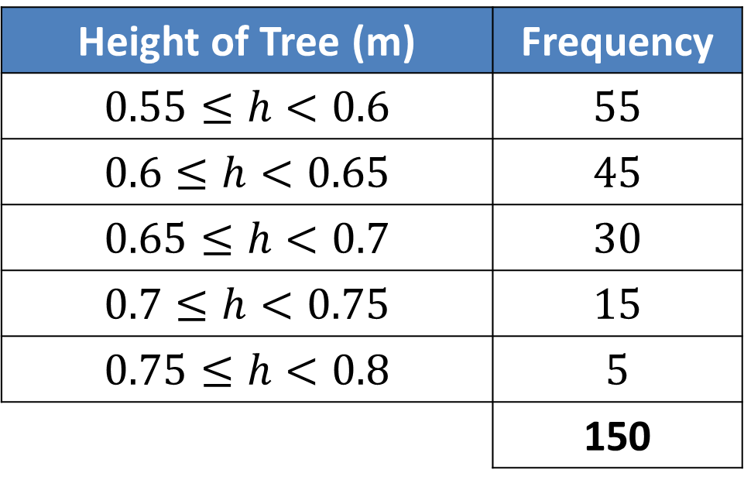
Median - Linear Interpolation
Height of Tree (m) | Frequency
$$0.55≤h<0.6$$ | $$55$$
$$0.6≤h<0.65$$ | $$45$$
$$0.65≤h<0.7$$ | $$30$$
$$0.7≤h<0.75$$ | $$15$$
$$0.75≤h<0.8$$ | $$5$$
 | 150
How could you find the median exactly using the table?
We could find the fraction of the way along
using the frequencies,
then go the same fraction along the class interval.

Slide 5
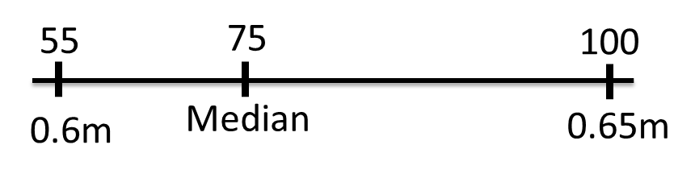

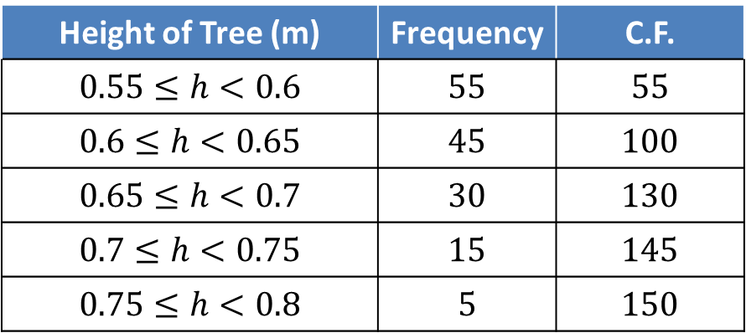
Median - Interpolation
Height of Tree (m) | Frequency | C.F.
$$0.55≤h<0.6$$ | $$55$$ | $$55$$
$$0.6≤h<0.65$$ | $$45$$ | $$100$$
$$0.65≤h<0.7$$ | $$30$$ | $$130$$
$$0.7≤h<0.75$$ | $$15$$ | $$145$$
$$0.75≤h<0.8$$ | $$5$$ | $$150$$
The 75th item is within the
$0.6≤h<0.65$ class interval

Slide 6
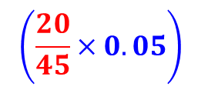
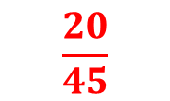


Median - Interpolation
Height of Tree (m) | Frequency | C.F.
$$0.55≤h<0.6$$ | $$55$$ | $$55$$
$$0.6≤h<0.65$$ | $$45$$ | $$100$$
$$0.65≤h<0.7$$ | $$30$$ | $$130$$
$$0.7≤h<0.75$$ | $$15$$ | $$145$$
$$0.75≤h<0.8$$ | $$5$$ | $$150$$
$$\frac{20}{45}$$
55
75
100
0.6m
Median
0.65m
$$\left(\frac{20}{45}×0.05\right)$$
Medain = 0.6 + $\frac{1}{45}$ = 0.623 (3 s.f.)

Slide 7

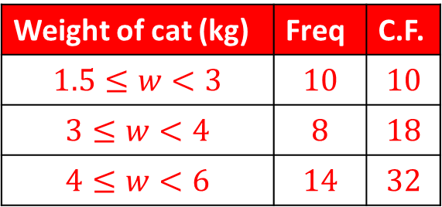
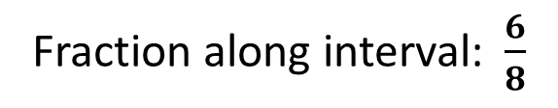
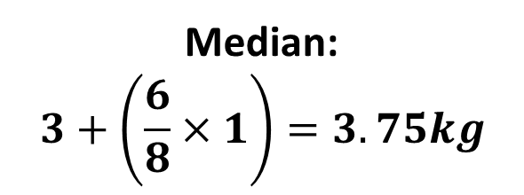
Median - Interpolation
Weight of cat (kg) | Freq | C.F.
$$1.5≤w<3$$ | $$10$$ | $$10$$
$$3≤w<4$$ | $$8$$ | $$18$$
$$4≤w<6$$ | $$14$$ | $$32$$
Median class interval:
$$3≤w<4$$
10
16
18
3kg
Med
4kg
Fraction along interval:$\frac{6}{8}$
Median:
$$3+\left(\frac{6}{8}×1\right)=3.75kg$$

Slide 8

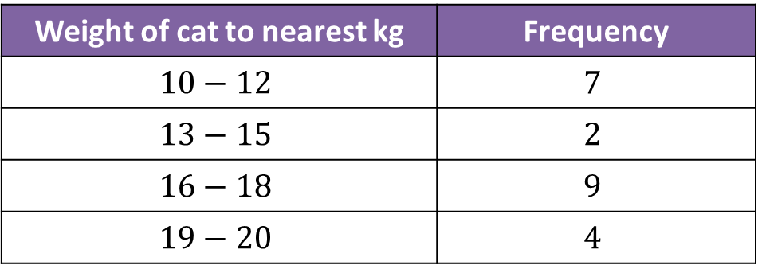

Linear Interpolation – with gaps
What’s different about the intervals here?
Weight of cat to nearest kg | Frequency
$$10−12$$ | $$7$$
$$13−15$$ | $$2$$
$$16−18$$ | $$9$$
$$19−20$$ | $$4$$
There are GAPS between intervals!
What interval does this actually represent?
$$10−12$$
$$9.5−12.5$$

Slide 9
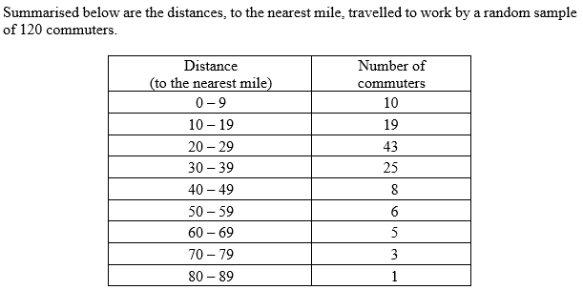
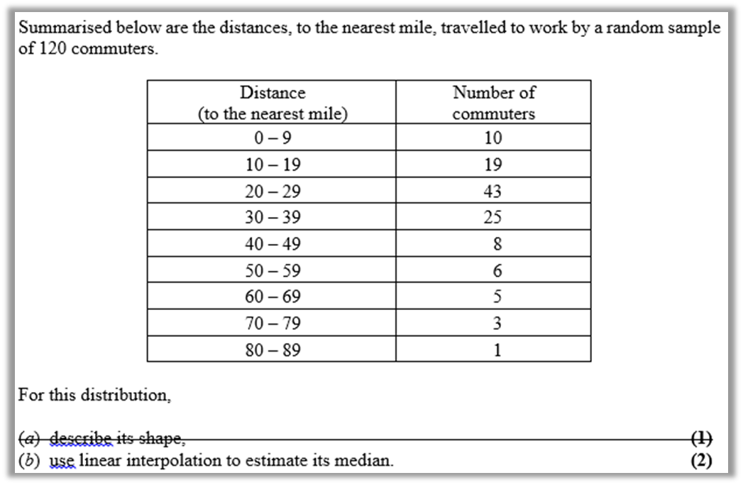
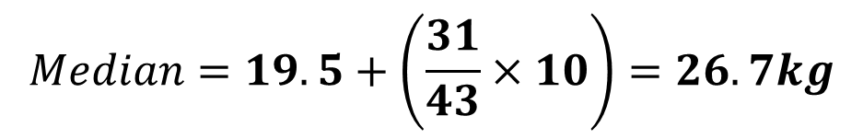
Linear Interpolation - with gaps
Cumulative
Frequency
10
29
72
97
105
111
116
119
120
29
60
72
19.5 miles
Median
29.5 miles
$$Median=19.5+\left(\frac{31}{43}×10\right)=26.7kg$$

Slide 10
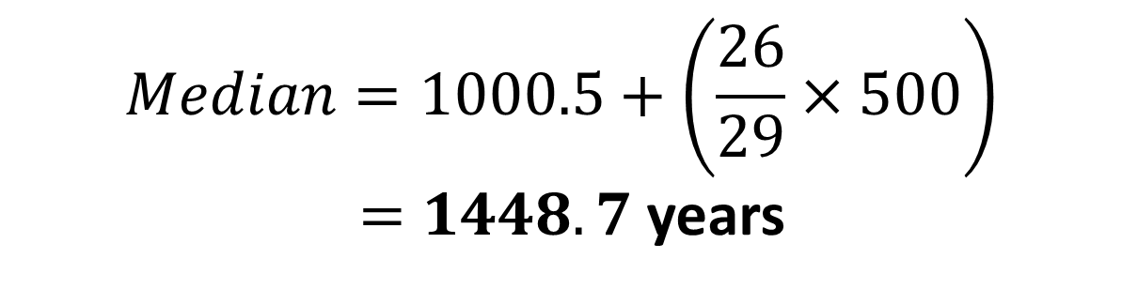
Linear Interpolation - with gaps
Find the median of the each grouped frequency table:
Age of relic (years) | Frequency
0-1000 | 24
1001-1500 | 29
1501-1700 | 12
1701-2000 | 35
$$Median=1000.5+\left(\frac{26}{29}×500\right)$$
$=1448.7$ years
Notes:
There’s a slip to print out here.

Slide 11
Exercises 2C
Pearson Statistics & Mechanics Year 1/AS
Pages 27-28
Q1a, 3, 4a, 5a
There is also a supplementary worksheet consisting of S1 exam questions (see next slides).
Complete before the lesson Q1-2
In Class:
Green Q3
Amber Q4
Red Q5-6

